Slide 1
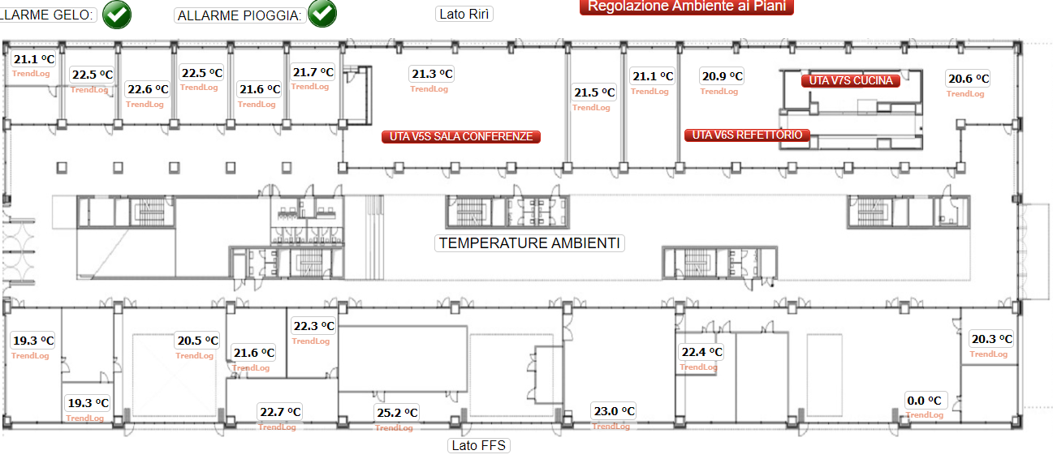
MA-0001
MA-0005
MA-0013
MA-0021
MA-0027
MA-0009
MA-0017
MA-0041
MA-0045
MA-0049
MA-0049
MB-0021
MB-0001
MB-0009
MB-0050
MB-0017
MB-0049
MB-0006
MB-0049
MB-0018
MB-0026
MB-0045

Slide 2
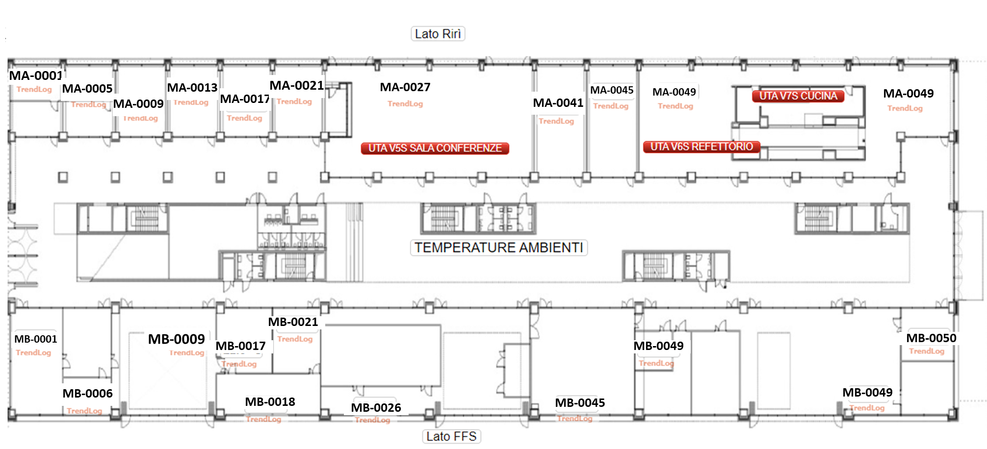

Slide 3
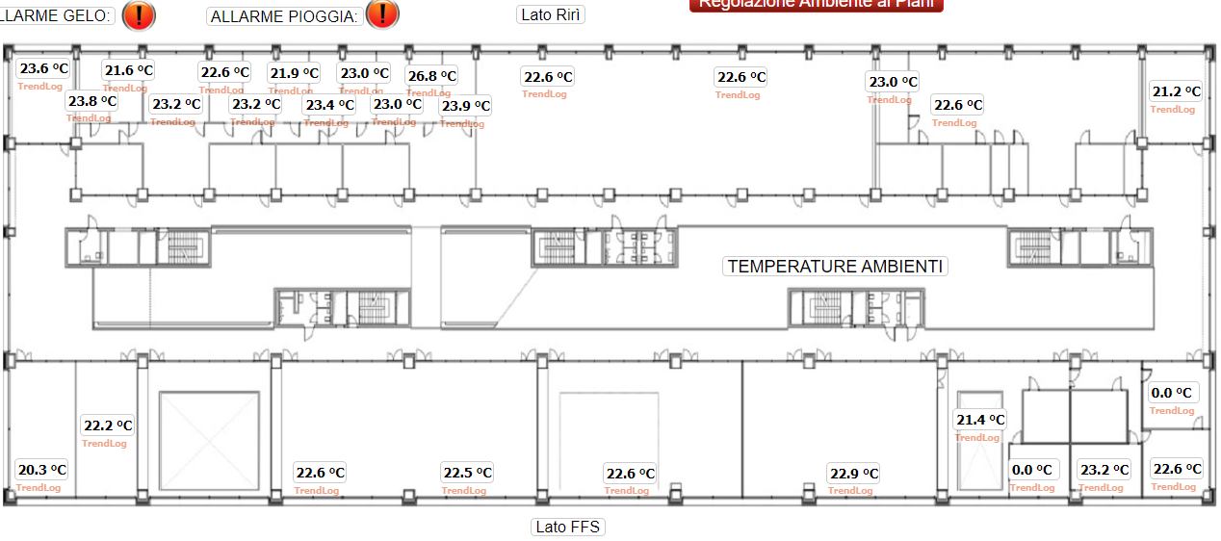
MA-1001
MA-1007
MA-1013
MA-1017
MA-1021
MA-1025
MA-1029
MA-1029
MA-1053
MA-1069
MA-1005
MA-1009
MA-1015
MA-1019
MA-1023
MA-1027
MA-1054
MB-1070
MB-1005
MB-1047
MB-1001
MB-1017
MB-1017
MB-1033
MB-1045
MB-1061
MB-1067
MB-1071

Slide 4
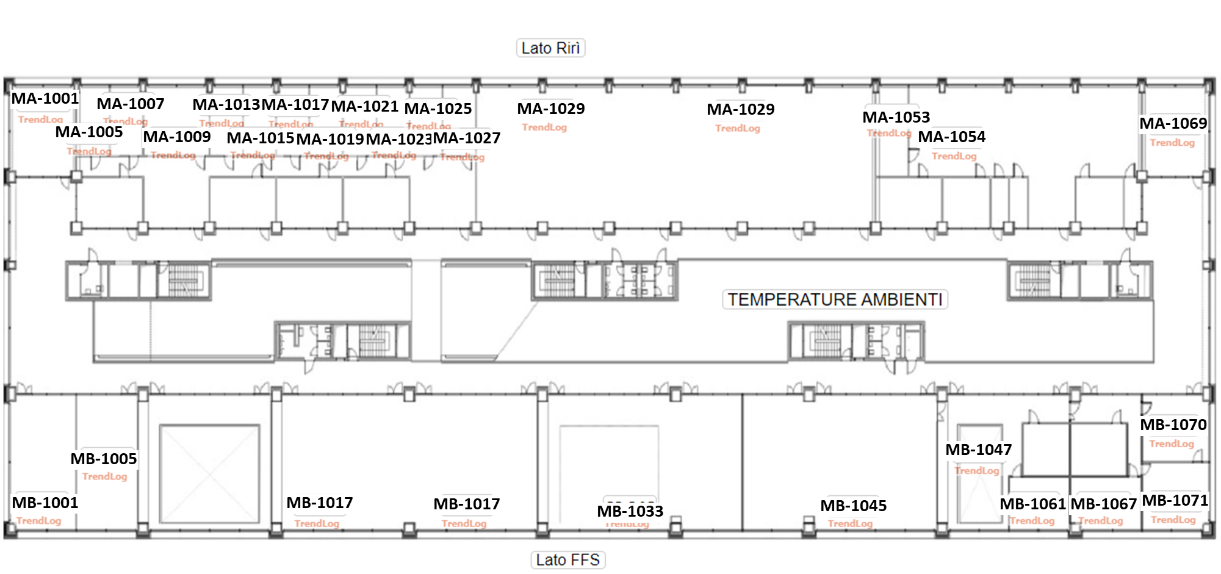

Slide 5
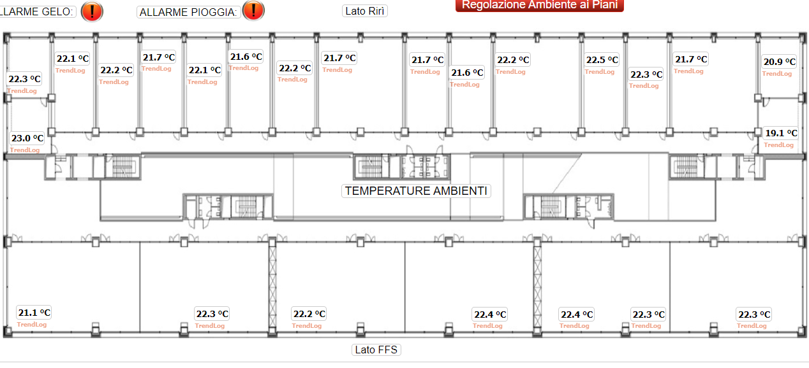
MA-2005
MA-2013
MA-2021
MA-2029
MA-2037
MA-2045
MA-2053
MA-2061
MA-2069
MA-2009
MA-2017
MA-2025
MA-2041
MA-2057
MA-2001
MA-2002
MA-2071
MB-2001
MB-2013
MB-2025
MB-2041
MB-2049
MB-2049
MB-2061

Slide 6
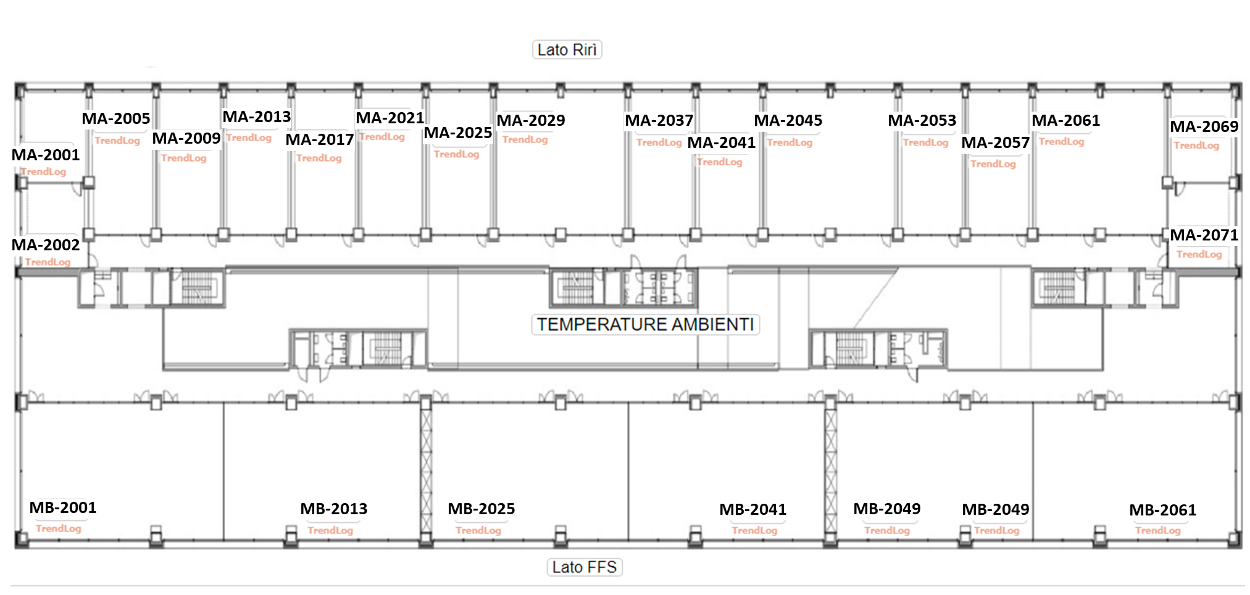

Slide 7
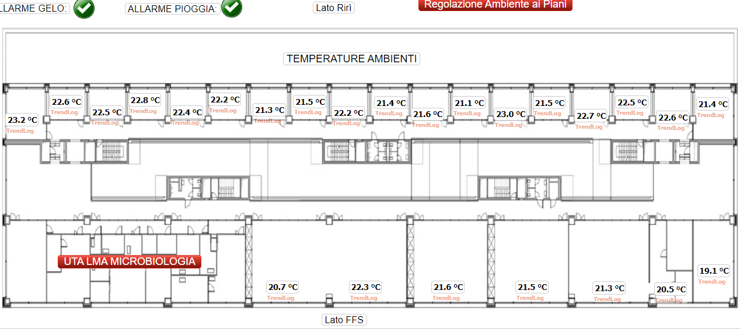
MA-3005/07
MA-3013/15
MA-3021/23
MA-3029/31
MA-3037/39
MA-3045/47
MA-3053/55
MA-3061/63
MA-3069
MA-3009/11
MA-3017/19
MA-3025/27
MA-3033/35
MA-3041/43
MA-3049/51
MA-3057/59
MA-3001/03
MA-3065/67
MB-3069
MB-3025
MB-3025
MB-3041
MB-3049
MB-3057
MB-3066

Slide 8
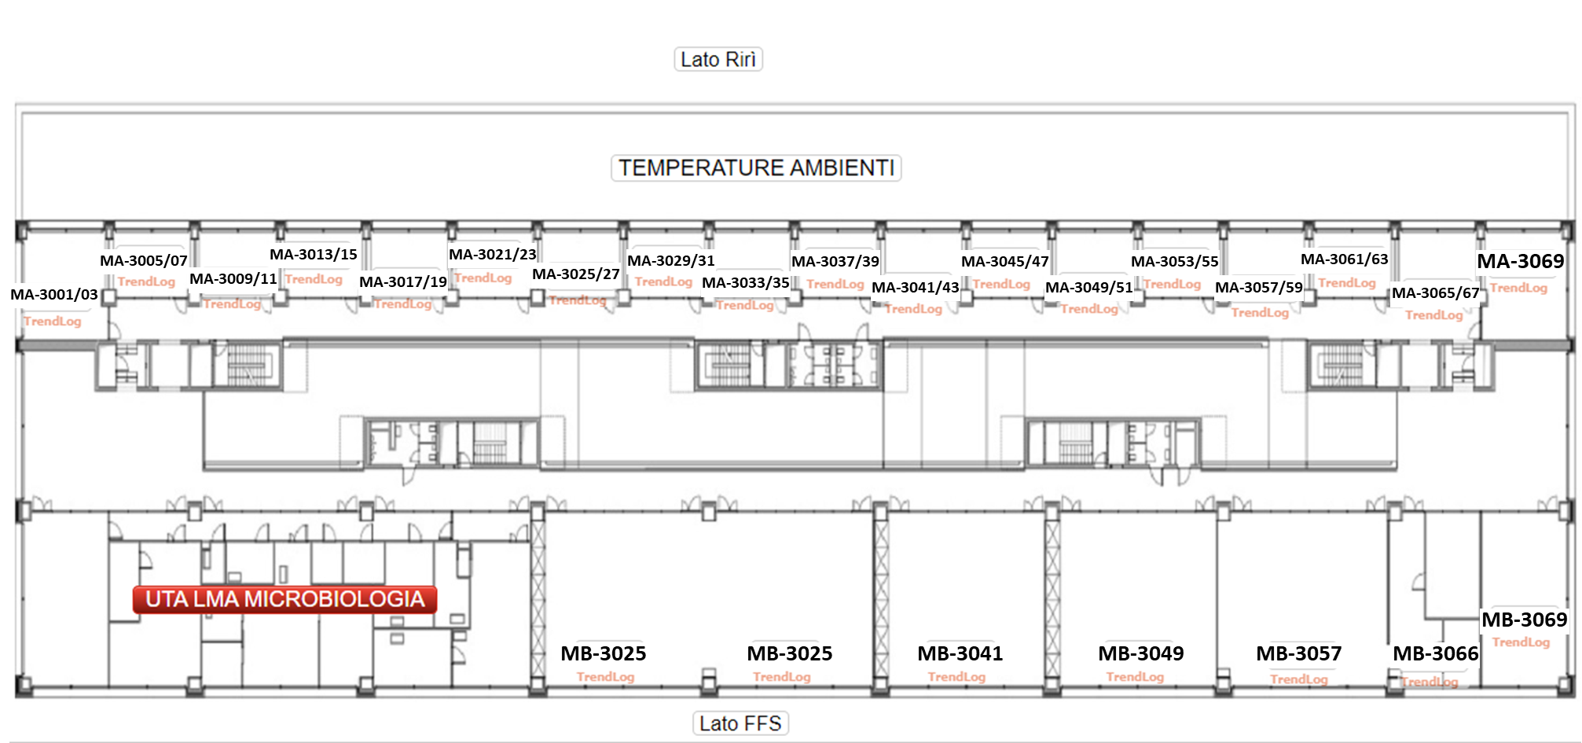

Slide 9
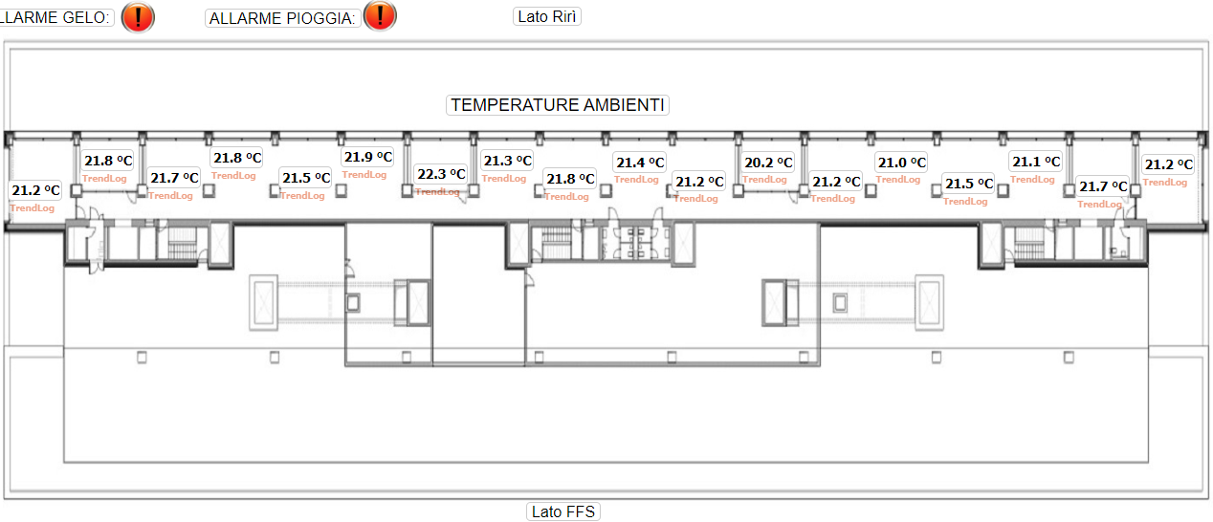
MA-4005/07
MA-4013/15
MA-4021/23
MA-4029/31
MA-4037/39
MA-4045/47
MA-4053/55
MA-4065/67
MA-4069
MA-4009/11
MA-4017/19
MA-4025/27
MA-4033/35
MA-4041/43
MA-4049/51
MA-4057/59
MA-4061/63
MA-4001/03

Slide 10
