Slide 1
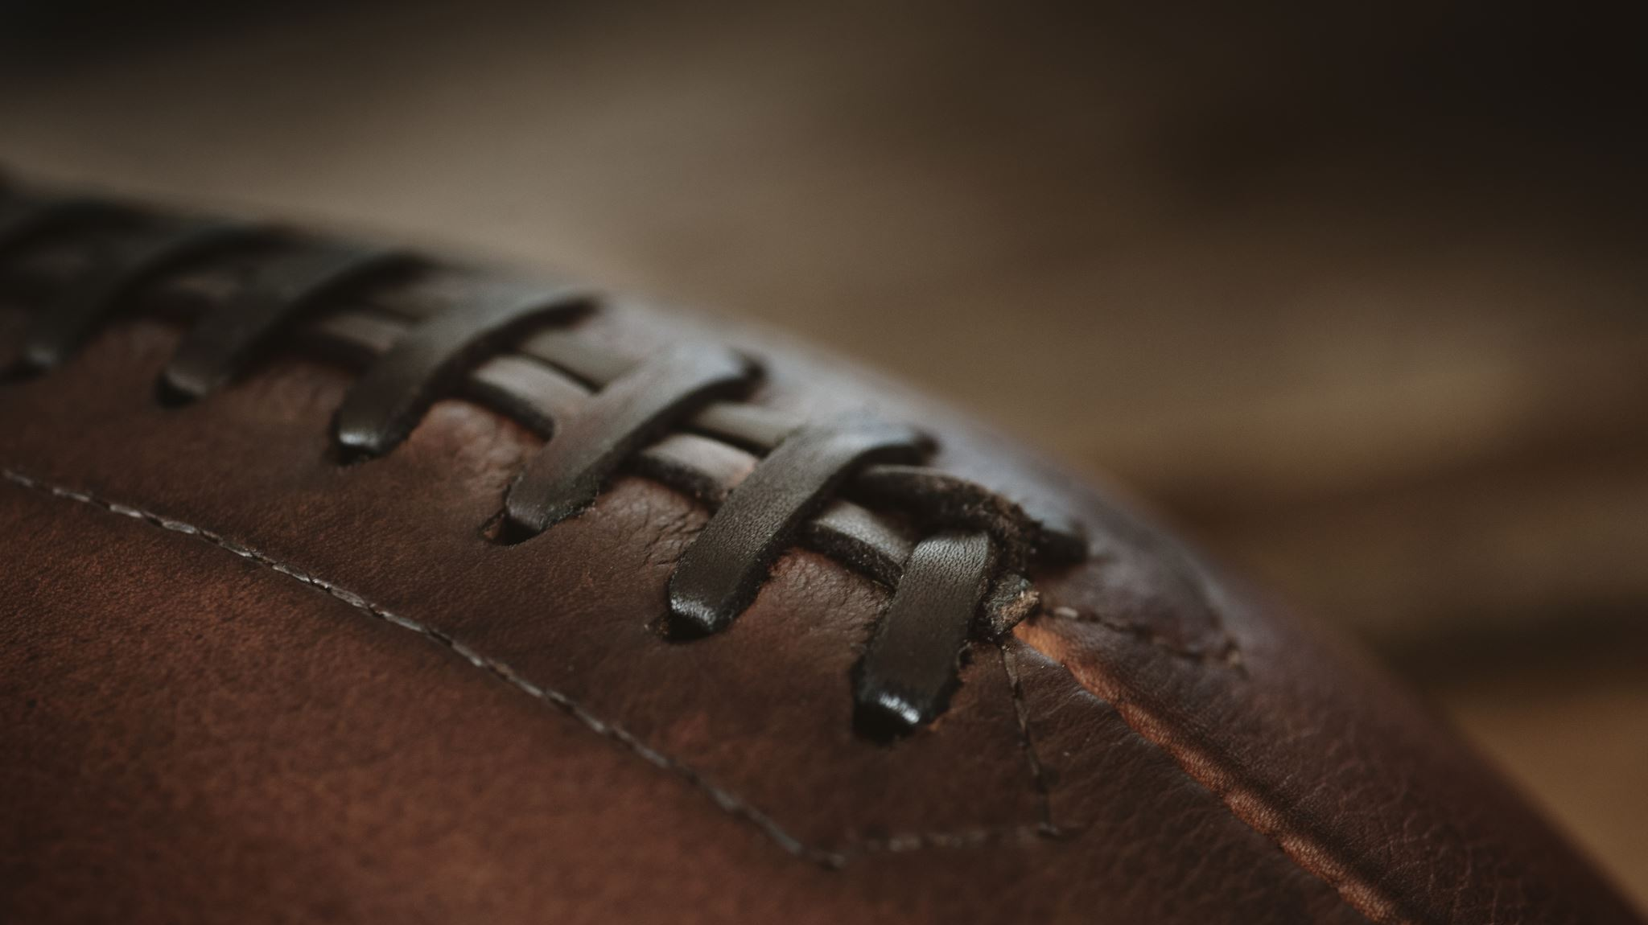
Super Bowl 55 Prediction
Marianna Carini

Slide 2
Prediction
31
Kansas City
30
Tampa Bay

Slide 3
Model #1: Success Rate
Context:
Looking for metric that did not rely on in-game stats like running yards, passing yards and turnovers
Success rate is percentage of plays that are a success defined by
For first down, 40% of yards needed to get your next first down
Second down, 60% of yards needed for next first down
For third or fourth down, 100% of yards needed for next first down
Data source: Sharp Football Stats
Methodology:
Used combination of stepwise variable selection and manual variable selection
Created model for each team using 2020 season data
Prediction based on linear regression using success rates going into the game

Slide 4
Model #1: Success Rate
Results:
Variables included: team 1 passing play success rate for both offense and defense, team 1 running play success rate for both offense and defense, team 2 passing play success rate for both offense and defense, team 2 running play success rate for both offense and defense,
KC model- R squared: 0.47, MAPE: 0.18
TB model- R squared: 0.68, MAPE: 0.29
Prediction:
29
Kansas City
34
Tampa Bay

Slide 5
Model #1.2: Success Rate + In-game Stats
Context:
Similar to the success rate model, but including in game stats as well
Data sources: Sharp Football Stats , Pro Football Reference
Methodology:
Used combination of stepwise variable selection and manual variable selection
Created model for each team using 2020 season data
Prediction based on linear regression using success rates going into the game, imputed in-game stats by taking average

Slide 6
Model #1.2: Success Rate + In-game Stats
Results:
Variables included for Tampa: team 1 passing yards, team 1 rushing yards, team 2 turnovers, team 1 offense passing success rate
Variables included for Kansas City: team 1 passing yards, team 1 offense passing rate, team 1 defense passing rate
KC model- R squared: 0.40, MAPE: 0.14
TB model- R squared: 0.82, MAPE: 0.24
Prediction:
22
Kansas City
30
Tampa Bay

Slide 7
Model #2: ”Lazy Man’s” Ensemble
Context:
Wanted to use knowledge of the crowd theory and leverage the models from NFL experts to make a “lazy man’s” ensemble model
Gathered Super Bowl score predictions from experts back to 2015
Data sources: ESPN, CBS Sports, Sports Illustrated, William Hill, Bleacher Report
Methodology:
Measured MAPE of each prediction
Did EDA to find best approach for combining predictions
Calculating prediction by source by averaging each expert’s prediction proved to be the most accurate
Took average of all the sources to get prediction
Also took weighted average by source MAPE and it was the same

Slide 8
Model #2: ”Lazy Man’s” Ensemble
Results:
Variables included: predicted score of winning team, predicted score of loosing team, MAPE
Overall MAPE: 0.17
Prediction:
31
Kansas City
26
Tampa Bay

Slide 9
Final Ensemble Method
Final Prediction:
Methodology: The r squared values for my Tampa Bay models were very high (0.82), but low for Kansas City (~0.4). Because of this, I am using the lower of my Tampa Bay predictions since it is closer to my Lazy Man’s Ensemble model. For Kansas City, however, since I am not as accurate, I am using the score from the Lazy Man’s model.
31
Kansas City
30
Tampa Bay

