Slide 1
Netflix Stock Forecast

Slide 2
Company: Netflix
Industry: tech & entertainment
What they do: media streaming service
The visionaries who brought us binge watching
204 million paid memberships in over 190 countries

Slide 4
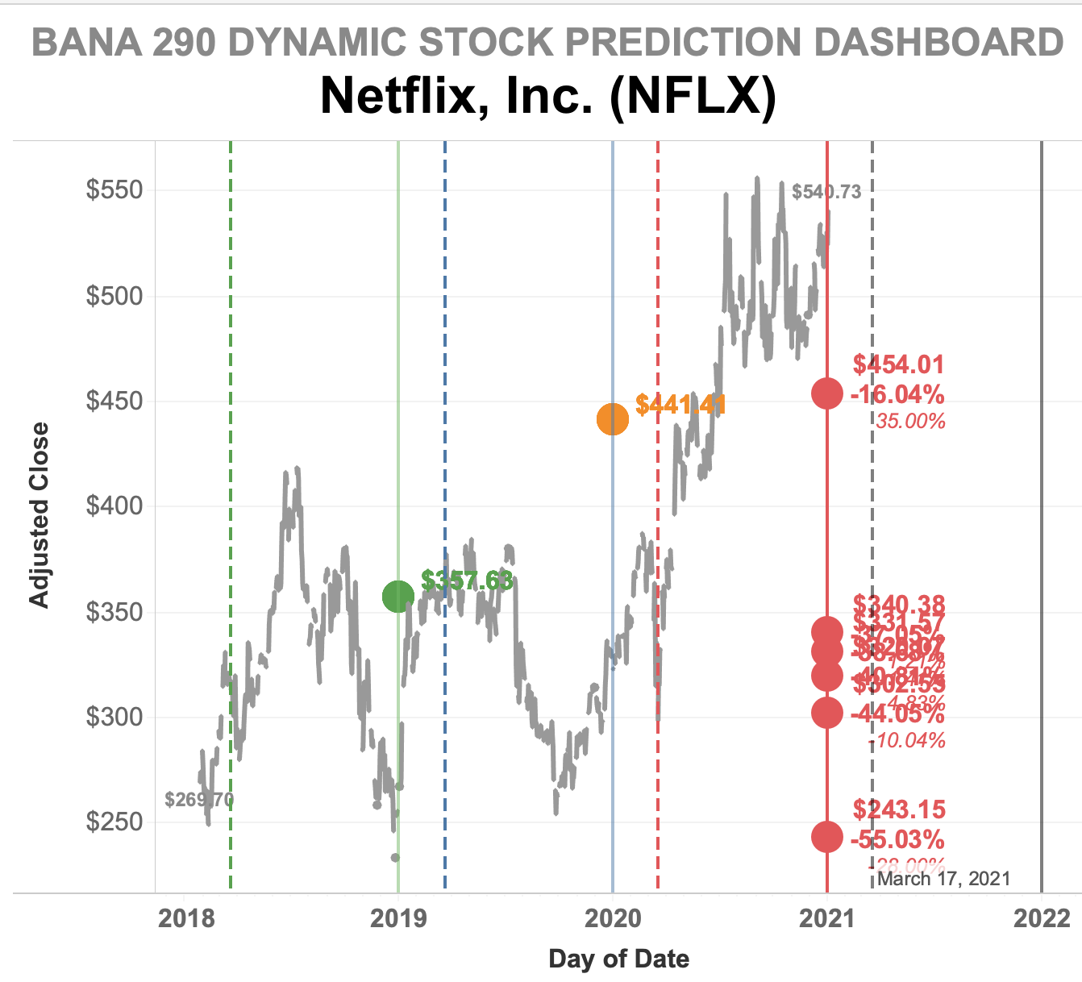

Slide 5
Simple ARIMA based on monthly 2020 through current values
Simple ETS based on monthly 2020 through current values
80% confidence interval
Moving 12mo avg.
Played with different months, this one had the best MAPE
Linear regression based on competitor’s stocks, market indexes (DJI), GDP monthly from past 5 years
Lagged competitors stock values & volume (Comcast, DirecTV)
Took logs were needed

Slide 6
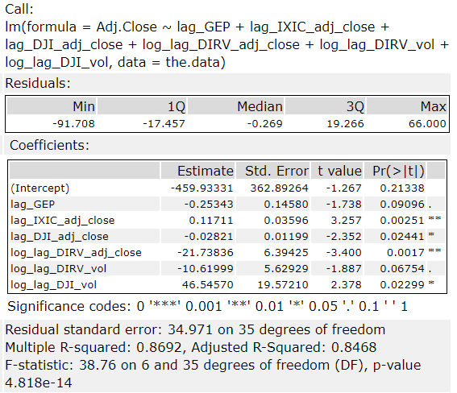
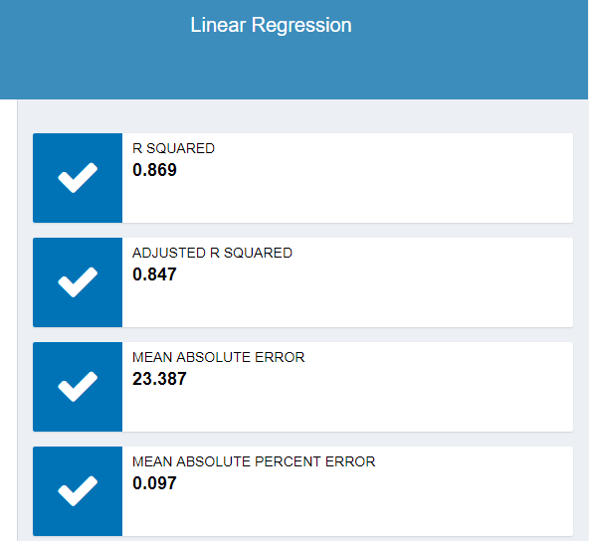
Linear model results

Slide 7
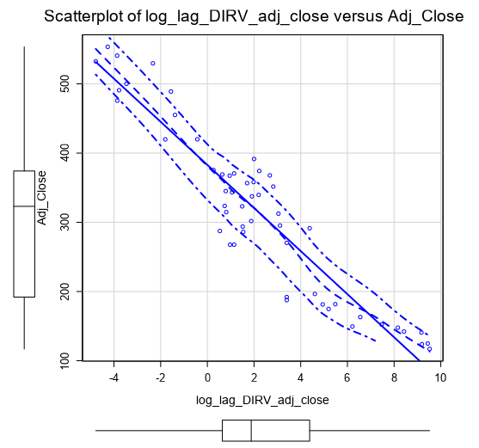
Log DIRV Scatter Plot

