Slide 1
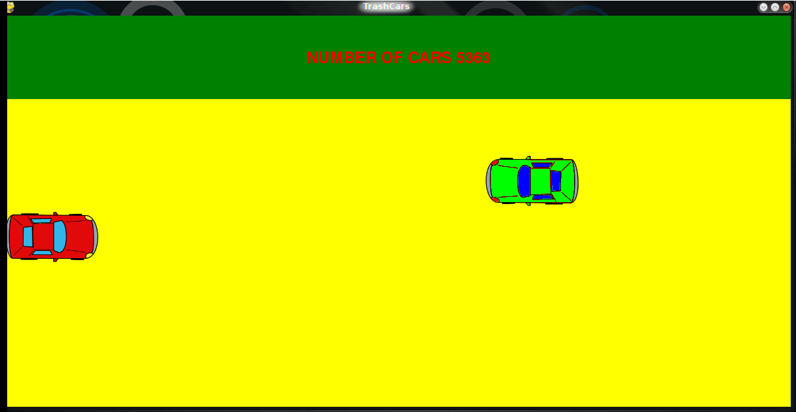
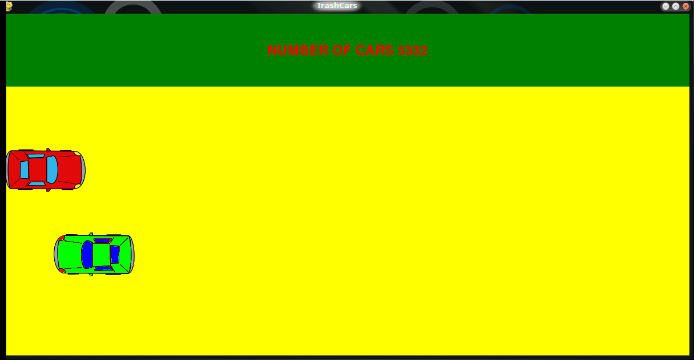
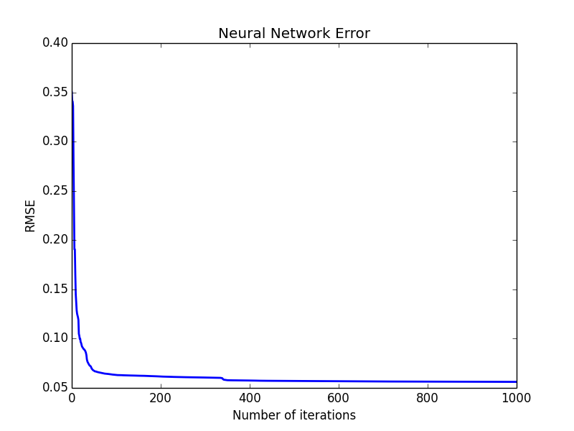
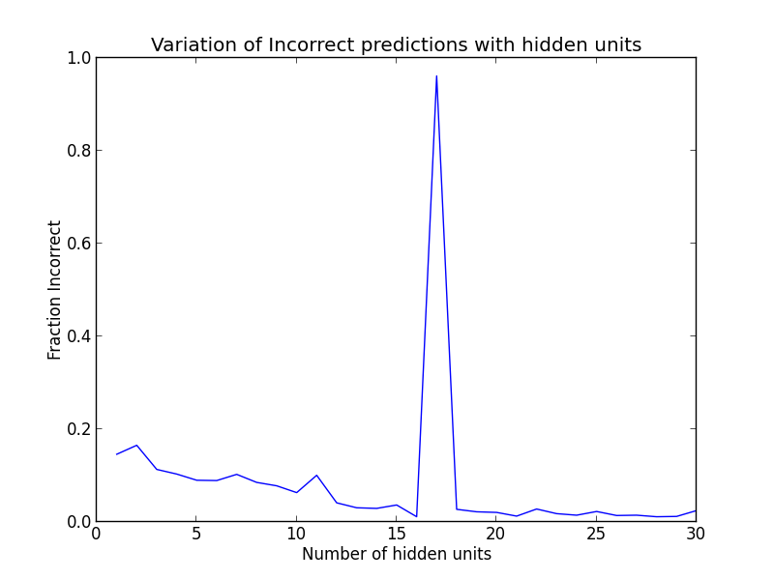
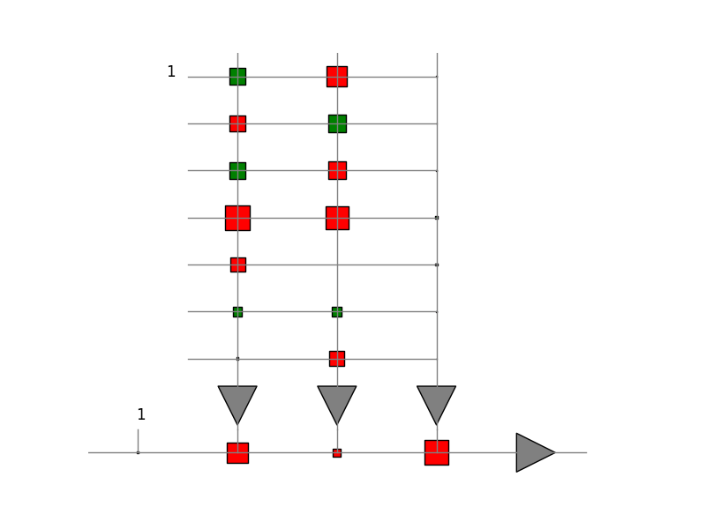
Simulating Automated Car Navigation Using Pygame and Machine Learning
MMANU CHATURVEDI
Summary
Method and Results
Observations
A very simple car game using the cross-platform Python library for making video-games, Pygame [1]
Pseudo-randomly positioned (in y direction) cars approach a user controlled car from right to left
User controlled car can move vertically or stay still
Collected data about the cars and trained a neural network
Let the trained neural network ‘navigate’ the car
‘Over-prediction’ of the still state
Although lesser error occurs for more number of hidden units, practically, the car navigates better for fewer number of them
When the coordinates of cars are given directly without taking the relative distance, the NN doesn’t work very well
We keep the car always moving
Polling frequently and predicting the most occurring state doesn’t help too much
Filler values are important
When the speeds of the approaching cars are changed, NN controlled car doesn’t navigate very well
When the car creation frequency is increased, our game doesn’t work very well
Car moving down
Car moving up
Background
Neural Network Description:
Inputs
Difference of x and y coordinates of the other cars w.r.t. the user controlled car
Distance of the y coordinate of the user-controlled car from the boundaries
Number of samples = 747 (Training/Testing = 80/20)
Output
State of the car, moving up/down
Number of units in the hidden layer : 3
Number of iterations : 1000
NavLab at CMU had proposed ALVINN, an autonomous land vehicle in a neural network [2]
They used simulated road images to train their neural network
Their neural network had one layer of hidden units
We take inspiration from them and use a single hidden layer neural network to navigate the user controlled car in our simple game
Future Work
Object related:
Different car speeds
Bends on the road
Cars could move vertically
Different size objects
Other props like friction – loss of control
Prediction related:
Reinforcement Learning
Create the pseudo-random objects depending on the position of the user-controlled car, like in real games
Explore ways to make the neural network not overtrain for the still state
Speeds of the cars can be given as another input
Steps Involved
Gameplay
User-controlled car has three states: still, moving up and moving down
Detect car-crashes
Detect road boundaries
Creating pseudo-randomly positioned cars
Decides the difficulty of navigation
Ensure that a reasonably easy navigation is possible
In our opinion critical for ‘good training’
Data collection
Collect the position of the user-controlled car and the state (moving up/moving down/still) its in
Collect the coordinates of the other cars
Neural network implementation
Used the neural network classifier code used in class [3]
Used the data collected to train a neural network
Used the predicted state to move the car
References
[1] http://www.pygame.org/wiki/about
[2] Dean A. Pomerleau. Advances in neural information processing systems 1. chapter ALVINN: An Autonomous Land Vehicle in a Neural Network, pages 305–313. Morgan Kaufmann Publishers Inc., San Francisco, CA, USA, 1989. ISBN 1-558-60015-9. URL http://dl.acm.org/citation.cfm?id=89851.89891. [3] http://www.cs.colostate.edu/~anderson/cs545/index.html/doku.php
Schematic of the neural network
PARAMETERS
SCALE_SPEEDS = 3
TIME_BETWEEN_LOGGING_MS = 500/SCALE_SPEEDS
TIME_BETWEEN_CAR_CREATION_MS = 7000/SCALE_SPEEDS
CAR_SPEED = 3*SCALE_SPEEDS
USER_CAR_SPEED = 2*SCALE_SPEEDS

