Slide 1

Digital Warranty Tracker
Backend Frameworks – Final ProjectackenmeworFinal Project
23CS404 - Backend Frameworks
Final Project
Name: | Manu Anandan G
Register No: | 727824TUIT124
Department | Information Technology
Institution | Sri Krishna College Of Technology
Academic Year | 2025 - 2026

Slide 2

Problem Statement
Managing product warranties is often inefficient due to scattered records, lack of security, and difficulty in tracking expiry dates and alerts. The Digital Warranty Tracker aims to solve this by providing a centralized, secure backend system with JWT‑based authentication, role‑based access control, and automated warranty management features, ensuring reliability, scalability, and ease of use for both users and administrators.
The Digital Warranty Tracker Project addresses these challenges by:
Designing a structured layered architecture that separates concerns across controllers, services, repositories, and security.
Using ORM-based persistence (Hibernate/JPA) to eliminate manual SQL and improve maintainability.
Implementing JWT-based authentication to secure endpoints and enforce role-based access control.
Introducing centralized exception handling to ensure consistent error responses across the application.

Slide 3
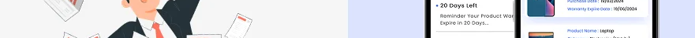
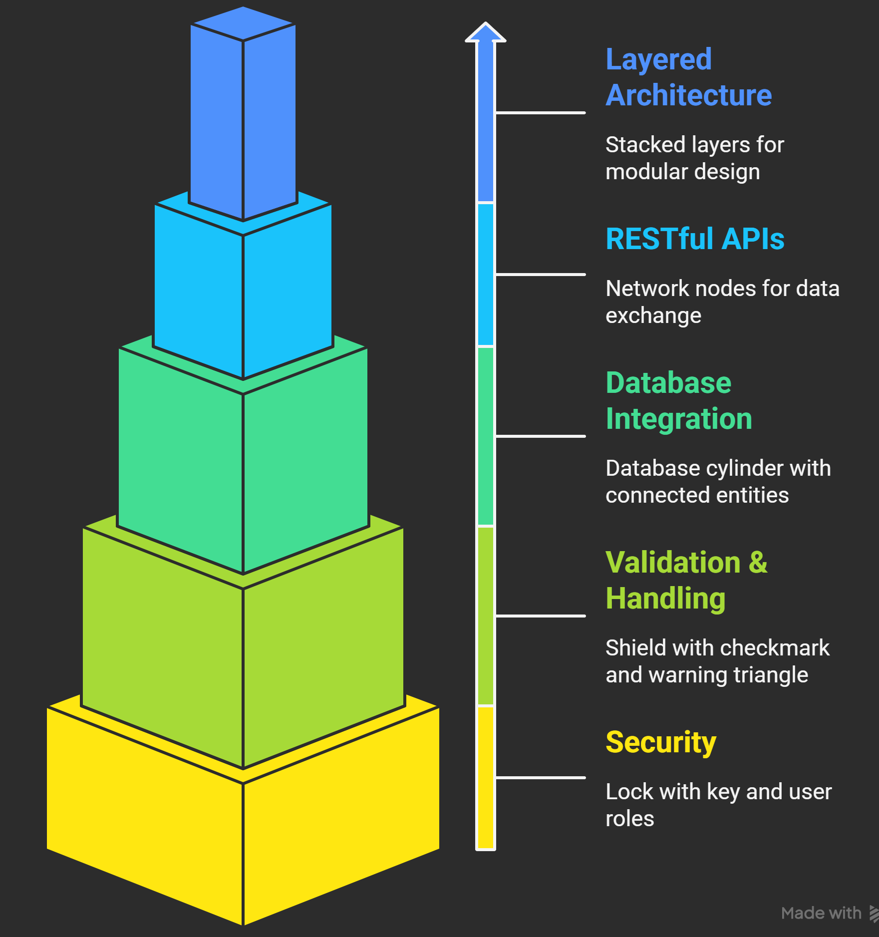
Objectives
The project was designed with the following objectives:
Layered Architecture: Ensure clean separation of concerns for scalability and maintainability.
RESTful APIs: Provide standardized endpoints for warranty-related operations.
Database Integration: Use JPA/Hibernate for persistence, ensuring entity relationships are managed efficiently.
Validation & Exception Handling: Enforce business rules and provide predictable error responses.
Security: Implement JWT authentication and role-based authorization to protect sensitive data.

Slide 4
TECHNOLOGY STACK
Core Technologies
Java 17+ → Programming language
Spring Boot → Builds REST APIs
Spring Security → Handles login and role checks (USER / ADMIN)
JWT → Tokens for authentication
Hibernate / JPA → Connects Java objects to database tables
MariaDB / MySQL → Database for users, products, warranties, alerts
Key Libraries
spring‑boot‑starter‑web → REST endpoints
spring‑boot‑starter‑security → Security + password encoding
spring‑boot‑starter‑data‑jpa → Database access
jjwt → JWT creation and validation
springdoc‑openapi → Swagger docs
Lombok → Cuts down boilerplate code
Tools
Maven → Build and dependencies
Swagger UI → API testing
Security
BCryptPasswordEncoder → Hashes passwords
JWT Filter → Reads token and role
@PreAuthorize → Restricts endpoints by role

Slide 5
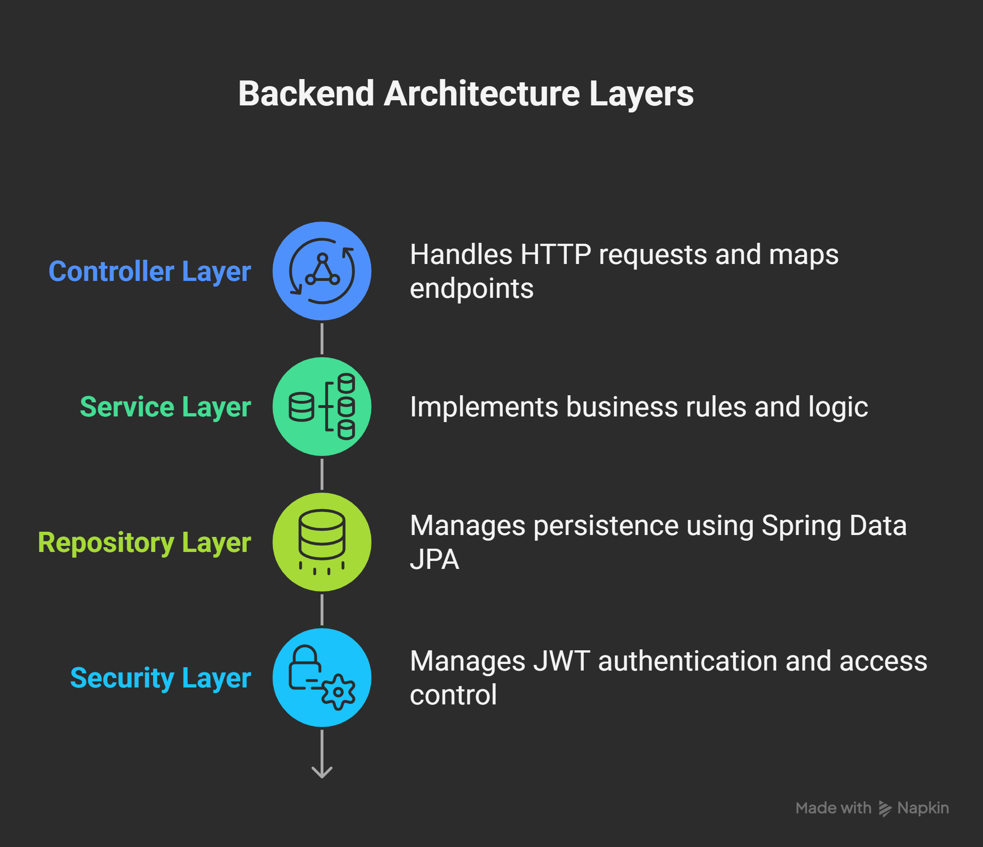
System Analysis & Design
1. System Overview
Client requests are handled by REST controllers.
Controllers delegate tasks to the service layer.
The service layer enforces business rules and interacts with the repository layer.
The repository layer manages persistence using Spring Data JPA.
Data is ultimately stored in the database.
Security is applied at the entry point using JWT authentication.
JWT ensures that only authorized users can access protected endpoints.
This flow guarantees a clean separation of concerns.
The design helps to prevent unauthorized access.

Slide 6
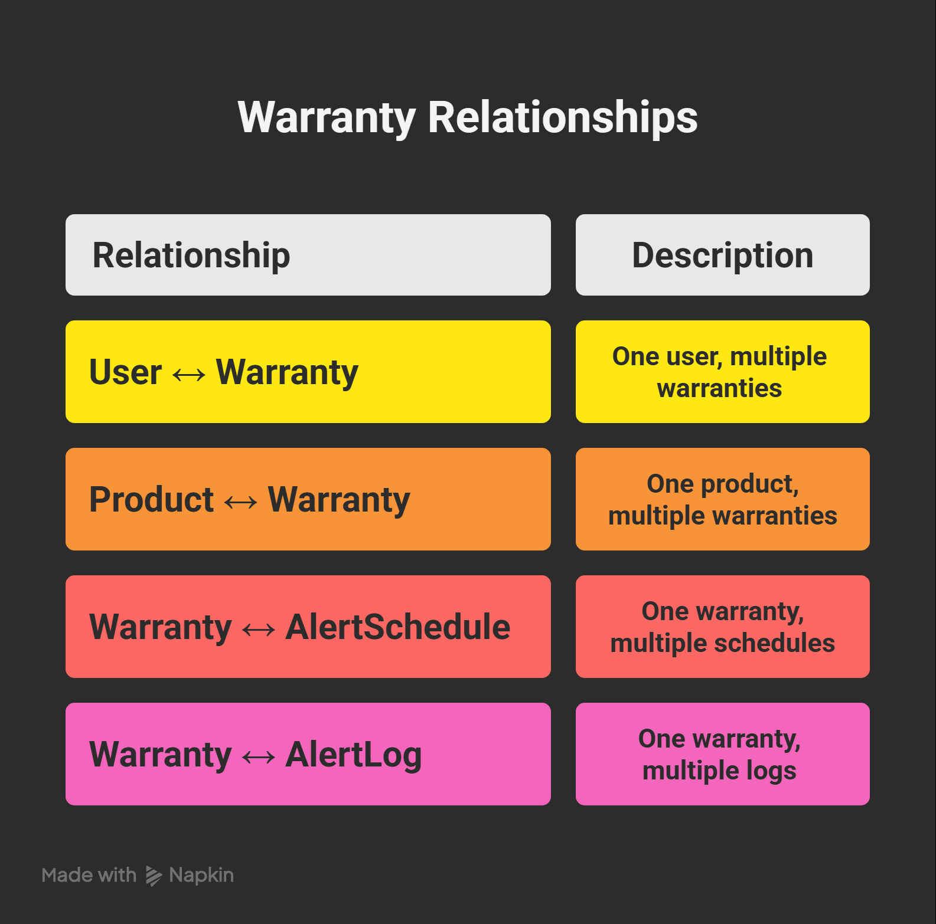
System Analysis & Design
3. Database Design
The database is normalized to reduce redundancy and improve performance. Key constraints include:
Unique email for users.
Unique serial number for warranties.
Expiry date validation to ensure logical warranty periods.
Indexes are applied on frequently queried fields such as email, serialNumber, and warrantyId to optimize query performance.

Slide 7
Implementation
Spring Boot Setup
Configured with Maven dependencies: Web, JPA, Security, Validation, Swagger/OpenAPI.
Application properties define MySQL connection, JWT secret, and token expiration.
Entry point: @SpringBootApplication in DemoApplication.java.
Business Logic (Service Layer)
Passwords hashed with BCrypt before persistence.
Default role set to USER during registration.
Warranty expiry date validated against purchase date.
Serial number uniqueness enforced before saving.
Repository Layer
All repositories extend JpaRepository.
Custom methods:
existsBySerialNumber() → warranty uniqueness.
findByUserId() → fetch warranties for a user.
findByEmail() → user authentication.

Slide 8
Implementation
Security (JWT + RBAC)
JWT Flow:
User logs in → token generated with claims (id, email, role).
Token passed in Authorization: Bearer <token> header.
Filter validates token and sets authentication context.
Filters & Entry Points:
JwtAuthenticationFilter → extracts/validates tokens.
JwtAuthenticationEntryPoint → handles unauthorized access.
Role-Based Access Control:
USER → manage own warranties, view products, create alerts.
ADMIN → full management access across users, products, warranties, alerts.
API Documentation (Swagger/OpenAPI)
Swagger UI at /swagger-ui/index.html.
JWT Bearer scheme for secured endpoints.
Controllers annotated with @Tag and @Operation.
Exception Handling
Centralized GlobalExceptionHandler with @ControllerAdvice.
Handles validation errors (e.g., “Model number required”, “Expiry date must be after purchase date”).
Returns structured JSON error responses with proper HTTP codes.

Slide 9
Outcomes Achieved
Developed a secure and scalable backend system
Achieved modular architecture with clean separation of concerns
Implemented JWT‑secured APIs with role-based access control
Improved maintainability, reliability, and developer experience
Problems Solved
Eliminated tightly coupled code by enforcing layered design
Prevented unauthorized access using JWT and Spring Security
Standardized API behavior with uniform error handling
Enhanced robustness of backend logic through validations and centralized exception handling

Slide 10
Future Enhancements
Frontend Integration
Develop a responsive, user‑friendly interface (React/Angular) for warranty registration, product management, and alert tracking. This will make the system accessible to non‑technical users and improve overall usability.
Cloud Deployment
Deploy the backend on platforms like AWS, Azure, or GCP to ensure scalability, high availability, and disaster recovery. Cloud hosting will also enable auto‑scaling and load balancing for peak usage
Advanced Filtering & Caching Implement dynamic filtering (by product, expiry date, user) and caching mechanisms (Redis/Guava) to reduce database load and improve response times for frequently accessed data.
Enhanced Monitoring Integrate monitoring tools (Spring Boot Actuator, Prometheus, Grafana) with centralized logging and alerting. This ensures production readiness by detecting anomalies early and improving system reliability.

Slide 11
Conclusion
The Digital Warranty Tracker Project delivered a secure and scalable backend with a clean layered architecture. By integrating Spring Boot, JPA/Hibernate, and RESTful APIs, the system ensures efficient data management and standardized communication. JWT authentication with RBAC strengthens security, while centralized validation and exception handling improve reliability.
The project achieved its goals of modular design, maintainability, and developer usability, laying a strong foundation for future enhancements such as frontend integration, cloud deployment, and monitoring. Overall, it provides a practical and extensible solution for modern warranty management.
THANK YOU

