Slide 1


SMART INDIA HACKATHON 2025
SAHAY: Smart Aqua Health Alert Yantra
Problem Statement ID – 25001
Problem Statement Title - Smart Community Health Monitoring and Early Warning System for Water-Borne Diseases in Rural Northeast India
Theme- MedTech / BioTech / HealthTech
PS Category - Software
Team ID -
Team Name - Achievers

Slide 2

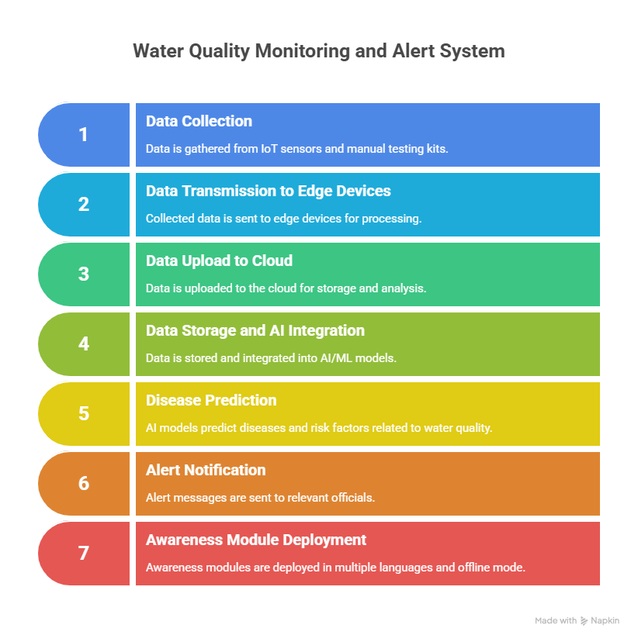
SAHAY: Smart Aqua Health Alert Yantra
PROPOSED SOLUTION:
To predict the risk of Water-Borne disease uses the IOT sensors/Manual Testing Kit to monitor the water quality.
By using the AI models predict the risk of disease and the water.
Alerts are sent to the head officials for early detection of contamination and reduce the cause of diseases.
Awareness is been displayed in multilingual and functions in offline mode.
UNIQUENESS AND INNOVATION:
Predict the risk of water in colour codes.
Mobile interface in multilingual.
Faster and accurate predictions.

Slide 3
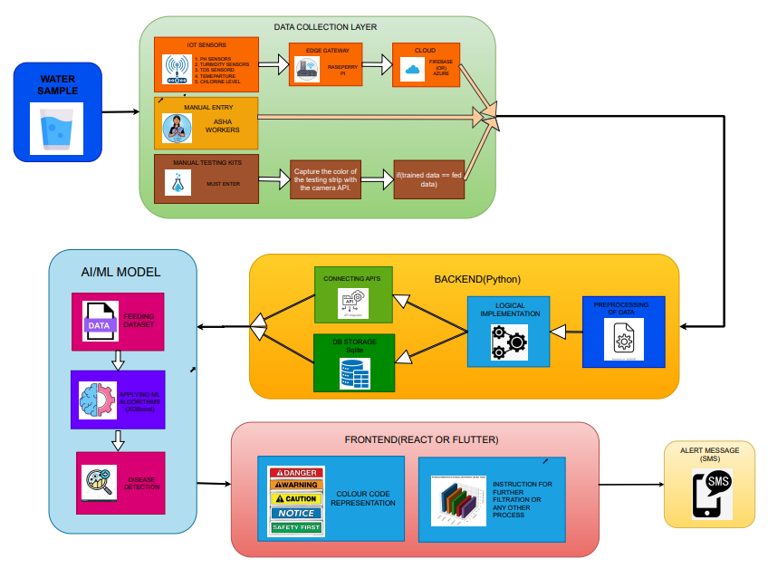
TECHNICAL APPROACH
1.DATA SOURCES:
Manual Testing Kit: color strip paper
IOT Sensors: pH,Temperature,Turbidity,TDS,Chlorine.
Manual Entry: Directly entered.
2. DATA TRANSFER:
Manual Testing kit: color of the testing strip → camera API
IOT Sensors: sensor data → Raspberry pi → cloud
3.BACKEND PROCESS:
Preprocessing → Logics → Data storage
4. AI ALGORITHMS:
Collected Data → XG Boost Algorithm → Disease prediction.
5.ALERTS:
The risk of the water will be given as an alert to the health officials through sms.
6.VISUALIZATION:
Color Code Represention:
Red → Danger, Yellow → Caution, Green → Safe
Educational Module:
General Instruction → Offline Mode → Multilingual

Slide 4
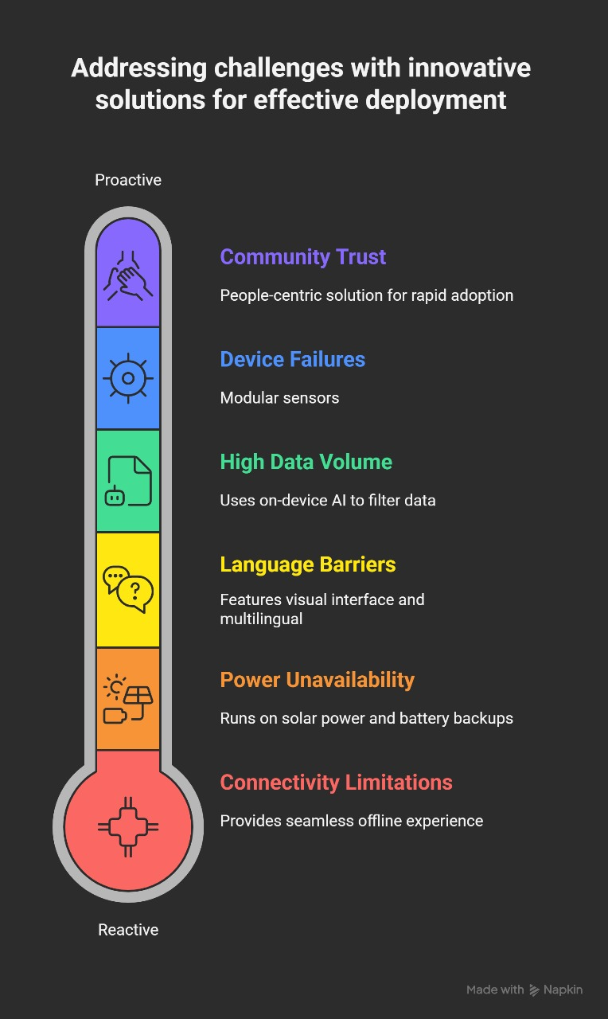
FEASIBILITY AND VIABILITY
TECHNICAL FEASIBILITY
Data collected easily from the IOT sensors and manual testing kit.
Fast and accurate prediction of the disease and the risk of the water using ML model.
OPERATIONAL FEASIBILITY
Easy to use and detect the risk and control the diseases.
Instructions are given for the proper usage of water
SOCIAL VIABILITY
Multilingual → Local people can also get knowledge of the risk of the water and disease caused.
Alerts are given to the health officials so that they can control the water flow before the disease caused.

Slide 5
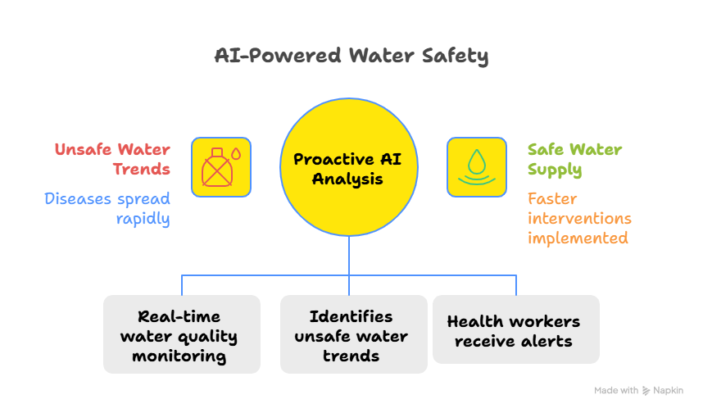
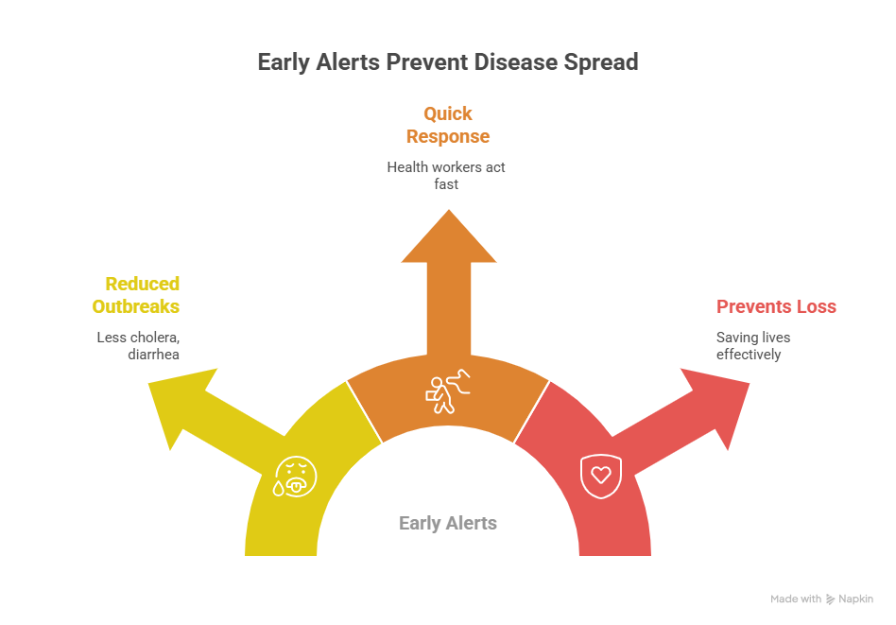
IMPACT AND BENEFITS
BENEFITS:
Prevent The Disease Before It Spread:
Predict the disease before the symptoms occur.
Allow health officials to take action quickly.
Helps to control the water flow if the water is risk
Real Time Water Quality Monitoring:
Give Instructions according to the water quality
IMPACTS
Saving Lives Through Early Disease Prevention:
Predicting the unsafe water and prevent from the causage of the diseases.
Empowering Rural Communities With Smart Technologies:
By providing real time data

Slide 6
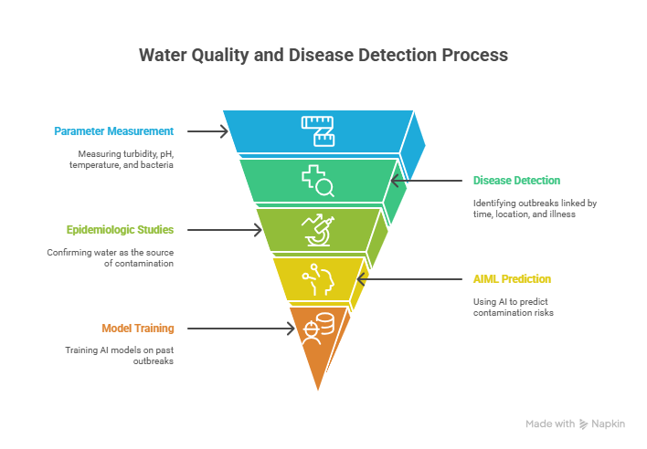
RESEARCH AND REFERENCES
Category | Details | Reference Links
Water Quality Parameters | Turbidity, pH, temperature, and presence of coliform bacteria are often the parameters that are measured to access water quality and contamination risk. | CDC – Healthy Water Data
How Disease Detection Works | Disease detection involves outbreak investigations where two or more people are linked by time, location, and type of illness. Contaminated water is confirmed as the source by epidemiologic studies. | CDC – Healthy Water Data
How AIML Prediction Works in Disease Detection | The AIML models analyze large datasets to. By training them on past outbreaks, they can predict risks of contamination and possible disease outbreaks. | ResearchGate – AI in Waterborne Diseases
Existing AIML Models for Disease Detection | The AI model used for disease detection is XG Boost . Preprocess and train the AI model. Use the trained model to predict outcomes on new/test data. | Springer – AI in Disease Detection

