Slide 1
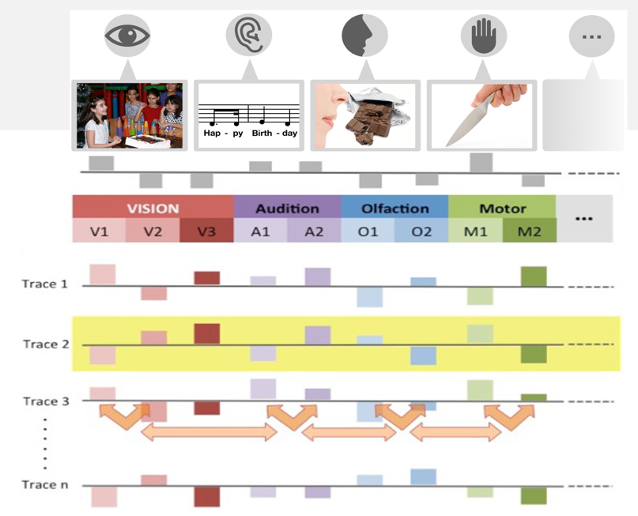
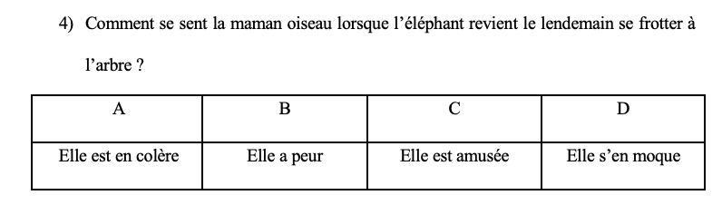
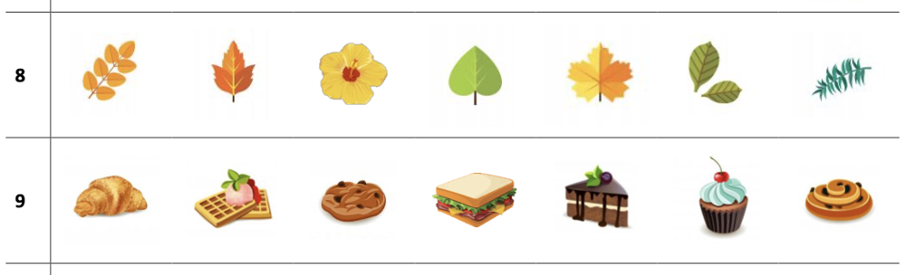







What are the effects of regular interactions with nature, on understanding, categorisation and memory.
L. Kolodzienski^{1,2}, G. Plancher¹, Y. Lathuilière³, N. Hmed², B. Marcourt², H. Chainay¹ & R. Versace¹
¹ Laboratoire d’Étude des Mécanimes Cognitifs, Université Lyon 2, France, ² Ville de Lyon, Direction de l’éducation France, ³ Direction des Services Départementaux de l’Éducation Nationale du Rhône, France.
l.kolodzienski@univ-lyon2.fr
Introduction
Interacting with nature has beneficial effects on psychological health (e.g., McDonnell & MacGregor-Fors, 2016), reduction of stress (e.g., Bratman et al., 2012) and attention restauration (e.g., Stevenson et al., 2019)
Our aim was to show that regular interactions with nature might improve the learning skills of second grade students and can be optimized by daily sensorimotor training in class
Act-In model of memory
Cognition is situated and embodied
Every experience activates and integrates sensorimotor traces
Memory is the accumulation of the traces
Knowledge is the activation of the traces adapted to a specific context
→ Interactions with nature and training should stimulate sensorimotor activation and integration mechanisms and in turn enhance learning
Method
Grp 1 | Grp 2 | Grp 3 | Grp 4 | Control
Base Test
C1 | C2 | C3 | C4 | CC
Test 1
C2 | C1 | C4 | C3 | CC
Test 2
C3 | C4 | C1 | C2 | CC
Test 3
C4 | C3 | C2 | C1 | CC
Test 4
x2
Participants:
5 schools of Lyon
155 students of second grade
Tests before and after each condition
Comprehension task
4 weeks
Daily trainings in class:
- Sensorimotor simulation and integration
- Visualisation of sensorimotor scenarios and integration of multisensorial in memory
1 text, 1 reading, 10 questions
Categorisation task
Weekly outdoor activities:
14 outdoor pre-defined sessions:
- 7 sensorimotor based activities
- 7 based on the scholar program
in parks near the schools
10 lines, 7 images, 1 intruder, 15s/line
Recognition task
C1 : Outdoor activities + trainings in class
C2 : Outdoor activities + no training in class
C3 : No outdoor activities + training in class
C4 : No outdoor activities + no training in class
CC : No outdoor activities + no training in class
30 images, 10 seen, 10 not seen categorial, 10 not seen ⍯ cat, 1min
Results and Discussion
P=.01
- Regular activities in nature better improved comprehension scores and recognition scores
Some cognitive abilities involved in learning seem to be improved when children interact regularly with nature
Nature offers a suitable context for sensorimotor experiences to promote learning mechanisms
P=.07
P=.37
Bratman, G. N., Hamilton, J. P., & Daily, G. C. (2012). The impacts of nature experience on human cognitive function and mental health. Annals of the New York Academy of Sciences, 1249(1), 118–136.
Brouillet, D. & Versace, R. (2019). The Nature of the Traces and the Dynamics of Memory, Psychology and Behavioral Sciences, 8(6): 151-157.
Brunel, L., Vallet, G.T., Riou, B.A., Rey, A., & Versace, R. (2015). Grounded conceptual knowledge: Emergence from sensorimotor interactions. In Y. Coello & M. Fischer (Eds.) Foundations of Embodied Cognition. Hove: Psychology Press.
McDonnell, M. J., & MacGregor-Fors, I. (2016). The ecological future of cities. In Science (Vol. 352, Issue 6288, pp. 936–938). American Association for the Advancement of Science.
Stevenson, M. P., Dewhurst, R., Schilhab, T., & Bentsen, P. (2019). Cognitive restoration in children following exposure to nature: Evidence from the attention network task and mobile eye tracking. Frontiers in Psychology, 10
Versace, R., Vallet, G. T., Riou, B., Lesourd, M., Labeye, É., & Brunel, L. (2014). Act-In: An integrated view of memory mechanisms. Journal of Cognitive Psychology, 26(3), 280-306.

