Slide 1
A Financial Evaluation Framework for Blockchain Implementations
A structured framework to evaluate the cost and benefits of the targeted blockchain solution
Mehmet Demir, Ozgur Turetken, Alex Ferworn

Slide 2
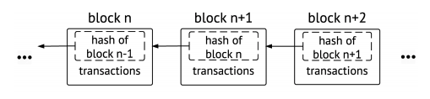
Blockchain subject is interesting since
+The blockchain technology is (still) new and exciting
+Cryptocurrencies are spectacular
+Distributed applications (Dapp) are different.
+Every bit of implementation is sensitive and important
+Almost every implementation is ground breaking
-The subject is new. There is not enough data.
-Limited analysis yet. Findings of the existing studies are limited.
Notes:
+The blockchain technology is (still) new and exciting
+Cryptocurrencies are spectacular
+Distributed applications (Dapp) are different.
+Every bit of implementation is sensitive and important. Risk is high. Attackers have high motivation.
+Almost every implementation is ground breaking
-The subject is new. There is not enough data.
-Limited analysis yet. Findings of the existing studies are limited.

Slide 3
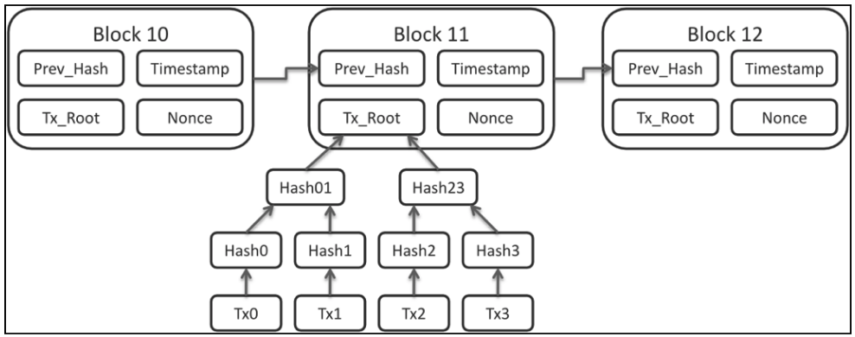
Our subject is interesting since
+Cryptocurrencies are well discussed
+Conversations start with blockchain and end with cryptocurrencies
+Blockchain is more than cryptocurrencies, payment, money, ..
+When you have a new blockchain implementation idea, the first question is
Why should we use blockchain?
Does it makes sense financially?
-no study providing a framework to decision makers aiding financial assessment of their blockchain implementation projects
-decision makers can simply get carried away with the hype and make inaccurate estimations about the financial aspects of the blockchain implementation

Slide 4
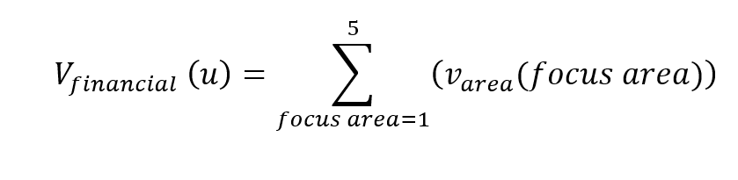
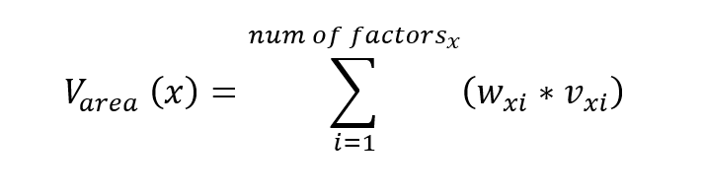
A Financial Evaluation Framework for Blockchain Implementations
A structured framework to evaluate the cost and benefits of the targeted blockchain solution.
Evaluates different aspects of the blockchain project.
Structures the evaluation process by dividing the overall scope into focus areas
Results in a set of formulations that will detail the overall financial model
Formulates a resulting monetary amount.

Slide 5
Focus Areas
What purpose blockchain serves in the target architecture
Features that blockchain provides.
Costs that blockchain potentially reduces.
Other environmental factors and motivation.
Actual implementation and operational costs.

Slide 6
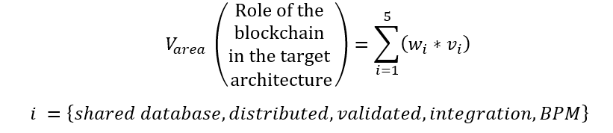
What is the role of the blockchain in the target architecture?
Shared Database
+ distributed computing
Distributed Database
+ validation of transactions
Validated Immutable Transaction Database
+ multi party, processing transactions on a flow
Validated immutable Integration Platform
+ Automation, contracts, monetary integration
Immutable Business Process Management System
Notes:
..is a shared information database There is a single version of the information.
..is a distributed information database Blockchain becomes distributed, replicated, and a single version of the truth
..is a validated immutable transaction database
consensus eliminates the invalids, duplicates or misfit.
can be specific business logic in the validation.
There are also infrastructure requirements about signatures, encryption, and data format checking as part of validation.
Validation and consensus make the data more secure, valid, relevant, and trusted.
..is an integration platform with a validated immutable transaction database
Participants of a blockchain network collaborate over the blockchain network by sharing information in the form of transactions. The seller, the buyer, banks, factory, the land transportation company, ports, shipping companies, the receiving port, customs, delivery company, and destination receiver all issue transactions for order, bank-letter-o-guarantee, production of an item, custodianship of the traveling item, customs documentation, receipt or arrival, and payment. Some participants may also benefit from these communications without actively issuing transactions. Insurance companies have a stake in the loss and damages. Government officials have governance interest on audit, taxation, and duty.
..is an immutable business process management database
Smart contracts add custom application capabilities to the blockchain.
In business process management systems (BMPS), business process entities, and the business rules defined around them form a business process. The business rules control interactions and interactions create/update instances of the business process entities.
A BPMS blockchain [7] contains entity instances with their metadata waiting for their next interaction.

Slide 7
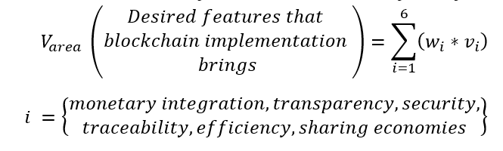
What are the desired features that blockchain implementations bring to the solution?
Enhanced monetary integration – smart contracts
Greater transparency
Enhanced security
Improved end-to-end traceability and assurance
Increased process efficiencies and speed
Sharing economies
Notes:
Enhanced monetary integration – smart contracts This integration introduces automatic monetary settlements capability to business activities
Greater transparency
Enhanced security hackers do not have a chance to attack, update the data, or destroy any information.
Improved end-to-end traceability and assurance
Increased process efficiencies and speed Businesses with blockchain infrastructures can avoid error-prone bulk operations where error handling is a challenge. Individual processing also enables healthy transactions to be processed much faster while unhealthy transactions suffer from their own issues
Sharing economies Outsourcing well defined and distributed tasks remove the need for procuring, hiring, and allocating resources. These resources, such as personnel, comes with additional costs such as benefits, insurance, planning, management, and payroll.

Slide 8
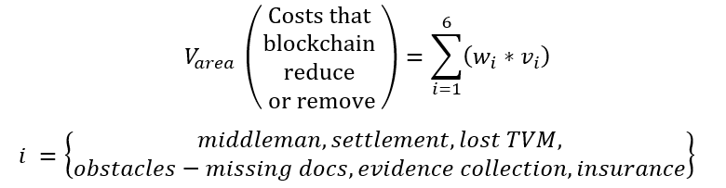
Which costs does blockchain reduce?
Removal of the intermediaries
Streamlining clearinghouse structures and settlement processes
Reducing settlement time and the time value of money
Removing obstacles such as missing documentation
Removing the burden of proof
Reduction of insurance rates

Slide 9
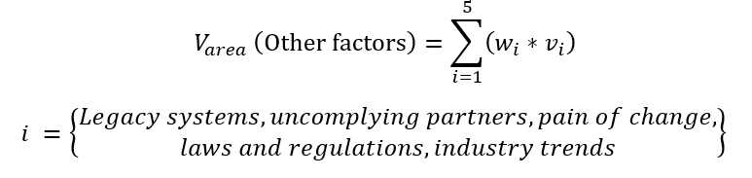
What are other factors and the motivation for implementing a solution?
Existing systems in place
Uncomplying partners
The pain of change - Starting a new business on a new technology
Compliance with laws and regulation.
Industry trends

Slide 10
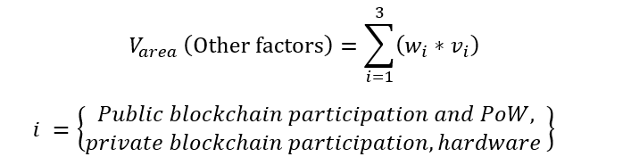
What is the cost of implementing or operating a blockchain solution?
Public vs. permissioned/private blockchains
Cost of participating in a blockchain
Do you need new hardware?

Slide 11
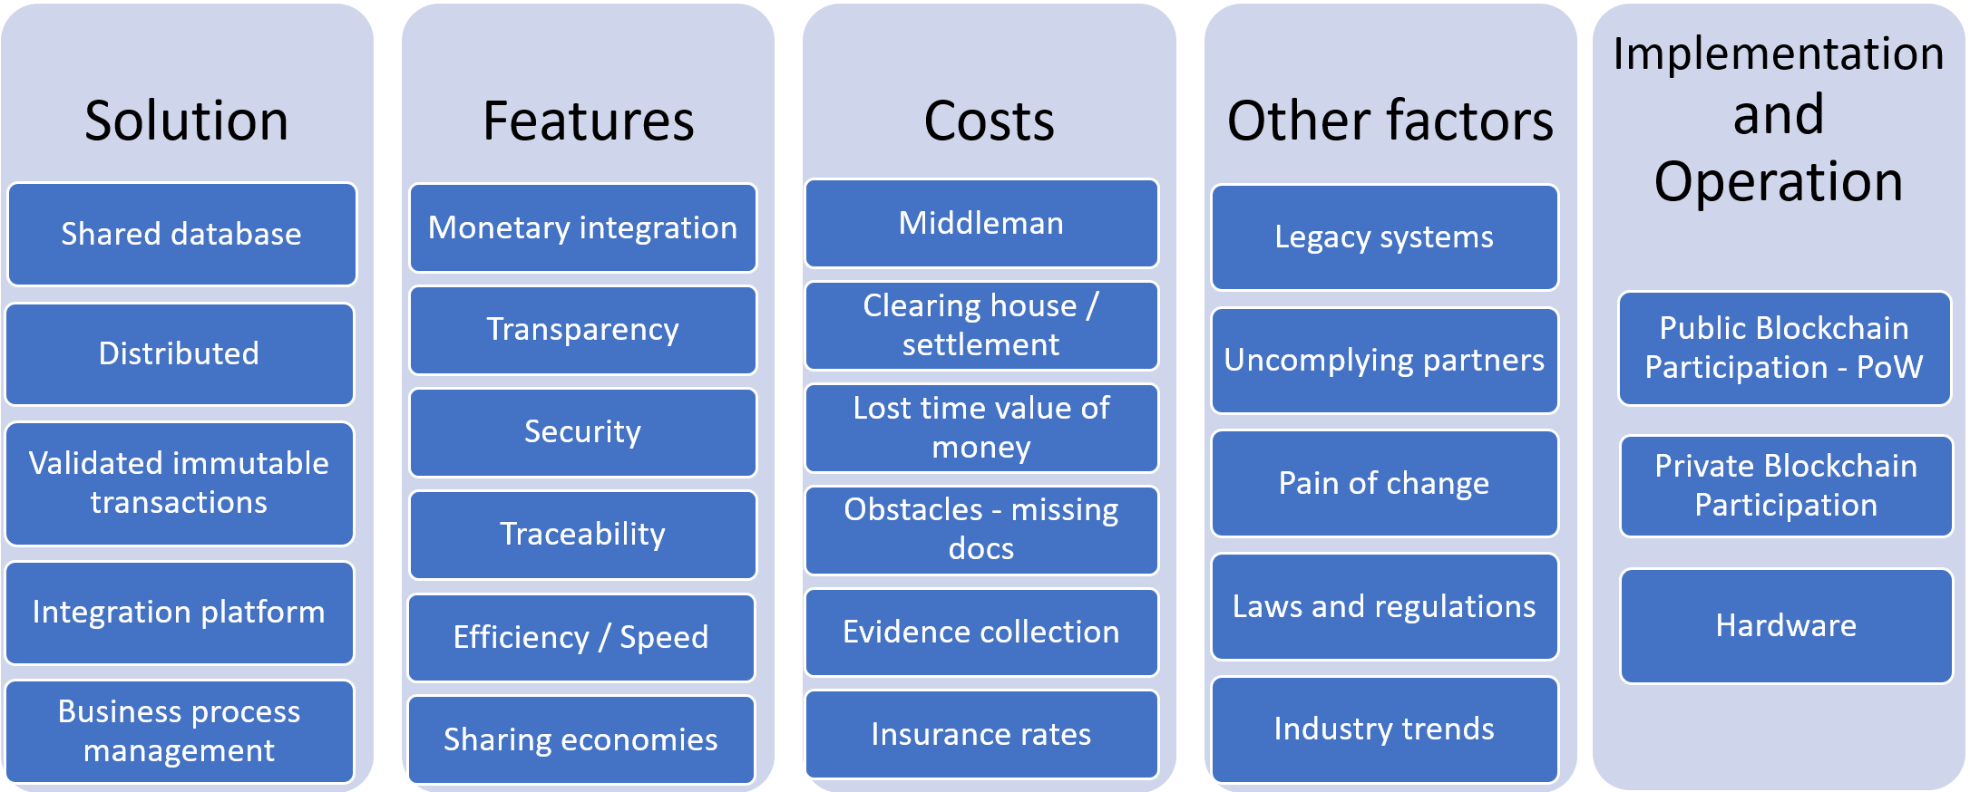

Slide 12
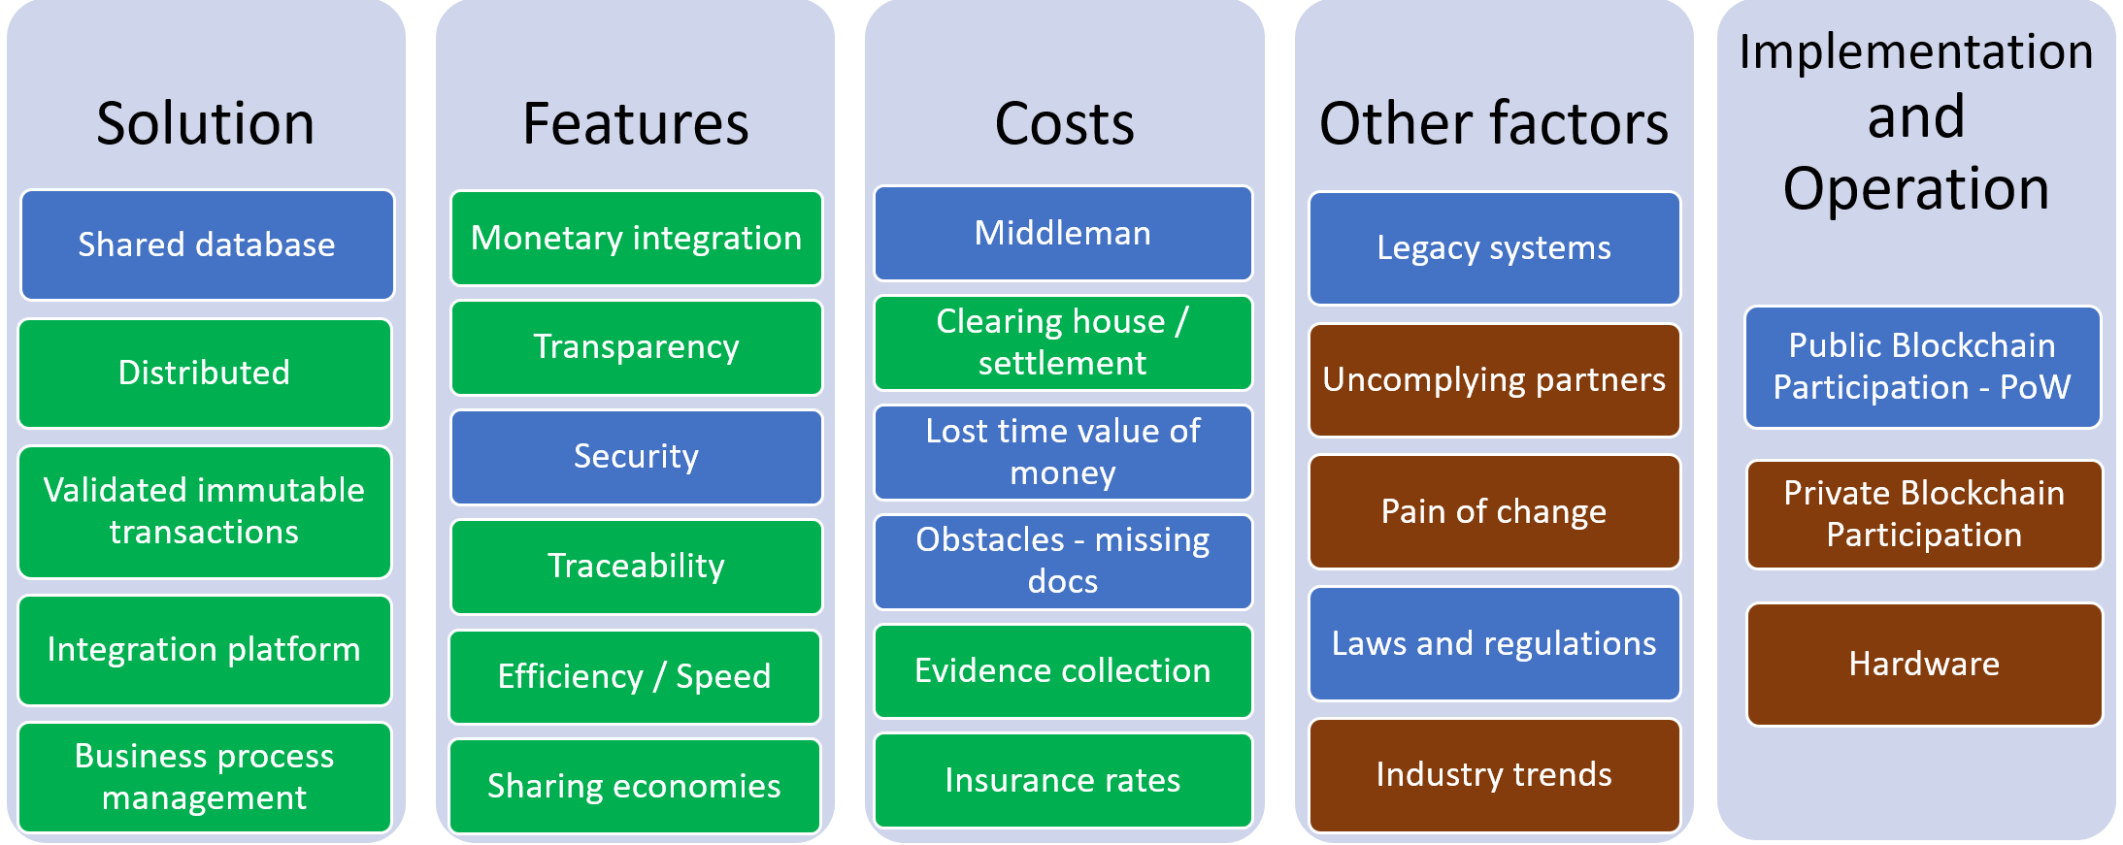
Delivery Assurance - High Volume Package Delivery

Slide 13
Questions?
Contact: Mehmet.Demir@Ryerson.ca

