Slide 1


Data Quality in Healthcare
Steve Delaney
CP 9102
November 18th, 2019
Everyone Makes a Mark

Slide 2
Agenda
Background
Research Focus
Current Healthcare Landscape
Data Quality Challenges & Opportunities
Data Quality Research & Potential Solution
Summary

Slide 3
Background
Presenter’s Background:
Academic (Ryerson University, University of Toronto, York University)
Business (Capital Blockchain, CIO Association Board)
Significant Healthcare IT Experience (Public & Private sectors)
Improving the delivery of healthcare to patients has inspired me to focus my research in this area.
Page 3

Slide 4
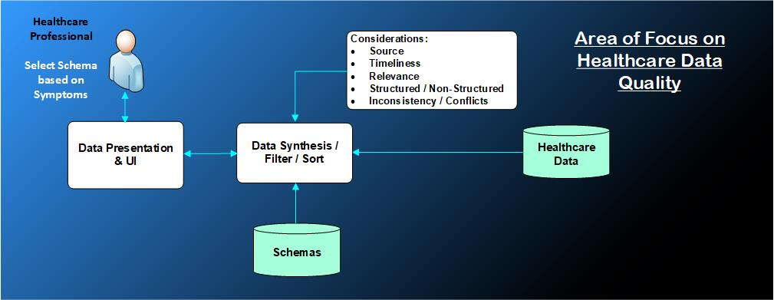
Research Focus

Slide 5
eHealthcare Data : Introduction
What is EMR, EHR and why the focus is on EHR:
Def^{n} of EMR: Electronic Medical Records
First standard for Medical records.
EMR’s are electronic versions of paper records.
Not easily used outside of the Doctors.
Def^{n} of EHR: Electronic Health Records
Contains a broader range of healthcare information including EMR.
EMR is a subset of EHR.
Adheres to standards that allows the data to be more easily shared between healthcare systems.

Slide 6
Current Healthcare Landscape:
Healthcare costs in developed countries currently average 10% of their GDP.
Costs continue to increase in part, because a patients healthcare biography is spread across multiple heterogeneous data silos. For example, hospitals, pharmacies, labs and clinics.
Costs rise due to:
Susceptibility to fraud.
Replication of tests.
Aging population.
Population growth.
Increased travel.
300,000 physician visits per day.

Slide 7
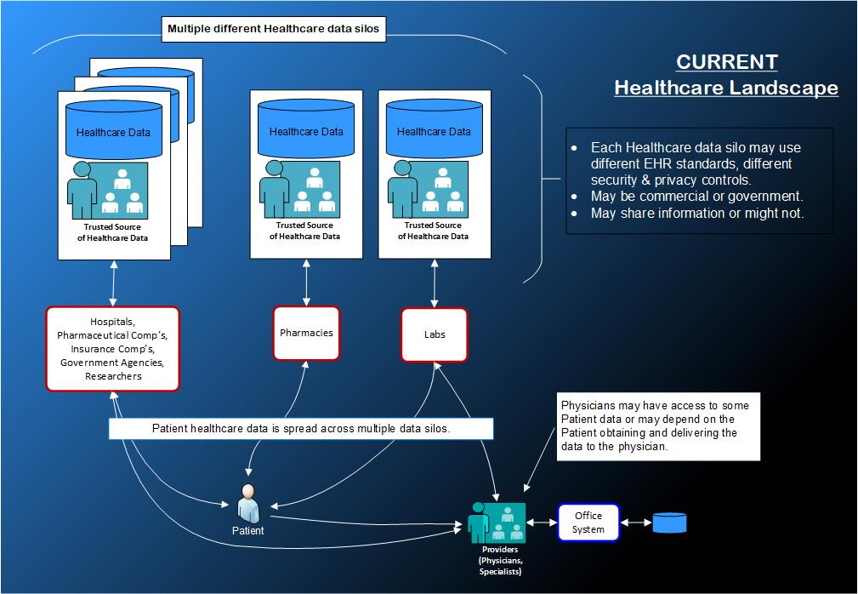
Current Healthcare Landscape:

Slide 8
Goal: Unified Healthcare Records
Challenge: Government
Challenge: Social
Challenge: Corporations
Challenge: Technical
Linking data across the multiple data silos to the correct patient.
Differing EHR standards.
Achieving consistent performance levels and scalability.
Security & privacy controls.
Differing levels of Data Quality.

Slide 9
Focus: Interoperability & Data Quality
My goal to improve data quality in the context of improving patient healthcare: To improve the treatment of a patient by synthesizing the “patients healthcare information” and presenting it in order of relevancy for treating the patients current condition. Synthesizing healthcare information involves combining healthcare facts with schemas to allow an evolved understanding of what information is most relevant to the patients condition and treatment.

Slide 10
Definition: Data Quality
The aspect of Data quality of interest to me is not about limiting access to a patients healthcare data or generating a diagnosis.
It’s about using knowledge of the patients current condition to synthesize and present the patients healthcare information most important to the attending healthcare professional. The goal is to speed the ability of the healthcare professional to diagnose a patients condition and determine an appropriate treatment. Also, to highlight any inconsistencies in the healthcare data.

Slide 11
Use Case Examples for Data Quality:
A patient is brought into an emergency room and is unable to communicate. The physician on duty can benefit from a patients list of prescriptions and existing conditions being treated.
First responders are communicating to someone trapped in rubble. They can find out if the individual is being treated for a condition requiring medication. eg. diabetes.
Police responding to reports of someone creating a disturbance. Knowledge of whether the individual is autistic, diabetic or has a condition that may explain their behaviour would be important for knowing how to respond.
A doctor prescribing medicine can check if the patient has been prescribed drugs that would result in a dangerous mix.

Slide 12
Use Case Examples for Data Quality (continued):
A doctor requires a full allergy test on a patient and is presented with a test recently done that can be used instead.
Key medical information is derived from a doctors or nurses notes and presented to the attending physician thus, removing the delay due to the physician having to read and pull out the information themselves.
A doctor conducting the yearly physical of a patient is presented with a history of the patients healthcare information created since their last physical and a analysis of trends over time of the results of blood tests and weight.
A patient relates symptoms to a doctor and any of the patients healthcare information relevant to the symptoms is displayed on the first screen.

Slide 13
Data Synthesis to Determine Relevancy:
Information to which Weighting Factors will be Applied:
Source of the Information:
Info from a specialist is given more weight than from a nurse.
Timeliness of the Information:
An allergy test taken recently is preferred over one taken 5 years ago.
Relevance:
The information must be relevant to the patients current condition.
Structured vs Non-Structured information:
Non-Structured information can be more ambiguous and open to interpretation.
Consistency of Information:
Information inconsistent with other information may be suspect.

Slide 14
Data Synthesis to Determine Quality:
Input:
Symptoms:
Symptoms identify the schemas to be used to identify healthcare information most relevant to the patients condition.
Data Analysis & Selection:
Algorithms to be developed to:
Identify and build the schemas to be used.
To identify healthcare data that is inconsistent.
To graph a trend analysis on selected data.
To select and weight the most relevant healthcare data and the order in which it is to be displayed.
Algorithms to pull pertinent medical facts from unstructured data (eg. doctors notes).

Slide 15
Data Synthesis to Determine Quality (continued):
Data Classification:
Determine the meta-data requirements to classify healthcare information to support the selection and synthetize the information. This will influence the healthcare data model.
Support the attending healthcare worker to drill down into the presented information to gather more facts to support diagnosis.

Slide 16
Potential impact on Healthcare:
Changes the way healthcare professionals use healthcare data.
Reduce the time healthcare professionals search for and interpret Patient data:
The correct treatment will begin sooner.
Less wait time and money spent on tests that are not needed (reduce costs).
Less time and effort reading non-structured data to identify pertinent facts.
Add new sources of healthcare data which are currently being ignored as not relevant or too difficult to discern.
For example, Physician, Nurses and Patient notes.
It could be disruptive to some healthcare information providers as they are now participants in an integrated healthcare ecosystem.
Flag important healthcare information found to be inconsistent requiring remediation.

Slide 17
Potential impact on Healthcare (continued):
Future Benefits:
Adoption and possible segue for AI to support and suggest diagnosis.
Provide a foundation to identify relevant health data from IoT devices.
Provide support for continuity of care.
Develop schemas to support a patient centric view of their healthcare information.

Slide 18
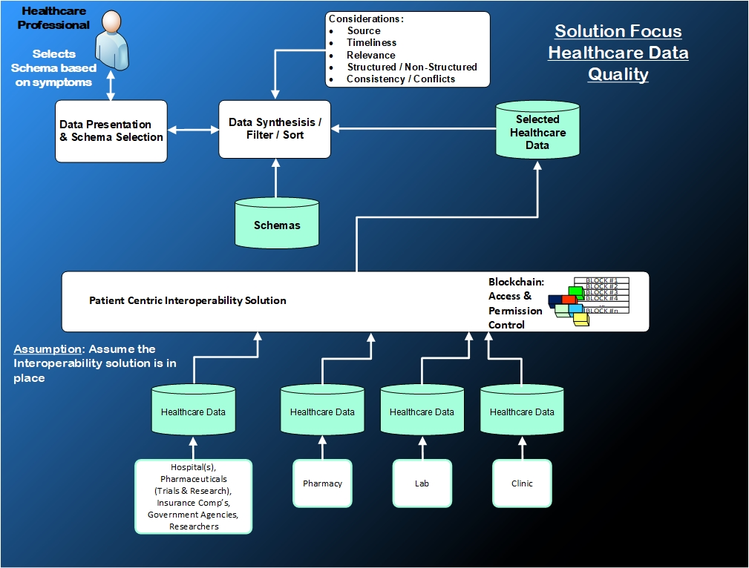
Possible Future Landscape :

Slide 19
Approach:
Phase 1A: Q4 2019 – Q1 2020 | Literature Review
Phase 1B: Q4 2019 – Q1 2020 | Information Collection: Physician requirements. Data requirements. Algorithm requirements.
Phase 2: Q1 2020 – Q2 2020 | Analysis : Separate poor data from good. Identify healthcare data types. Create schemas and map them to relevant types of healthcare data. Utilize algorithms that identify relevant medical information from non-structured data. Specifically, notes from physicians and nurses. Determine how to test the hypotheses.
Phase 3: Q2 2020 – Q3 2020 | Build the Experiments : Identify the healthcare professionals who will participate in the testing and collect feedback. Obtain data, develop the code and tests that will verify the hypotheses.

Slide 20
Approach (continued):
Phase 4: Q3 2020 – Q4 2020 | Execute the Experiments : Execute the experiments. Adjust as required. Analyze the results.
Phase 5: Q4 2020 | Conclusion : Document and present results.

Slide 21
Risks:
Engaging the right healthcare professionals to provide requirements and engage in testing and provide feedback.
Some providers of healthcare information may be reticent to provide information for testing due to:
Privacy concerns.
Having their data assessed as poor quality.
Private providers of healthcare data may have data ownership concerns.
Building a healthcare dataset.

Slide 22
Summary:
A very interesting and challenging project.
If successful, there could be significant societal benefits and a reduction in healthcare costs.

