Slide 1
Checking app behavior against app descriptions
CHABADA
Presenter: Mehmet Demir
Authors: Alessandra Gorla, Ilaria Tavecchia, Florian Gross, Andreas Zeller
ICSE 14

Slide 2
Outline
Overview
Discussion and Target of the research
Steps of the research and details
Evaluation
Limitations
Criticism

Slide 3
Abstract
Cluster Android apps by topic
Identify outliers
(weather app that send messages)
Flag as anomaly
22,500+ apps
56% of novel malware marked
Notes:
How we put the application together

Slide 4
Discussion
Sending text messages?
Track location
Sending the contact list to a server? WhatsApp
Is the program behaving as advertised?
Is there a questionable covert behaviour?

Slide 5
In this paper
Compare
implemented app behaviour
vs
advertised app behaviour

Slide 6
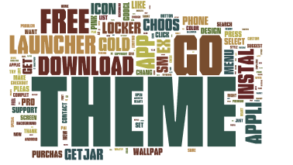

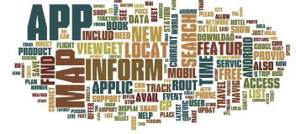


Slide 7
CHABADA
Gather good apps
Cluster
Apps with topics
Identify app access
Identify topics per app
Use Latent Dirichlet Allocation on description
22500+ good android apps from Android.
Identify which applications share topics?
Identify sensitive API access and collect the permission
Identify anomaly
Use unsupervised one-class SVM for anomaly classification and identify outliers w.r.t. their API usage
Notes:
How we put the application together

Slide 8
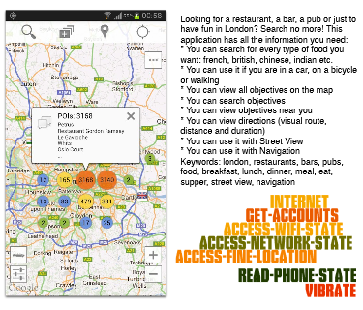
A sample
Is it malware
possibly
Is it unexpected behaviour
Certainly

Slide 9
Results
Cluster Android apps by topic
Identify outliers
(weather app that send messages)
Flag as anomaly
22,500+ good apps
56% of novel malware marked
Notes:
How we put the application together

Slide 10
Processing details
Collected the applications
(top 150 in their categories)
Clustering with k-means
NLP pre-process
(remove foreign lang, remove common words, stemming )
LDA
Identify topics
22,500+ good apps
Prepositions (to, at, of, between)
Articles (the, a, an)
Conjunctions (and, but, so)
Identify keywords per category
Limit 30 categories in total
Limit 4 category per app
App is assigned to category with a certain probability
32 clusters
.
Notes:
How we put the application together

Slide 11
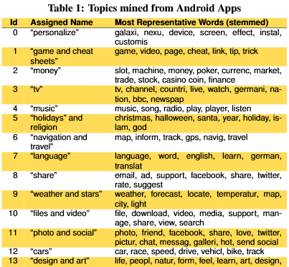
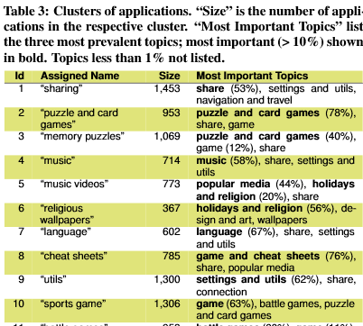
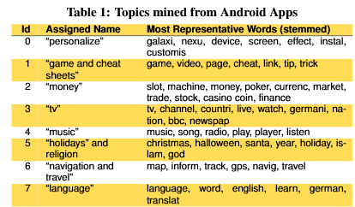
Processing details
32 clusters of applications
30 topics identified by LDA
.
Notes:
How we put the application together

Slide 12
Decision and evaluation
Extract the API usage
Classification
Sensitive APIs
Identify outliers with OC-SVM
From Permission settings. And from another research. .
One class of elements. All samples are from one class.
The class to be used for anomaly detection later
Notes:
How we put the application together

Slide 13
Evaluation – Anomaly and Malware Detection
160 outliers arose from 22500 applications
Manually inspected
their descriptions
their list of used APIs
their code.
Classified each as Malicious (42), Dubious, Benign.
Malware around following clusters: Kids(14), Connections(16),ad wallpapers(28)
Spyware in many apps
Dubious such as sound recording PhysicalTraining and Mail apps

Slide 14
Limitations
The learning of topic/feature relationship may not be transferrable
Free apps only
Top 150 but easily reproducible data sample
Manually classified.
Obfuscation may seal some “hacks” in apps
Static analysis may miss “reflection”
Might have included some never executed calls. (even test codes)
Sensitive API mapping is reused from another research

Slide 15
Good and Bad
Good: Describes well: how the applications are collected.
Bad: top 150 free apps in their category seems to much filtered.
Good: Detection of language differences in descriptions
Bad: only chose English as the language.
Question: what would be the impact of Lemmatization vs Stemming
Question: What would be the impact if not removed URLS and such but replace with a uniform word such as URL/EMAIL/HTMLTAG.
Bad: over processed by categorising then clustering.
Good: comparison of cluster approaches and results with and without clustering
Bad: manual work, analysis and decisions that impact the results

Slide 16
Questions?
Contact: Mehmet.Demir@Ryerson.ca

