Slide 1

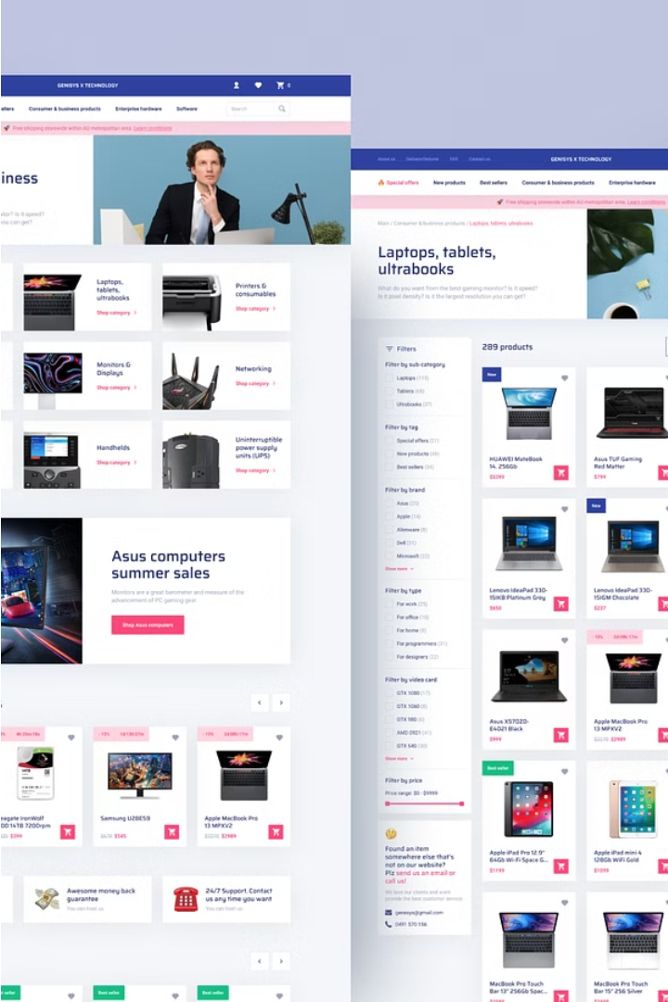

Introduction to E-commerce Sales Analysis
In this comprehensive e-commerce sales analysis, we'll dive into the key aspects of understanding and optimizing your online business performance. From data collection to insightful visualizations, this project will equip you with the tools and techniques to make data-driven decisions and drive sustainable growth.

Slide 2
Data Collection and Preprocessing
Gather Data
1
Collect all relevant e-commerce data, such as sales, customer information, and product details, from your various sources.
2
Clean and Transform
Ensure data integrity by cleaning, formatting, and transforming the raw data into a standardized format for analysis.
Enrich with Insights
3
Augment the data with additional insights, such as customer demographics and market trends, to unlock deeper understanding.

Slide 3
Exploratory Data Analysis (EDA)
Identify Patterns
Understand Drivers
Spot Opportunities
Uncover hidden patterns, trends, and relationships within your e-commerce data through comprehensive EDA.
Analyze the factors influencing your sales, such as seasonality, marketing campaigns, and customer behavior.
Leverage the insights gained to identify potential growth opportunities and areas for optimization.

Slide 4


Sales Trend Analysis
1
Historical Trends
Examine past sales data to identify long-term patterns, seasonal fluctuations, and growth trajectories.
2
Current Performance
Analyze recent sales data to understand your current position, detect any deviations from historical trends, and respond accordingly.
3
Forecasting
Leverage statistical models and machine learning techniques to predict future sales and prepare for upcoming demand.

Slide 5
Customer Segmentation
Identify Segments
Understand Needs
Target Effectively
Divide your customer base into distinct segments based on factors such as purchase behavior, demographics, and preferences.
Analyze the unique needs, pain points, and motivations of each customer segment to tailor your marketing and product offerings.
Develop targeted strategies to effectively reach and engage with each customer segment, driving higher conversion rates and loyalty.

Slide 6
Product Performance Evaluation
1
Sales Velocity
2
Profit Margins
Assess the sales performance of individual products, identifying top-sellers and underperformers.
Analyze the profitability of each product, considering factors such as cost of goods sold and pricing strategies.
3
Inventory Optimization
4
Product Bundling
Optimize inventory levels to avoid stockouts and minimize excess inventory, improving overall operational efficiency.
Explore opportunities for strategic product bundling to increase average order value and customer satisfaction.

Slide 7

Conclusion and Recommendations
Key Insights
Data-Driven Strategies
Next Steps
Summarize the critical insights and findings from the comprehensive e-commerce sales analysis.
Outline a clear roadmap for implementing the recommended strategies and continuously monitoring your e-commerce performance.
Provide actionable recommendations to optimize your e-commerce operations, improve customer experience, and drive sustainable growth.

