Slide 1
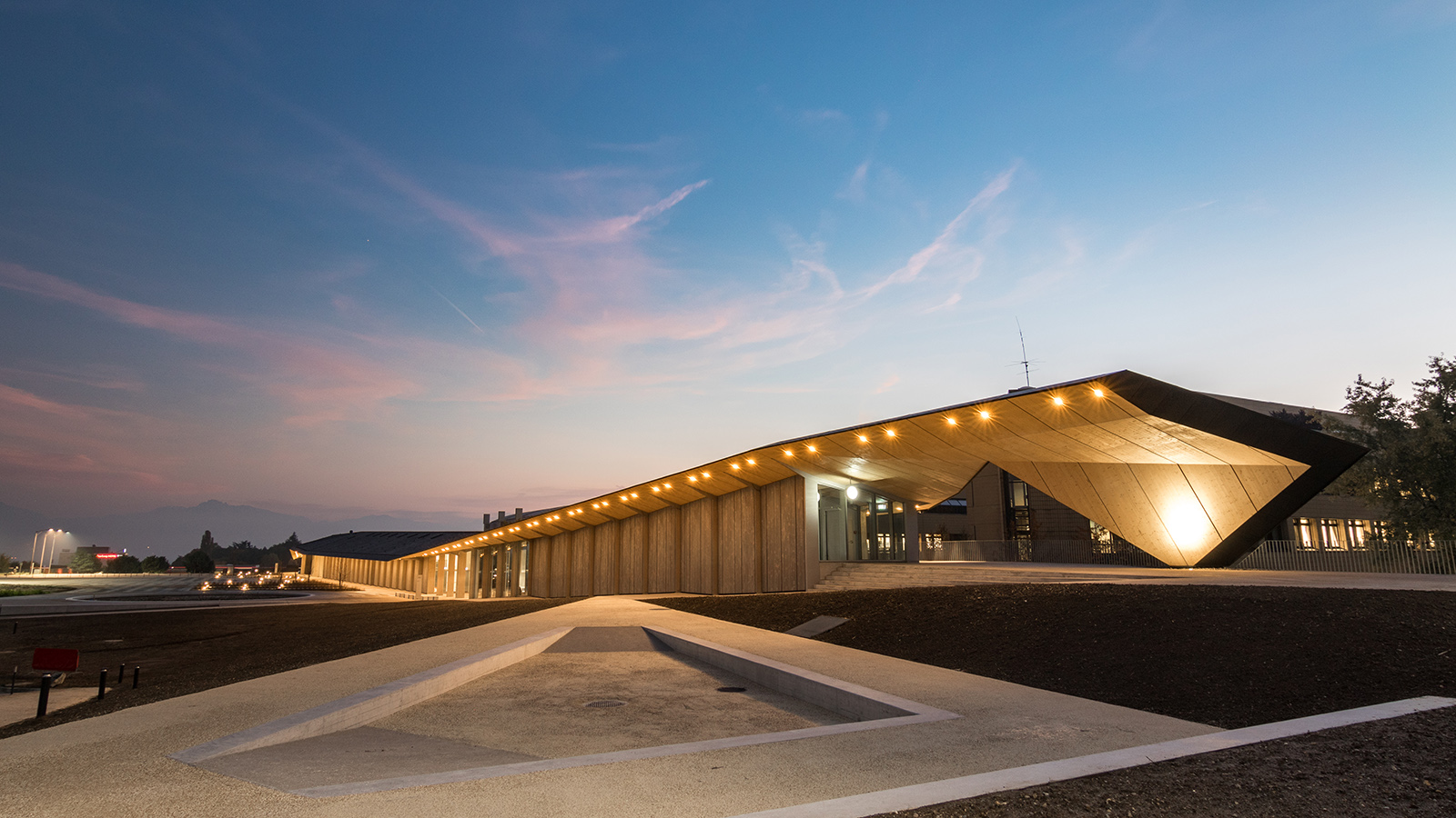

Ecole polytechnique fédérale de Lausanne
Route Planner

Slide 2
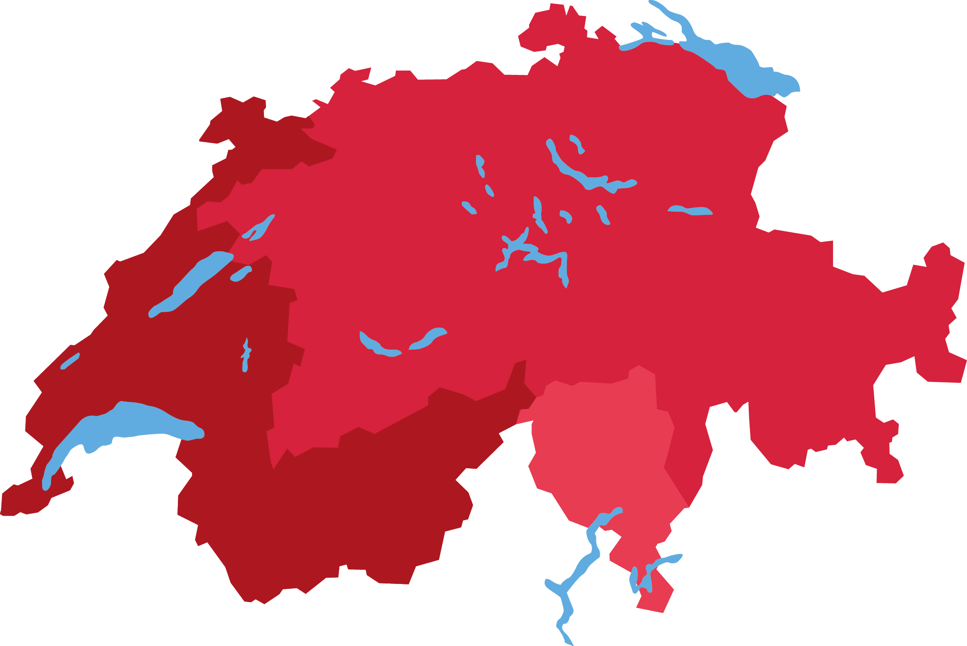
Where do you want to go ?
Bale
Zürich
St. Gallen
Bern
Lausanne
Geneva
Verbier

Slide 3
The problem we have
Robust Journey Planner
Isochronous
Map

Slide 4
Decompose the problem in small task
Data
Preprocessing
Delay distribution modelling
Visualization
Deterministic planner
with OTP
Robust route planning

Slide 5
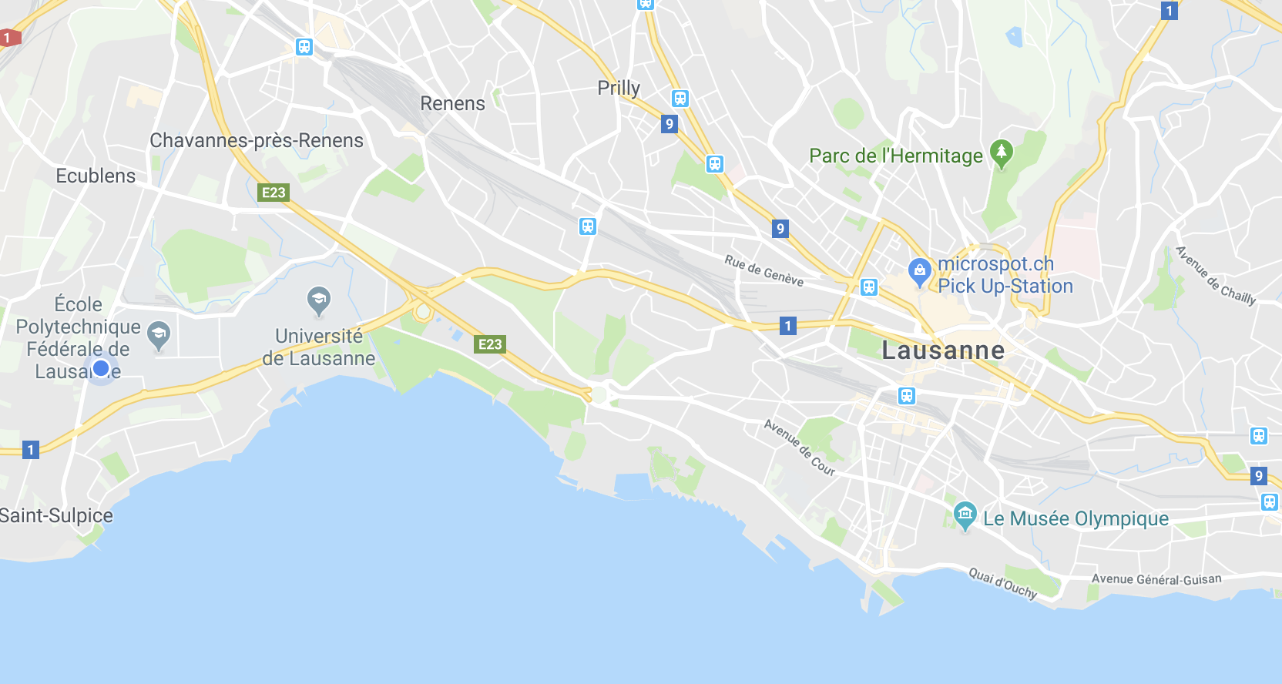
Preprocessing – Clean Metadata
Lausanne
Many redundancies
We use another dataset to recover name
38%

Slide 6
Deterministic journey planner solution
Harnessing the power of open-source community
OpenTripPlanner – trusted by governments from:
Finland
Norway
Oregon, New York, Los Angeles, Washington
Netherlands
Using SBB timetable

Slide 7
Decision tree for Feature selection
Best features
Hours
38%
StopName
2.9%
33%
Line ID
20%

Slide 8
Robust route planning
Choose start time, origin, destination and quality
Find the 3 fastest itineraries starting here
Respecting the desired quality
Departure
Destination
Compute overall quality and filter
For each stop in between

Slide 9
Isochronous map
Let’s try
Zurich morning rush hours
Zurich morning rush hours with quality

Slide 10
Preprocessing – Match Dataset – Get unique travel ID
GTFS
TripID
LIVE DATA
ShortTripName
ShortRouteName
RouteID

