Slide 1
Support Vector Machines
Muhammad Ehsan-Ul-Haq
Matriculation: 1098587
Department of Engineering
Frankfurt University of Applied Sciences

Slide 2
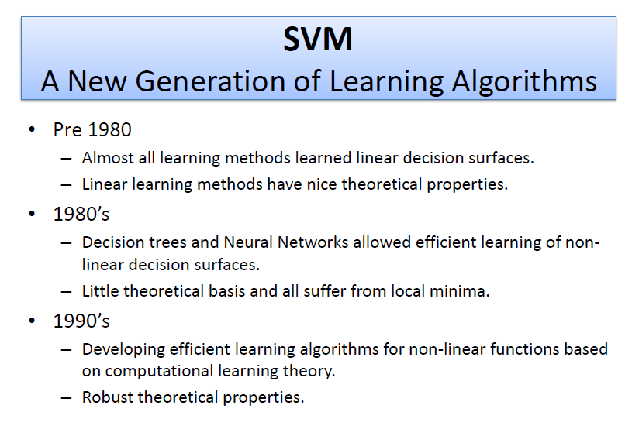

Slide 3
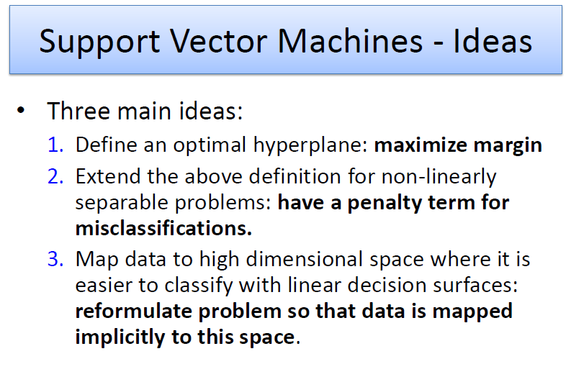

Slide 4
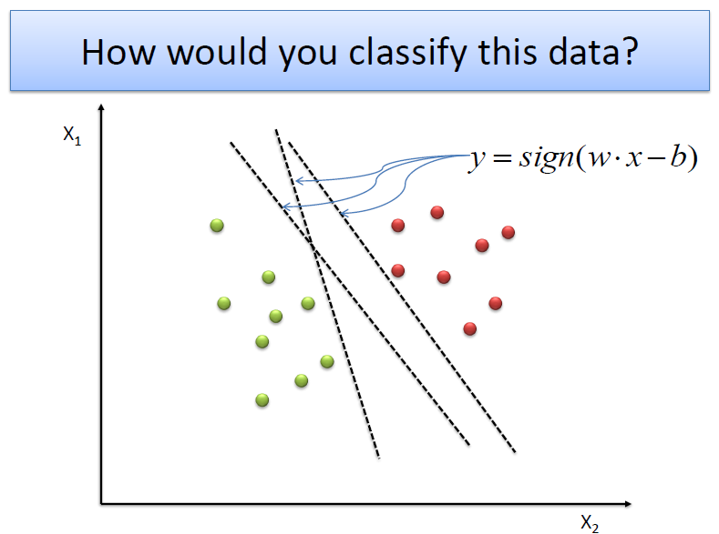

Slide 5
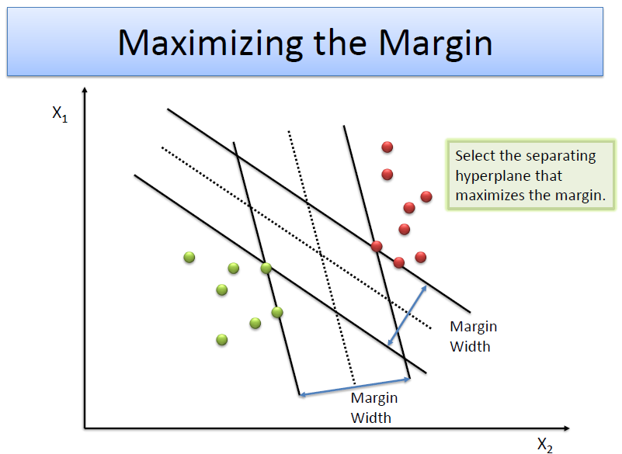

Slide 6
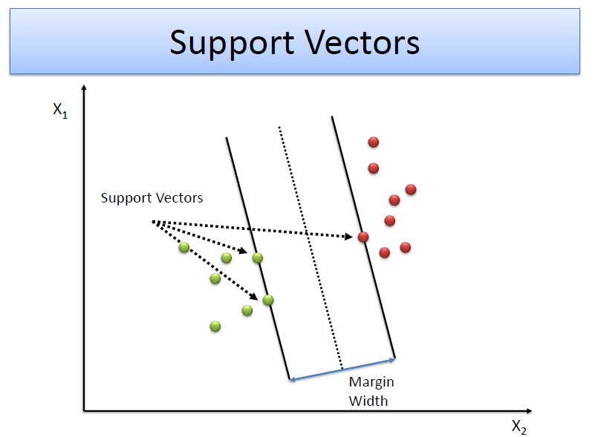

Slide 7
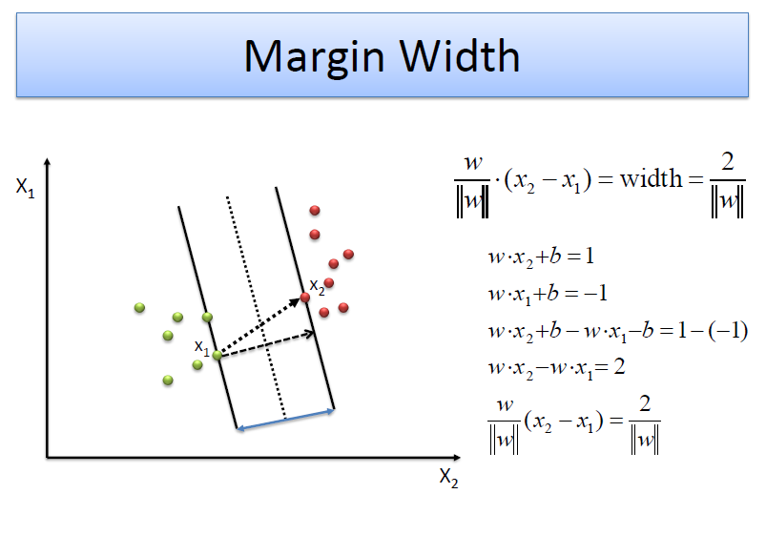

Slide 8
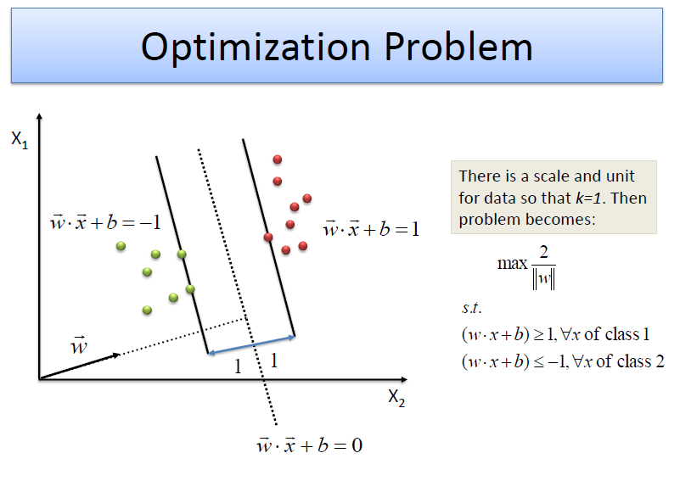

Slide 9
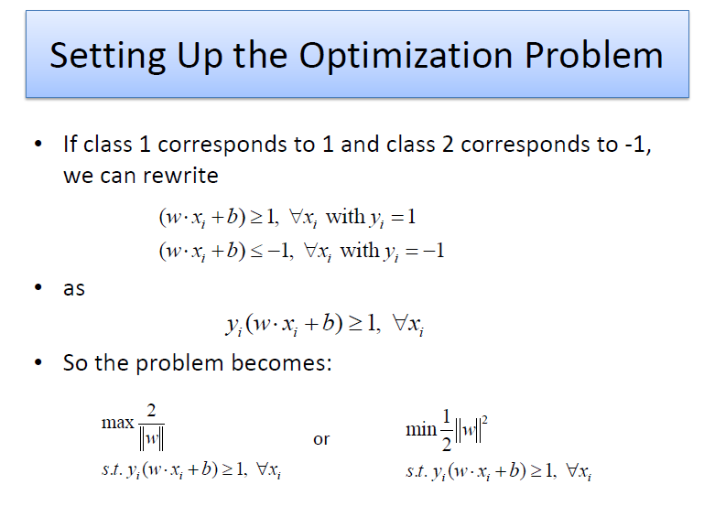

Slide 10
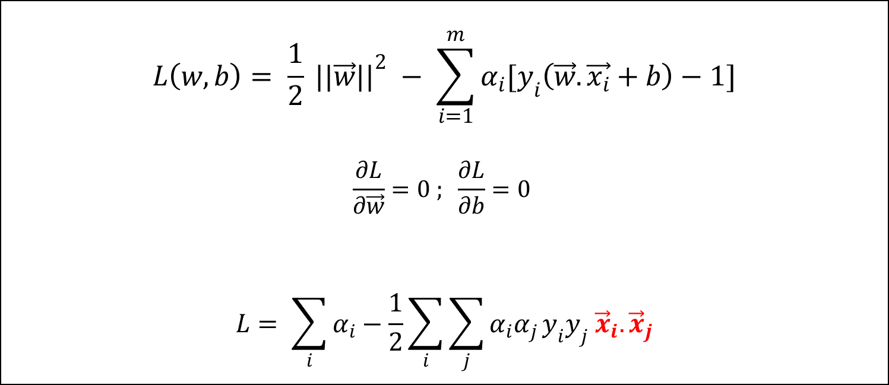
Lagrange Multipliers
$$L\left(w,b\right)= \frac{1}{2} {||\vec{w}||}^{2} − \sum_{i=1}^{m}{α_{i}[y_{i}\left(\vec{w}.\vec{x_{i}}+b\right)−1]}$$
$$\frac{∂L}{∂\vec{w}}=0 ; \frac{∂L}{∂b}=0$$
$$L= \sum_{i}{α_{i}}−\frac{1}{2}\sum_{i}{\sum_{j}{α_{i}α_{j}}}y_{i}y_{j} {\vec{x}}_{i}. {\vec{x}}_{j}$$

Slide 11
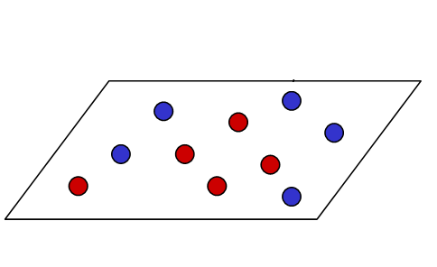
What if?!

Slide 12
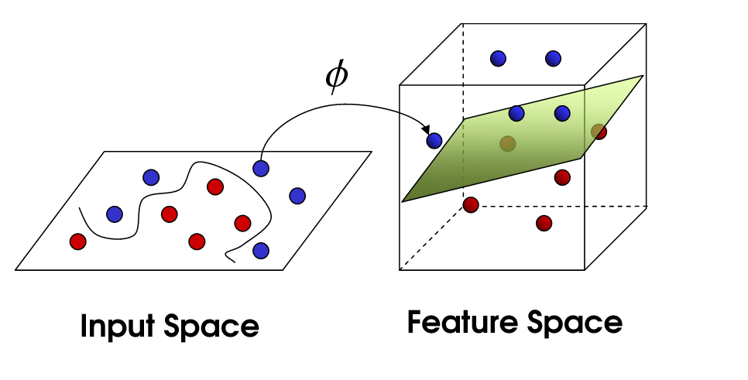
Mapping into another space

Slide 13
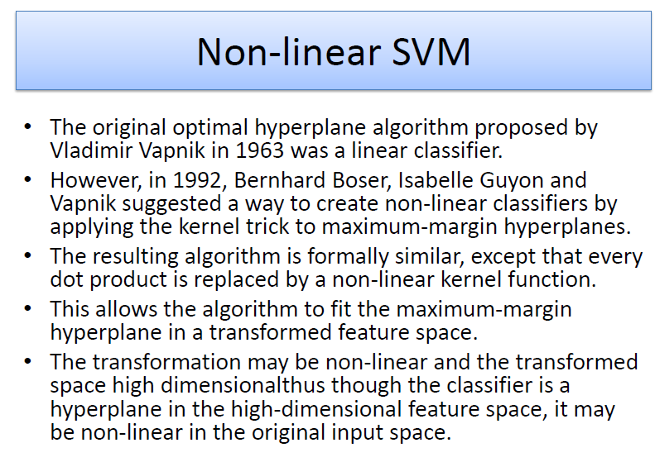

Slide 14
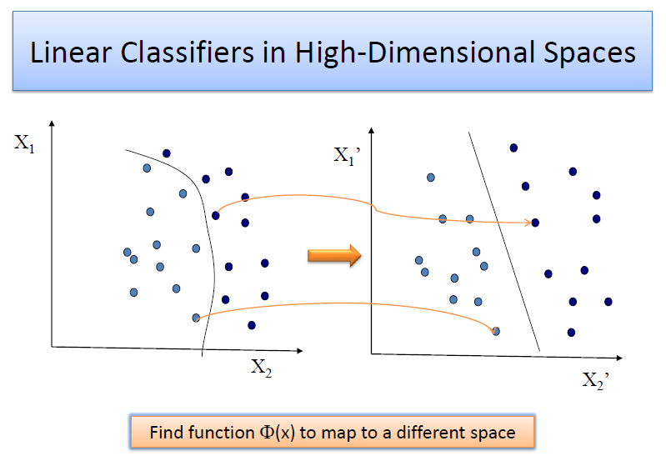

Slide 15
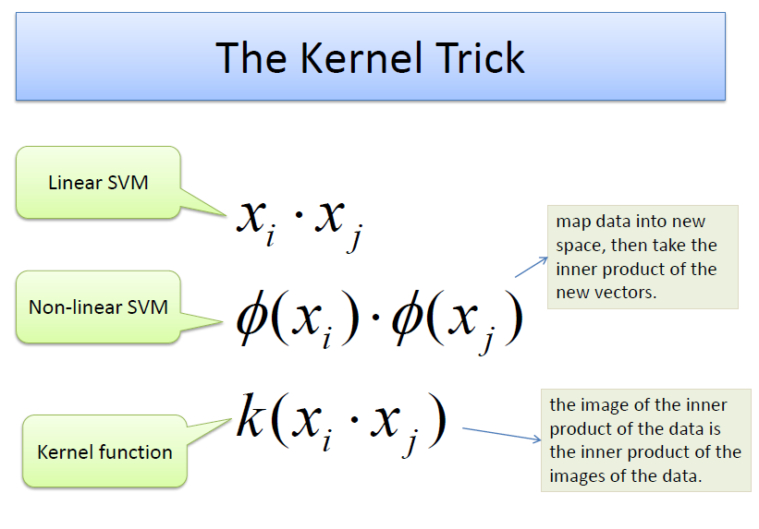

Slide 16
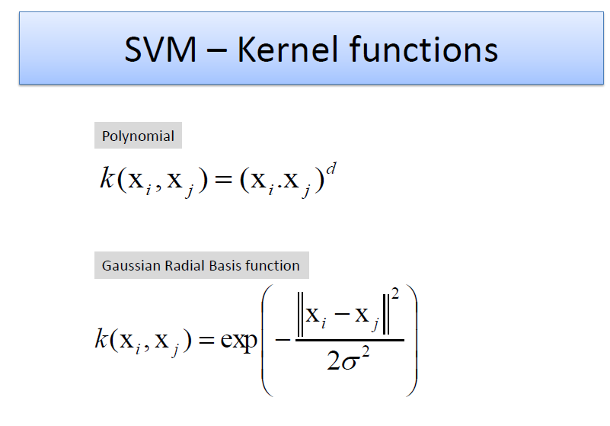

Slide 17
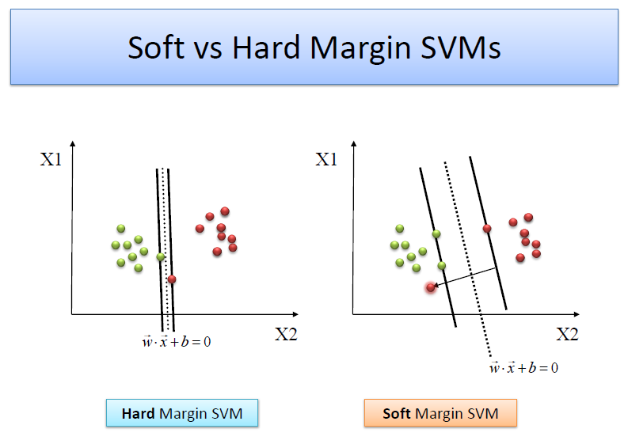

Slide 18
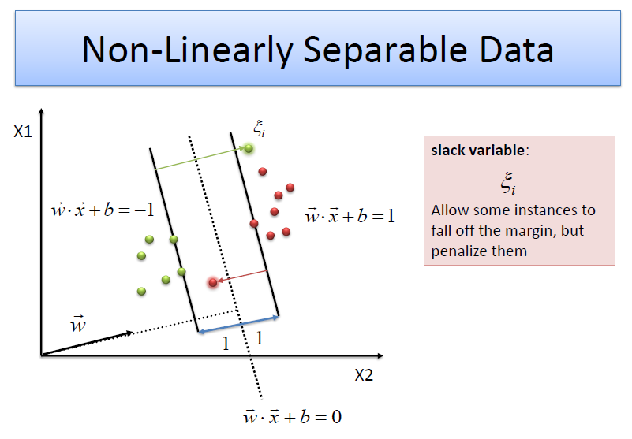

Slide 19
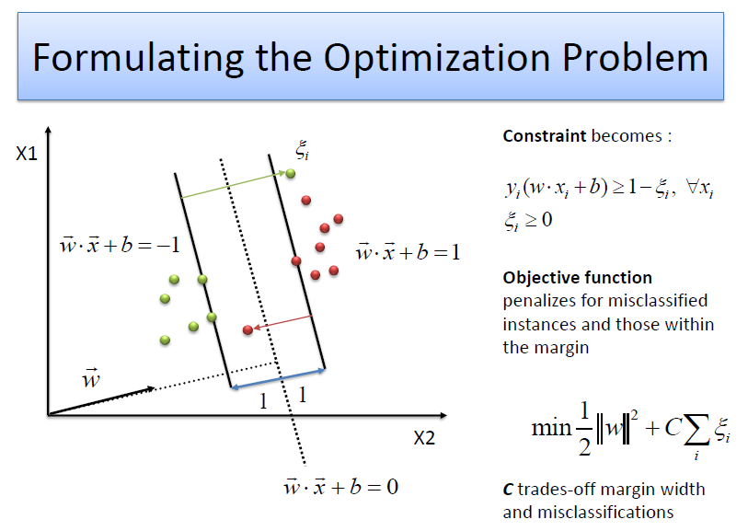

Slide 20
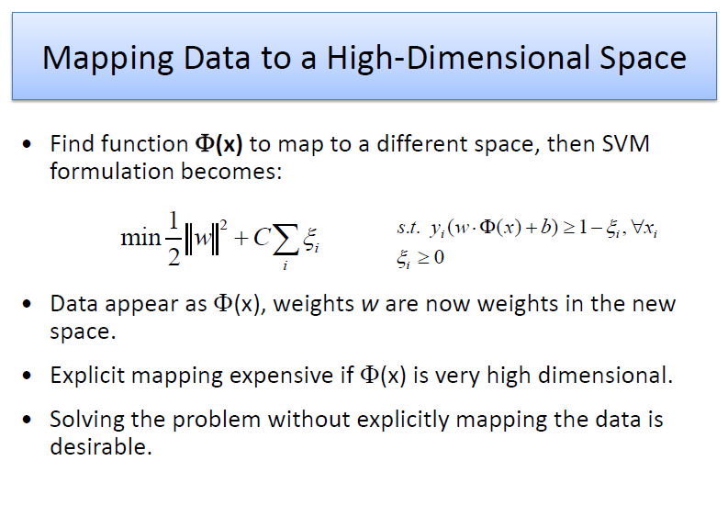

Slide 21
Advantages and Limitations
Advantages
Kernel trick
No local minima
Generalization
Robustness to outliers
Limitations
Extension to multiclass problem
Tricky Selection of parameters
Long training times for small feature dataset

