Slide 1

Cloud with ML Use case: Stroke Prediction
Realised by :
EL YOUBI Mouhcin
EL HADDIOUI Amine
ELHAMZAOUI Aissa
ELKABBAJ Hiba
ELHAMDAOUI Oumayma
OUMIMOUNE Imane
Framed by:
P.BENTALEB Asmae

Slide 2
Table of Contents
1
2
3
4
Presentation of project
ML with Cloud
Problem
Solution
Machine Learning
Cloud Computing
Procedure and Experimental Methodology
Tools & Technologies
Working environment
Libraries
Workflow
5
Implementation
6
Conclusion
Dataset
Proposed Algorithms

Slide 3
Presentation of Project
1

Slide 4

Introduction
Stroke is a leading cause of death and disability worldwide, and early recognition of warning signs is crucial. Machine learning algorithms have been developed to predict the likelihood of a stroke occurring in the brain.
4

Slide 5


Problem
Solution
5
Notes:
Our problem is that we want to predict whether a given parient will have a stroke or not based on several parametrs.
Solution : we will develop an ML model using ML algorithms to predict whether a given patient will have a stroke or not based on several parameters

Slide 6
ML with Cloud
2

Slide 7

What is Machine Learning ?
7
Notes:
Machine learning is a type of artificial intelligence that enables computers to learn and improve from experience without being explicitly programmed
Machine learning has many applications, including image recognition, natural language processing, fraud detection, and recommendation systems.

Slide 8

Relation between ML and Cloud
By leveraging cloud computing, machine learning can be used to unlock new insights and drive innovation.
8
Notes:
Cloud computing provides the infrastructure and resources needed for training and deploying machine learning models.
It offers scalable and cost-effective storage and processing power, enabling organizations to easily run machine learning algorithms on large datasets.

Slide 9
Benefits of ML in Cloud Computing
The benefits of using machine learning in cloud computing include:
Improved accuracy
By processing vast amounts of data
Scalability
Systeme can handle more work
Flexibility
Organizations can quickly adapt to changing their requierments
Cost-effectiveness
Organizations can pay for cloud resources as needed
9

Slide 10

What is Cloud Computing ?
11
Notes:
Cloud computing is a way of delivering computing services over the internet, such as storage and processing power. It offers scalability, flexibility, cost-effectiveness, and easy access to resources.

Slide 11
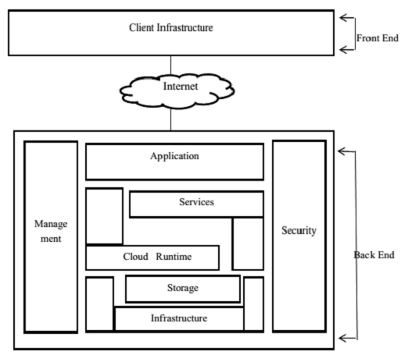
Architecture of Cloud Computing
12
Notes:
Cloud computing technology is used by both small and large organizations to store the information in cloud and access it from anywhere at any time using the internet connection.

Slide 12
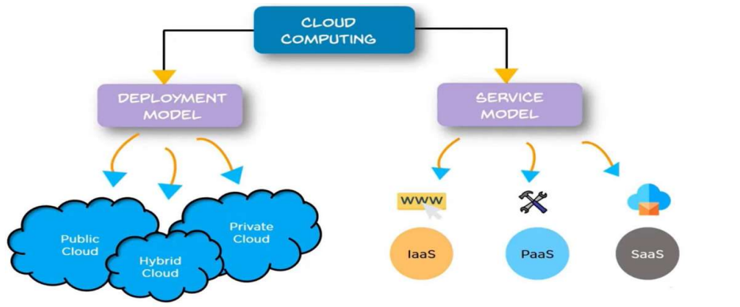
Cloud Computing Models
13

Slide 13
Procedure and Experimental Methodology
3

Slide 14
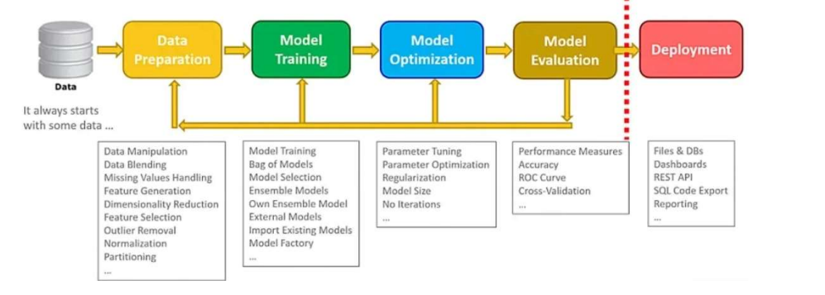
Data preparation we prepare de data
Model training where we train our data with alogirthms
Model Evaluation we evaluate our model based on accuracy score
And finnaly deployment
15
Notes:
Data preparation we prepare de data
Model training where we train our data with alogirthms
Model Evaluation we evaluate our model based on accuracy score
And finnaly deployment

Slide 15
Tools & Technologies
4

Slide 16



Working environment:
Python
IBM Cloud
Jupyter Notebook
17

Slide 17





Libraries
18

Slide 18
Implementation
5

Slide 19
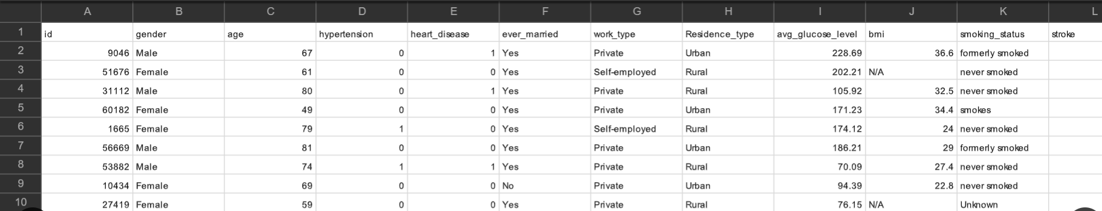
Dataset:
20

Slide 20
Propopsed Algorithm
Logistic Regression
K-Nearest Neighbor(KNN)
Decision Tree
Random forest
21

Slide 21
Result of ML algorithms
23
Notes:
As we can see, KNN has the highest score, which means it is the most accurate algorithm in predicting stroke risk

Slide 22

CONCLUSION
22

Slide 23
Conclusion
The development of a machine learning model to predict stroke risk is a valuable approach to improving healthcare outcomes. By leveraging cloud computing and machine learning algorithms, the project aims to develop an accurate and scalable model that can enable targeted prevention strategies and timely treatment to prevent strokes.
21

Slide 24
THANK YOU FOR YOUR ATTENTION !
23

Slide 25
Resources
[1] « 1.10. Decision Trees », scikit-learn. https://scikit-learn/stable/modules/tree.html (consulté le 13 mars 2023).
[2] « History of Cloud Computing | Brief Overview of Cloud Computing », EDUCBA, 2 janvier 2020. https://www.educba.com/history-of-cloud-computing/ (consulté le 13 mars 2023).
[3] « Matplotlib documentation — Matplotlib 3.7.1 documentation ». https://matplotlib.org/stable/index.html (consulté le 14 mars 2023).
[4] « NumPy Documentation ». https://numpy.org/doc/ (consulté le 14 mars 2023).
[6] « scikit-learn: machine learning in Python — scikit-learn 1.2.2 documentation ». https://scikit- learn.org/stable/ (consulté le 16 mars 2023).
[7] « sklearn.ensemble.RandomForestClassifier », scikit-learn. https://scikit- learn/stable/modules/generated/sklearn.ensemble.RandomForestClassifier.html (consulté le 16 mara 2023).
24

