Slide 1
Pediatric Bone Age Estimation
with Uncertainty Quantification
Deep learning regression · Post-hoc prediction intervals
RSNA Bone Age Dataset · EfficientNet-B3 · MC Dropout · Conformal Prediction
Notes:
Set the scene: this project builds a model that not only predicts bone age but also tells you how much to trust the prediction.

Slide 2
Why Automate Bone Age Assessment?
CLINICAL CONTEXT
Pediatric bone age is assessed from hand X-rays to diagnose growth disorders
Traditional method: radiologist compares X-ray to a reference atlas (Greulich-Pyle)
Limitations of the manual approach:
Subjective — significant inter-observer variability documented in literature
Time-consuming — 10–15 minutes per image
Inconsistent across institutions and experience levels
Goal of this project:
Automate prediction with deep learning (EfficientNet-B3)
Add calibrated uncertainty intervals — clinicians need to know when not to trust the model
Both methods are post-hoc — applied to an already-trained model without retraining.
Notes:
Emphasize the clinical stakes. An incorrect bone age estimate without any uncertainty indicator is harder to catch and act on than one that signals low confidence.

Slide 3
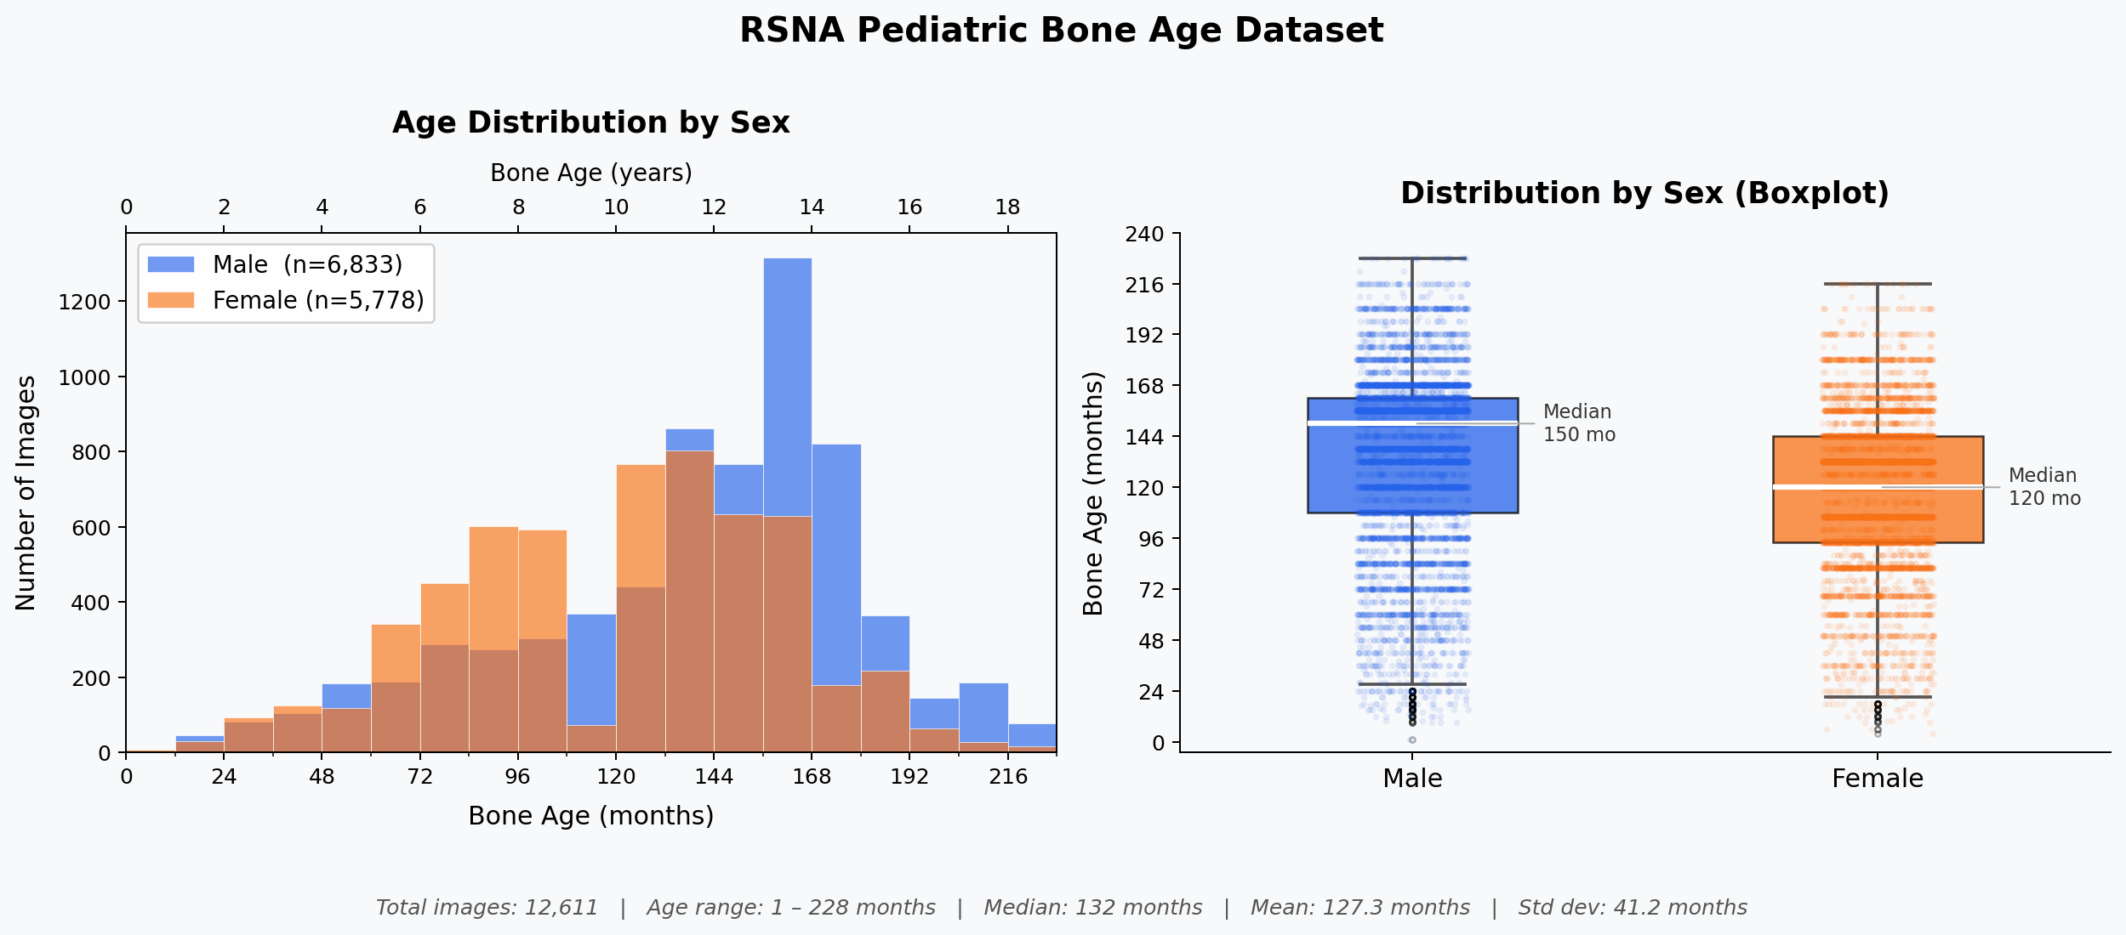
RSNA Pediatric Bone Age Dataset
Source: RSNA 2017 / Kaggle — publicly available
12,611 hand X-ray images
Labels per image:
boneage — true bone age in months (continuous regression target)
male — binary sex indicator (True / False)
Sex split: 54.2% male / 45.8% female
Pre-processing:
Resize to 300×300, EfficientNet normalization
Augmentation: rotation ±20°, zoom ±10%, brightness
Statistic | Value
Min | 1 month
Max | 228 months (19 yr)
Median | 132 months (11 yr)
Mean | 127.3 months
Std Dev | 41.2 months
5th–95th pct | 50 – 186 months
Notes:
The age distribution is roughly Gaussian centered around 11 years. Males have a higher median (150 months) than females (120 months) — a direct consequence of sex-specific growth timing, which motivates the multi-input model design.

Slide 4
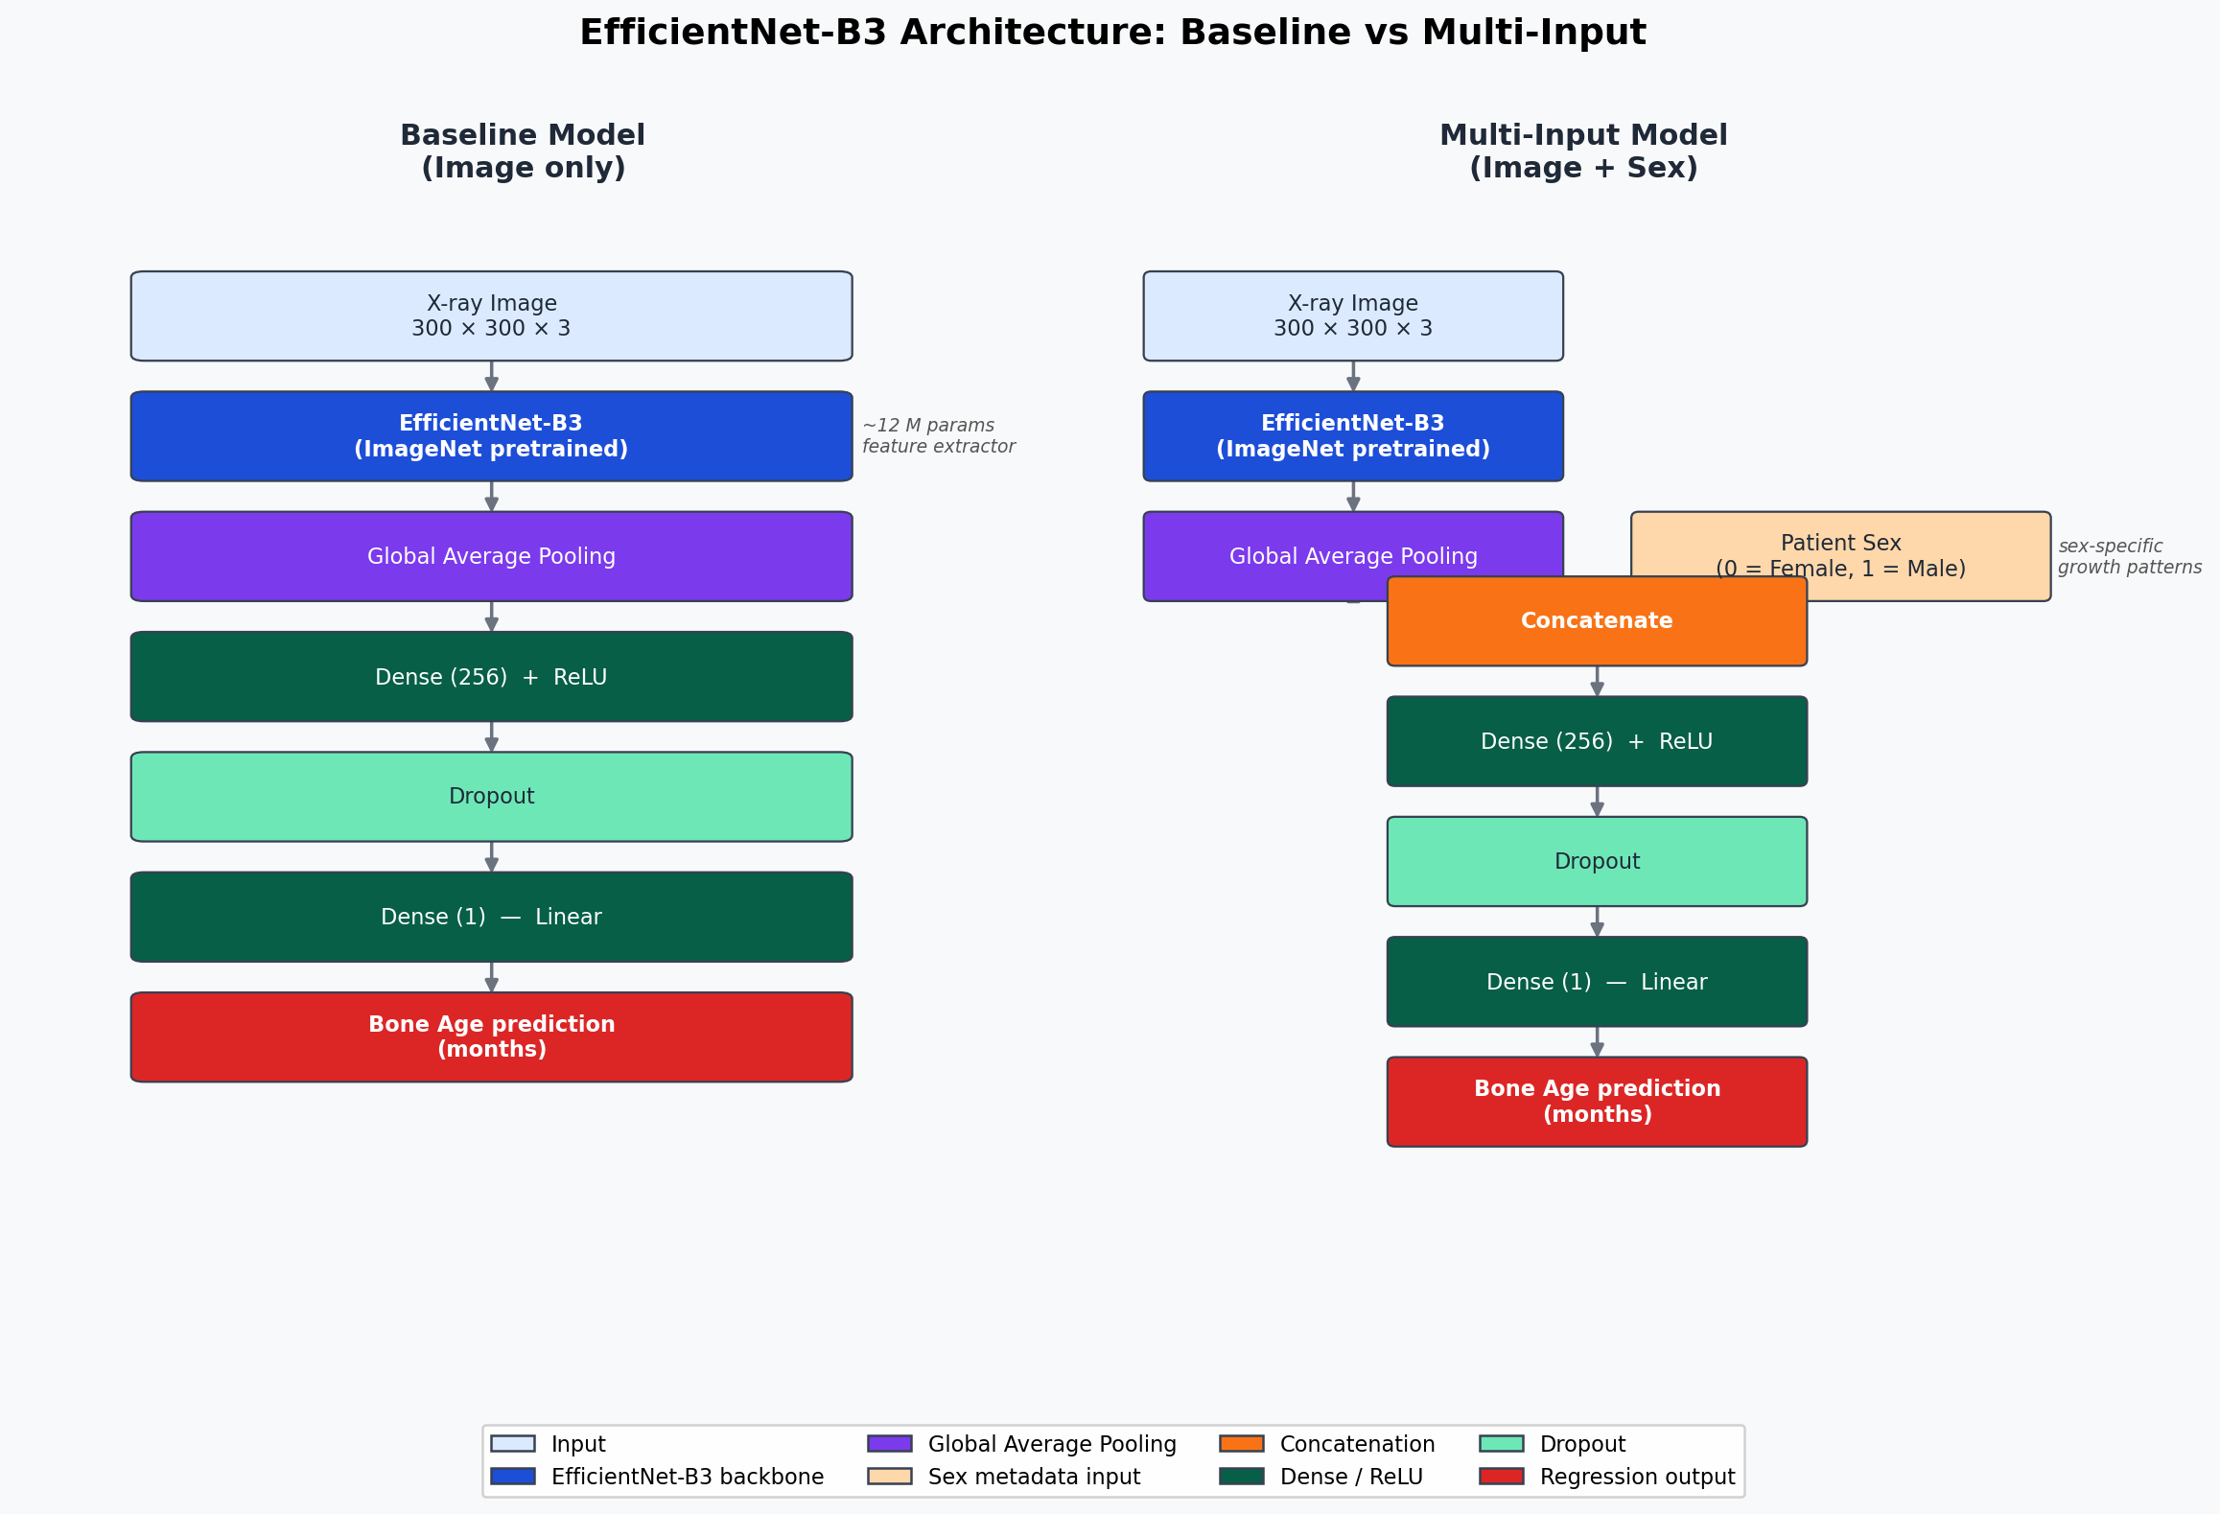
EfficientNet-B3 Regression Models
ImageNet-pretrained EfficientNet-B3 · Global Avg Pool → Dense(256)+ReLU → Dropout → Linear output
Output normalized by max training age; rescaled to months at inference
Split: 80% train · 10% val (also calibration) · 10% test (seed=42, stratified)
Training: loss=MAE, Adam, batch=32, early stopping + LR scheduling
Notes:
The Dropout layer in the model head is the same one repurposed for MC Dropout inference later — no architectural change is needed. The key insight: sex concatenation lets the network learn sex-specific growth patterns alongside the visual features.

Slide 5
Point Prediction Performance (Regression)
Model | MAE (months) | RMSE (months) | R²
Baseline — image only | 4.47 | 5.78 | 0.90
Multi-Input — image + sex | 3.82 ↓15% | 4.98 | 0.917
Adding sex reduces MAE by ~15% (4.47 → 3.82 months)
~80% of predictions fall within ±6 months of the true age
~98% of predictions fall within ±12 months of the true age
Error distribution is approximately Gaussian, centred near zero
Higher errors at extremes: very young ages and older adolescents (sparse data)
These are point predictions — they tell us HOW ACCURATE the model is, but not HOW CONFIDENT it is. That is what UQ addresses next.
Notes:
These are training evaluation numbers. The UQ evaluation in later slides uses the same test split and will show slightly different MAE/RMSE because the inference pipeline re-runs the model. The direction is consistent: Multi-Input is always better on point accuracy.

Slide 6
From Point Predictions to Trustworthy Intervals
A point prediction answers:
Prediction | What it tells the clinician
132 months | Model says 11 years — but how reliable is this?
132 ± 16 months (90% CI) | True age is 116–148 months with 90% confidence
"What is the estimated bone age?"
But a clinician also needs to know:
"How confident should I be in this estimate?"
UQ answers:
Which predictions are reliable vs uncertain?
What range covers the true age at a given probability?
Two methods applied:
Monte Carlo Dropout — model-based, stochastic inference
Split Conformal Prediction — data-driven, calibration residuals
Notes:
Both methods are post-hoc — applied to the already-trained model without retraining.

Slide 7
UQ Method 1: Monte Carlo Dropout
GAL & GHAHRAMANI, 2016
Standard Dropout: active during training, OFF at inference
MC Dropout: keep dropout ON at inference — T = 50 forward passes
For each test image run the model T = 50 times with dropout active
Each pass randomly zeros different neurons → slightly different prediction
Collect 50 predictions: [ŷ₁, ŷ₂, ..., ŷ₅₀]
Mean of 50 passes = final bone age estimate
Standard deviation of 50 passes = uncertainty estimate
Interval at confidence level α: lower = mean − z(α) × std upper = mean + z(α) × std z = 1.645 for 90%, z = 1.960 for 95%
Key property:
No separate calibration step needed — uncertainty comes from the model's dropout structure.
Limitation:
No guarantee that interval width reflects actual prediction errors — the model can be overconfident.
Notes:
The model architecture already has a Dropout layer in the head. The MC Dropout script calls model(inputs, training=True) to keep it stochastic, then batches the 50 passes efficiently using tensor tiling.

Slide 8
UQ Method 2: Split Conformal Prediction
POST-HOC · DISTRIBUTION-FREE · FINITE-SAMPLE COVERAGE GUARANTEE
Step 1 — Calibrate on validation set (n = 1,261 images) Compute residuals: residuals = | y_true − y_pred | for each image
Step 2 — Compute the conformal quantile k = ceil((n + 1) × α) → q̂ = k-th smallest residual Example: α=0.90, baseline model → q̂ = 20.09 months
Step 3 — Build test-set intervals lower = ŷ_pred − q̂ upper = ŷ_pred + q̂ Interval width = 2 × q̂ (same for every image at a given α)
Coverage guarantee: at least α fraction of test samples will have y_true inside the interval — under the exchangeability assumption, regardless of model or data distribution.
Notes:
Because q_hat is a single scalar from the calibration set, every test image gets the same interval width for a given model and alpha. This is the main limitation compared to adaptive conformal methods.

Slide 9
UQ Metrics: PICP and MPIW
PICP — Prediction Interval Coverage Probability
MPIW — Mean Prediction Interval Width
PICP = fraction of test samples where: lower ≤ y_true ≤ upper
MPIW = mean( upper − lower ) across all test images (months)
Target: PICP ≥ α (e.g., ≥ 0.90 for a 90% interval)
PICP < α → intervals too narrow → overconfident
PICP >> α → intervals too wide → over-conservative
Want this as SMALL as possible while still achieving target PICP
A narrow interval that covers the true value is more informative clinically
The coverage–width tradeoff:
MPIW | PICP | Interpretation
Very wide | High | Safe but uninformative
Very narrow | Low | Precise but unreliable
Narrow | ≥ α ✓ | Ideal — calibrated and tight
Notes:
Think of it as a precision-recall tradeoff. PICP is reliability; MPIW is usefulness. A good UQ method achieves target PICP with the smallest possible MPIW.

Slide 10
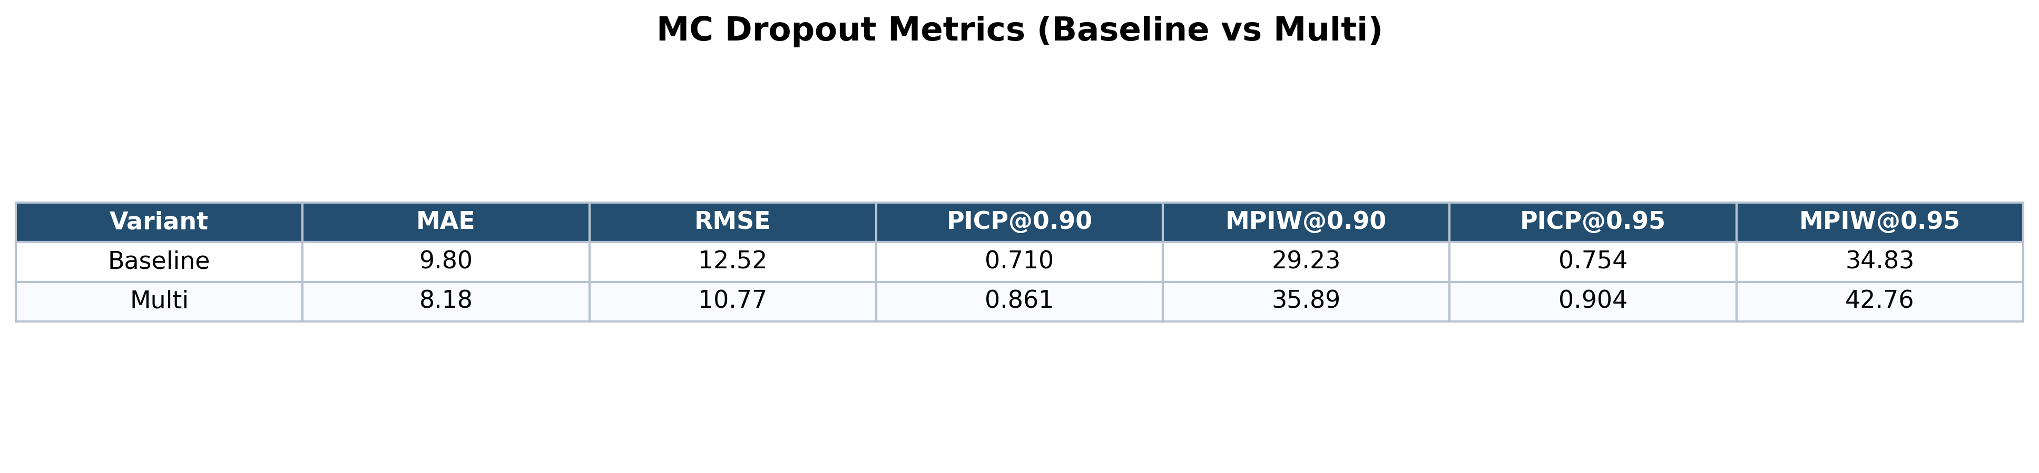
MC Dropout Results — Overconfident Intervals
Baseline severely overconfident: nominal 90% → actual coverage only 71.0%
At nominal 95%, baseline coverage is only 75.4% — far below target
Multi-input improves: 86.1% at α=0.90; 90.4% at α=0.95 (barely meets one target)
Widths (29–43 months) are narrower than conformal — but coverage targets are missed
Multi has wider MC Dropout intervals than Baseline despite better accuracy:
Higher predictive std (10.9 vs 8.9 months) → wider Gaussian intervals
MC Dropout uncertainty reflects the model's internal stochasticity, not its actual errors — it cannot self-correct for systematic mis-calibration.
Notes:
Overconfidence in MC Dropout typically occurs because dropout-based uncertainty reflects the model's internal variability, not its actual prediction errors on the data. It is a relative signal, not an absolutely calibrated one.

Slide 11
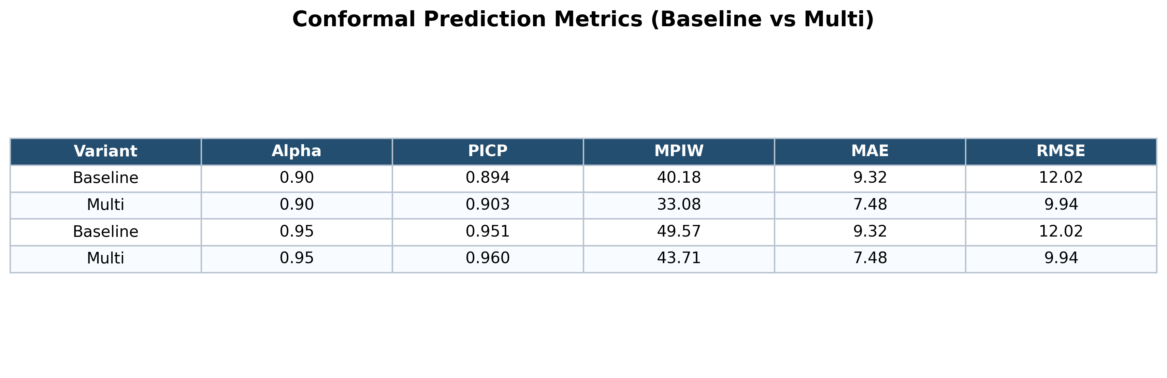
Conformal Prediction Results — Coverage Targets Met
Both variants meet their nominal coverage targets at α=0.90 and α=0.95
This is the conformal guarantee working in practice
Multi-input is strictly better on both dimensions:
Higher PICP AND narrower intervals than baseline at every alpha level
Narrower multi intervals explained by calibration: better point predictions →
smaller validation residuals → smaller q̂ (20.09 → 16.54 months at α=0.90) → tighter intervals
Width increases with α (40.18 → 49.57 for baseline) — expected behaviour
q̂ values (conformal threshold from validation residuals): Baseline α=0.90: 20.09 mo · α=0.95: 24.78 mo Multi α=0.90: 16.54 mo · α=0.95: 21.86 mo (MPIW = 2 × q̂, symmetric intervals)
Notes:
The q_hat values are the conformal threshold computed from the validation residuals. MPIW = 2 × q_hat since the intervals are symmetric around the point prediction.

Slide 12
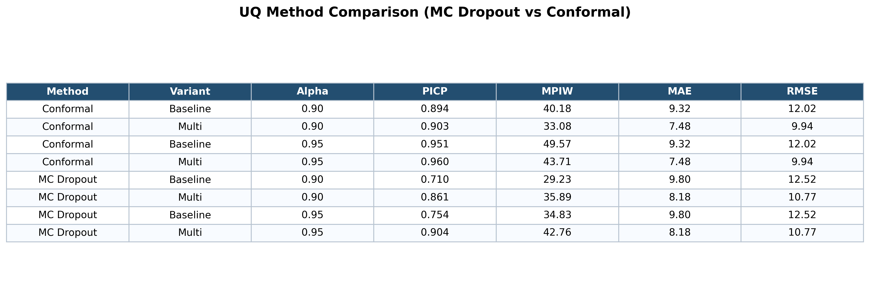
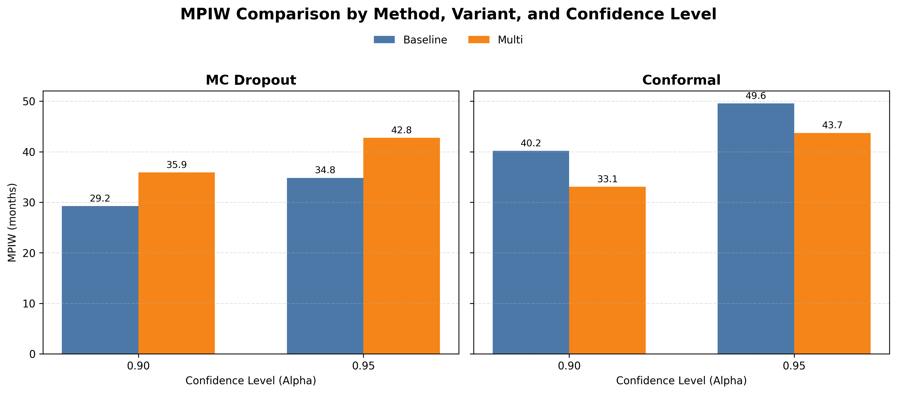
Combined Comparison: Method × Variant × Coverage Level
MC Dropout (left chart): Multi has WIDER intervals than Baseline
Counter-intuitive — but multi has higher predictive std (10.9 vs 8.9 mo) → wider Gaussian intervals
Conformal (right chart): Multi has NARROWER intervals than Baseline
Better predictions → smaller residuals → smaller q̂ → tighter intervals
Method | Variant | PICP @ 0.90 | MPIW @ 0.90 | Verdict
MC Dropout | Baseline | 0.710 | 29.23 | ❌ Under-covers
MC Dropout | Multi | 0.861 | 35.89 | ❌ Under-covers
Conformal | Baseline | 0.894 | 40.18 | ✓ Meets target
Conformal | Multi | 0.903 | 33.08 | ✓ Best overall
Notes:
The key difference: MC Dropout width is driven by model-internal stochasticity; conformal width is driven by actual errors on held-out data. Only conformal + multi meets the coverage target with the smallest interval.

Slide 13
Key Takeaways
1
Adding sex metadata consistently improves the model.
MAE drops ~15% and conformal intervals narrow by ~7 months at α=0.90.
2
Conformal prediction reliably achieves its stated coverage.
Both variants meet targets at α=0.90 and α=0.95 — provable under exchangeability.
3
MC Dropout is overconfident, especially for the baseline model.
At nominal 95%, actual baseline coverage is only 75.4%. Intervals are narrower but miss the target.
4
Best combination: Conformal + Multi-input.
90.3% coverage with 33.1-month intervals at α=0.90 — reliably calibrated and tight.
5
MC Dropout is still useful as a relative uncertainty signal.
Even if absolute coverage is off, high std → flag uncertain images for clinical review.
6
Conformal intervals are fixed-width per alpha.
Every image gets the same interval — not adaptive to image difficulty. Main limitation.
Notes:
Summarise the narrative: the project shows both that adding metadata helps and that the choice of UQ method matters — conformal is better calibrated than MC Dropout for this task.

Slide 14
Limitations and Future Work
CURRENT LIMITATIONS
FUTURE DIRECTIONS
No hand segmentation — background noise and cropping artifacts can degrade predictions
Only sex used as metadata — height, weight, ethnicity, pubertal stage could help
Conformal intervals are symmetric and non-adaptive — same width for every image at a given α
Higher errors at extreme ages (infants, older adolescents) are not specifically addressed
Segmentation pre-processing: U-Net to isolate hand region before EfficientNet
Richer metadata: height, weight, clinical variables as additional model inputs
Adaptive conformal prediction: Mondrian / locally-weighted methods for image-specific interval widths
Hybrid architectures: CNN + Transformer (ViT) for richer feature extraction
Deployment: FastAPI REST endpoint for real-world clinical integration
Dataset: RSNA Bone Age (Kaggle) · Models: EfficientNet-B3 (TensorFlow/Keras) · UQ: MC Dropout (Gal & Ghahramani, 2016) · Split Conformal Prediction
Notes:
Future adaptive conformal methods (Mondrian conformal, RAPS) would give each image its own interval width based on difficulty, making the uncertainty more actionable for individual clinical decisions.

