Slide 1
Geophysical Fluid Dynamics
Model atmospheric and oceanic flows
Applications: meteorology, Tsunami prediction
Primary model: Shallow Water Equations
Need to account for rotation and topography

Slide 2
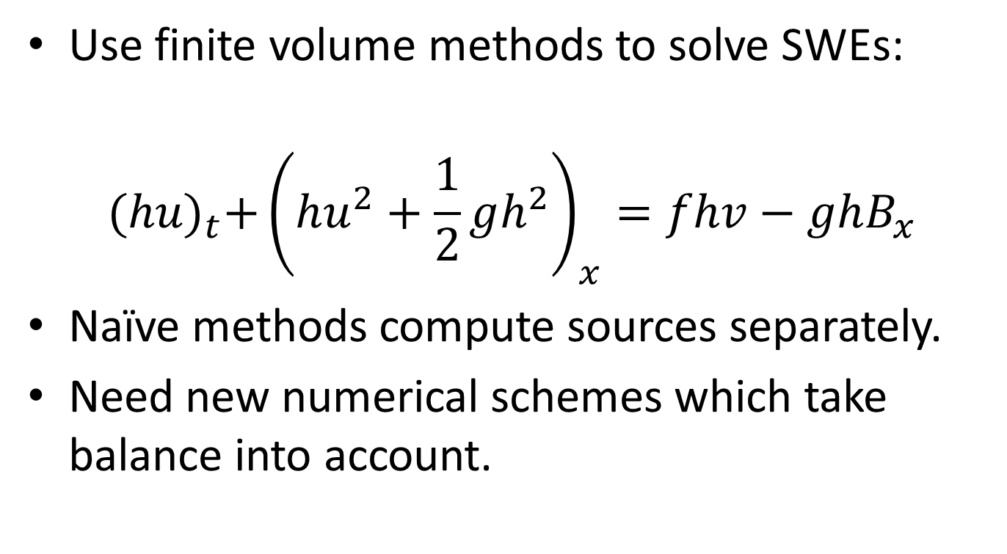
Well-Balanced Numerical Methods
Use finite volume methods to solve SWEs:
$${(hu)}_{t}+{\left(hu^{2}+\frac{1}{2}gh^{2}\right)}_{x}=fhv−ghB_{x}$$
Naïve methods compute sources separately.
Need new numerical schemes which take balance into account.

Slide 3
“Accurate methods for computing rotation-dominated flows”
Term 1:
Review existing well-balanced methods.
Term 2:
Set up evaluation framework with Clawpack (Fortran + Python).
Adapt and implement selected methods.
Evaluate and compare them.
(Apply them to novel problems.)

