Slide 1
PORTFOLIO
ChargeScape London
A spatial decision system for EV charging networks under uncertain demand
Where should the next rapid-charging hubs in Greater London go, how many ports and what power —
and how sure can we be? Built end-to-end from open data, with every assumption visible.
Marija Ercegovac · urban planner turned geospatial data scientist · September 2026

Slide 2
Charging is an infrastructure business that lives or dies on utilisation
London facts behind the question
31,371
8%
296k
34 %
public chargers in London
(DfT, 2026-07-01)
of them are 50 kW+ —
vs 24 % across the UK
plug-in cars kept in London
(41 % company-kept)
occupancy of rapid units
(TfL, observed 2025)
The economics
The analytics gap
A hub in the wrong hex idles at 5 % and never pays back; the right one runs above 20–30 % with queues. McKinsey and ICCT put the break-even between 15 % and 20 % utilisation — payback halves between 10 % and 20 %.
Operators describe site selection as a demand model on dozens to hundreds of factors. Public projects almost never predict usage (they predict where chargers already are), carry uncertainty into the decision, model queues and cannibalisation, or say how they would be proven wrong.
ChargeScape London · github repository · September 2026
2

Slide 3
Four things this system does that gap maps do not
1
Labels on every dataset
2
Usage, checked against reality
observed / proxy / synthetic — 23 sources in the catalog, and the label follows the number into every table.
Demand is modelled bottom-up, then checked against DfT charger counts × TfL occupancy and open session logs.
3
Uncertainty reaches the decision
4
Queues, cannibalisation, grid
P10/P50/P90 per hex; a robust MILP picks hubs that hold across scenarios; the overlap with the P50 answer says which sites are safe.
Erlang-C capacity per hub, new vs stolen demand for any candidate, primary-substation headroom as a filter.
ChargeScape London · github repository · September 2026
3

Slide 4
Pipeline: open data → hex features → demand → choice & queues → siting
Reproducible on a laptop: make data · make features · make models · make maps
Open data
H3 res-8 features
Structural demand
Choice & queues
Siting
Delivery
DfT · ONS · OSM PBF · UKPN DFES & headroom · TfL · LAEI · Dundee/PKC/Palo Alto/Boulder sessions
areal interpolation of Census & EV licensing; POIs; vehicle-km; transit; substation headroom; igraph drive times
EV stock × km × kWh/km × public share; 500 Monte Carlo draws; taxi/PHV layer; DFES 2030 pathways
MNL station choice on drive times; Erlang-C per site; incremental vs cannibalised demand
capacitated MCLP + robust two-stage MILP (HiGHS); budget, capacity, grid filter
deck.gl maps, notebooks, model card, post-hoc validation plan
Validation stance
Spatial cross-validation by default (random K-fold shown only to expose its optimism); consistency with observed aggregates; and a named observable — utilisation of hubs opened after July 2026 — that would confirm or refute each recommendation.
ChargeScape London · github repository · September 2026
4

Slide 5
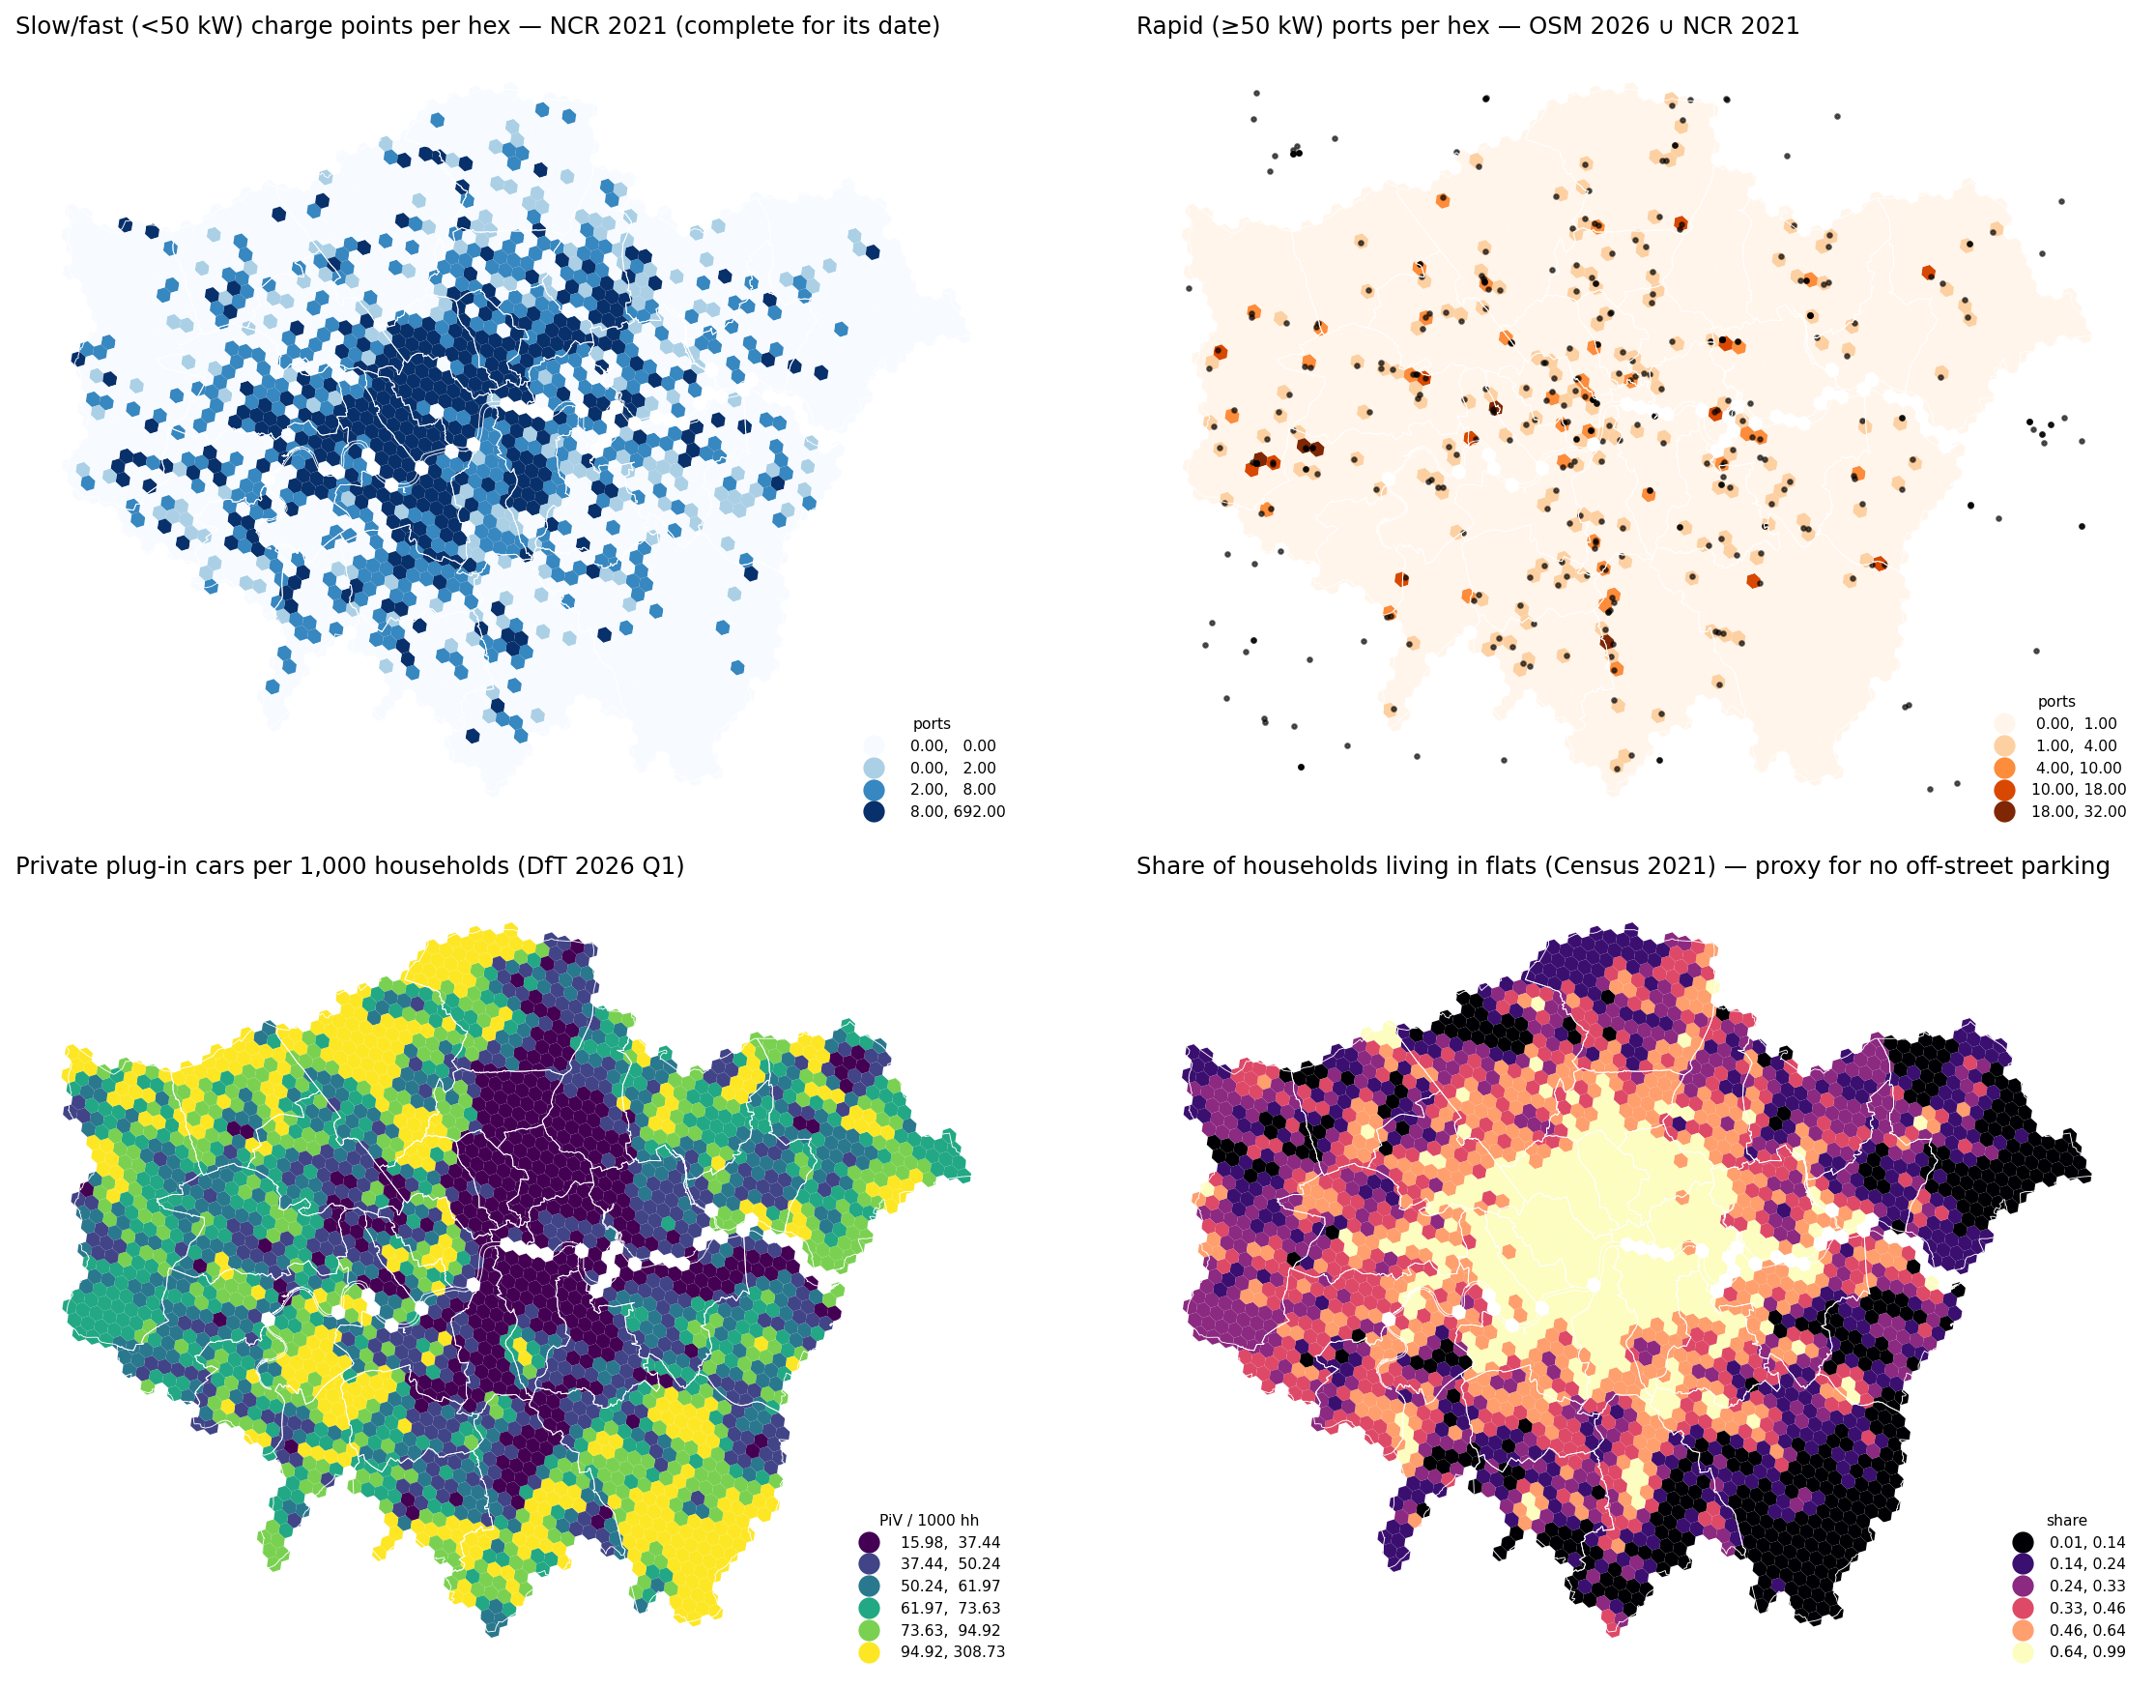
Supply follows devices; need follows cars without driveways
Notebook 01 — all observed data
• Inner boroughs have ~1,400 chargers per 100k residents, mostly 5–7 kW lamp-post units; rapid share is 40 % in Havering and Hillingdon, under 4 % in Westminster and Hackney.
• Private plug-in cars cluster in outer, house-rich boroughs (Barnet, Bromley, Croydon); Moran's I = 0.73 — strongly clustered.
• The group that depends on public charging — EV owners in flats — forms Gi* hot spots in inner-west and inner-south London.
• On the road network, median drive time to a rapid site is 2.9 min: distance is rarely the binding constraint in London; capacity and queues are.
ChargeScape London · github repository · September 2026
5

Slide 6
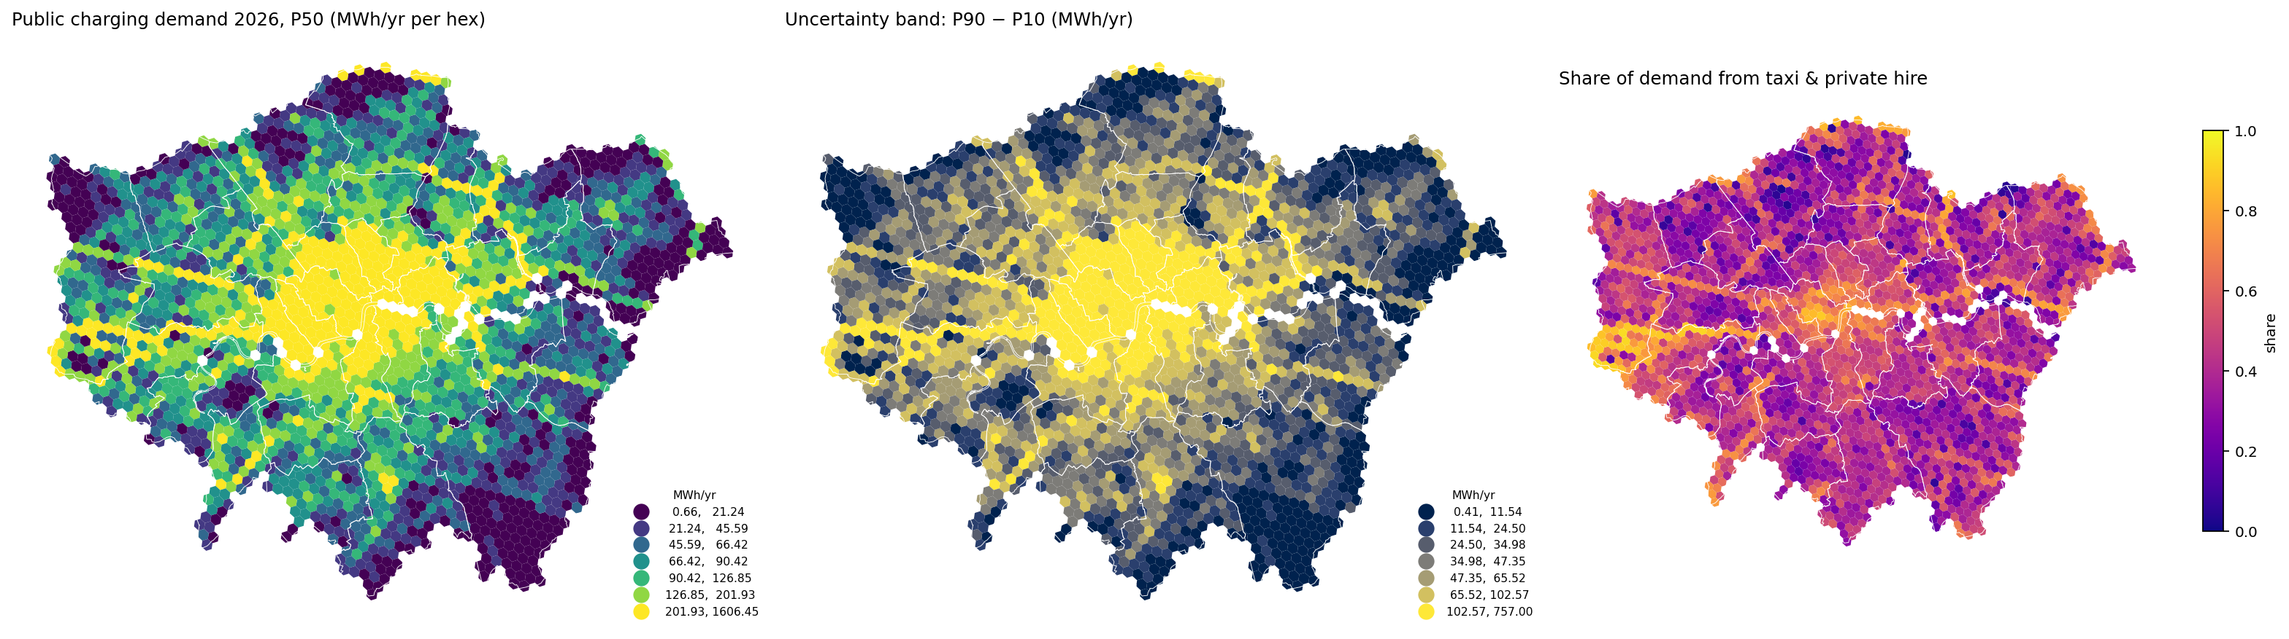
A demand surface with the uncertainty attached
Notebook 02 — structural Monte Carlo model on observed inputs
285 GWh
152 GWh
1350 GWh
Near-home 78 · destination 55 · PHV 152 GWh. Priors and mix are documented in the model card.
public charging demand 2026, P50
(P10–P90 216–361)
of it from taxi & private hire —
London's rapid-charging anchor
in 2030, DFES mid pathway
(low–high 1,100–1,410)
ChargeScape London · github repository · September 2026
6

Slide 7
No London usage data is open — so the model is checked against what is observed
Notebook 02, section 2
Supply-implied energy
Modelled demand
28.8k slow + 2.5k rapid chargers (DfT) × TfL-observed occupancy (47 % slow, 34 % rapid) × charging-time share ⇒ ≈ 760 GWh/yr the network could be delivering.
285 GWh P50 (P10–P90 216–361); rapid-type (destination + PHV) ≈ 207 GWh — the same order of magnitude as the rapid side of the supply estimate.
13.1
≈13
≈3
implied rapid sessions per charger per day
what TfL's 34 % occupancy implies with 38-min sessions
observed in Dundee's open session log (small city)
The band is the honest statement: the two levers are the public-charging share of drivers without a driveway and the size of the electric PHV fleet — both named as the first things to calibrate once operator data exist.
ChargeScape London · github repository · September 2026
7

Slide 8
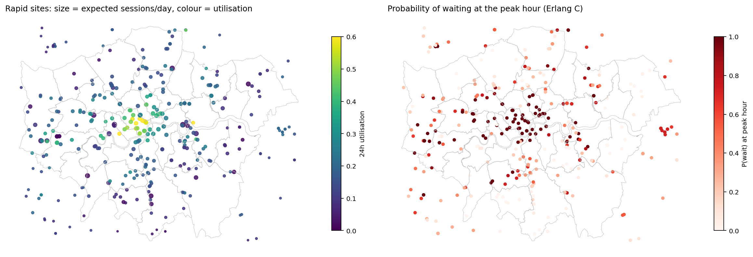
Where the demand lands today — and where queues form at the peak hour
Notebook 03 — MNL station choice on drive times + Erlang-C queues
174 / 366
rapid sites with P(wait) > 0.5 at the peak hour
17%
median 24 h utilisation of a rapid site
Supply calibrated to DfT borough counts: OSM maps ~15 % of rapid devices.
For any candidate hub the model splits captured demand into new vs cannibalised — typically 70–80 % is taken from existing sites within 20 minutes.
ChargeScape London · github repository · September 2026
8

Slide 9
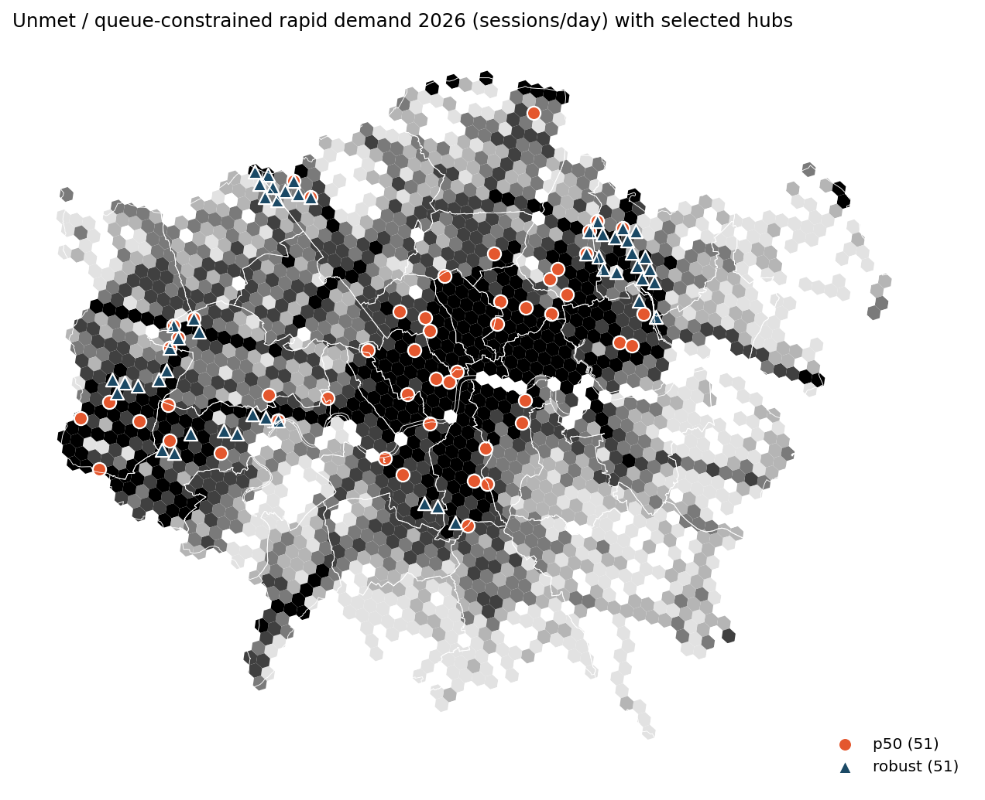
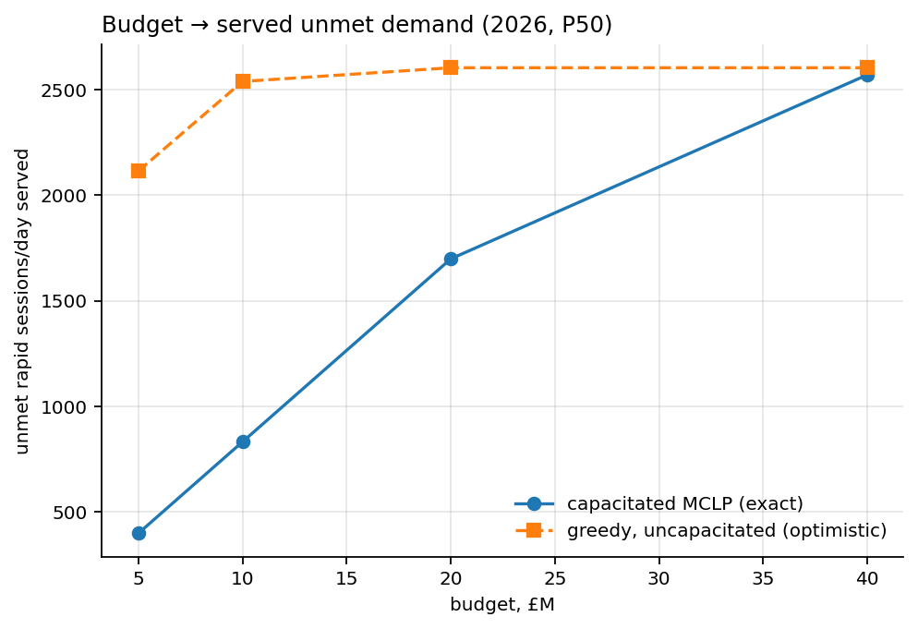
Siting new 4 × 150 kW hubs under budget, capacity, grid and demand uncertainty
Notebook 04 — capacitated MCLP + robust two-stage MILP (HiGHS)
£20M ⇒ 51 hubs serving 58% of unmet rapid demand (1,699 sessions/day of 2,936).
Robust solution overlaps with P50 on 11 of 51 sites; greedy uncapacitated would claim 2,604/day — the gap is demand a hub cannot absorb at an acceptable wait.
ChargeScape London · github repository · September 2026
9

Slide 10
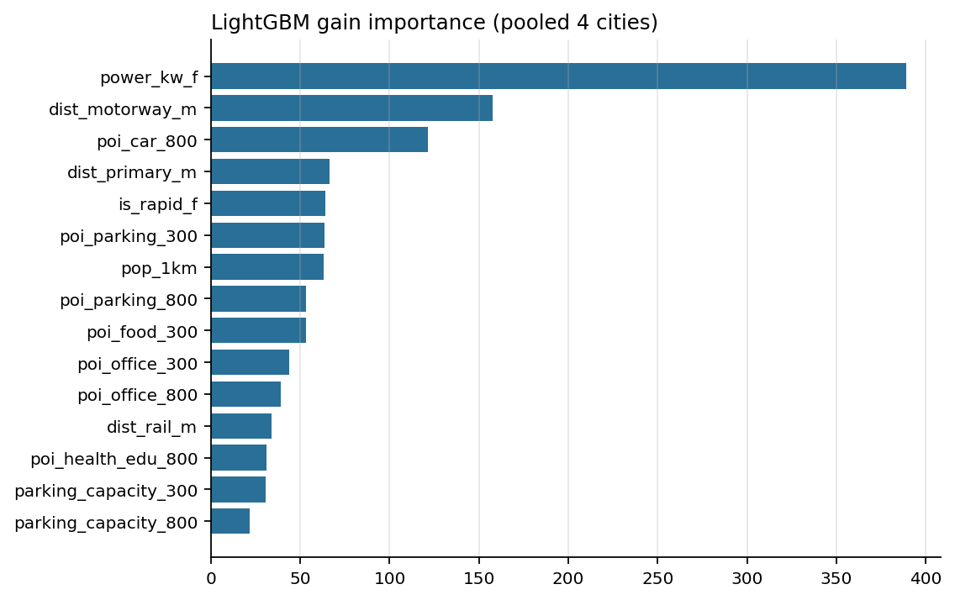
Do context features explain observed utilisation anywhere? A negative result, on purpose
Notebook 05 — 204 chargers with open session logs in four cities
0.70
−0.25
R² with random 5-fold CV
(looks respectable)
R² with leave-city-out CV
(the number that matters)
• Charger power and the city's level dominate; OpenStreetMap context adds little that transfers.
• Rankings do not transfer reliably either (Spearman −0.3 to +0.6 by city); a level-free target barely helps.
• Implication: any 'geo-embedding site model' must be validated out-of-city against observed usage — this is the test to ask for.
ChargeScape London · github repository · September 2026
10

Slide 11
Limitations — and how the whole thing would be proven wrong
Known limitations
The post-hoc test
• No open London charger-level usage; behaviour from other UK cities and fleet trials.
• OSM's hub bias and a 2021 registry snapshot: unmapped rapid devices enter as scaled ports, not positions.
• Choice-model coefficients are literature-informed, not estimated.
• Grid constraint stops at primary-substation headroom.
• Area-weighted LSOA→hex interpolation; ≈1.4 % of population in dropped edge hexes.
DfT/Zapmap publish borough device counts quarterly; TfL publishes utilisation by charger type.
Hubs opened after July 2026 in hexes flagged here as high unmet demand should reach above-median utilisation within a year.
If they do not, the model card names the priors to revisit first: PHV fleet size, public share without home charging, choice radius.
Predict → deploy → measure → retrain is the product; the maps are its interface.
ChargeScape London · github repository · September 2026
11

Slide 12
What an operator or investor gets from this
The same stack applies to any city with open geodata — and improves the moment usage data are plugged in
Ranked candidates with intervals
Capacity, not just location
Every hex: expected sessions/day, P10–P90, share taken from neighbours, headroom label, drive-time catchment.
Ports and power sized from the queue model against a service level, instead of a fixed template.
Portfolio robustness
A learning loop
Which sites hold under low demand and which depend on the optimistic tail — phase the latter.
Aggregate calibration now; revealed-preference choice parameters and per-hex uncertainty once the network reports.
ChargeScape London · github repository · September 2026
12

Slide 13
Explore it
Repository: github.com/OWNER/chargescape-london — code, 16 tests, data catalog with 23 source cards, methodology and model card
Notebooks 01–05: supply audit · demand surface · choice & queues · siting · utilisation transfer
Interactive maps (deck.gl, no keys): demand 2026 · rapid network load & queues · selected hubs under a £20M budget
Reproduce: pip install -e . → make data → make features → make models → make maps
Marija Ercegovac · mercegovacm@gmail.com

