Slide 1

Machine learning classification of schizophrenia from EEG brain networks
by Matthew Fredericks
Supervisors:
Prof. Henrik Jensen
Hardik Rajpal

Slide 2
The data
Supplied by Stefan Brugger from UCL
9 healthy patients, 7 schizophrenic patients
64 EEG channels, 1000 recordings per second
~300 million data points across all patients

Slide 3
Procedure
Raw time series (preprocessed)
Causality analysis:
ParCorr (partial correlation)
PMIME (mutual information-based)
Weighted directed networks
(64x64 adjacency matrix)
Characterise via network metrics e.g. density, clustering, betweenness, ...
Network metrics
Employ machine learning algorithms using network metrics as predictors
Classification of schizophrenia/healthy

Slide 4
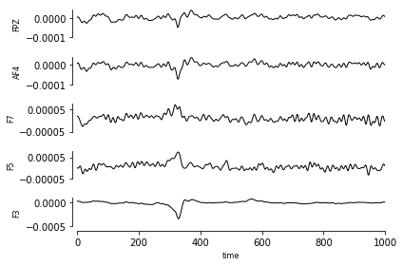
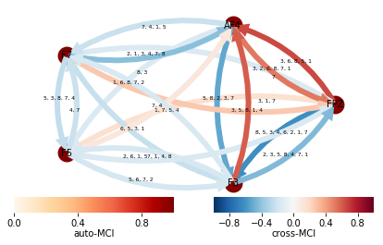
Causality measures
The mathematical ‘heavy lifting’

Slide 5
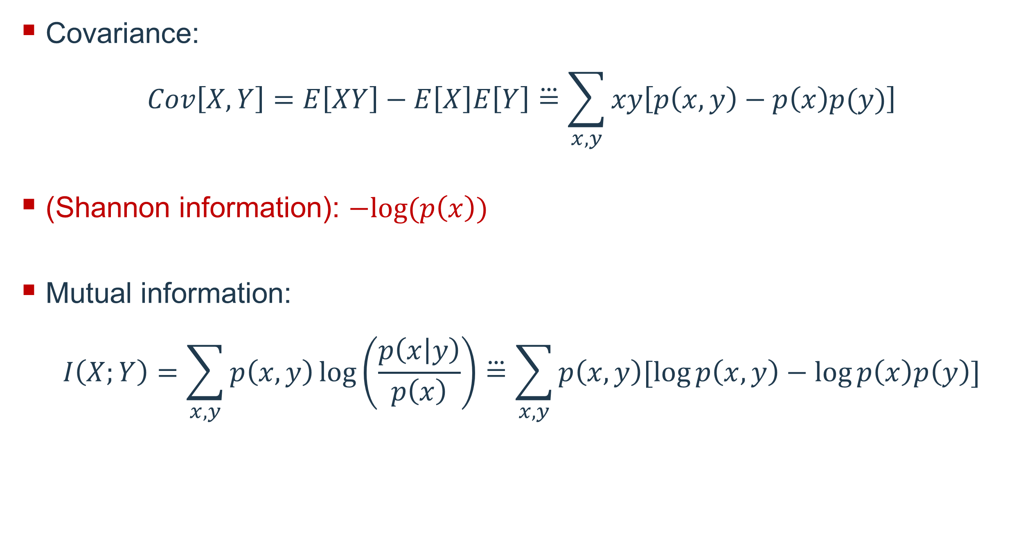
Undirected measures
Covariance:
$$Cov\left[X,Y\right]=E\left[XY\right]−E\left[X\right]E\left[Y\right]\overset{⃛}{=}\sum_{x,y}{xy\left[p\left(x,y\right)−p\left(x\right)p(y)\right]}$$
(Shannon information): $−log⁡(p\left(x\right))$
Mutual information:
$$I\left(X;Y\right)=\sum_{x,y}{p\left(x,y\right)\log\left(\frac{p\left(x | y\right)}{p\left(x\right)}\right)}\overset{⃛}{=}\sum_{x,y}{p\left(x,y\right)[\log{p\left(x,y\right)}−log⁡p\left(x\right)p\left(y\right)]}$$
Both are weighted measures.

Slide 6


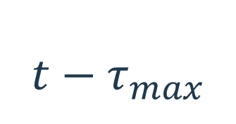
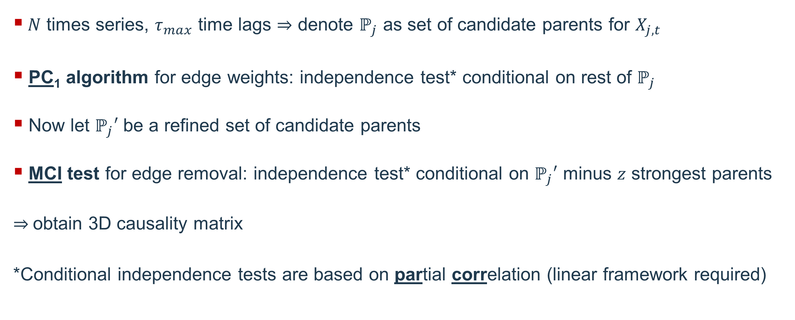





PCMCI (ParCorr)
...
$$t−τ_{max}$$
$$t−2$$
$$t−1$$
$$t$$
...
$$\left\{X_{1}\right\}$$
$$X_{1,t}$$
...
$$\left\{X_{2}\right\}$$
$$X_{2,t}$$
$N$ times series, $τ_{max}$ time lags denote $ℙ_{j}$ as set of candidate parents for $X_{j,t}$
PC₁ algorithm for edge weights: independence test* conditional on rest of $ℙ_{j}$
Now let $ℙ_{j}′$ be a refined set of candidate parents
MCI test for edge removal: independence test* conditional on $ℙ_{j}′$ minus $z$ strongest parents
obtain 3D causality matrix
*Conditional independence tests are based on partial correlation (linear framework required)

Slide 7





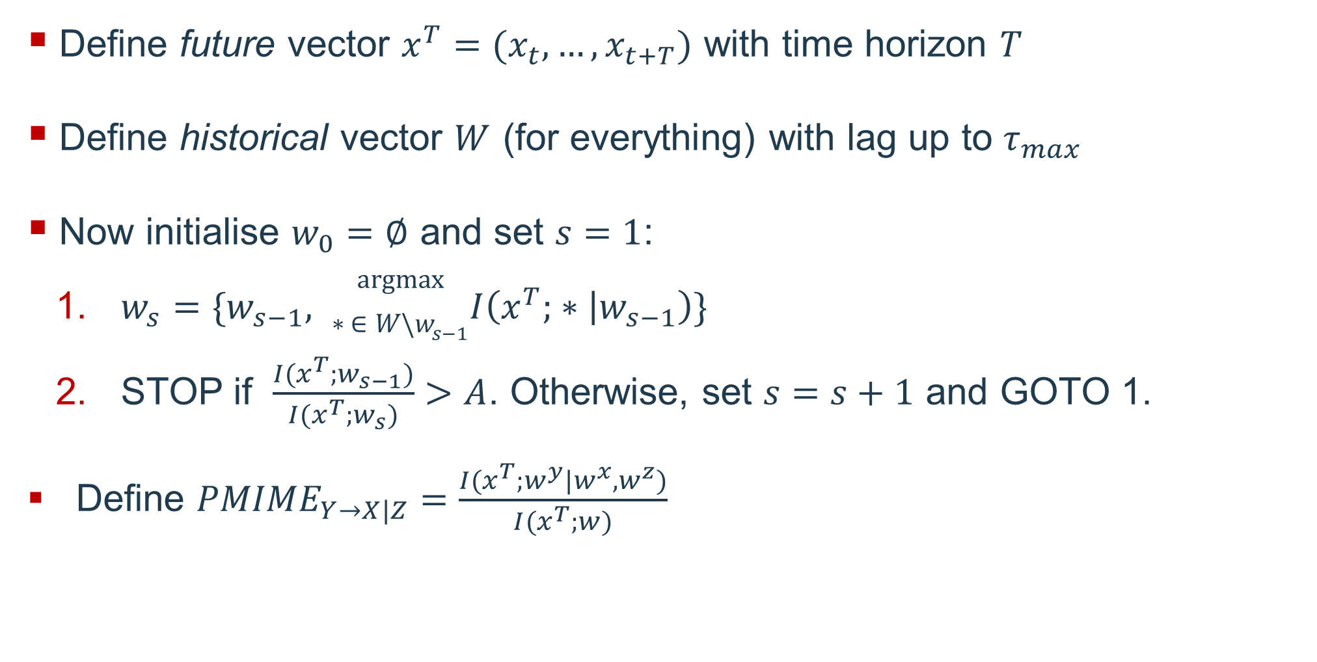







PMIME – a nonlinear measure
...
...
$$t−τ_{max}$$
$$t−2$$
$$t−1$$
$$t$$
$$t+1$$
$$t+T$$
...
$$\left\{X\right\}$$
$$X_{t}$$
...
$$\left\{Y\right\}$$
$$Y_{t}$$
...
$$\left\{Z\right\}$$
$$Z_{t}$$
Define future vector $x^{T}=(x_{t},…,x_{t+T})$ with time horizon $T$
Define historical vector $W$ (for everything) with lag up to $τ_{max}$
Now initialise $w_{0}=∅$ and set $s=1$:
$w_{s}=\{w_{s−1}, \begin{matrix}argmax \\ ∗ ∈W\backslash w_{s−1}\end{matrix}I\left(x^{T}; ∗ | w_{s−1}\right)\}$
STOP if $\frac{I(x^{T};w_{s−1})}{I(x^{T};w_{s})}>A$. Otherwise, set $s=s+1$ and GOTO 1.
Define ${PMIME}_{Y→X|Z}=\frac{I(x^{T};w^{y}|w^{x},w^{z})}{I(x^{T};w)}$

Slide 8
A lot of computation time later...
~5000 ParCorr adjacency matrices
~5000 PMIME adjacency matrices

Slide 9
Matrix ‘backboning’
ParCorr matrices have ~98% edge density
PMIME matrices have ~5% edge density
Using ‘backboning’ we threshold ParCorr down to ~5% density
An unexpected finding...
~5000 unthresholded ParCorr matrices
~5000
backboned ParCorr matrices
~5000 PMIME matrices

Slide 10
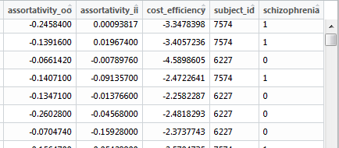
Network metrics
Translation of causal networks into meaningful data

Slide 11
List of metrics (node level)
in-degree (mean, sd), out-degree (sd), degree difference (sd)
in-strength (mean, sd), out-strength (sd), strength difference (sd)
node betweenness (mean, sd)
clustering coefficient (mean, sd)

Slide 12
List of metrics (edge level)
edge betweenness (mean, sd)

Slide 13
List of metrics (global level)
density
wiring cost
global efficiency
modularity
assortativity (in-in, in-out, out-out, out-in)
cost efficiency

Slide 14
Machine learning classification
Extraction of data insights via supervised machine learning
Classifier
(predicts schizophrenia given metric inputs)
Metric importance

Slide 15
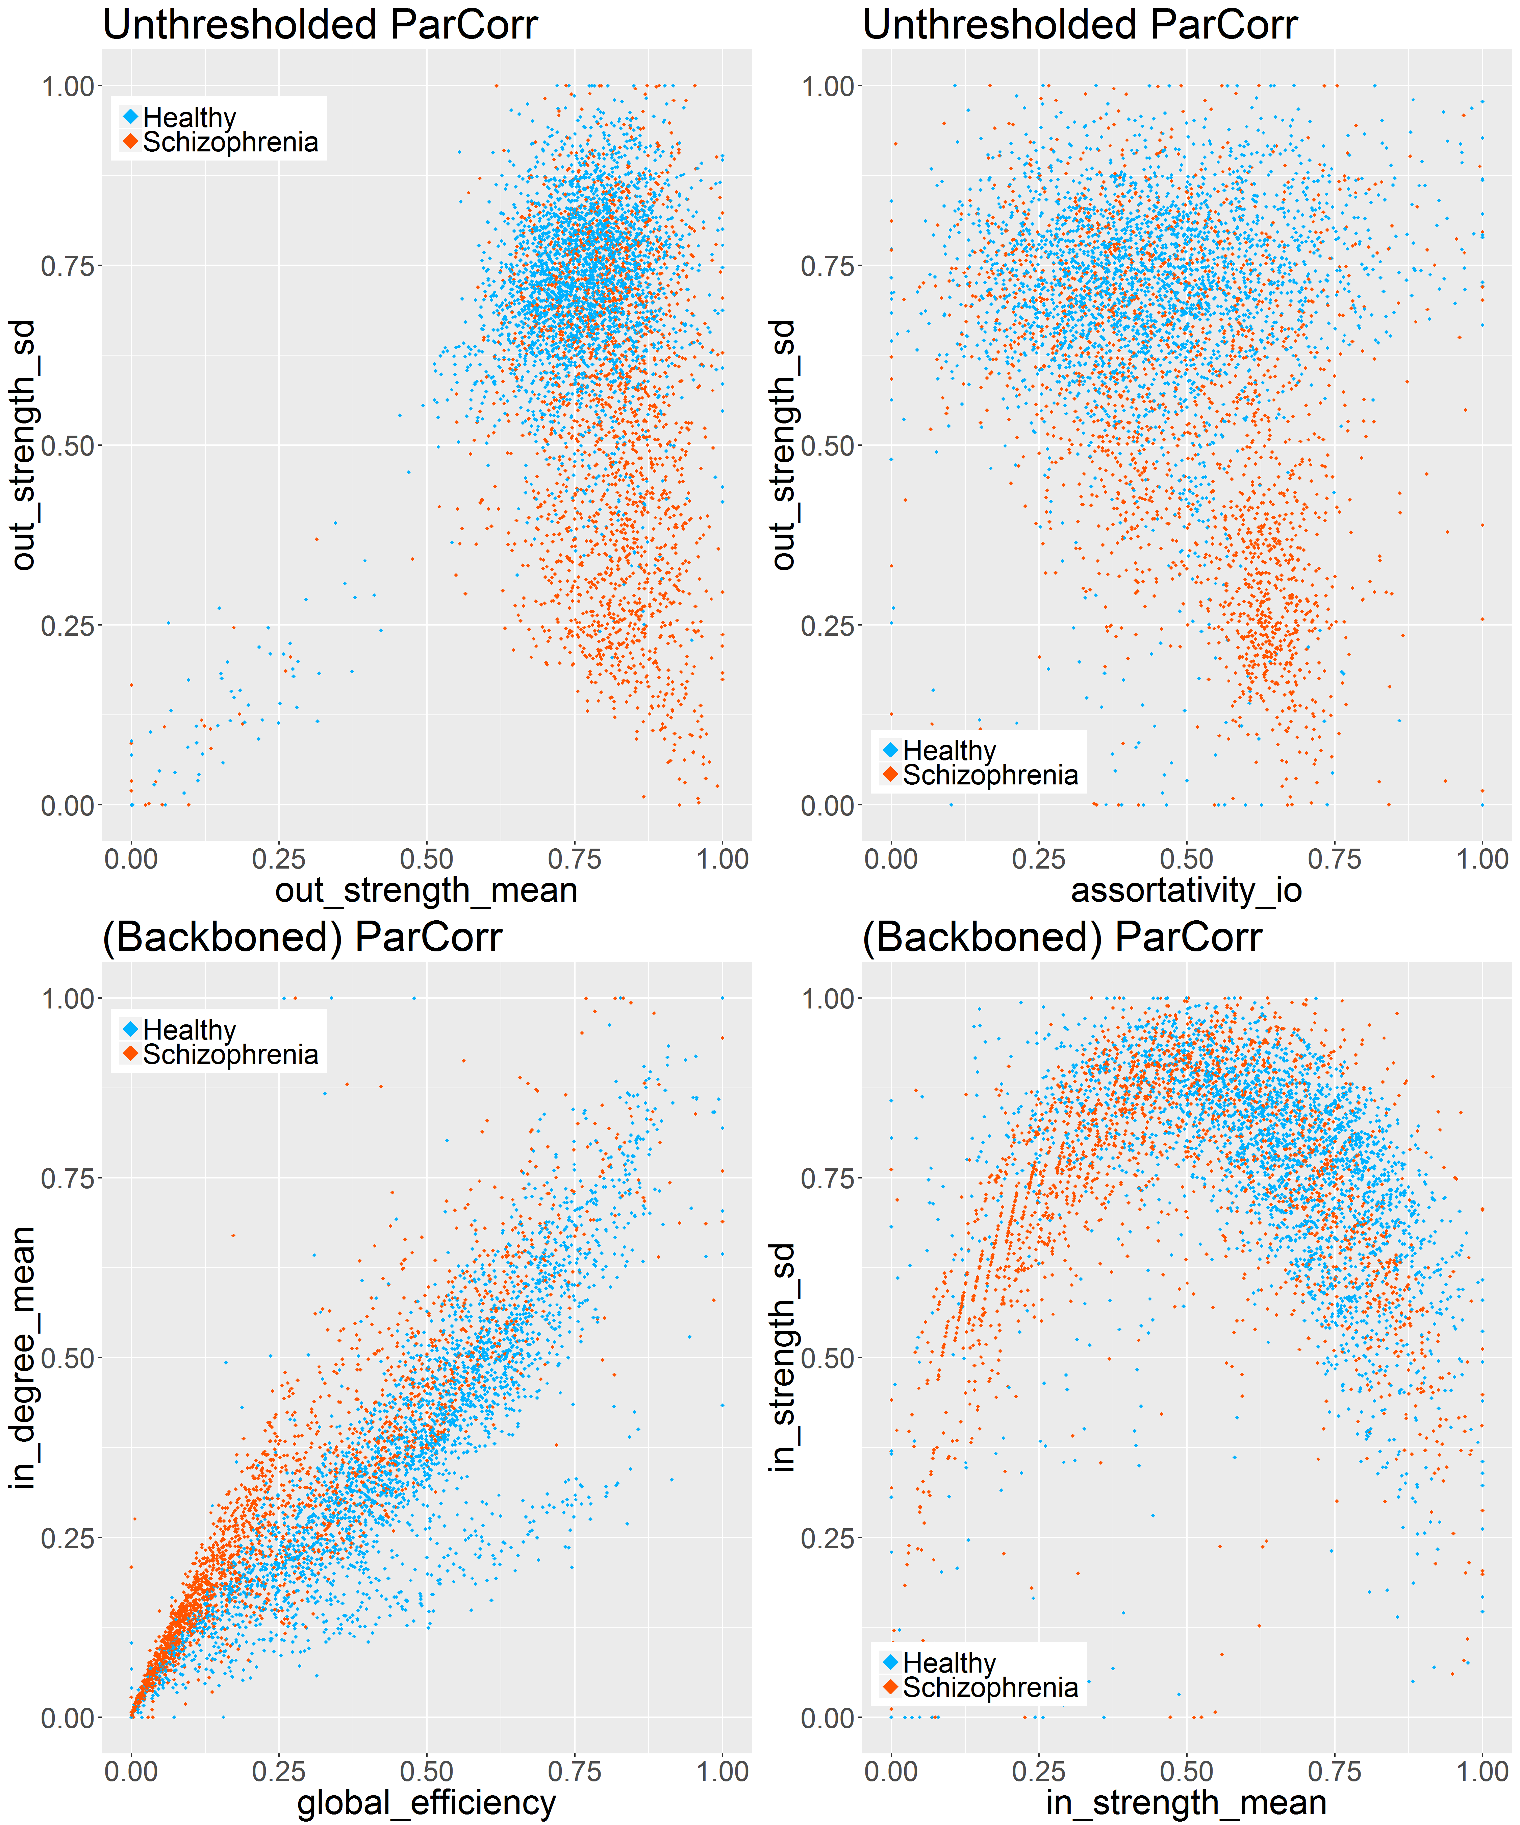
Exploratory plots

Slide 16
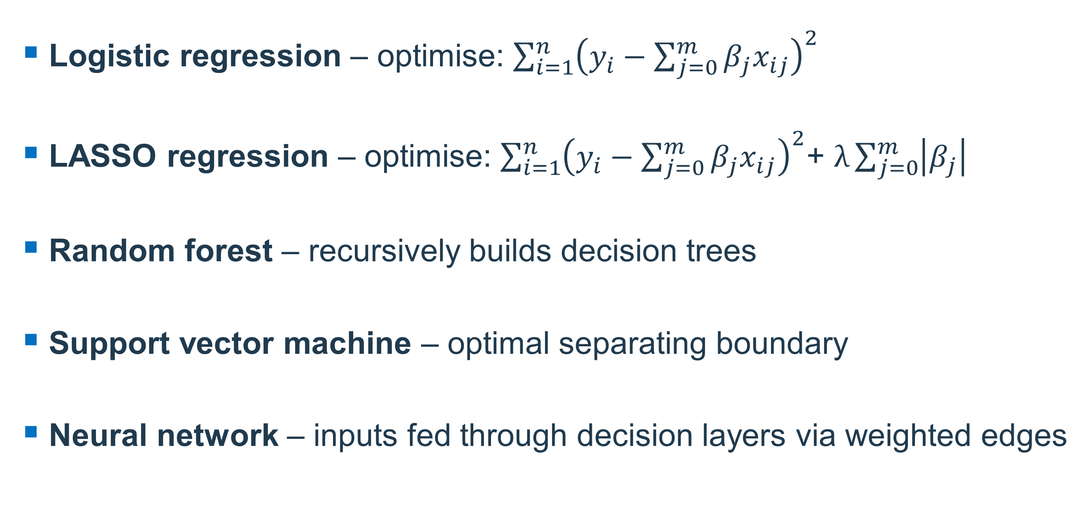
Classification algorithms
Logistic regression – optimise: $\sum_{i=1}^{n}{{\left(y_{i}−\sum_{j=0}^{m}{β_{j}x_{ij}}\right)}^{2}}$
LASSO regression – optimise: $\sum_{i=1}^{n}{{\left(y_{i}−\sum_{j=0}^{m}{β_{j}x_{ij}}\right)}^{2}}$+ $λ\sum_{j=0}^{m}{\left|β_{j}\right|}$
Random forest – recursively builds decision trees
Support vector machine – optimal separating boundary
Neural network – inputs fed through decision layers via weighted edges
(intuition)

Slide 17
Cross-validation procedure
Want to simulate performance on unseen data
Train data should contain ZERO information about test data
Allows monitoring of overfitting

Slide 18
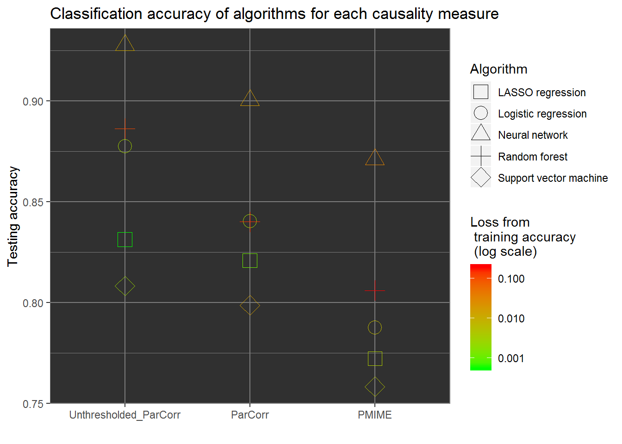
Classification accuracy

Slide 19
Implications
Diagnostic utility of weak edges
PMIME produces more accurate causal networks... but means little in a machine learning context?
Computational efficiency of ParCorr

Slide 20
Metric importance measures
Logistic regression coefficients
Logistic regression transformed p-values
LASSO regression coefficients
Random forest Gini importance
AUC

Slide 21
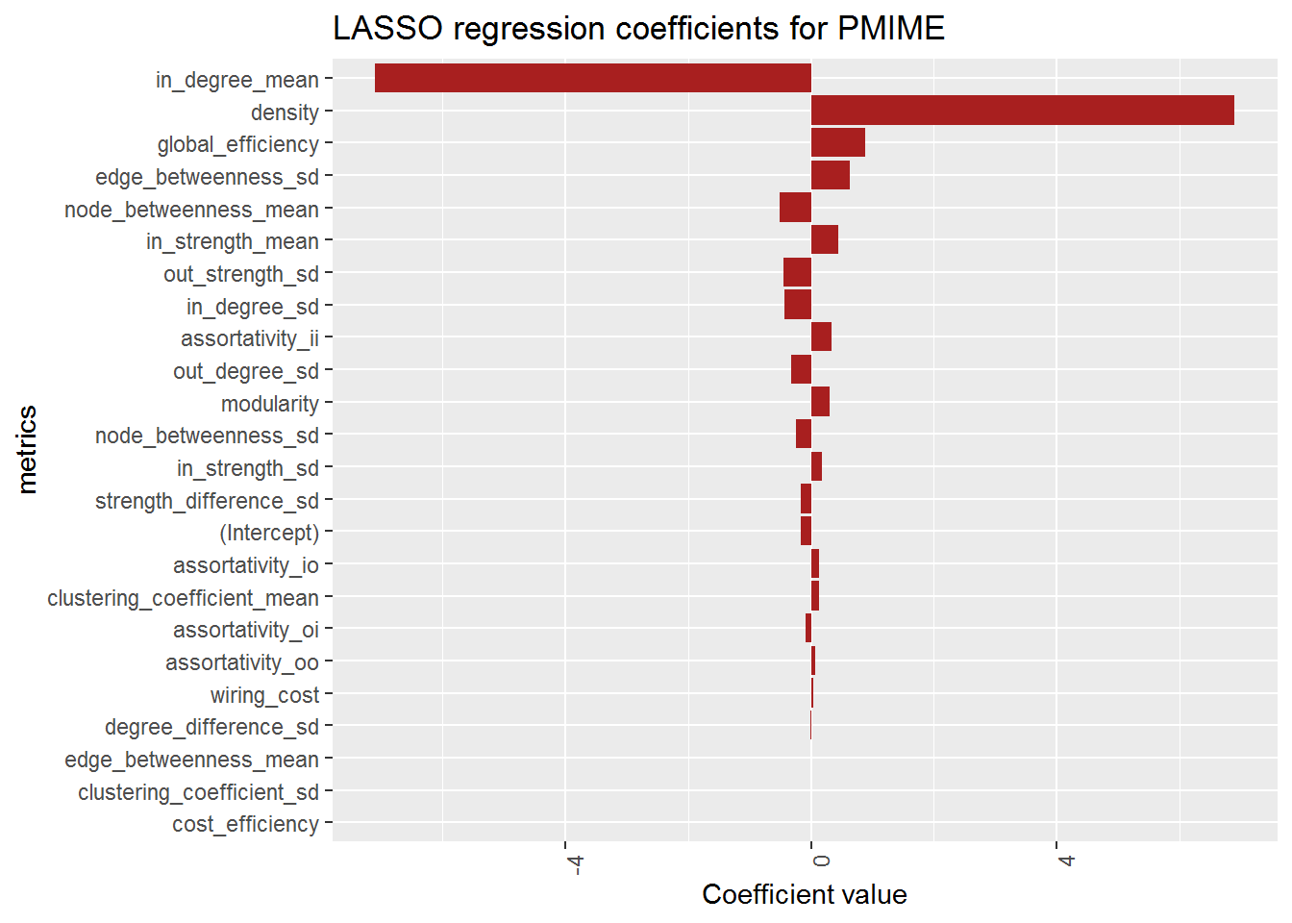
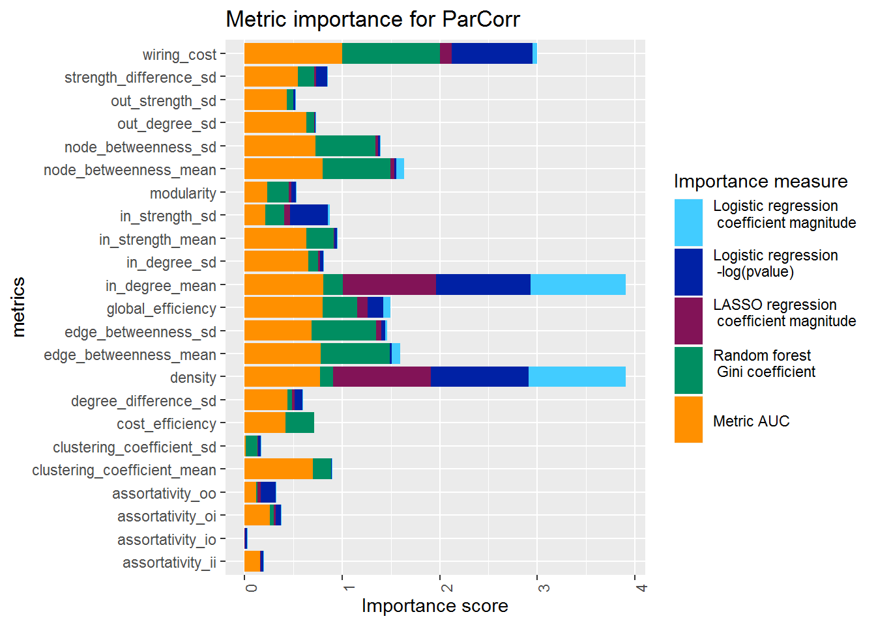
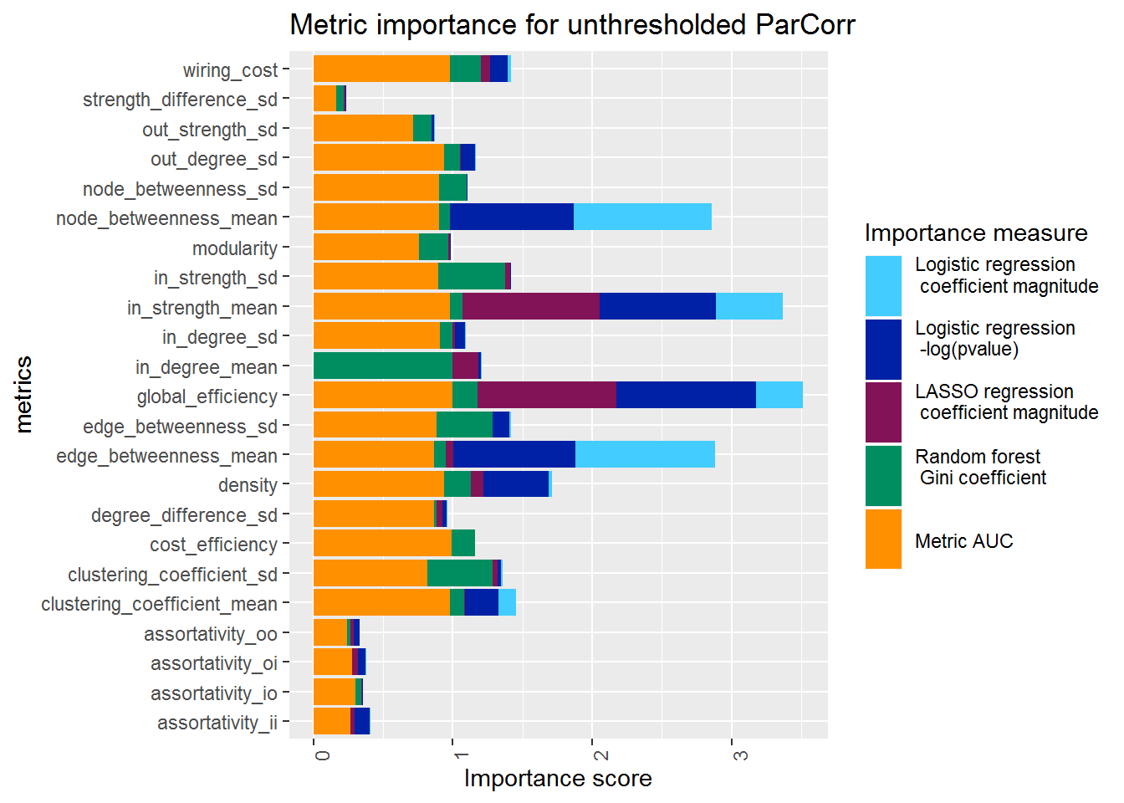
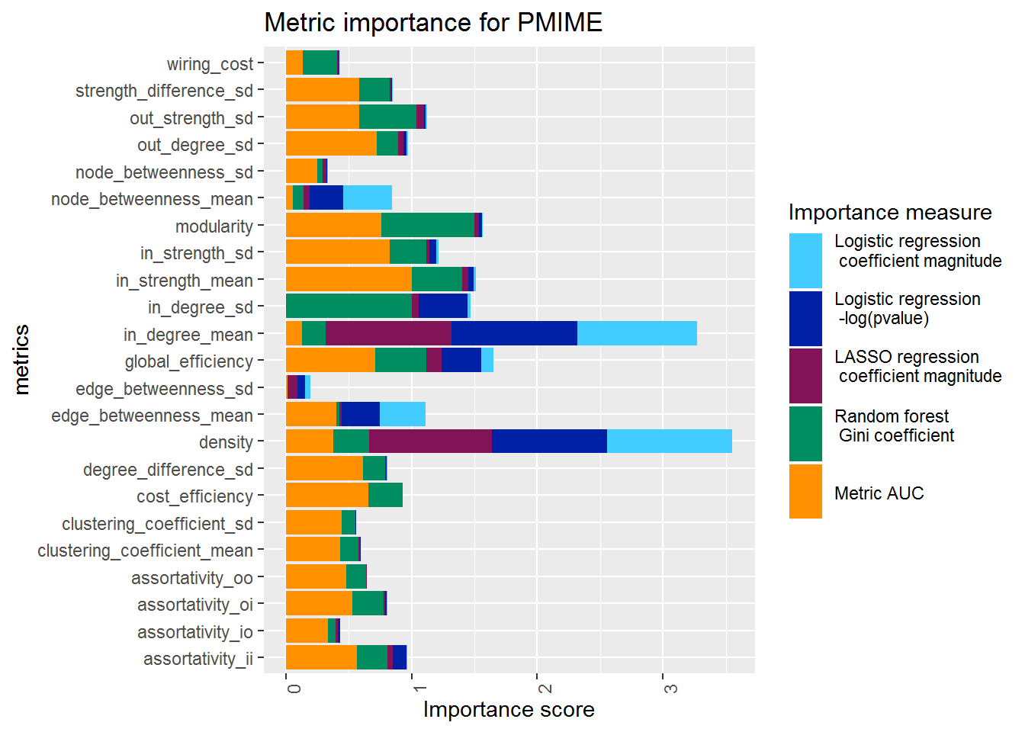

Slide 22
Interpretations?
Mixed results; importance measure disagreement
Same-density networks lead to similar important variables
Comparison to other research may not be appropriate

Slide 23
Thanks for listening!
Questions?

