Slide 1


The Comparative Legitimacy of Arms Exports A Conjoint Experiment in Germany and France
Lukas Rudolph (LMU Munich and ETH Zurich),
Markus Freitag (LMU Munich), and
Paul Thurner (LMU Munich)
Presentation at the Z-PESS Political Economy Seminar, 21. April 2021

Slide 2
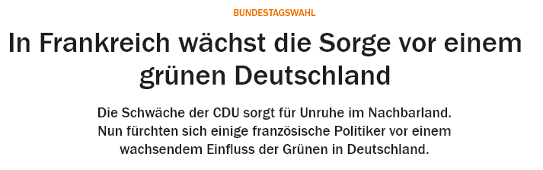
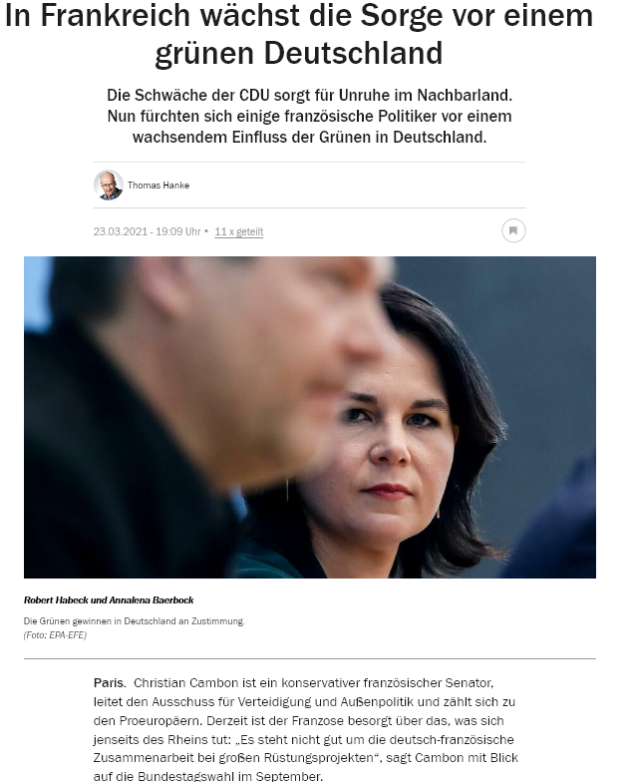
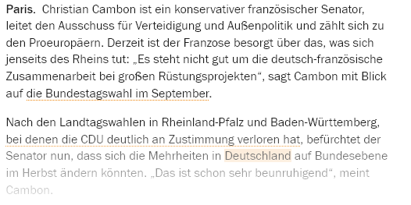
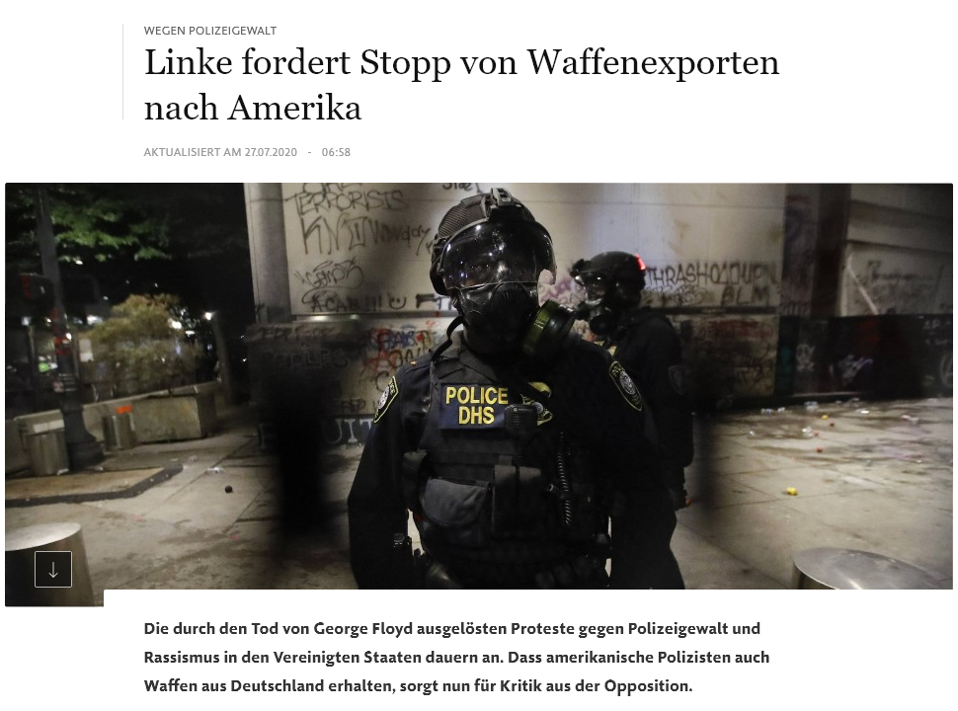
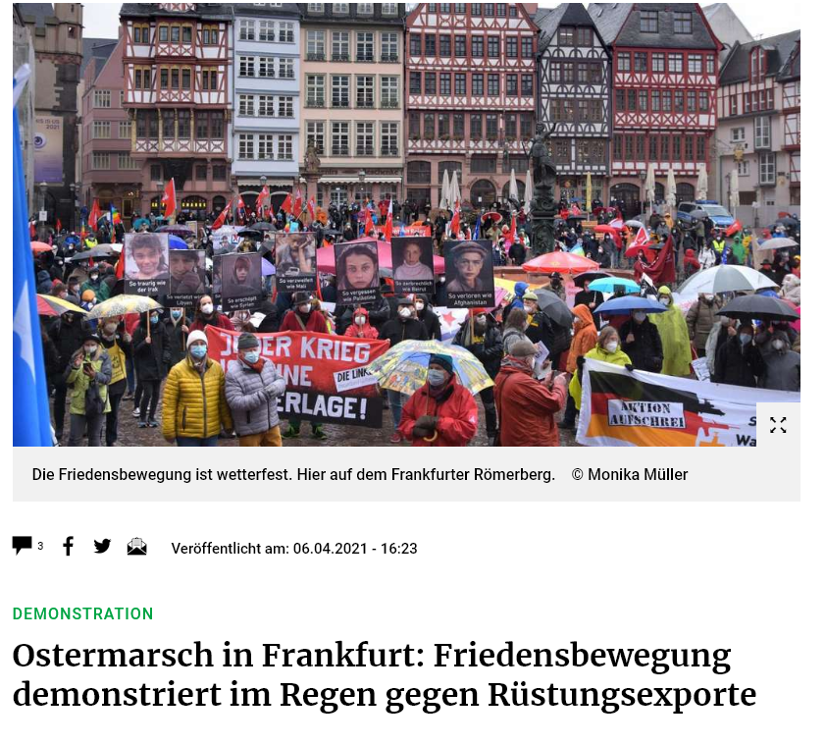

Slide 3
Core questions
Trade in arms is politically contested in democracies
This is much more visible in some than in others
Arms trade allows for a value-based and interest-based perspective on foreign policy
➔ Exemplary policy field for nuanced trade-offs in decision making

Slide 4
Core questions
Trade in arms is politically contested in democracies
But: This is much more visible in some than in others
Arms trade allow for a value-based and interest-based perspective on foreign policy
What explains mass public preferences on weapons exports?
Why are the preferences in some countries structured seemingly differently?

Slide 5
Basis of our argument
Trade in arms is
„far more than an economic occurrence,
a military relationship, or an arms control challenge –
arms sales are foreign policy writ large” (Pierre 1982: 3)
Arms trade combines elements of high and low politics
We draw on the
trade literature (economic incentives; norms & values)
foreign policy literature (strategic interests; norms & values)
political economy models (strategic interests; economic incentives)

Slide 6
Argument
Premise I: Citizens are neither ignorant nor elite-driven
Premise II: Citizens (foreign policy) preferences form based on interests and values
H1: Acceptance of arms trades should
increase with economic value
decrese with moral repulsiveness
increase with geopolitical benefits
Open question: Which of these is more important on average?

Slide 7
Argument
Moral, strategic and economic incentives interact
Citizens can form preferences based on a consequentialist logic or on a logic of appropriateness
These are potentially linked in two ways:
With high economic value, following through on norms is costly
When the relevance of appropriateness is enhanced (decreased), the weight of moral arguments increases (decreases)

Slide 8
Argument
Two tests for interaction effects:
H2: Do respondents show lower weight of moral arguments when a lot of economic gain is at stake?
H3: Do respondents show less weight for moral arguments when
a signal of non-compliance is sent by others or
the harm potential is of the traded good is lower

Slide 9
Argument
Do abstract foreign policy values structure concrete arms trade policy preferences?
H4: Different systematic structures of preferences for
militant internationalists,
cooperative internationalists and
isolationalists

Slide 10
Argument
Preferences of respondents aggregate to country preferences
This links to arguments of elite-level „strategic culture“
H5: German respondents are
less supportive of arms deals overall,
show more fundamental opposition, and
structure preferences around norm-related dimensions (compared to French respondents)

Slide 11
Research design
Survey with 6,600 German and French respondents
Population-representative quota sample
Conjoint experiment with
9 dimensions
6 conjoint choice tasks, 12 rating tasks
and overall 79,404 observations.
Additional survey items, vignette and ordering experiments (not reported upon here)

Slide 12
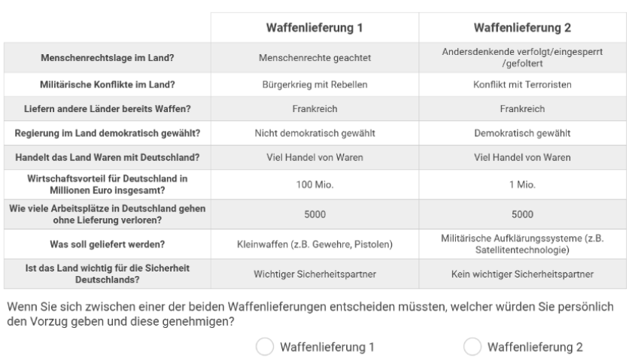

Conjoint design

Slide 13
Dimensions of the Conjoint Experiment
Norm-related
Democracy yes/no
Human rights (upheld, violated, strongly violated)
Conflict (peace, civil war, terrorists, war (attacks), war (defends))
Geopolitical interests
Security partner yes/no
Economy-related
Trade partner yes/no
Economic value (1m to 1bn)
Jobs at risk (100 to 5000)

Slide 14
Dimensions (ctd.)
Moderating factors
Type of good (direct harm potential yes/no)?
Which other countries trade? (GER/FR; NATO; Russia/China)

Slide 15
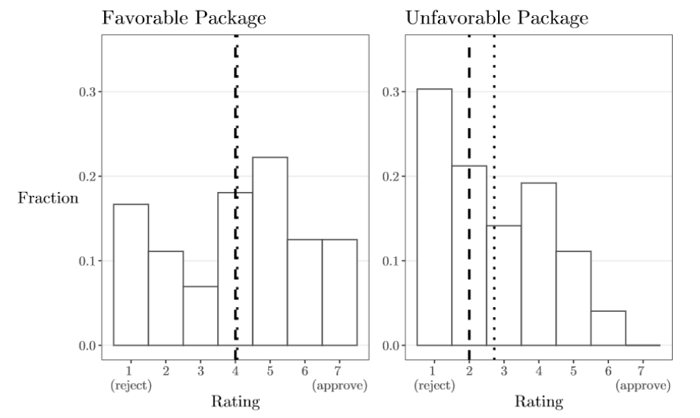
Baseline ratings
Notes:
Unfavorable package has attribute combination:
autocratic; human rights (strongly) violated; war or civil war;
no trade or security partner;
low monetary and employment benefit;
deal with large weapons or small arms;
unknown other countries or China/Russia also trading.
Favorable package arethe inverse of this list.

Slide 16
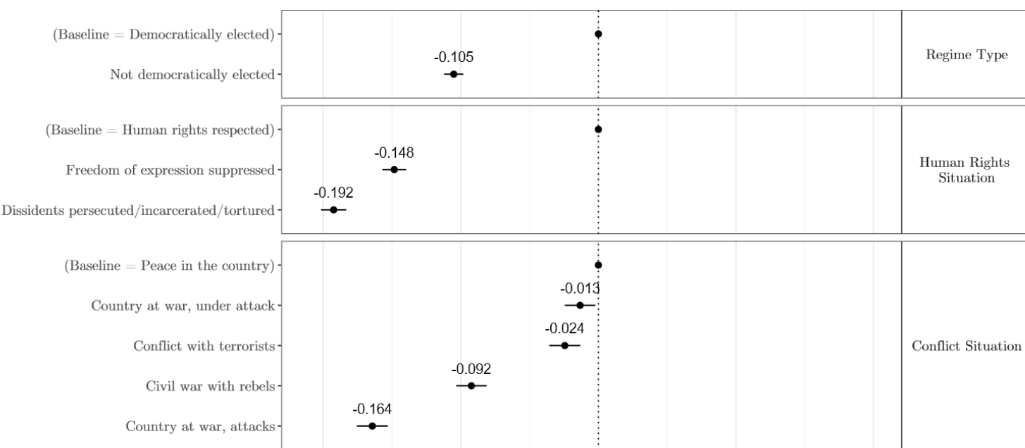
Baseline effects – Moral dimensions

Slide 17
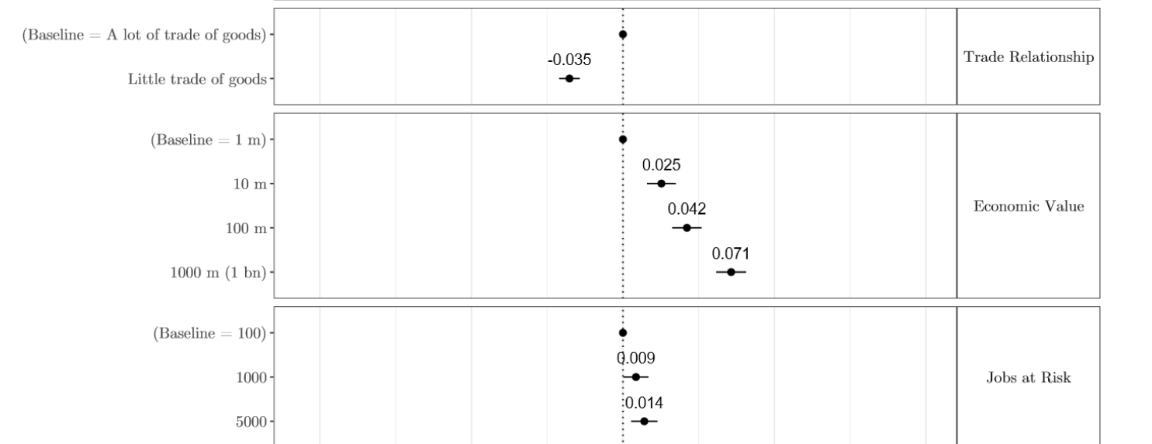
Baseline effects – Economic dimensions

Slide 18
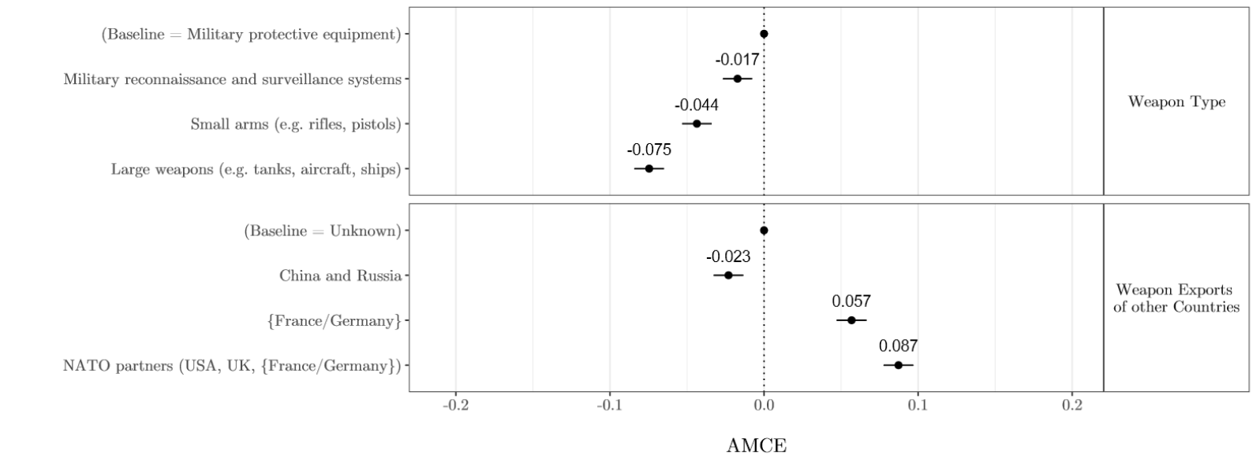
Baseline effects – Geopolitical, type, signal

Slide 19
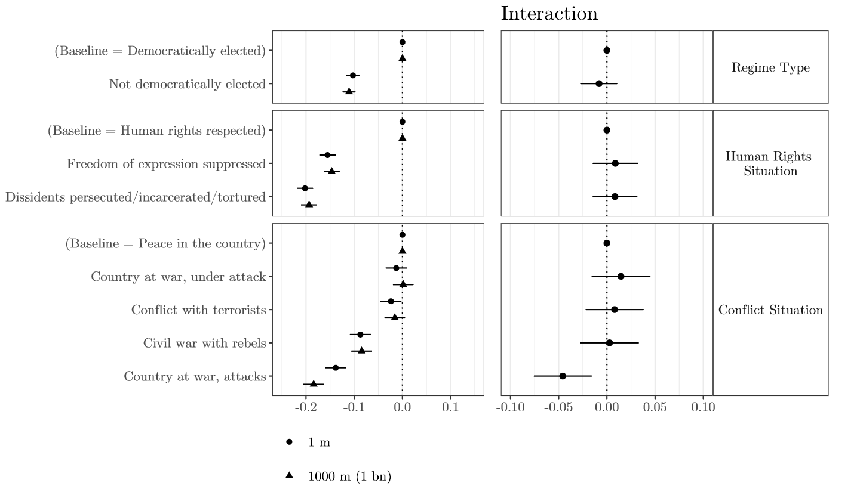
Trade-offs: Morals with high/low econ. value

Slide 20
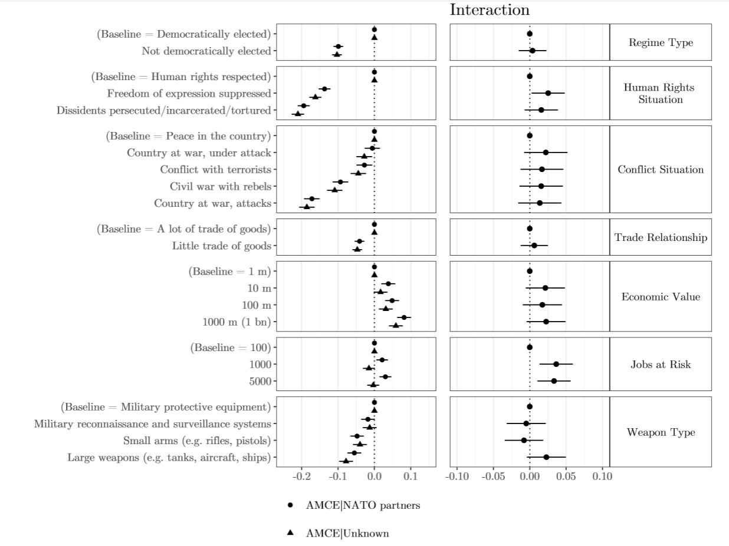

Trade-Off: Econ vs. morals with allies trading

Slide 21
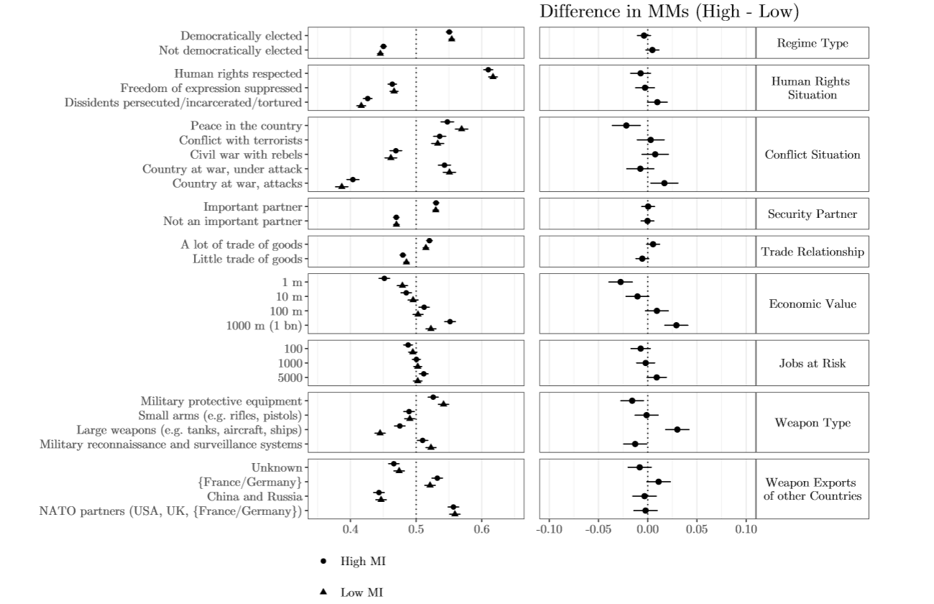

Foreign policy values: Militant internat. subgroup

Slide 22
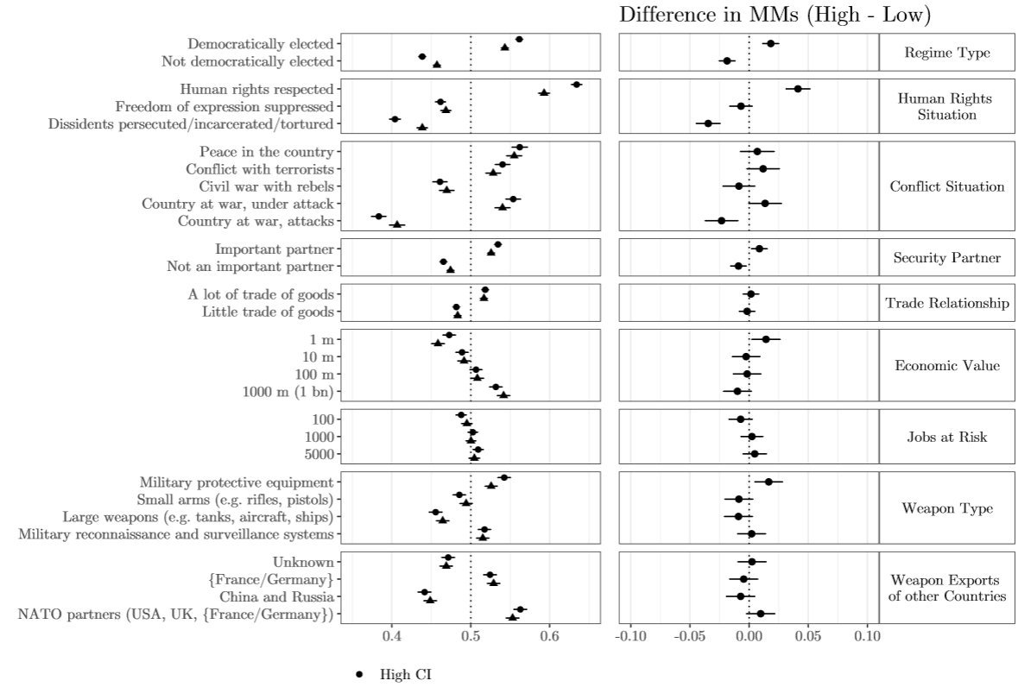

Foreign policy values: Coop. internat. subgroup

Slide 23
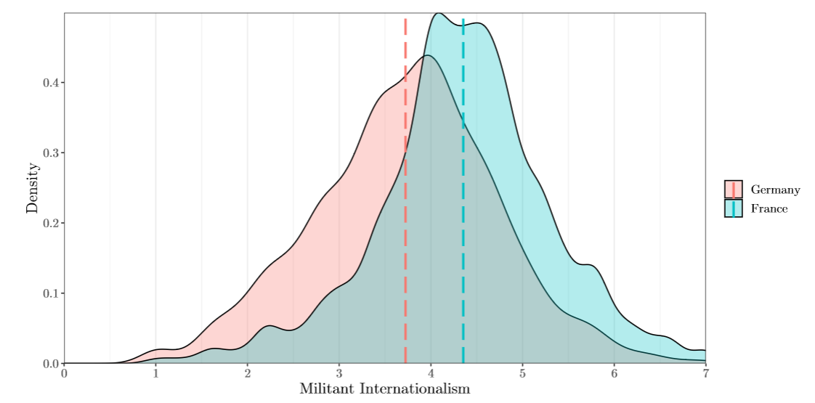
Expression of foreign policy attitudes in Germany and France

Slide 24
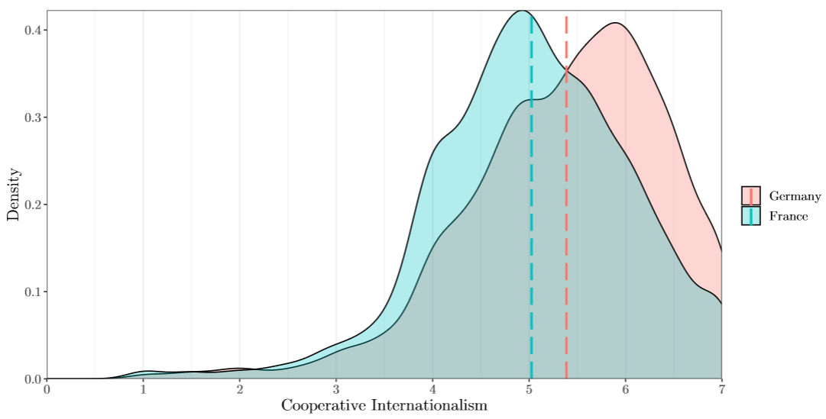
Expression of foreign policy attitudes in Germany and France

Slide 25
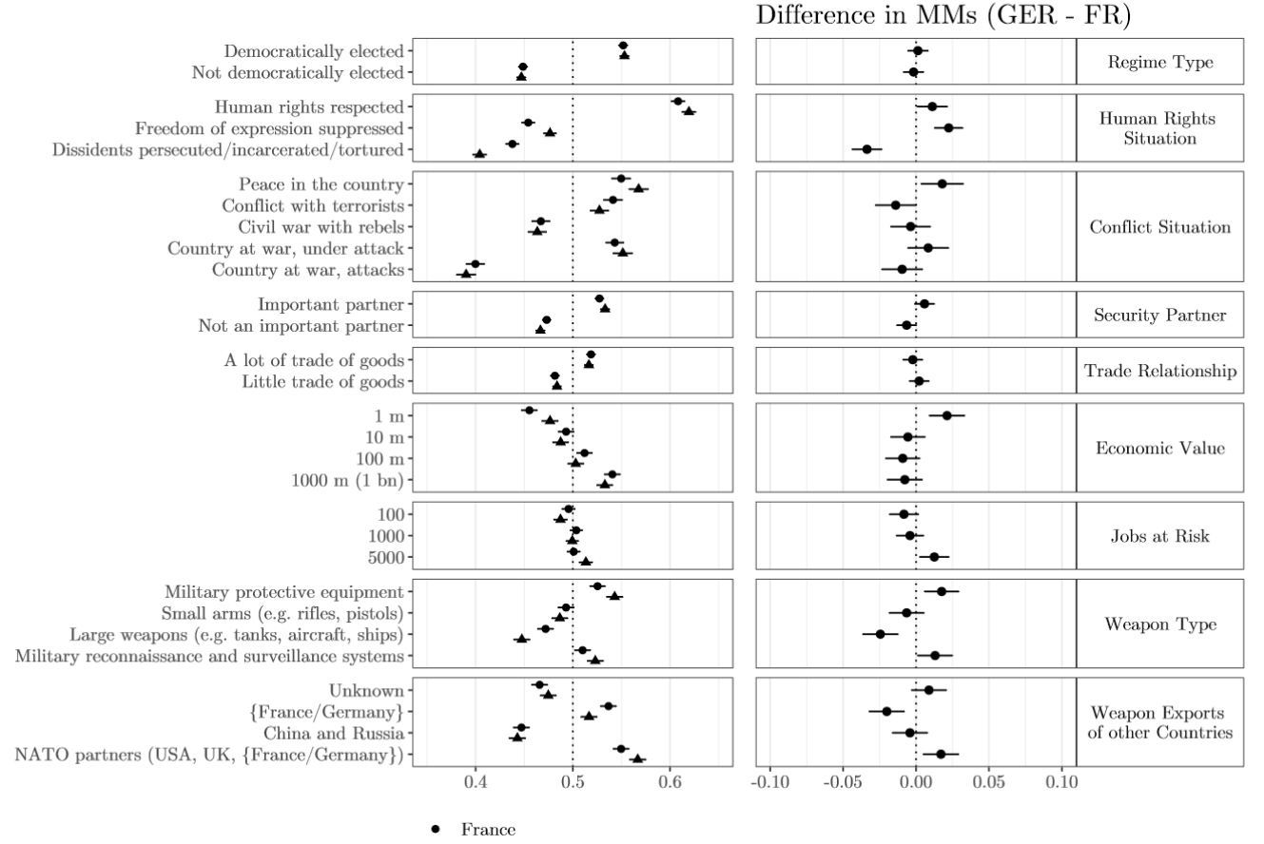

Conjoint attributes by country

Slide 26
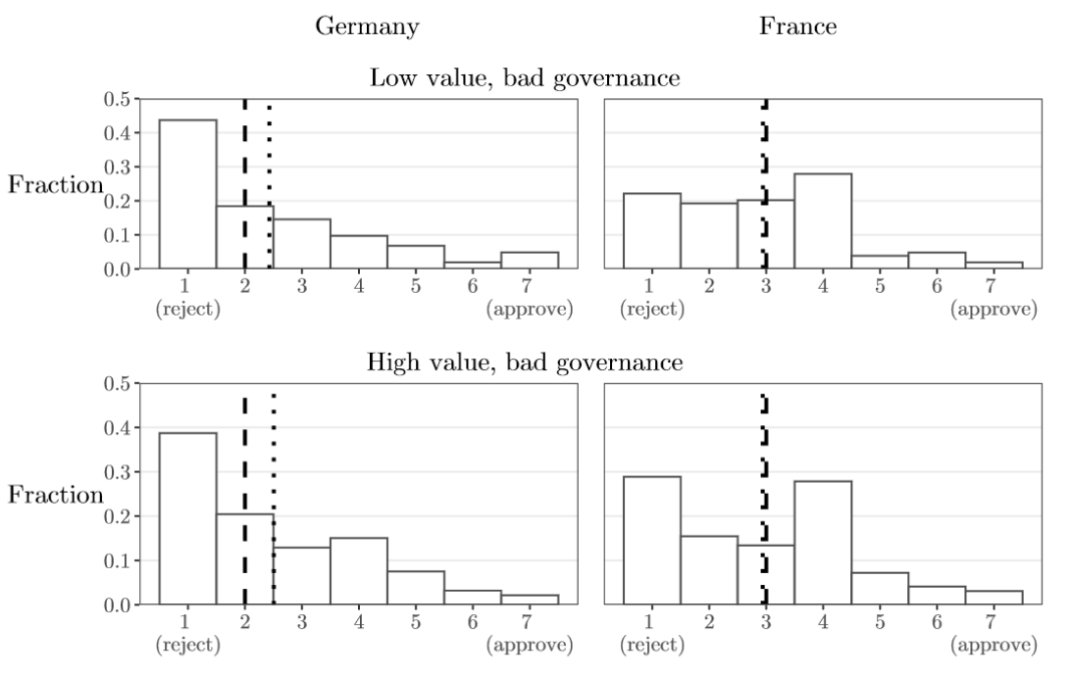
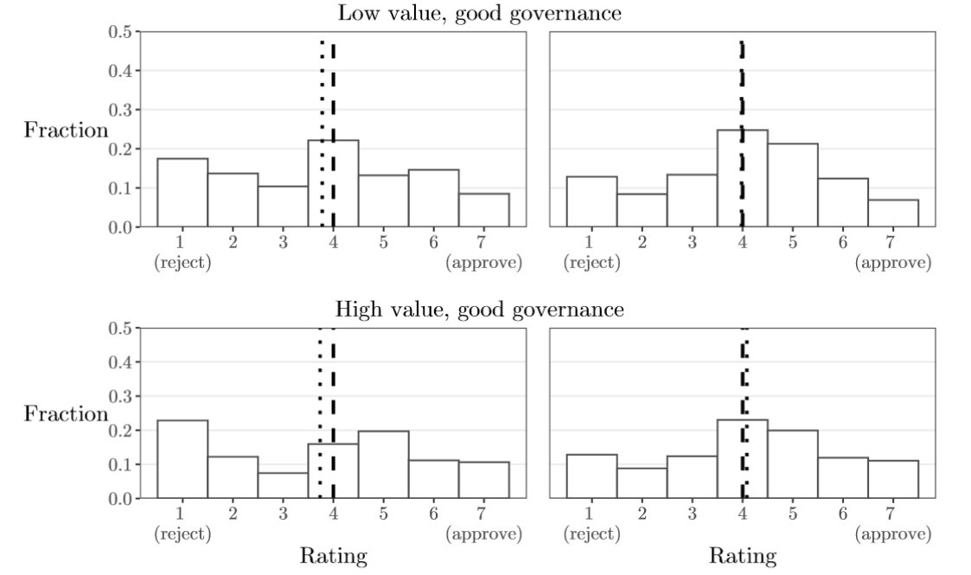
Ratings in Germany and France

Slide 27
Ratings in Germany and France

Slide 28
Discussion
Baseline effects
Preferences structured primarily by norm-related dimensions, though economy and trade and country context play a role
Trade-offs
No strong conditional effects. In tendency: Other countries trading can activate an economic logic

Slide 29
Discussion
Foreign policy values:
Militant internationalists: driven by econ. dimension
Cooperative internationalists: driven by moral dimension
German-French differences: Germans with…
larger share of cooperative internationalists
overall moral dimension more, economic dimension less strongly expressed
larger share of fundamental opposition
substantially lower ratings with bad governance

Slide 30
Conclusion
Citizens hold well-structured preferences on this important and under-researched policy field
Norm-related aspects of a policy prove most important
Relevance of norms affected by behavior of third actors
Underlying foreign policy values can explain the expression of concrete policy choices
On the country level
… differences in the expression of foreign policy values link to
… differences in public attitudes, which link to…
… differences in elite-level strategic cultures.

Slide 31
Thank you for your attention.
Contact: Lukas.Rudolph@gsi.uni-muenchen.de
Pre-print available at https://osf.io/arxb3/
Rudolph, Freitag and Thurner
# 31

Slide 32
Conclusion
Citizens hold well-structured preferences on this important and under-researched policy field
Norm-related aspects of a policy prove most important
Relevance of norms affected by behavior of third actors
Underlying foreign policy values can explain the expression of concrete policy choices
Differences in the expression of foreign policy values leads to differences in strategic cultures

Slide 33
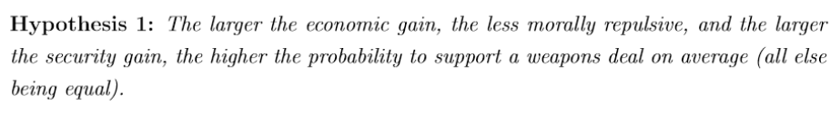

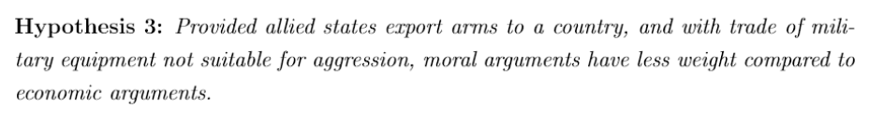
Hypotheses I

Slide 34
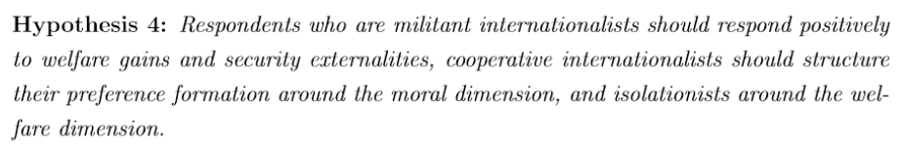
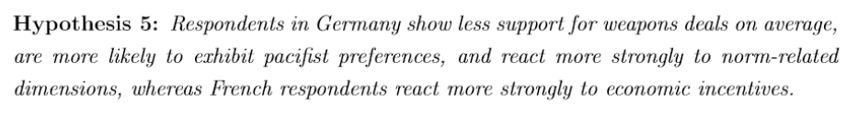
Hypotheses II

