Slide 1

















All Classes
PC Sample
Class 1
$$N_{1}=15$$
$${(y_{1},X}_{1})$$
Class 4
$$N_{1}=8$$
$${(y_{4},X}_{4})$$
Draw $G_{b}$classes
With replacement
Class 45
$$N_{2}=10$$
$${(y_{45},X}_{45})$$
Class 2
$$N_{2}=10$$
$${(y}_{2},X_{2})$$
$$⋮$$
$$⋮$$
$$⋮$$
$$⋮$$
Class G
$$N_{G}=20$$
$${(y}_{G},X_{G})$$
Class $G_{b}$
$$N_{G_{b}}=20$$
$${(y_{G_{b}},X}_{G_{b}})$$

Slide 2


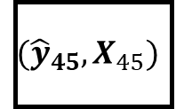



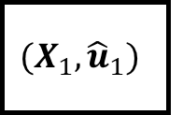
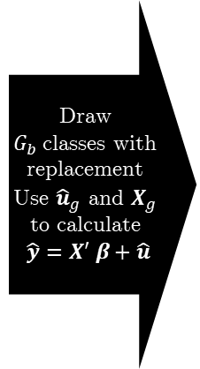





All Classes + OLS Model
PC Sample
Class 1
$$N_{1}=15$$
$${(X}_{1},{\hat{u}}_{1})$$
$$β$$
Class 4
$$N_{1}=8$$
$${({\hat{y}}_{4},X}_{4})$$
Draw $G_{b}$classes with replacement
Use ${\hat{u}}_{g}$ and $X_{g}$ to calculate
$\hat{y}=X′ β+\hat{u}$
Class 45
$$N_{2}=10$$
$${({\hat{y}}_{45},X}_{45})$$
Class 2
$$N_{2}=10$$
$${(X}_{2},{\hat{u}}_{2})$$
$$⋮$$
$$⋮$$
$$⋮$$
$$⋮$$
Class G
$$N_{G}=20$$
$${(X}_{G},{\hat{u}}_{G})$$
Class $G_{b}$
$$N_{G_{b}}=20$$
$${({\hat{y}}_{G_{b}},X}_{G_{b}})$$

