Slide 1
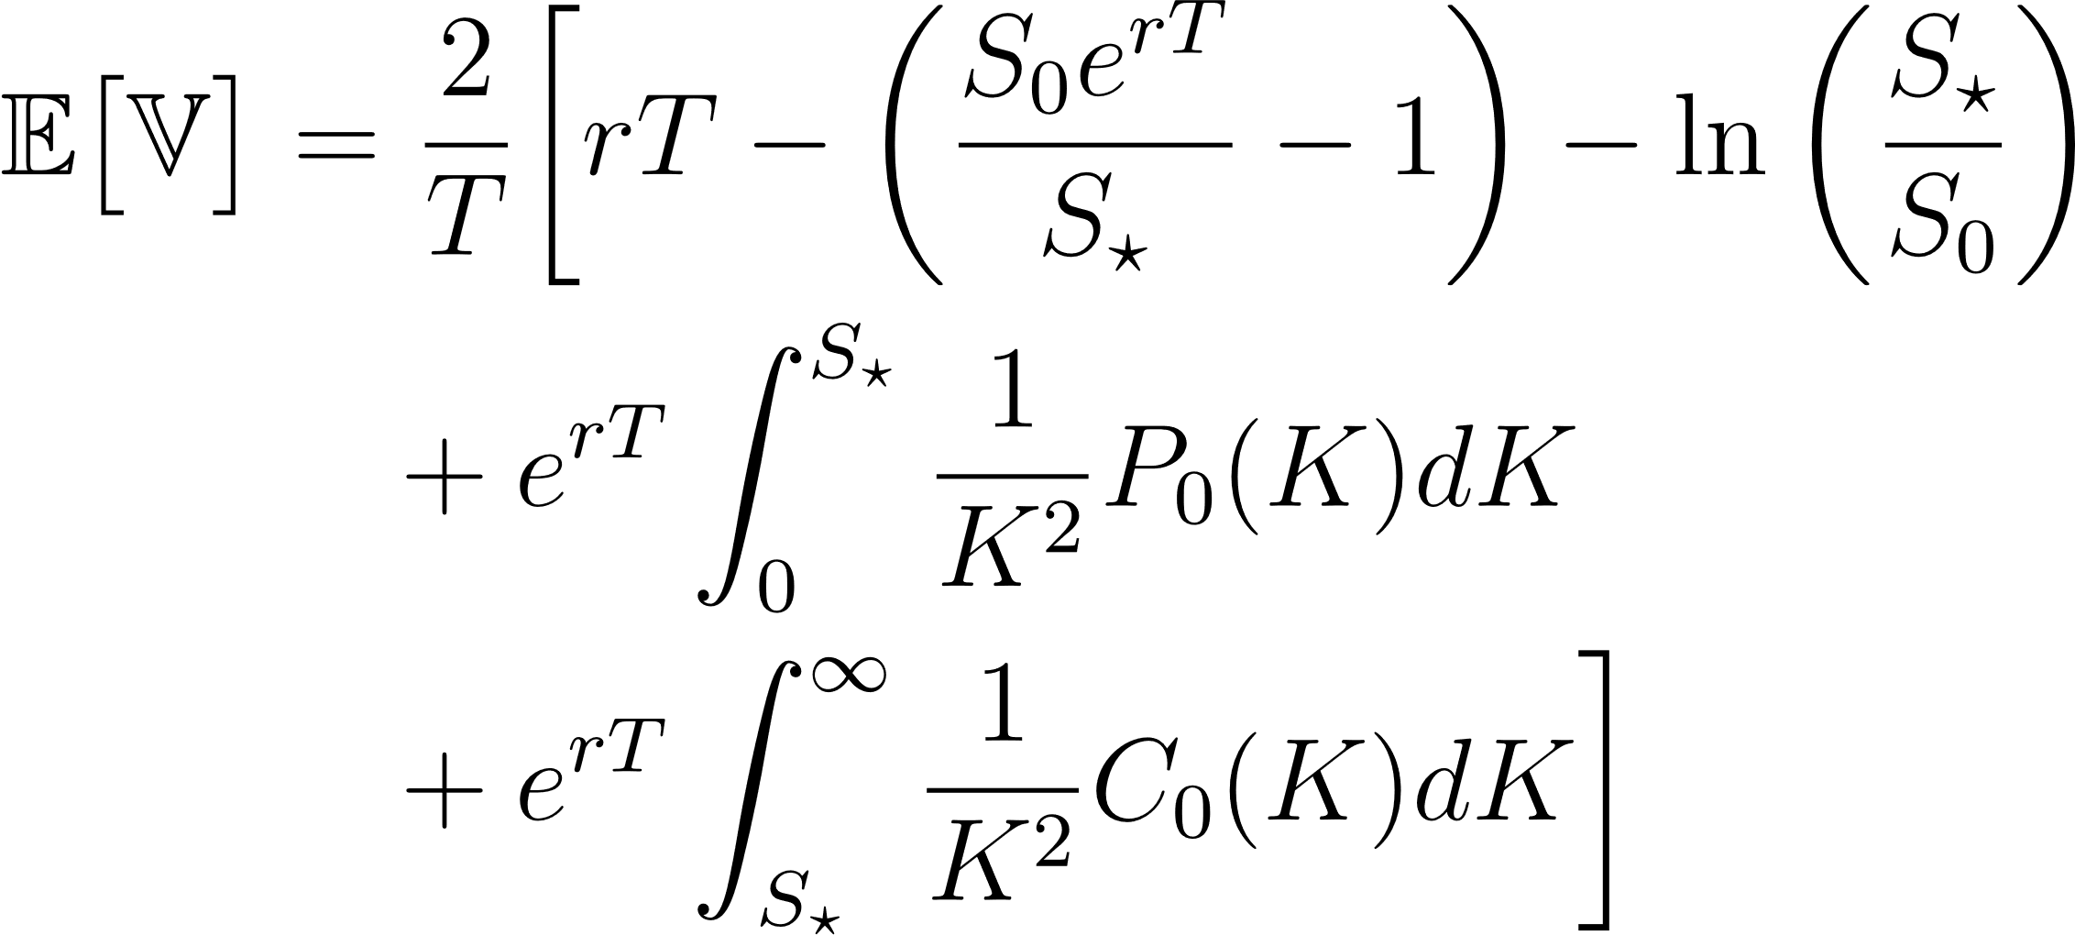
R.MFIV
<scrapurrr/>

Slide 2
