Slide 1









Automation with scrapurrr()
purrr::map() oriented workflow
Error Handling
Tidy Data
User defined flexible scrapefun()
Parallel Workers via furrr
Writing a flexible
scrapefun()
Download webpage content
Proxy Rotation
Extract hmtl elements
Control remote browser
Execute Javascript
Useful Helpers and Tutorials
Time Requests

Slide 2
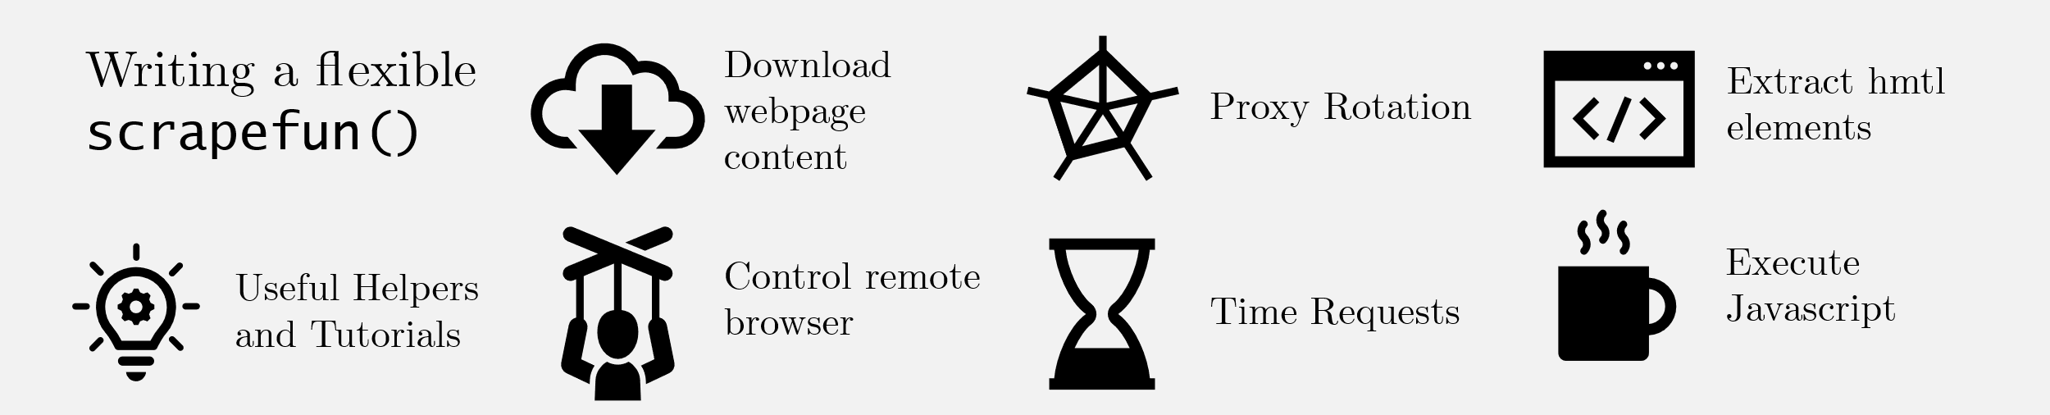
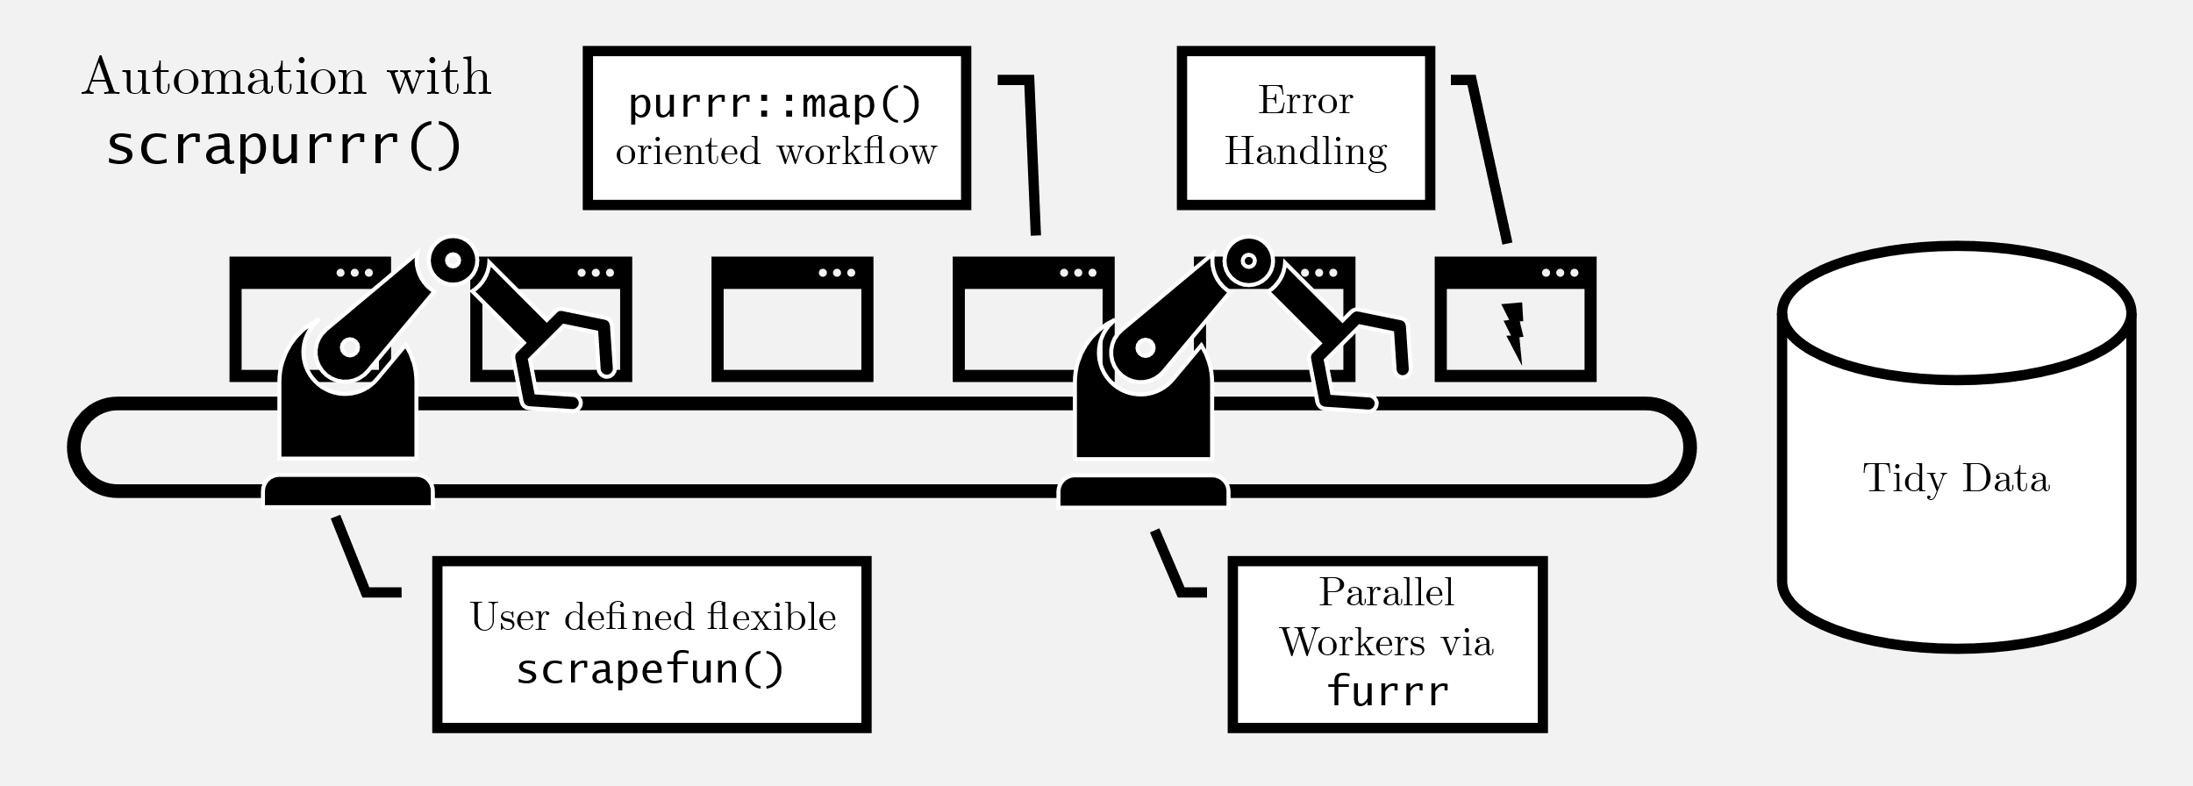

Slide 3
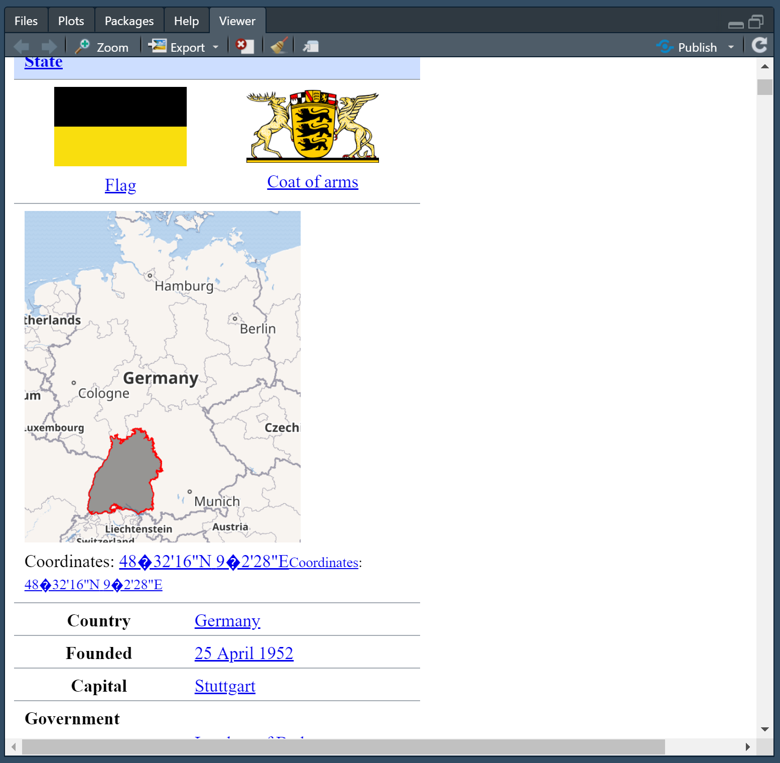

Slide 4


<scrapurrr>
<scrapurrr/>

Slide 5


Slide 6

<html>
<title> HTML </title>
<body>
This is HTML!
</body>
<html>
Data

Slide 7
