Slide 1
PPE Compliance Checker
Multi-Agent Computer Vision System
Detect • Reason • Report
Construction-site PPE compliance using a custom-trained YOLO11 detector and three-agent pipeline.
Solo expansion of the earlier midterm group project, developed and completed by Mary Ann Mastri.
ITAI 1378 • Computer Vision Capstone • Tier 3 • Solo Project
Mary Ann Mastri

Slide 2
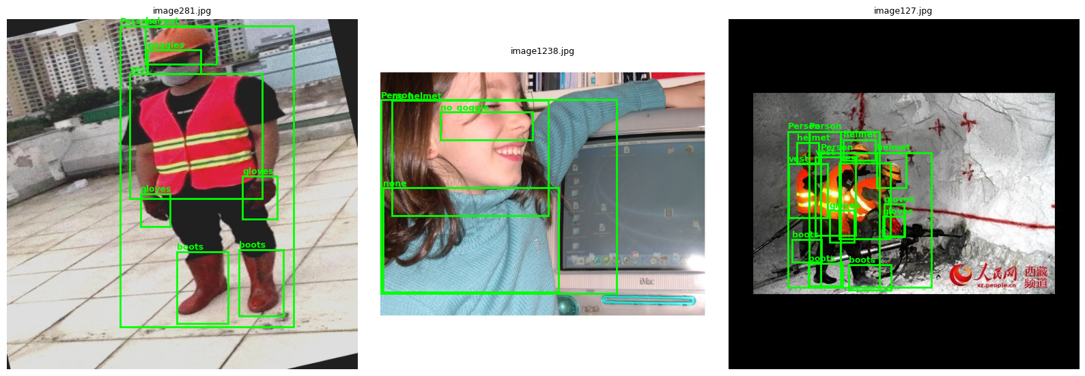
The problem
02
A useful safety system must detect PPE and turn detections into an actionable compliance decision.
1 • PERCEIVE
2 • REASON
3 • ACT
Construction photos contain workers, PPE, occlusion, small objects, and visual clutter.
A detection alone is not a safety judgment. The system must identify missing or explicit violation classes.
The final result should be understandable: annotated image, structured JSON, and an alert when a scene is non-compliant.
Example labeled construction-PPE training images
Project context: this capstone work expands the midterm group prototype into an individually developed end-to-end system.

Slide 3
System architecture
03
Three agents communicate through structured messages; only the Perception Agent touches pixels.
PERCEPTION
COMPLIANCE
REPORTER
IMAGE
YOLO11 ONNX class • confidence • bbox
Rule-based reasoning compliant • violations • missing
Annotated image JSON report • console alert
Raw construction photo
Message 1
Message 2
Output
detections[] → {class, conf, bbox}
compliance{} → {compliant, violations, missing, detected}
Useful artifacts for a human reviewer
PPE Compliance Checker • ITAI 1378 Computer Vision Capstone • Mary Ann Mastri

Slide 4
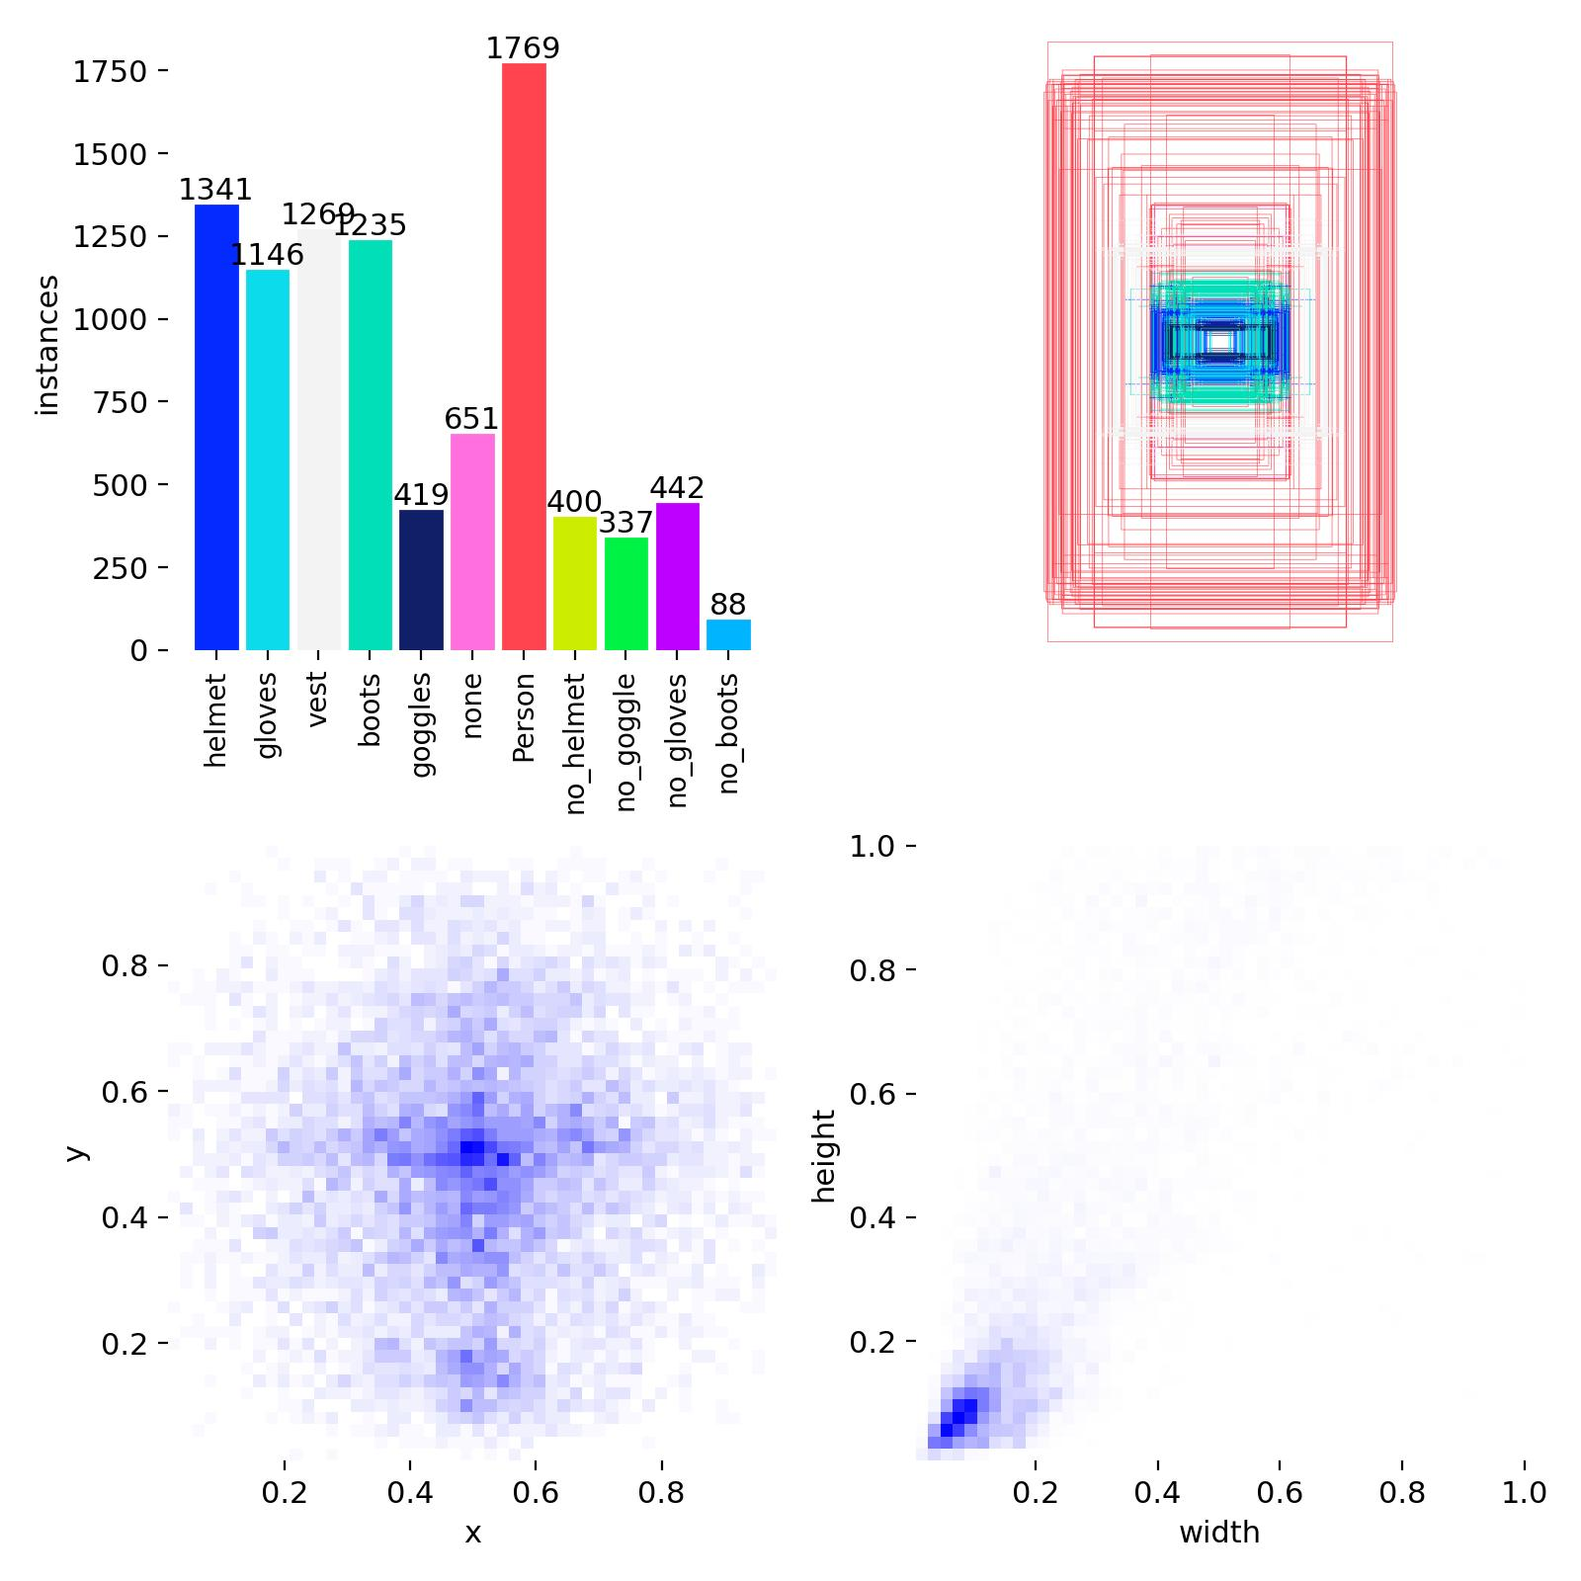
Dataset & labels
04
Ultralytics Construction-PPE dataset: 1,416 images across 11 classes.
1,416
1,132
143
141
11
total images
train
validation
test
classes
WORN PPE
VIOLATIONS
helmet • gloves • vest • boots • goggles
no_helmet • no_gloves • no_boots • no_goggle
OTHER
Key challenge: violation labels encode absence/missing PPE, making them harder to learn than visible worn items.
Person • none

Slide 5
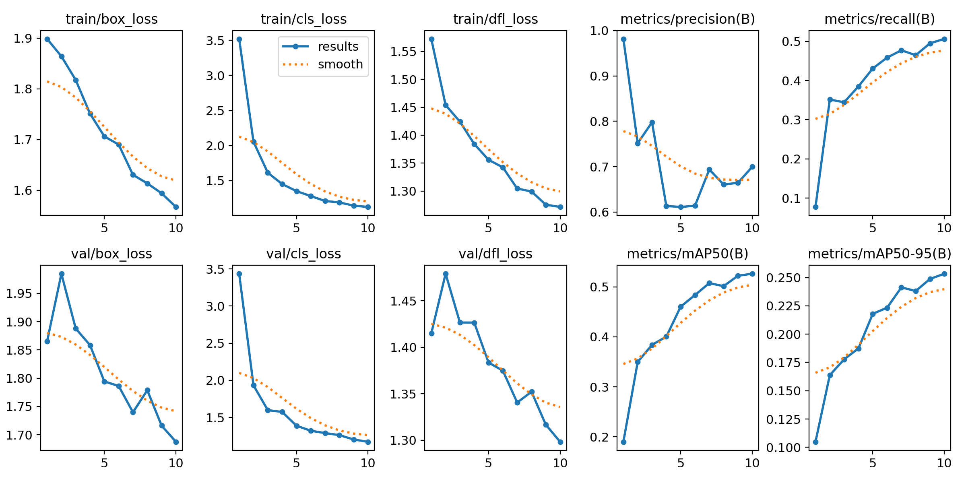
Model training & inference
05
A lightweight YOLO11n model was fine-tuned, exported to ONNX, and used for CPU inference.
BASE MODEL
FINAL RUN
DEPLOYMENT FORMAT
YOLO11n, COCO-pretrained
10 epochs • 320px
ONNX + onnxruntime CPU provider
WHY THIS CONFIG?
The run began as a smoke test to validate train → export → agents → reports end-to-end.
TRAINING CONSTRAINT
A longer 50-epoch / 640px run was attempted, but repeated Colab disconnects and resets prevented completion.
PPE Compliance Checker • ITAI 1378 Computer Vision Capstone • Mary Ann Mastri

Slide 6
The three-agent workflow
06
The pipeline separates perception, reasoning, and reporting so each stage has a clear contract.
Perception Agent
Runs YOLO11 ONNX inference • letterbox preprocessing • decode detections • returns structured dicts
↓
Compliance Agent
Applies safety rules • explicit no_* violations • required worn-PPE checks • returns compliance state
↓
Reporter Agent
Turns the decision into action • annotated image • JSON report • console alert for violations
PPE Compliance Checker • ITAI 1378 Computer Vision Capstone • Mary Ann Mastri

Slide 7
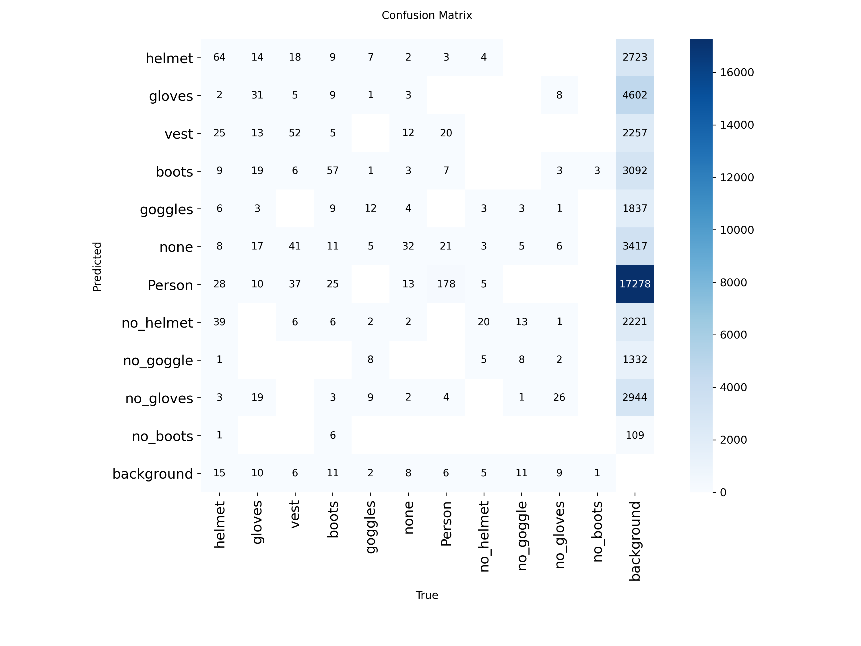
Evaluation: strong on common worn PPE, weak on violations
07
Validation set: 143 images / 1,172 ground-truth instances.
0.524
0.253
0.710
0.504
mAP50
mAP50–95
mean precision
mean recall
Representative class results
vest
0.842
Person
0.876
helmet
0.768
goggles
0.745
no_helmet
0.331
no_goggle
0.161
no_gloves
0.126
no_boots
0.000
Confusion matrix: head-region classes show cross-talk.

Slide 8
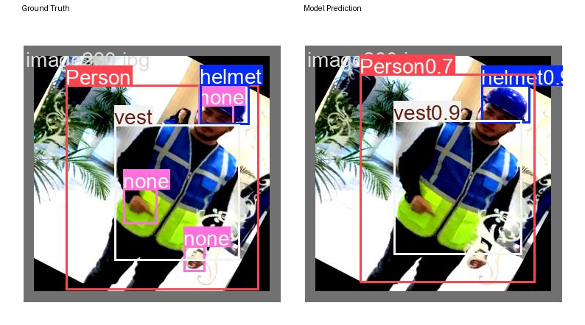
What success looks like
08
Held-out validation example: the model correctly detects a typical, unoccluded worker.
GROUND TRUTH
Person • helmet • vest
PREDICTION
Person 0.7 • helmet 0.9 • vest 0.9
TAKEAWAY
All three main PPE classes are detected with high confidence and well-aligned boxes.
PPE Compliance Checker • ITAI 1378 Computer Vision Capstone • Mary Ann Mastri

Slide 9
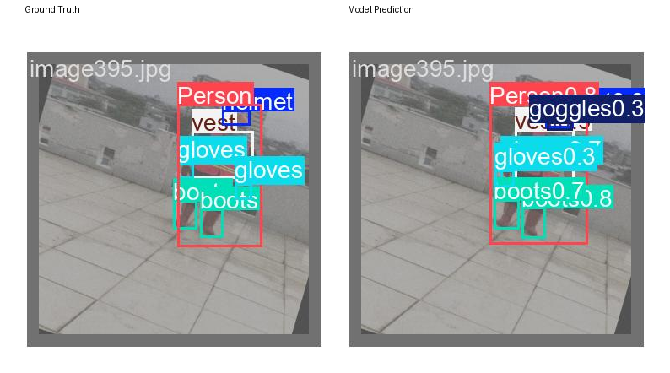
Failure mode #1: helmet ↔ goggles confusion
09
Small, visually similar head-region objects are difficult at 320px.
GROUND TRUTH
Person • helmet • vest • gloves ×2 • boots ×2
PREDICTION
Person 0.8 • goggles 0.3 • vest • gloves 0.3 • boots 0.7/0.8
EVIDENCE
Confusion matrix shows cross-talk in both directions.

Slide 10
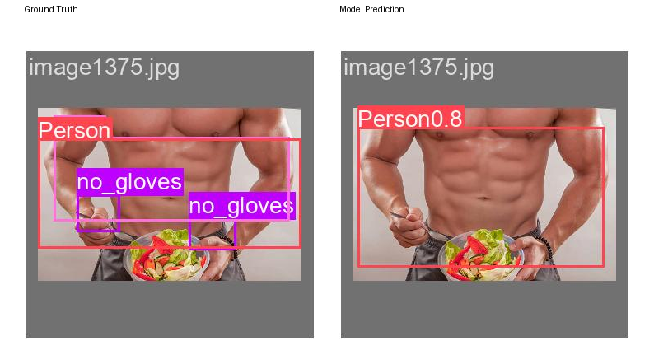
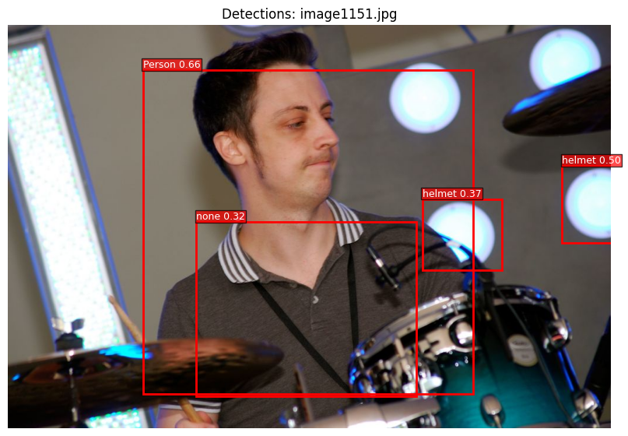
Failure modes #2 & #3: missed violations and domain shift
10
The most important limitation is not a cosmetic error — it can produce a false compliance decision.
MISSED NO-GLOVES
OUT-OF-DOMAIN FALSE POSITIVE
Ground truth: no_gloves ×2. Prediction: Person only. no_gloves recall = 0.071; mAP50 = 0.126.
A stage light is labeled as a helmet. The model generalizes poorly outside construction imagery.
PPE Compliance Checker • ITAI 1378 Computer Vision Capstone • Mary Ann Mastri

Slide 11
Limitations, mitigations & next steps
11
The project is intentionally honest about what the current model can and cannot support.
LIMITATION
MITIGATION
NEXT MODEL
Violation classes are under-trained; no_boots recall is 0.0 and no_gloves recall is 0.071.
Raise confidence thresholds, restrict deployment to in-domain imagery, and add stronger violation-focused evaluation.
Train longer at 640px with a stable GPU runtime; increase representation of missing-PPE examples.
Engineering priorities
Bottom line
01
Improve recall on explicit violations
A complete Tier-3 multi-agent pipeline was built and validated end-to-end. The next improvement should target violation recall, not just overall mAP.
02
Reduce helmet / goggles confusion
03
Test more varied construction scenes
04
Add threshold tuning and deployment guardrails

Slide 12
From pixels to a safety decision
Perception → Compliance reasoning → Actionable report
DETECT
REASON
REPORT
Find PPE and people
Determine compliance
Communicate the result
Thank you
Questions?
Source materials: project README • evaluation metrics • diagnostic plots • held-out examples • AI usage log

