Slide 1

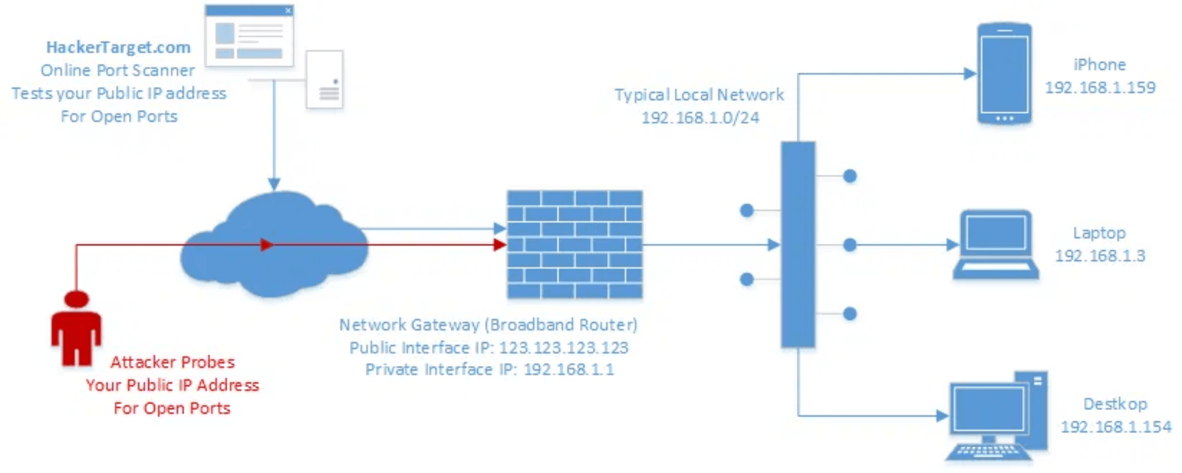
┌─────────────────────────────────────┐
NETWORK
PORT
SCANNER
# Python Scripting Mini Project
INSTITUTION:
Karunya Institute of Technology & Science
[PORT_SCANNING_ARCHITECTURE]
SEMESTER:
SEM 1
PRESENTED BY:
Prasad - PRK25DS1015
Vinoth Karthik - PRK25DS1012
Gokul Raj - PRK25DS1018
└─────────────────────────────────────┘

Slide 2

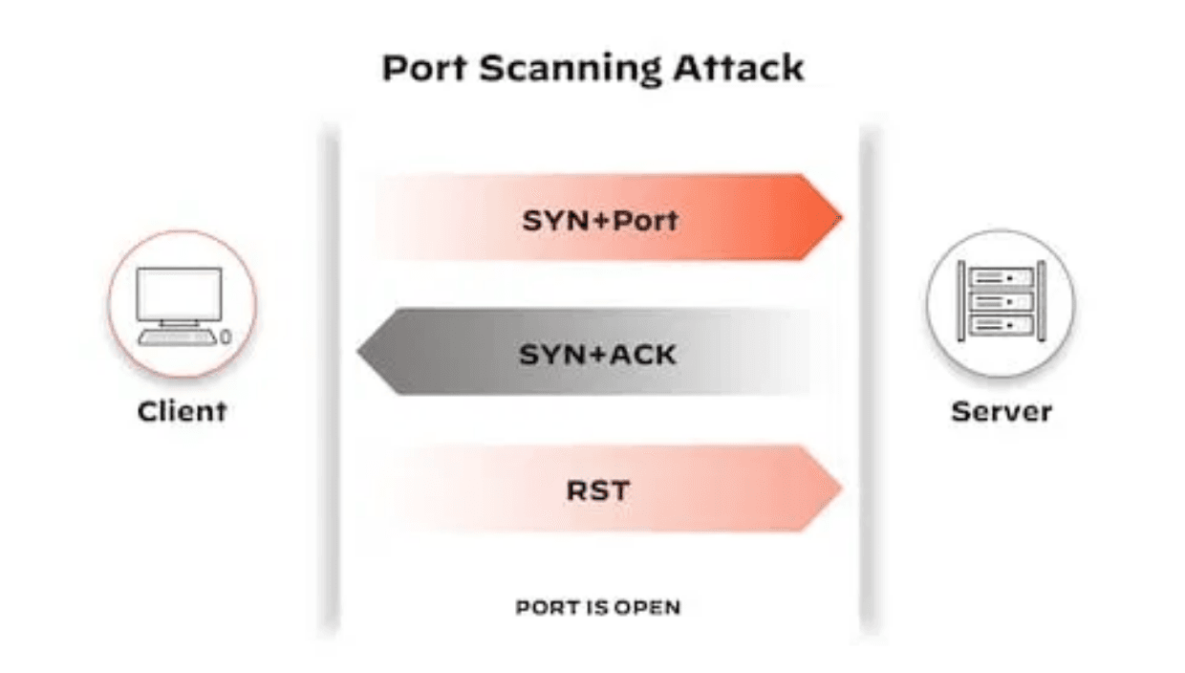
PROJECT ABSTRACT
════════════════════════════════════════
[1]
Objective: Develop a Python-based automated Network Port Scanner to identify port states (open, closed, filtered) on target systems.
[2]
Core Mechanism: Utilizes socket programming to send TCP SYN requests and interpret responses (SYN-ACK/RST).
[3]
Integration: Implements a Flask REST API to provide scanned results in structured JSON format.
[4]
Application: Designed for security auditing, identifying active services, and detecting potential vulnerabilities.
[TCP_HANDSHAKE_MECHANISM]
KEYWORDS:
Python
Port Scanner
TCP
Flask API
Cybersecurity

Slide 3

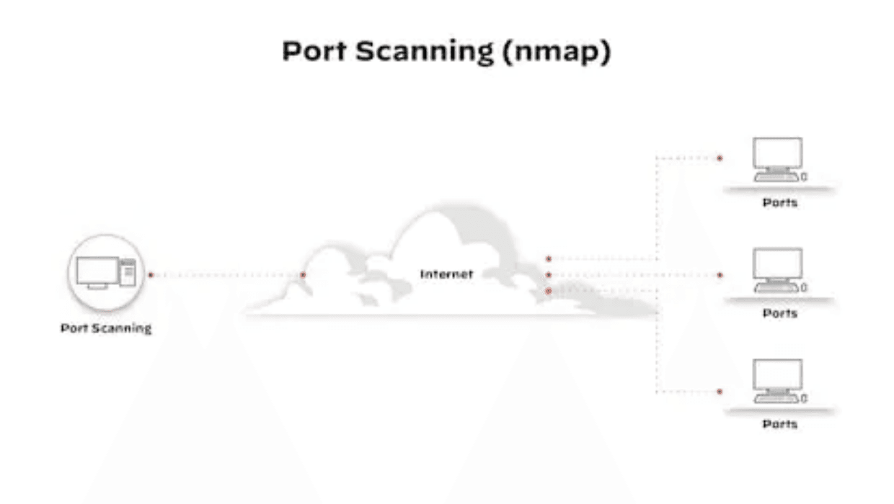
EXISTING SYSTEM: METHODS
════════════════════════════════════════
[METHOD 1] Manual Port Checking
Using command-line tools like telnet or netcat to check ports individually.
Time-consuming process
✗
Requires high technical knowledge
✗
[METHOD 2] Large Tools (Nmap)
Comprehensive, feature-rich network mapping tools.
Heavy and complex installation
✗
Steep learning curve
✗
[METHOD 3] Basic Scanners
[NMAP_ARCHITECTURE]
Simple scripts without advanced features.
Cannot customize results
✗
Limited reporting capabilities
✗

Slide 4

EXISTING SYSTEM: LIMITATIONS
════════════════════════════════════════
[IMPACT] Manual Checking
CRITICAL GAPS:
Scanning 1000 ports manually takes hours
⚠
No JSON API for integration
→
Error-prone and unreliable results
⚠
No real-time progress updates
→
Cannot integrate with automation tools
⚠
No vulnerability detection
→
Not suitable for large-scale networks
⚠
No banner grabbing capability
→
No OS fingerprinting
→
[IMPACT] Large Tools (Nmap)
Complex installation and configuration
MODERN REQUIREMENTS:
⚠
Difficult to integrate with web services
⚠
API-first architecture needed
→
Overkill for simple scanning tasks
⚠
Lightweight and portable solution
→
Limited customization for specific needs
⚠
Easy to customize and extend
→
Suitable for educational labs
→
JSON output for tool integration
[IMPACT] Basic Scanners
→
Output formats not suitable for APIs
⚠
No real-time progress tracking
⚠
Difficult to scale or extend
⚠
Lacks security assessment features
⚠
CONCLUSION:
Existing methods fail to meet modern security automation requirements. There is a critical need for a lightweight, API-driven, customizable port scanner that integrates seamlessly with contemporary security workflows and educational environments.

Slide 5
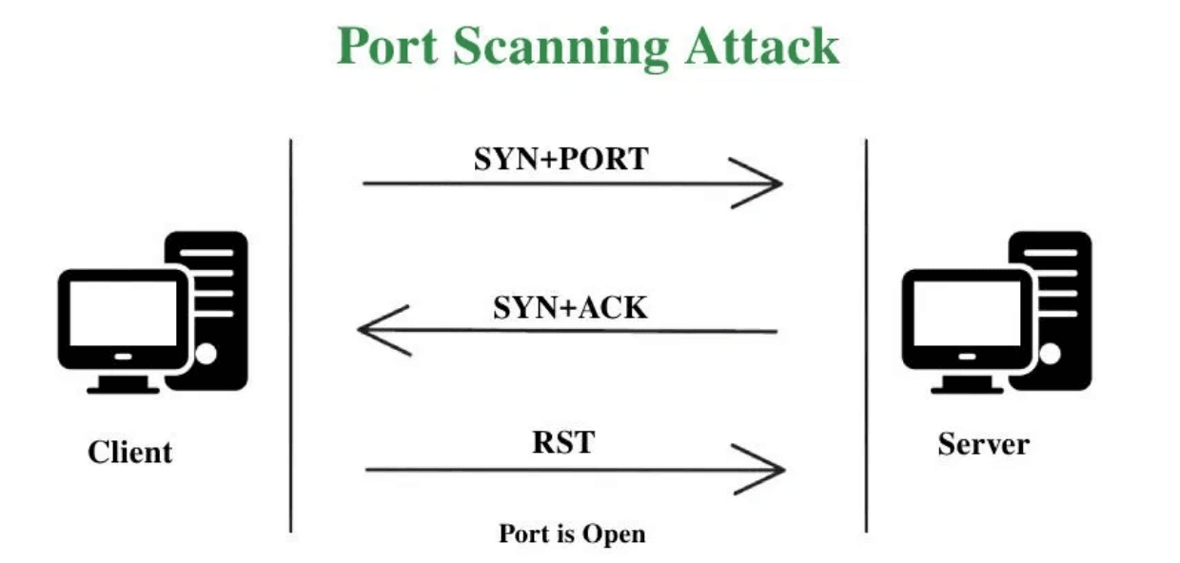
PROPOSED SOLUTION
════════════════════════════════════════
KEY FEATURES:
✓
Lightweight & Portable - Built with Python and minimal dependencies
✓
Automated Scanning - Scans defined port ranges using efficient threading
✓
Flask REST API - Provides results via web service endpoint
✓
Advanced Detection - Accurate open/closed/filtered port identification
ADVANTAGES:
✓
Easy to use and deploy on any platform
[SCANNING_MECHANISM]
✓
Highly customizable for specific use cases
✓
Faster scanning via multithreading
✓
Ideal for cybersecurity and scripting labs

Slide 6
SOFTWARE REQUIREMENTS (PART 1)
════════════════════════════════════════
PROGRAMMING LANGUAGE
CORE LIBRARIES
WEB FRAMEWORK
Version:Python 3.12
→
socket
→
Flask
→
Core scripting and application logic
Low-level TCP connection handling
RESTful API and web server
threading
→
Flask-CORS
→
Concurrent port scanning
Cross-origin request handling
json
→
Data serialization and formatting
> next_slide — Environment, tools, and installation instructions follow in Part 2

Slide 7

> system_requirements --list --continued
SOFTWARE REQUIREMENTS (PART 2)
════════════════════════════════════════
ENVIRONMENT
DEVELOPMENT TOOLS
OS:Windows / Linux
→
Editor:VS Code / PyCharm
→
Cross-platform compatibility
Integrated Development Environment for coding and debugging
Hardware:Basic computer with internet
→
Minimal resource requirements
ADDITIONAL TOOLS
RUNTIME ENVIRONMENT
Package Manager:pip
→
Python:3.12+
→
Python package installation and management
Required for running the application
Version Control:Git
→
Port:5000 (Flask server)
→
Source code management and repository access
Must be available and not blocked by firewall
INSTALLATION & SETUP STEPS
Install Python 3.12 from official website (python.org)
✓
Verify Python installation: python --version
✓
Install Flask and Flask-CORS: pip install flask flask-cors
✓
Clone project repository using Git: git clone <repo-url>
✓
Navigate to project directory: cd port_scanner
✓
Run application: python app.py
✓
Access web interface at: http://localhost:5000
✓

Slide 8

BACKEND IMPLEMENTATION: CORE CLASS
════════════════════════════════════════
[CLASS] AdvancedPortScanner
[METHODS] Core Scanning Logic
classAdvancedPortScanner:
→
scan_port(port, host)
__init__(target,
Performs TCP connection attempt on target port using socket.connect_ex()
start_port=1,
→
grab_banner(host, port)
end_port=1024,
Extracts service identification banner from open ports
threads=50)
→
get_service_name(port)
Identifies service running on port using socket.getservbyport()
CORE ATTRIBUTES:
→
detect_os_hints(ports)
Fingerprints OS based on open port signatures (SMB, SSH, RDP)
target - IP or hostname to scan
→
scan_common_vulnerabilities()
→
open_ports - List of accessible ports
Detects dangerous services (Telnet, FTP, exposed databases)
→
banner_info - Service banners per port
→
lock - Thread synchronization
→
→ Next: Flask REST API endpoints, request/response formats, and multithreading architecture

Slide 9
BACKEND IMPLEMENTATION: FLASK API
════════════════════════════════════════
[FLASK API] REST Endpoints
POST/api/scan
# Initiate port scan in background thread
Request: {"target": "192.168.1.1",
"start_port": 1, "end_port": 1024}
Response: {"status": "scan started"}
GET/api/status
# Get real-time scan progress and results
Response: {"status": "scanning|completed",
"progress": 45.2, "open_ports": [22, 80, 443],
"banner_info": {...}, "vulnerabilities": [...]}
[ARCHITECTURE] System Design
CONCURRENCY MODEL:
DATA HANDLING:
Multithreading: Concurrent port scanning
→
JSON Output: Structured result format
→
Threading Lock: Thread-safe data access
→
Real-time Updates: Progress tracking
→
Background Tasks: Non-blocking API calls
→
CORS Enabled: Cross-origin requests
→

Slide 10
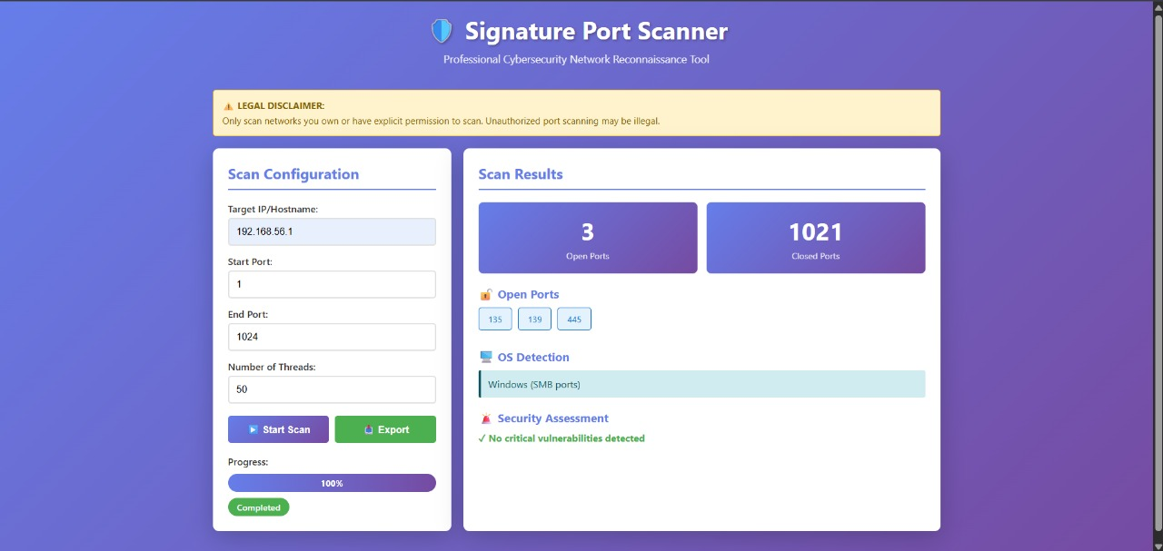
Project Output: Network Port Scanner

Slide 11

FUTURE ENHANCEMENTS
════════════════════════════════════════
PROTOCOL SUPPORT
ADVANCED FINGERPRINTING
UDP Port Scanning
→
OS Fingerprinting
→
Extend scanning capabilities to include UDP protocol for comprehensive port enumeration
Implement techniques similar to Nmap for more accurate OS detection and version identification
ICMP Ping Sweep
→
Service Version Detection
Implement host discovery before port scanning to identify active targets
→
Identify specific service versions running on open ports for vulnerability mapping
Phase:HIGH PRIORITY
Phase:HIGH PRIORITY
USER INTERFACE
SECURITY & SCALABILITY
Full Frontend Dashboard
→
User Authentication
→
Build professional web dashboard with real-time visualization of scan results and statistics
Implement JWT-based authentication for secure API usage and multi-user support
Advanced Reporting
→
Cloud Deployment
→
Generate comprehensive PDF/HTML reports with graphs, charts, and security assessments
Deploy on AWS, Azure, or Google Cloud with containerization (Docker) and orchestration (Kubernetes)
Phase:MEDIUM PRIORITY
Logging & Audit Trail
→
Comprehensive logging system for security audits and compliance tracking
Phase:MEDIUM PRIORITY

Slide 12
PROJECT CONCLUSION
════════════════════════════════════════════════════════════════
SUCCESSFUL IMPLEMENTATION
EFFICIENCY & AUTOMATION
Demonstrated Python scripting mastery through socket programming and network communication
→
Implemented multithreading for concurrent port scanning
→
Achieved faster scan times compared to traditional methods
→
Built a fully functional port scanner from scratch with advanced features
→
Enabled automated security assessment without manual intervention
→
Integrated Flask REST API for modern web service architecture
→
MODERN ARCHITECTURE
EDUCATIONAL VALUE
Designed API-first approach for seamless integration with other tools
→
Provided hands-on experience with cybersecurity concepts and tools
→
Provided JSON output format for data portability and automation
→
Demonstrated real-world application of Python scripting in security
→
Created scalable and customizable solution for diverse use cases
→
Created ideal learning resource for security labs and courses
→
PROJECT IMPACT:
This Network Port Scanner represents a complete, efficient, and scalable solution for network security assessment. It successfully combines technical excellence with educational value, making it an invaluable tool for cybersecurity professionals and students alike.

Slide 13

┌─────────────────────────────────────┐
THANK YOU!
└─────────────────────────────────────┘
QUESTIONS & DISCUSSION
════════════════════════════════════
We welcome your questions, feedback, and suggestions regarding the Network Port Scanner project.
→ Specific discussion prompts and Q&A topics on next slide →

Slide 14
QUESTIONS & DISCUSSION
ENGAGEMENT PROMPTS
════════════════════════════════════════
We welcome your questions, feedback, and suggestions regarding the Network Port Scanner project.
[Q1] How would you extend this scanner for your use case?
[Q2] What additional security features would be valuable?
[Q3] How could this integrate with your existing tools?
[Q4] What challenges did you encounter in similar projects?
════════════════════════════════════════
Let's discuss the implementation, design decisions, and future possibilities!
Thank you for your attention and engagement!

