Slide 1
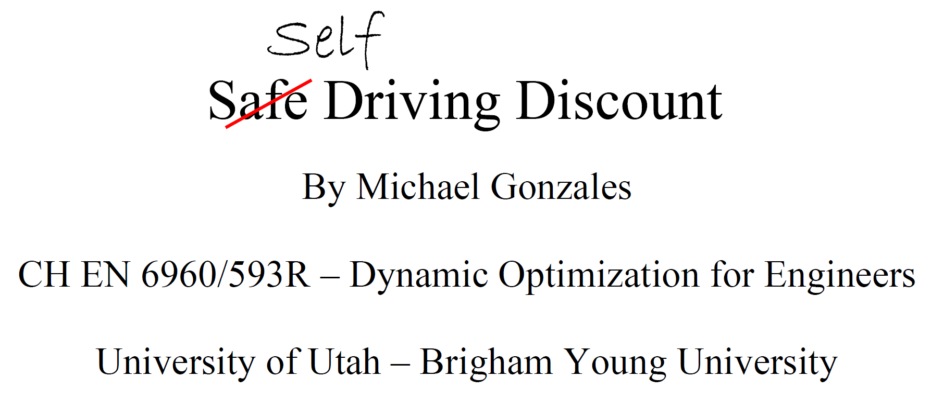

Slide 2
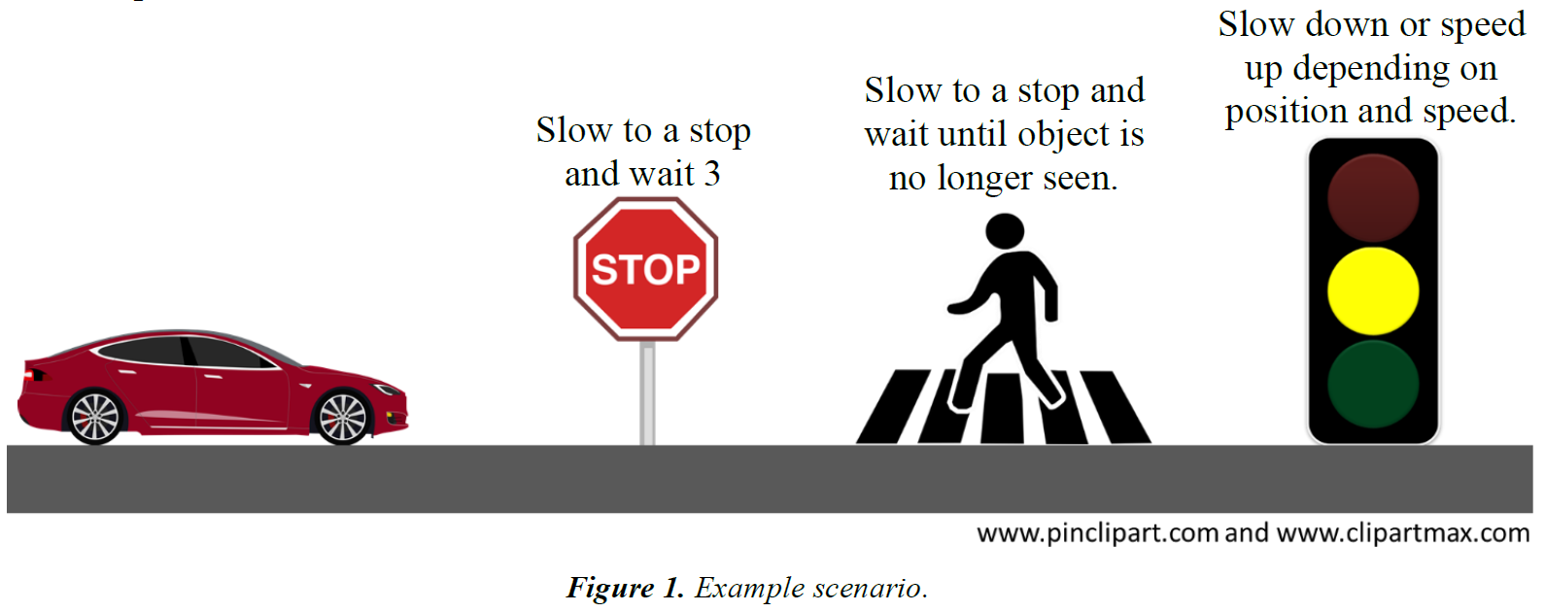
Introduction

Slide 3
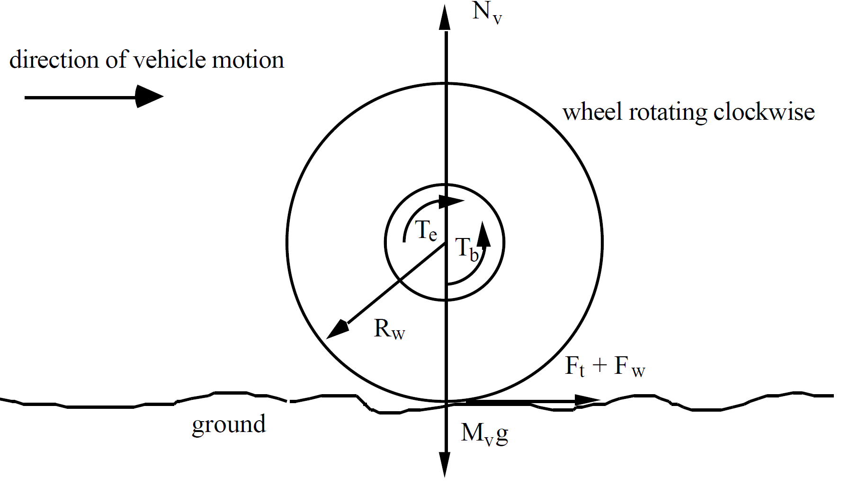
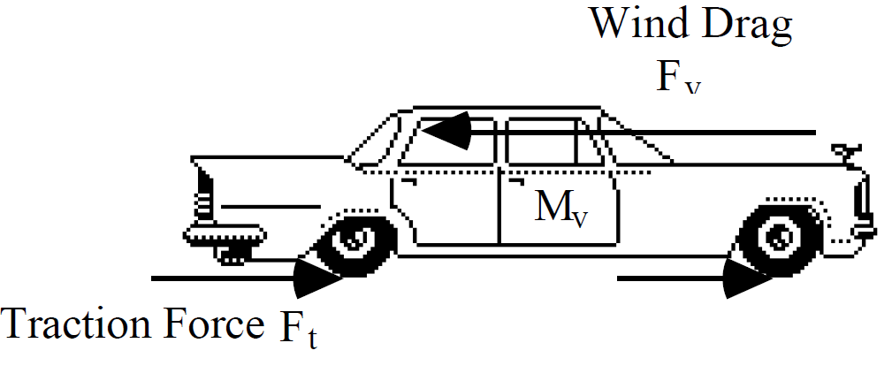
Dynamic Model
Combined Wheel and Vehicle Dynamic Model [1]
Control Variable:
Velocity
Manipulated Variables:
Gas pedal
Brake pedal
[1] Kachroo, P., & Tomizuka, M. (1994). Vehicle Traction Control And its Applications. UC Berkeley: California Partners for Advanced Transportation Technology. Retrieved from https://escholarship.org/uc/item/6293p1rh.

Slide 4


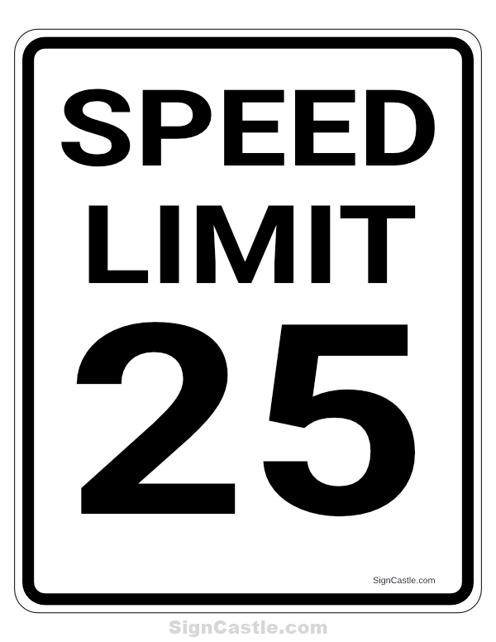
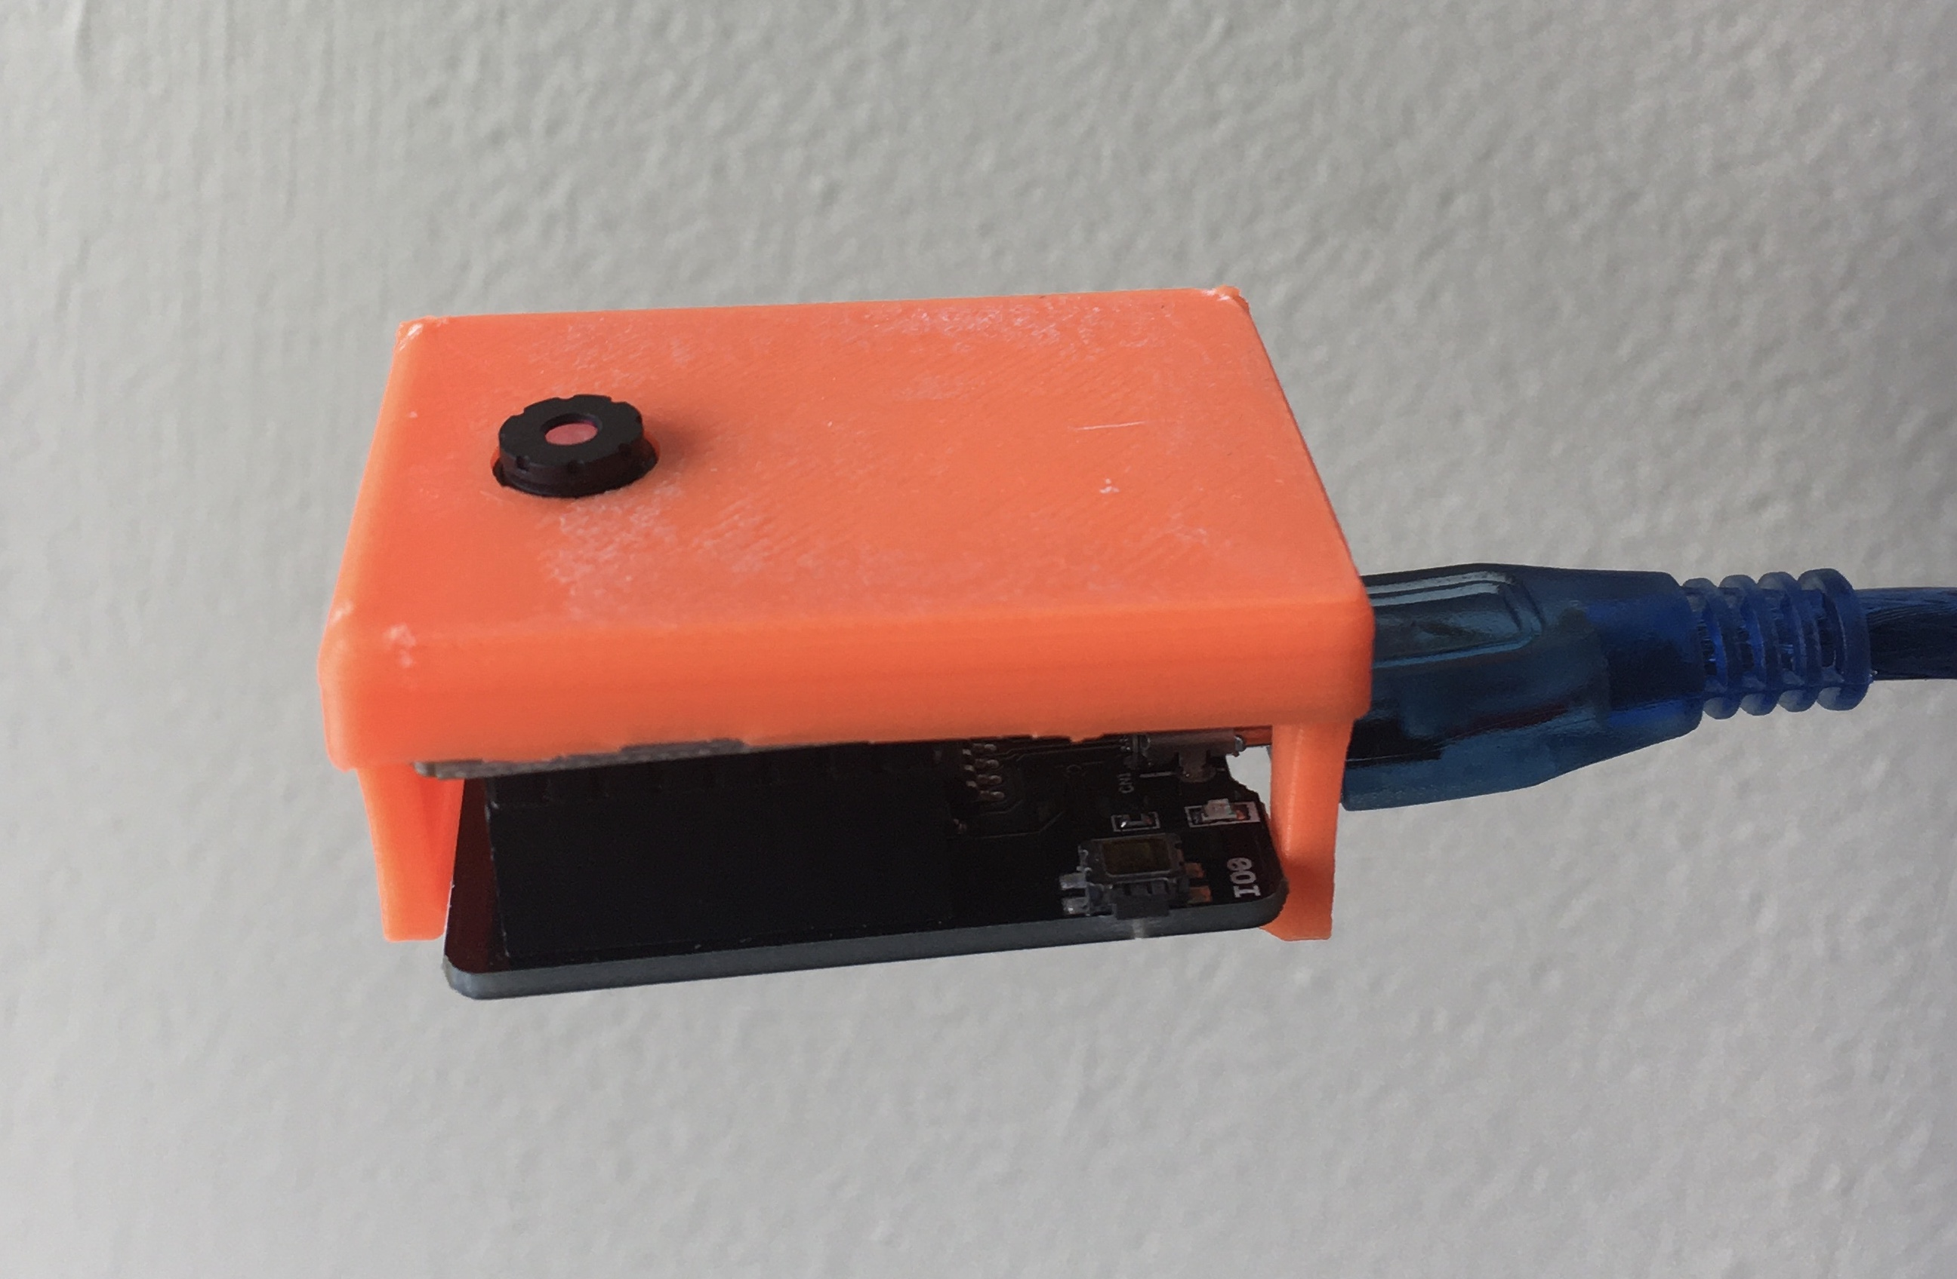
Image Classification

Slide 5
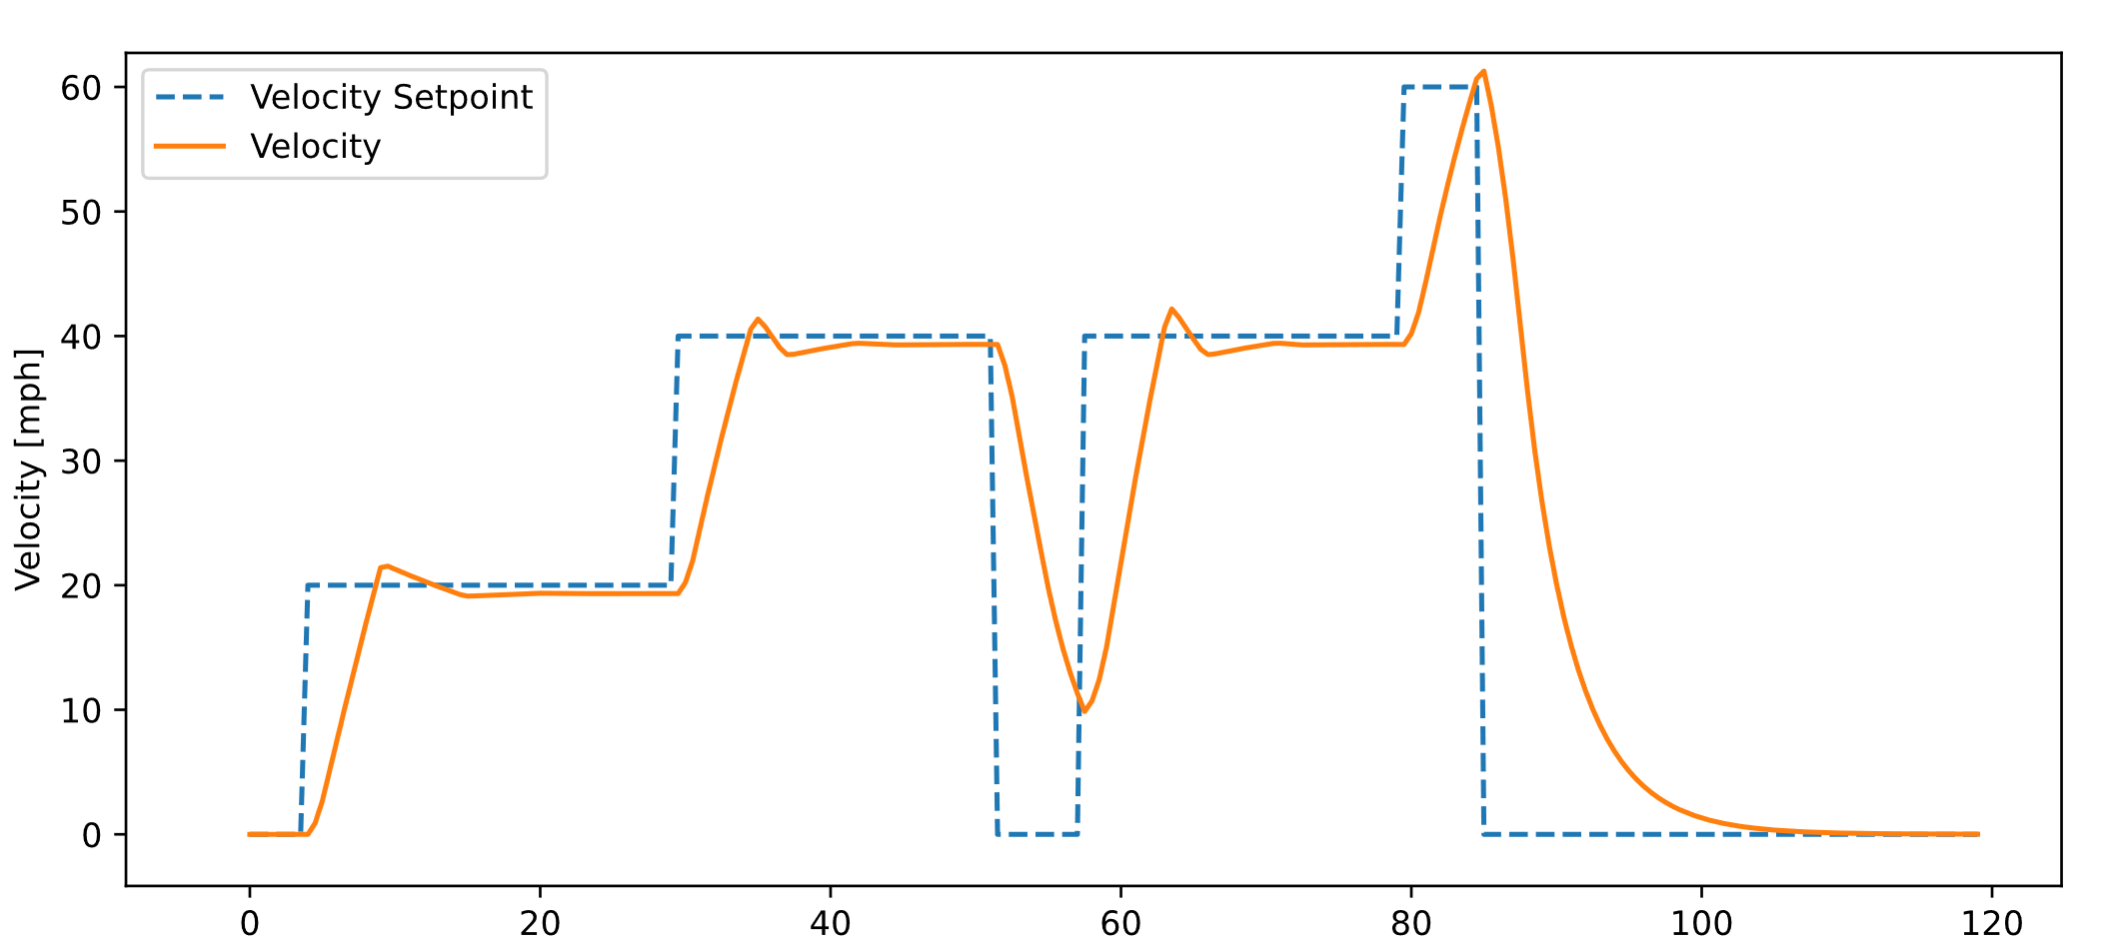
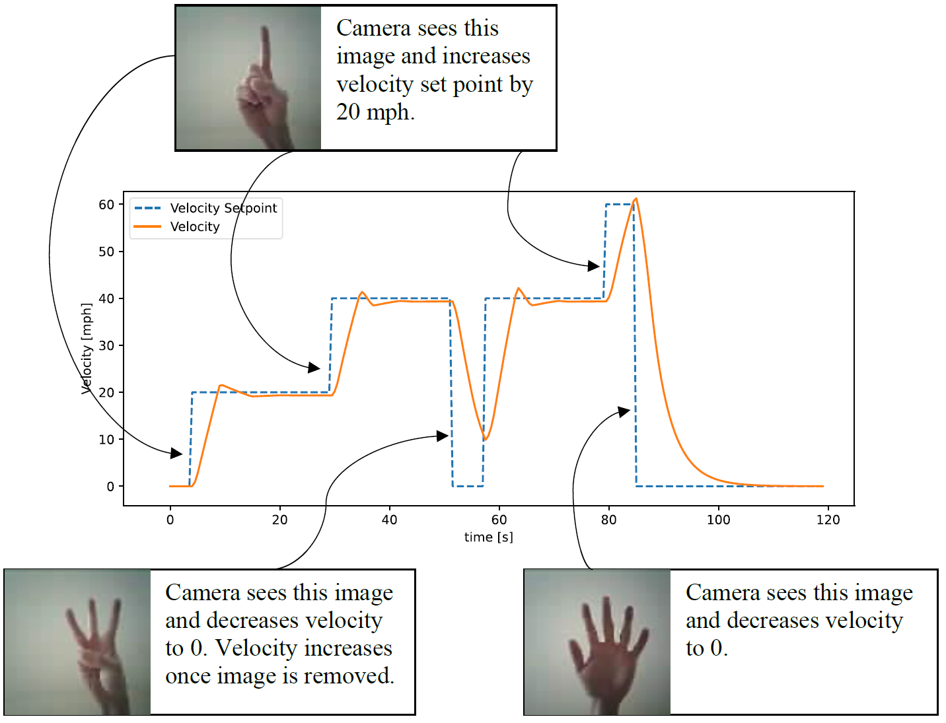
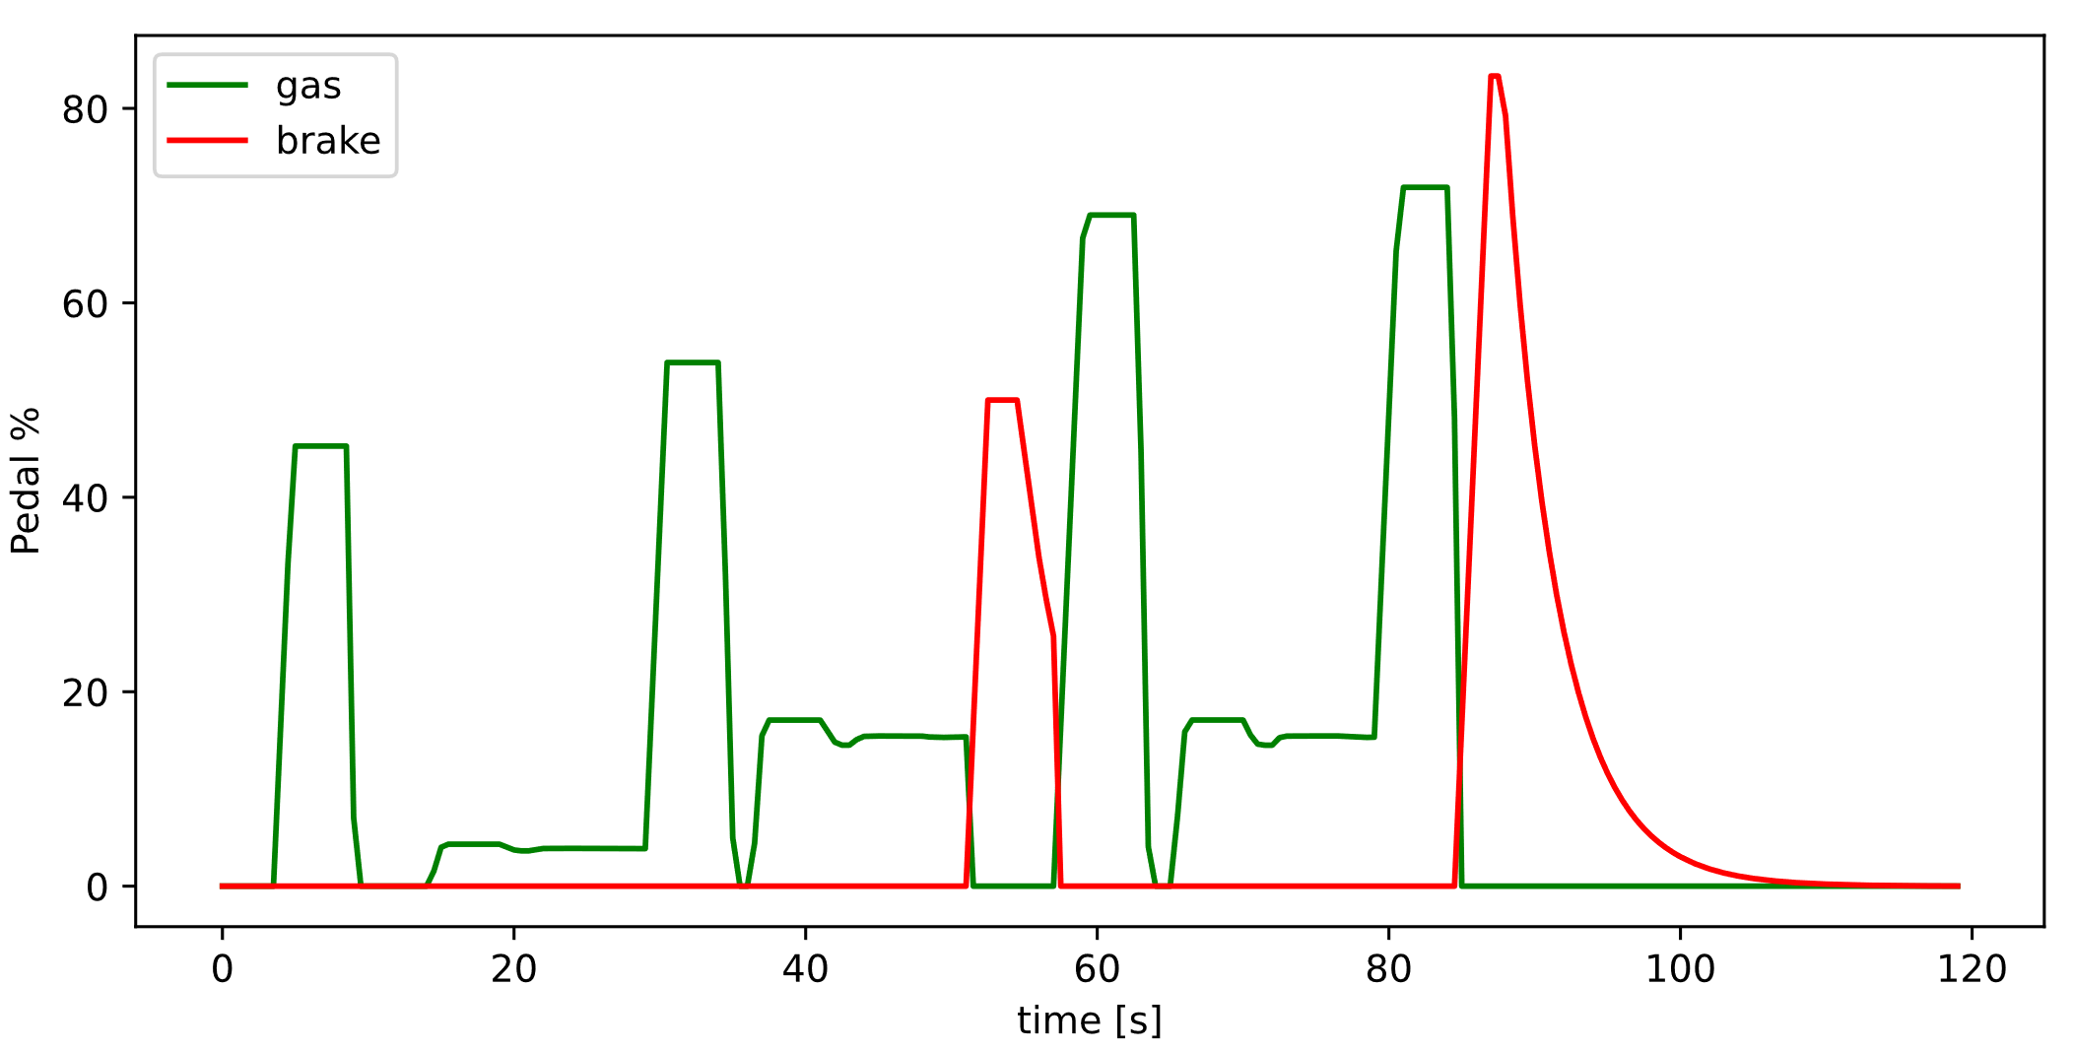
Results

Slide 6
Demo

