Slide 1
Classifying Relevance Of Products To A Search Query
Mohammad Habiballah
Supervised by DR. Roman Kaplan
April 2021

Slide 2
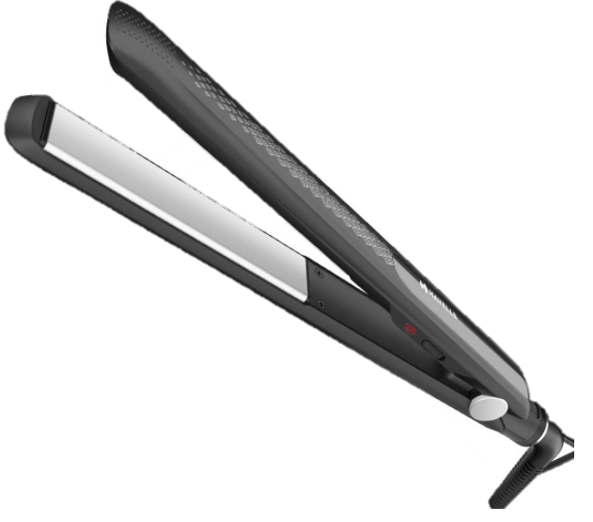

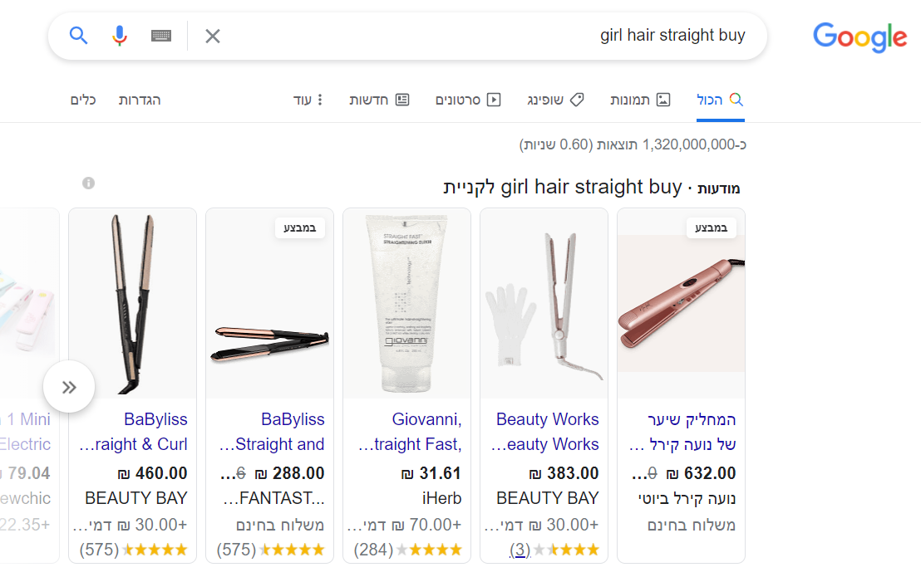

Motivation
Online shopping.
Customers expect to get to the appropriate products to their queries with a click of a mouse.
Customers are not always accurate.
“Girl hair straight buy”
Non-native Speaker

Slide 3
Project Goals
Build a Machine Learning system which:
Helps online shopping websites
Suggest the most appropriate products, based on customer search queries.
Speed up getting to the product.
Suggests similar products.
Use 3 main NLP approaches and analyze results:
TF*IDF.
Bag Of Words.
Word2Vec.
Personal:
Experience in NLP and Data Science.
My first opportunity to experience Machine Learning.

Slide 4
Outline
Dataset
Solution
Implementation
Results Analysis
Conclusions
Future Work

Slide 5
Dataset

Slide 6
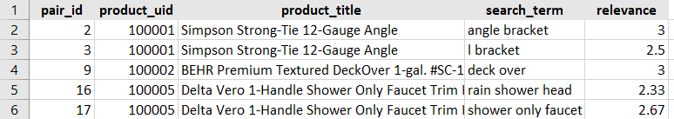
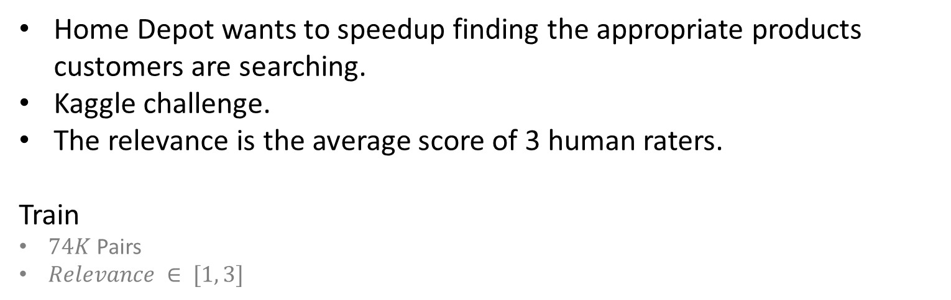
Dataset
Home Depot wants to speedup finding the appropriate products customers are searching.
Kaggle challenge.
The relevance is the average score of 3 human raters.
Train
$74K$ Pairs
$Relevance ∈ [1, 3]$

Slide 7
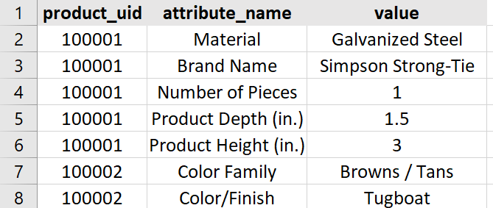
Dataset
Product Attributes
Extended information about products.
Not every product will have attributes.

Slide 8
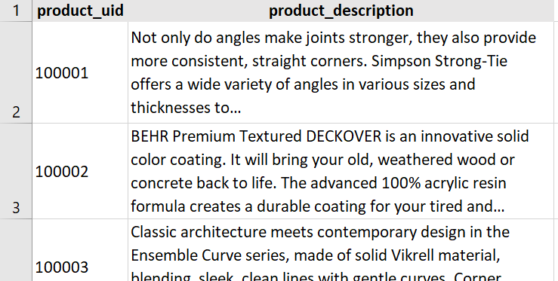
Dataset
Product Description

Slide 9
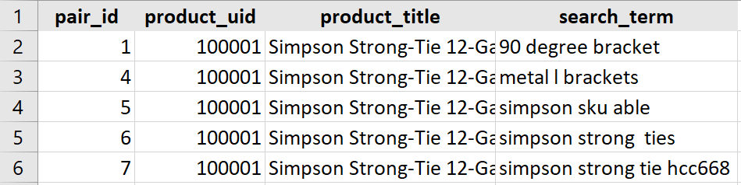
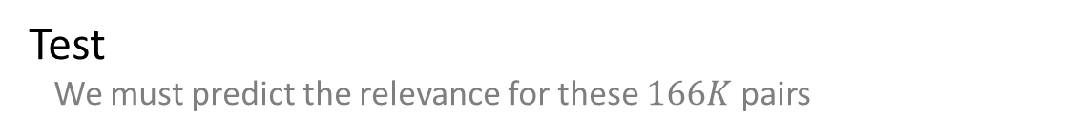
Dataset
Test We must predict the relevance for these $166K$ pairs

Slide 10
Solution Flow

Slide 11
Flow
Preprocessing
Align attributes
Data Cleaning
Spell Correction
Lemmatization
Stemming
Feature Extraction
TF-IDF
Bag Of Words
Word2Vec
Model Training
Random Forest
Linear Regression
Gradient Boosting
Data
Prediction

Slide 12
Solution Stages

Slide 13
Preprocessing

Slide 14
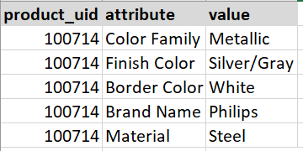

Attributes Alignment
Merge similar attributes
Attach attributes to products
Pivot
From Dataset

Slide 15
Data Cleaning
To lower case.
Whitespaces.
HTML code.
Stop words (the, on, is, etc.).
Numbers to words (5 → Five).
Uniforms units (using regular expressions):
[0-9]* v → [0-9] volts.
[0-9]* foot → [0-9] ft.

Slide 16
Spell Correction
Used Python’s TextBlob library:
toliet → toilet.
steeo → steel.
Manually corrected what TextBlob couldn’t:
airconditioner → air conditioner.
bbq → barbeque.
From Dataset

Slide 17
Stemming and Lemmatization
Stemming removes the last few characters of a given word.
Studying → Study.
Studies → Studi.
Lemmatization converts a word into its base form.
Studies → Study.
Lemmatization is computationally expensive.
We chose Stemming!

Slide 18
Features Extraction

Slide 19
Features Extraction
Statistical algorithms work with numeric data.
Three NLP approaches:
TF*IDF
Bag Of Words
Word2Vec

Slide 20
Naïve Approach
Common words count between search-term & description\title\color…
Common words ratio.
Search-term exact match (existence) in description or product title.

Slide 21
Bag Of Words
Build a vocabulary and weight words based on frequency.
Catches highly indicative words.
Represent sentences as histograms.
Disaster Indicative Words
Hiroshima was attacked by an atomic bomb
Hiroshima
Hiroshima | Massacre | Bomb | Fire
1 | 0 | 1 | 0
Massacre
Bomb
Fire

Slide 22
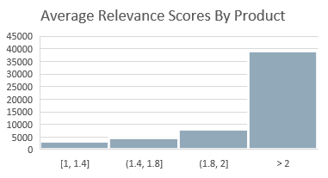

Bag Of Words
Cross-Product vocabulary in our problem is meaningless. (not like “Disaster Tweets” problem)
Each product has its own highly indicative words.
Our approach: For each product, we built a vocabulary from train search-terms with relevance higher than 2.
Score based on search-term similarity to the specific product’s vocabulary.

Slide 23
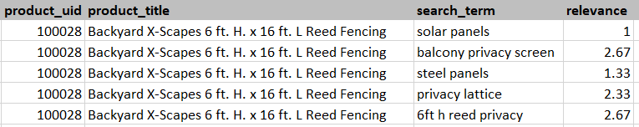
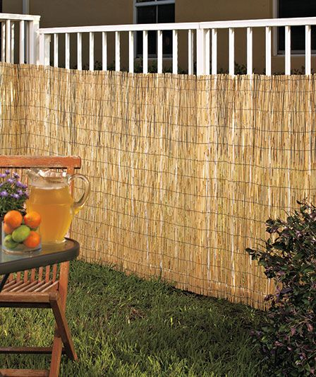



Bag Of Words
Highly indicative!
Bag Of Words
Privacy
Lattice
Reed
Screen
From Dataset

Slide 24
Bag Of Words → TF*IDF
→ TF*IDF
Treating all words equally.
Some words are very frequent in the dataset but meaningless.
“Weight”
“lbs”
TF*IDF
Helps our model focus more on meaningful words.
↓ Weighs down the effect of too frequent word (in the Dataset).
Rare words may be very meaningful for a specific product.
↑ Weighs up the effect of less frequent words (in the Dataset).

Slide 25

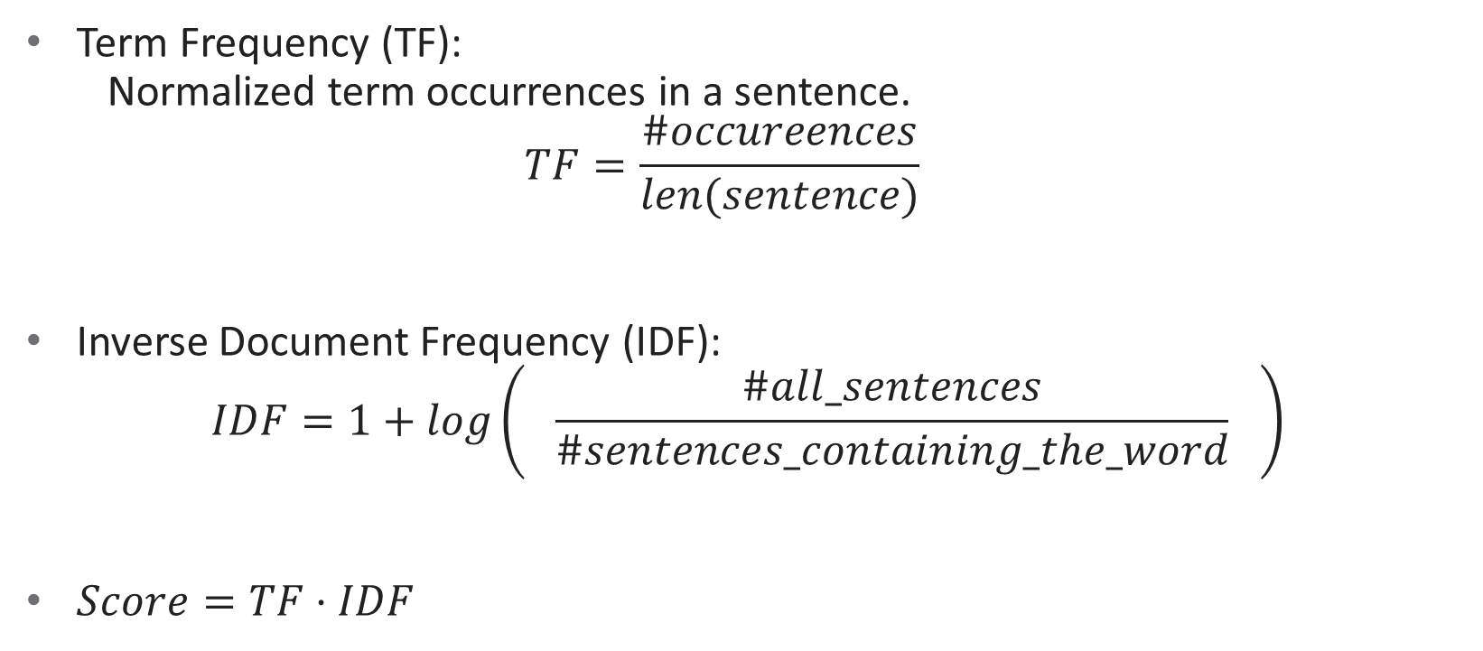

TF*IDF
Term Frequency (TF): Normalized term occurrences in a sentence. $TF=\frac{\#occureences}{len(sentence)}$
Inverse Document Frequency (IDF): $IDF=1+log\left( \frac{\#all_sentences}{\#sentences_containing_the_word} \right)$
$Score=TF⋅IDF$
$$0$$
$$\#all\text{_}Sentence$$

Slide 26
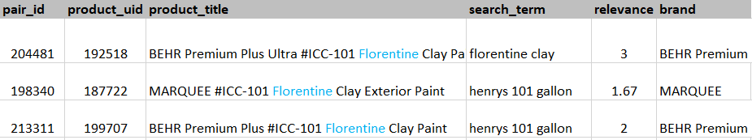
TF*IDF
“Florentine” appeared only in 3 products out of 224k products $⇒$ High IDF Score ↑
From Dataset
Notes:
TF-IDF sklearn

Slide 27
TF*IDF
Calculated the TF*IDF Cosine similarity of search-term and product info.
Calculated for:
Search-Term – Product Title.
Search-Term – Product Description.
Notes:
TF-IDF sklearn

Slide 28



TF*IDF & Bag Of Words
In production, the model will encounter words that didn’t appear in the training set.
Can’t handle new words even if it has seen very similar words in training.
Cannot capture semantic relationship between words in sentences (discrete).
$$Fridge≈Refrigerator$$
Bag Of Words TF*IDF
Word2Vec
Notes:
TF-IDF sklearn

Slide 29
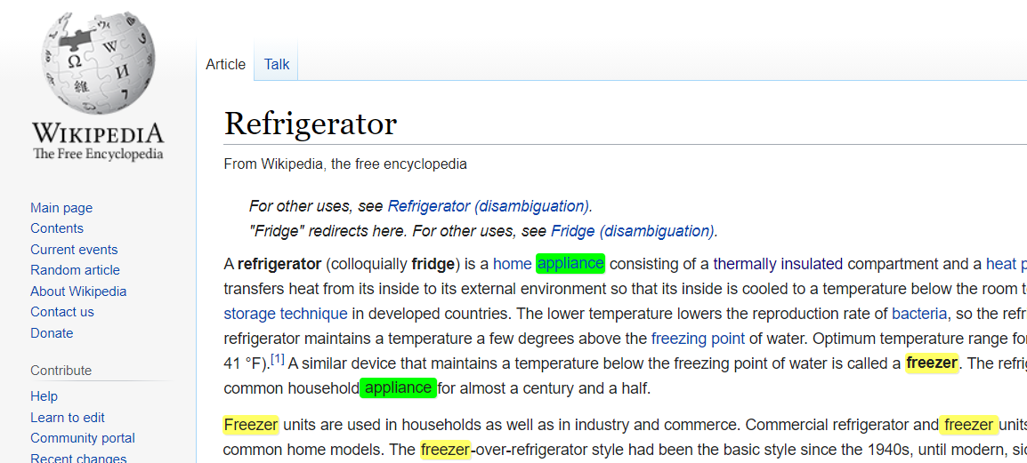
Word2Vec
Words that appear in the same contexts tend to have similar meanings.
We can learn words meaning by looking on the context they appear at.
Notes:
TF-IDF sklearn

Slide 30
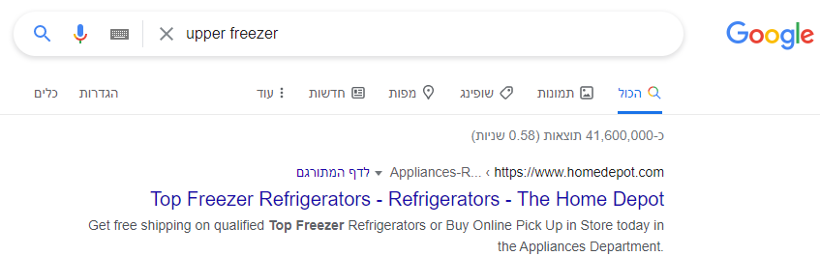



Word2Vec
Notes:
TF-IDF sklearn

Slide 31
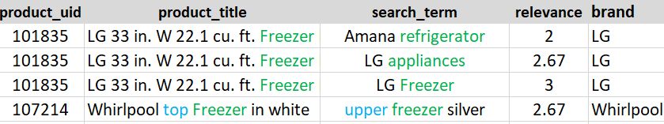

Word2Vec
Generates a 300-dimension vector for each word in a vocabulary.
Vectors of words of similar meaning are closer to each other.
$$\overline{Fridge}≈ \overline{Refrigerator}$$
$$\overline{King} –\overline{Man} + \overline{Woman}≈\overline{Queen}$$
Bag Of Words TF*IDF
Word2Vec
From Dataset
Notes:
TF-IDF sklearn

Slide 32

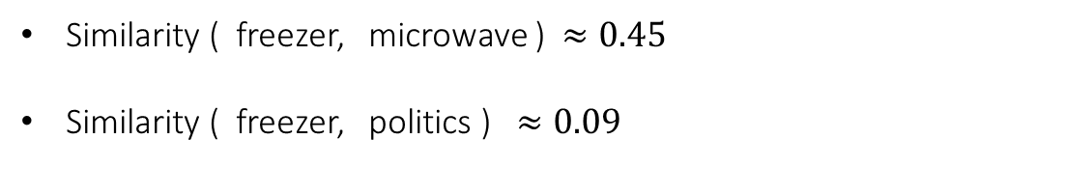

Word2Vec
Google News 300
freezer
$$\text{−1.52}$$ | 2.51 | . . . | 2.25 | 3.19
Cos
$$≈0.74$$
refrigerator
-3.2 | 1.4 | . . . | 4.61 | 1.22
Similarity ( freezer, microwave ) $≈0.45$
Similarity ( freezer, politics ) $≈0.09$
Real Numbers
Notes:
TF-IDF sklearn

Slide 33

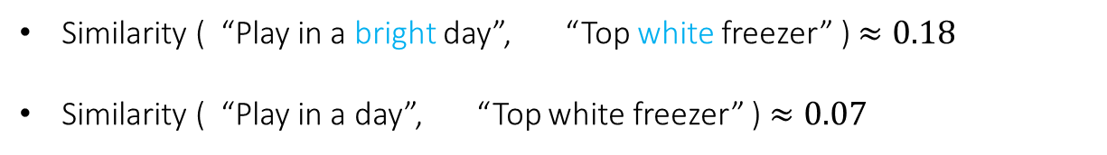
Word2Vec
Sentence embedding: Average Word2Vec scores of all words in the sentence.
Bright upper freezer
Top refrigerator white
Word | Vector
bright | [1.3, 0.42 …. -2.6]
upper | [0.7, 0.51 …. 3.2]
freezer | [2.2, 4.13 …. -1.5]
Word | Vector
Top | [2.4, 1.03 …. -1.7]
refrigerator | [0.4, 2.71 …. 2.1]
white | [1.5, 1.73 …. 4.3]
Cos
$$≈0.61$$
Similarity ( “Play in a bright day”, “Top white freezer” ) $≈0.18$
Similarity ( “Play in a day”, “Top white freezer” ) $≈0.07$
Real Numbers
Notes:
TF-IDF sklearn

Slide 34
Word2Vec
Google-News-300 Model doesn’t recognize all words:
New terms since training.
Unknown brand names.
Very specific products (e.g., Cristallo – סוג זכוכית)
Used without Stemming.
Funny finding:
It doesn’t recognize “Grey” but recognizes “Gray” (Was it trained only on American articles?😉)
Notes:
TF-IDF sklearn

Slide 35
Word2Vec
For unrecognized words:
Score += 1 If the word appears as an exact match in product details.
Ignore it otherwise.
Similarity ( “White cristallo” , “Bright cristallo”)
= 1 + Similarity ( “White” , “Bright”)
= 1 + 0.35 = 1.35
Real Numbers
Notes:
TF-IDF sklearn

Slide 36
Word2Vec
Calculated Word2Vec Score for:
Search-term & Product title.
Search-term & Product Description.
Search-term & Product Material.
Search-term & Product Color.
Notes:
TF-IDF sklearn

Slide 37
Training

Slide 38


Training
Data
80% (60K)
Train
Train
Model
Test
20% (15K)
Accuracy
Notes:
TF-IDF sklearn

Slide 39
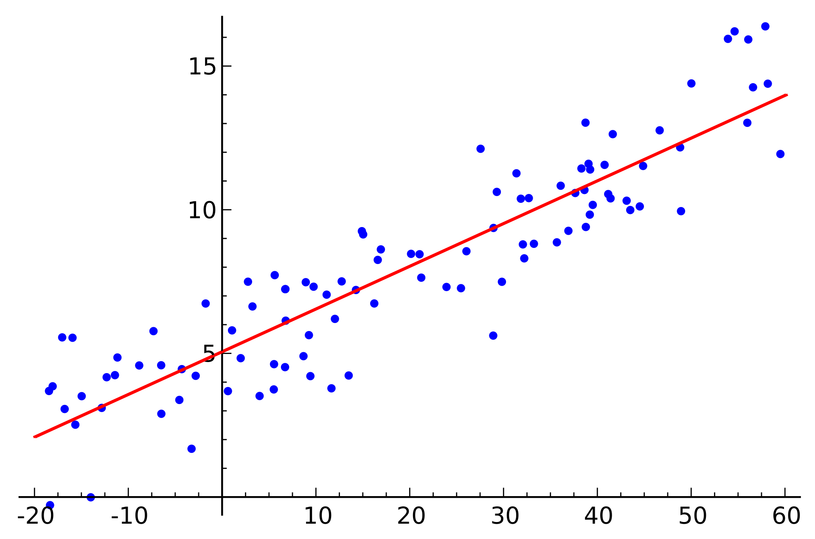
Linear Regression
Estimates the relationship between y and x using a straight line.
Notes:
TF-IDF sklearn

Slide 40
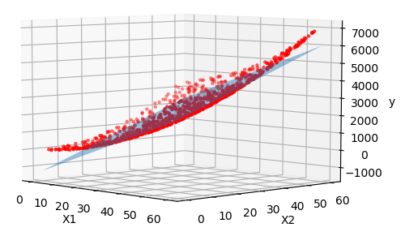
Multiple Linear Regression
Estimates the relationship between y and two or more independent variables using a straight line.
Notes:
TF-IDF sklearn

Slide 41
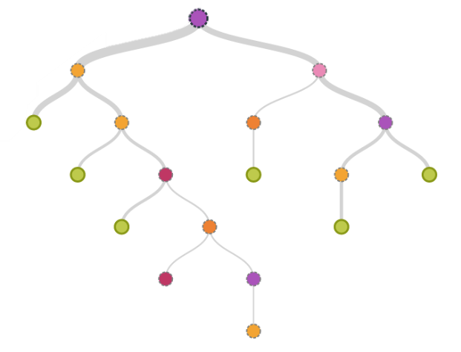
Decision Trees
What feature allows splitting to groups as different as possible?
What feature allows splitting to groups where members are as similar as possible?
Notes:
TF-IDF sklearn

Slide 42
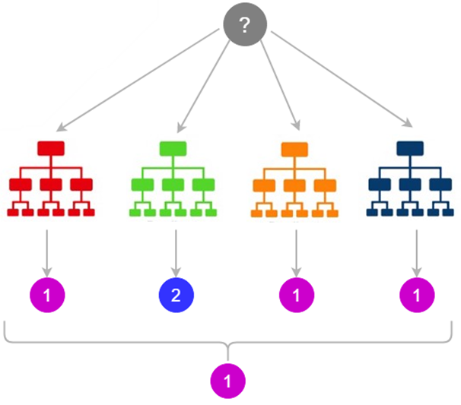
Random Forest
The wisdom of crowds!
Consists of many individual decision trees.
The trees protect each other from their individual errors.
Notes:
Bagging
Random features
The low correlation between models is the key

Slide 43
Design and Implementation

Slide 44
Orchestrator
Data Manager
Preprocessor
Feature Manager
Train Manager
Spell Checker
Cleaner
Stemmer
BOF
W2V
TF-IDF
Spell Checker
LR
Spell Checker
Stemmer
BOF
W2V
Spell Checker
Cleaner
Stemmer
BOF
W2V
TF-IDF
RF
Cleaner
Stemmer
Pandas
Cleaner
LR
Pandas
Pandas
Pandas
CSV
CSV
NLTK
SKLEARN
Google
300
GENSIM
SKLEARN
CSV
CSV
SKIPY

Slide 45
Results

Slide 46


Results
$$Relevance Score ∈ \left[1, 3\right]$$
Naïve | Bag Of Words | TF*IDF | Word2Vec | Random Forest | Gradient Boosting | Linear Regression
V |  |  |  | 0.459 (77.5%) | 0.399 (78.8%) | 0.402 (78.2%)
V | V |  |  | 0.308 (85.2%) | 0.280 (86.7%) | 0.289 (86.1%)
 |  | V |  | 0.425 (78.0%) | 0.400 (78.7%) | 0.399 (78.2%)
 |  |  | V | 0.429 (78.2%) | 0.408 (78.1%) | 0.416 (76.8%)
V | V | V |  | 0.290 (86.0%) | 0.277 (86.7%) | 0.285 (86.3%)
V | V |  | V | 0.283 (86.5%) | 0.279 (86.7%) | 0.288 (86.2%)
V |  | V | V | 0.401 (79.0%) | 0.400 (78.6%) | 0.400 (78.2%)
V | V | V | V | 0.280 (86.6%) | 0.277 (86.8%) | 0.285 (86.4%)
ABS-Error (Accuracy)
$$⇒ABS Error∈[0,2]$$
Best single approach
Winner!
Notes:
הרכבת מודל חדש על מודל קיים
מתפקס בשיפור חולשות חיזוי המודל הקודם
Initial model to the data. Then a second model is built that focuses on accurately predicting the cases where the first model performs poorly.
Each new model takes a step in the direction that minimizes prediction error,
target outcomes for each case are set based on the gradient of the error

Slide 47
Conclusions

Slide 48
Conclusions
Bag of words seems to give the best results as a single approach.
The combination of the three models gives the best results.
Word2Vec in production may give better results, depending on the needs.
Suggests similar products.
Google-News-300 is not the best choice for HomeDepot products.
Notes:
באג דורש שאילתות עם תאימות גבוהה לכל מוצר בשביל שיעבור טוב
זה לא המקרה כאשר הדאטא בייס גדל ומתווספים מוצרים חדשים שאין להם שאליתות מתוייגות
כשנרצה לתת ציון רלוונטיות למוצרים שרואים בפעם הראשונה ואין עבורם שאליתות טובות לדוגמא, אז לא נדע לתת ציון

Slide 49
Future Work

Slide 50
Future Work
Use Neural Network.
Use more Machine Learning models and compare performance.
Expand the dataset.
Notes:
TF-IDF sklearn

Slide 51
Questions?

Slide 52


