Slide 1
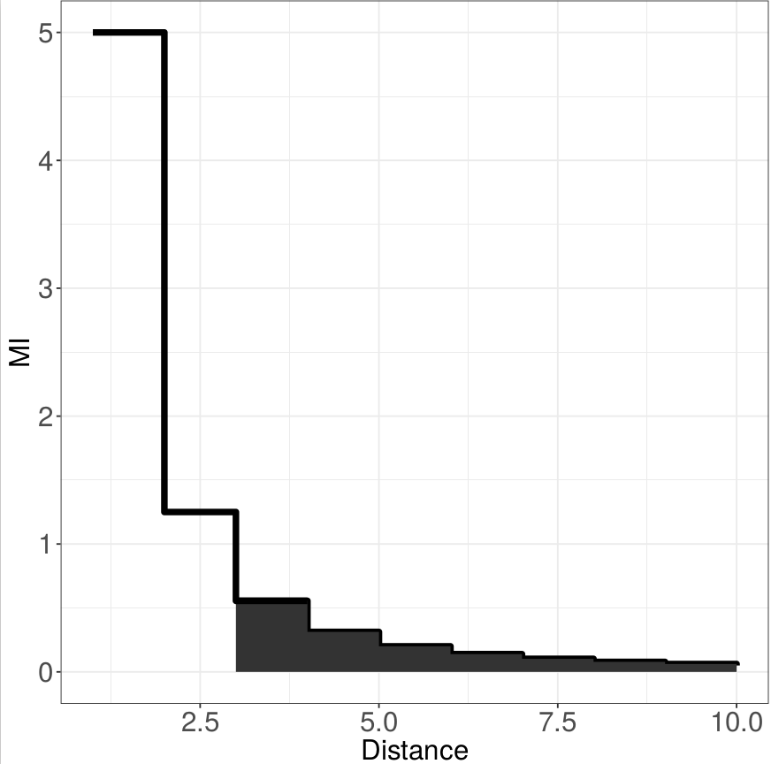
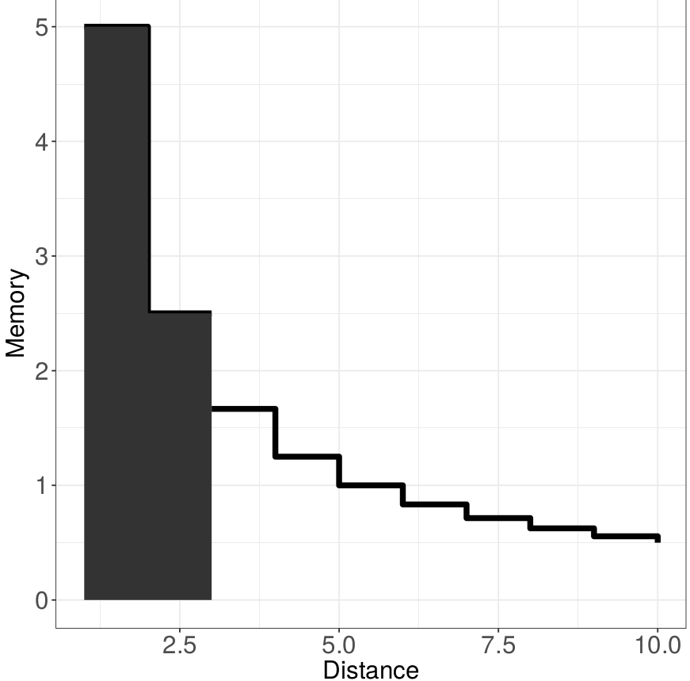
Excess surprisal incurred:
I_{t}
T
A
t
Bits of memory:
t I_{t}
T
B
t

