Slide 1
CLASS LIBRARY
BY Muhammad Hamza Ahmed (8618)

Slide 2
CLASS LIBRARY:
A class library defines types and methods that are called by an application

Slide 3
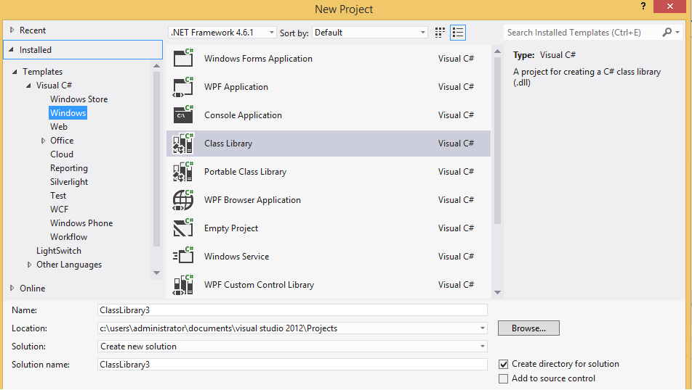
Creating a class library:
On the Visual Studio menu bar, choose File > New > Project.
In the New Project dialog, select the class library and click the OK button.

Slide 4
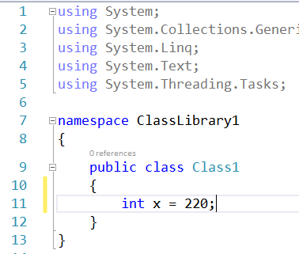
Creating a class library:
Now make a method which you want to access as a library.
Build the solution by right-clicking on one and choosing from the menu “Build”:
Now make a method which you want to access as a library.

Slide 5
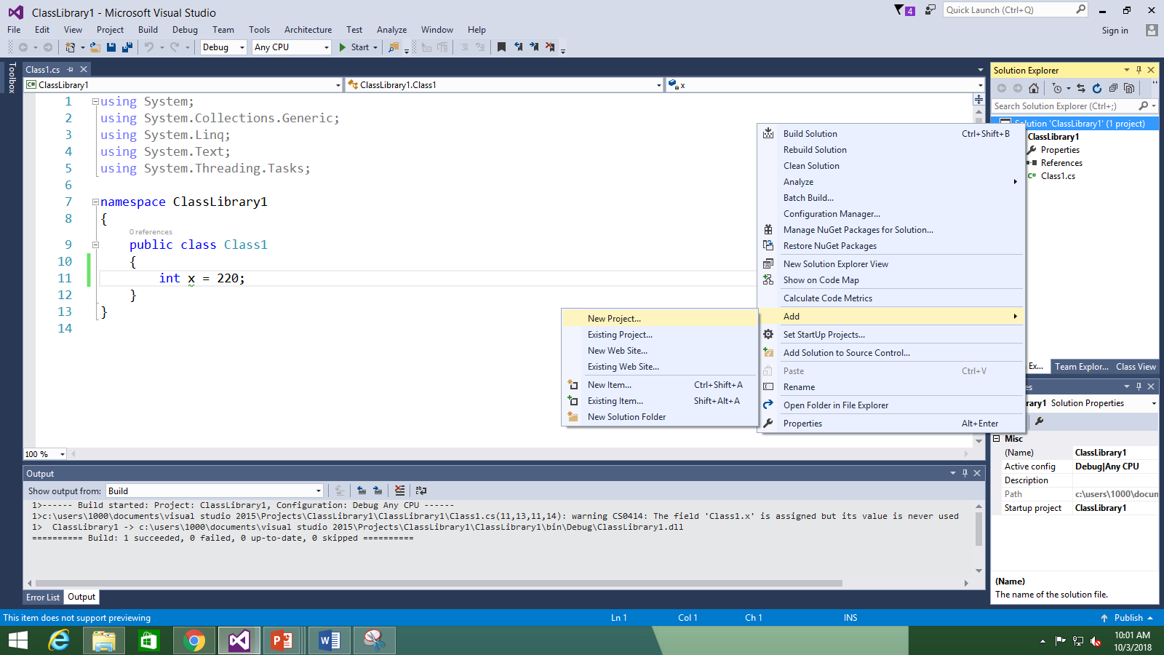
Creating a class library:
Now add a new project.

Slide 6
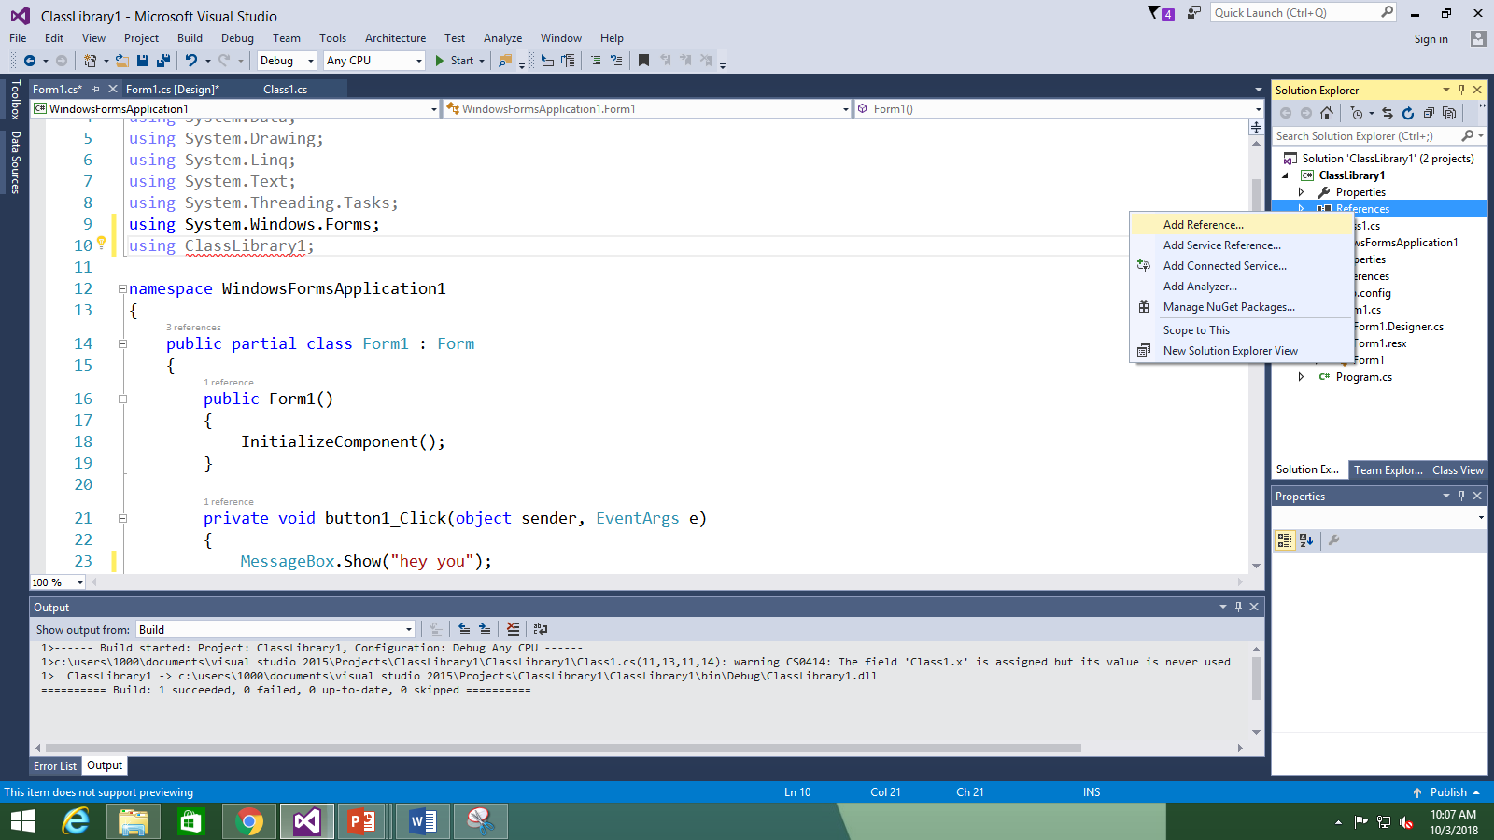
Creating a class library:
Now whatever project you choose, on the right side click on the “references” and add a reference of library you created.
And include that library by “using” keyword.

Slide 7
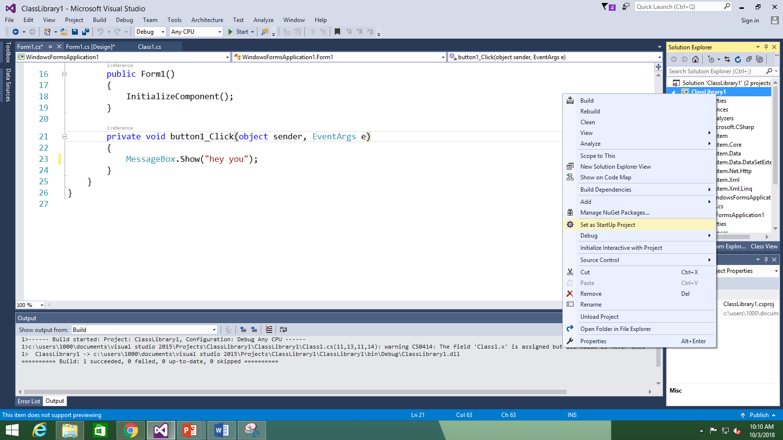
Creating a class library:
Before compiling and running set the project as a Startup project by right click.

Slide 8
When class library is/will-be helpful:
Class Libraries are created so that the DLLs (assemblies) that reside in it may be used across multiple number of projects & applications. This of course, is a big advantage.
Class libraries also serve the purpose of creating our own namespaces, instantiating objects created by us at our will.
They don’t serve as stand-alone applications though.

