Slide 1
Algorithmic Trading Using Deep Reinforcement Learning
Faculty Supervisor: Dr. Theodore Trafalis
Harikiran Madishetti
August 2, 2021

Slide 2
Project Definition
Algorithmic trading accounts for 70-80% of the total trading volume.
Market crashes are difficult to predict using traditional methods.
The main goal of this project is to create an autonomous trading system that will assist investors and individual traders in maximizing portfolio profits.
I have worked with Dr. Trafalis to develop the Reinforcement Learning based trading agent.

Slide 3
Data Ingestion
As part of this project, we collected data from Yahoo Finance
Used python library yfinance to download the data from Yahoo Finance
Challenges:
Yahoo Finance disabled API to download historical market data.
Manually downloaded 30 stocks and DJIA Index data from Yahoo.
Written python script to read all the data files and consolidated it to a CSV file.

Slide 4
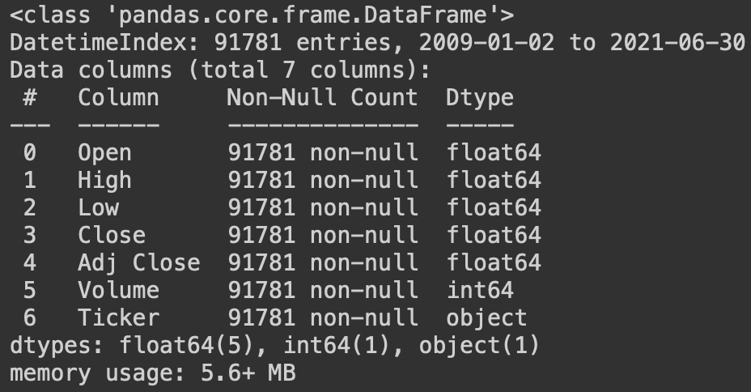
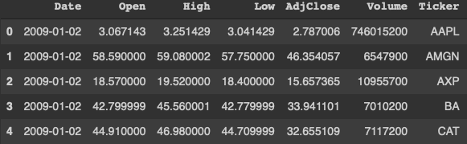
Data Exploration and Preparation
The downloaded data contains stock opening price, closing price, high price, low price and volume of shares traded.

Slide 5
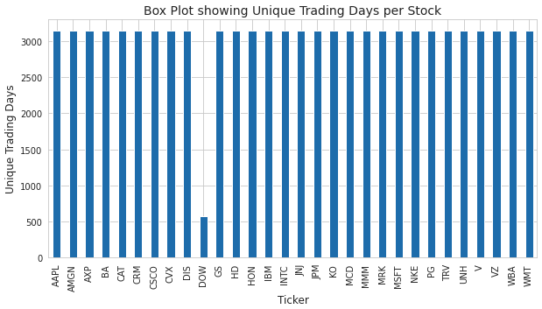
Data Exploration and Preparation
To handle the missing trading data of DOW, we used the Next observation carry backward method.

Slide 6
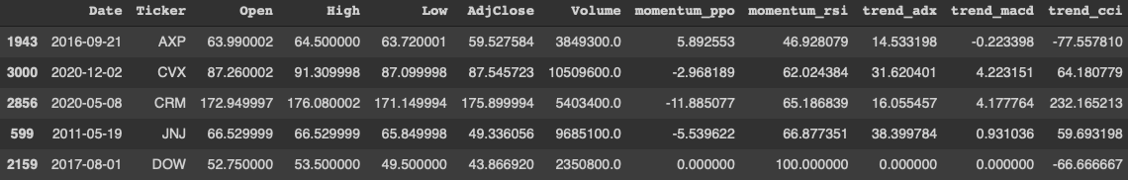
Feature Engineering
Technical Indicators are used to analyze the stock
MACD measures the market price movement
RSI assess overbought and underbought stocks
CCI calculates difference between current and historical prices.
ADX assess short-term and long-term trades.
PPO compares assets performance and its volatility

Slide 7
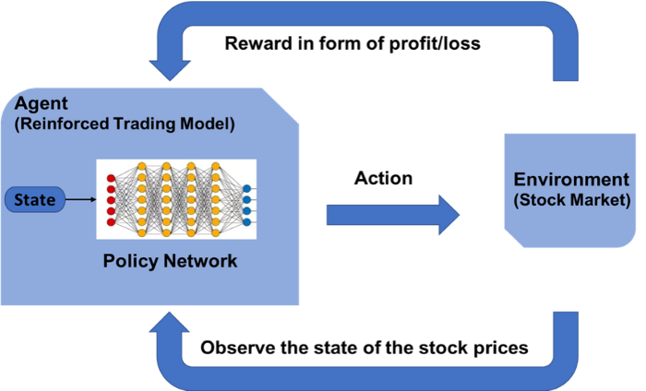
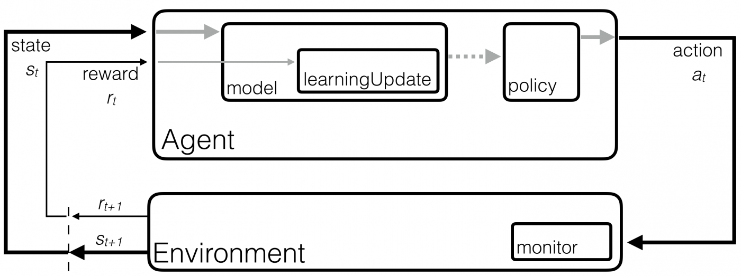
Methodology
Reinforcement Learning uses Markov Decision Process.
It consists of:
Agent
Action
State
Environment
Reward

Slide 8
Model Design and Validation
Model Selection
Process Validation
To build an autonomous trading agent, we used the below reinforcement algorithms
A2C
PPO
These two algorithms uses Actor-Critic network to update its policy and value function.
RL agent was used to automatically select the the trading strategy and execute orders on trading data.
The resulting portfolio was compared with Buy and Hold strategy portfolio on DJIA Index
We have used Final Portfolio, Sharpe ratio and Annualized returns as metrics to compare the strategies.

Slide 9

Training, Validation and Trading
The data was divided into three parts:
Training Data – 01/01/2009 – 12/31/2015
Validation Data – 01/01/2016 – 12/31/2016
Trading Data – 01/01/2017 – 06/30/2021
To identify the best hyperparameters, we tuned RL models using the training and validation dataset.
Trained model using both training and validation dataset using identified hyperparameters
Finally, we used actual trading data to compare the trained model’s strategy with Buy and Hold strategy on DJIA Index.

Slide 10
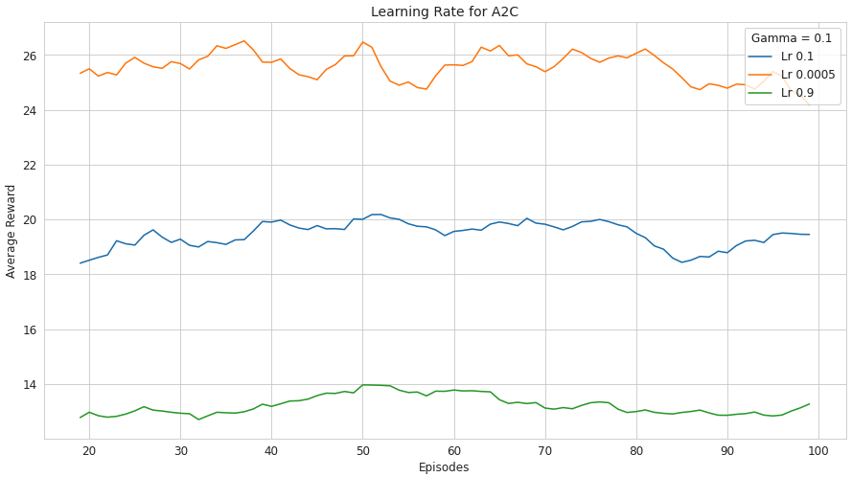
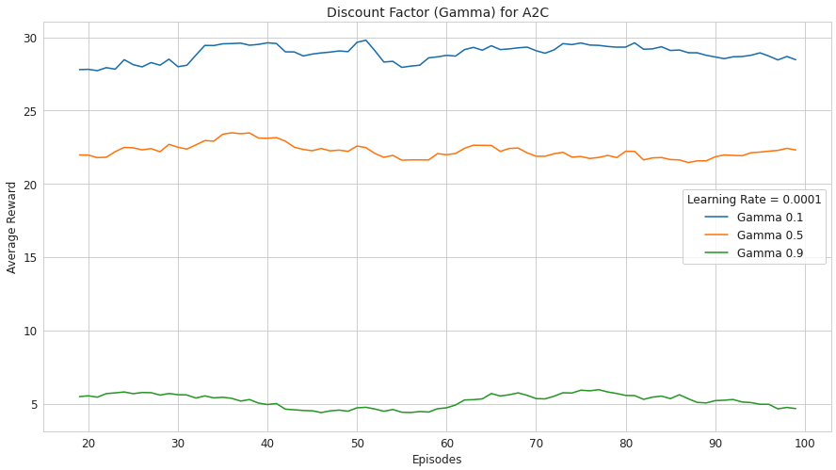
A2C Model Tuning
Tuning learning rate of A2C model by keeping constant discount factor.
Tuning discount factor of A2C model by keeping constant learning rate.

Slide 11
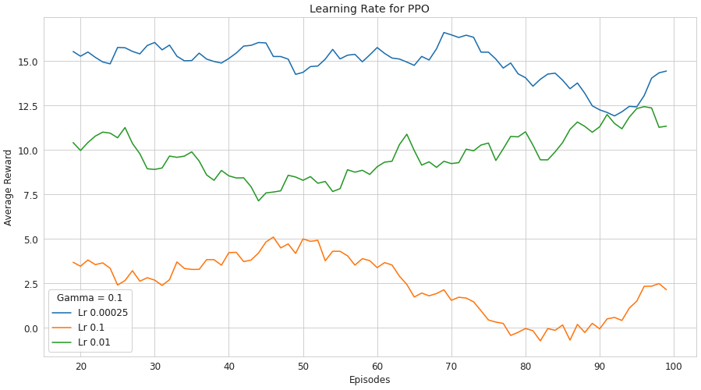
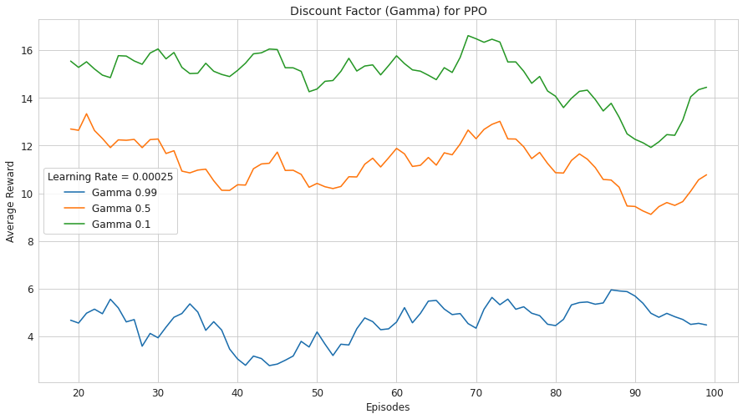
PPO Model Tuning
Tuning learning rate of PPO model by keeping constant discount factor.
Tuning discount factor of PPO model by keeping constant learning rate.

Slide 12
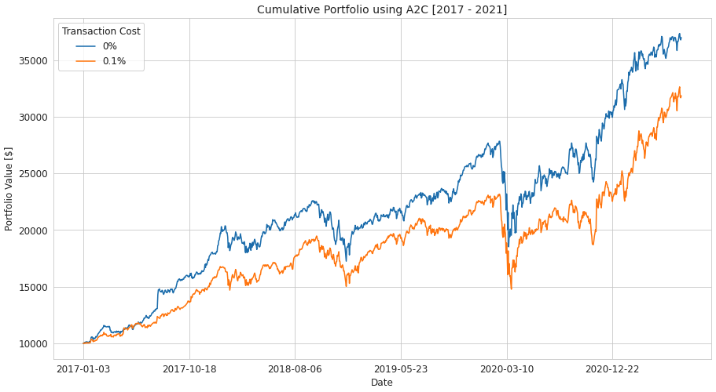
A2C Model Results
Cumulative portfolio returns of A2C model with and without transaction cost.

Slide 13
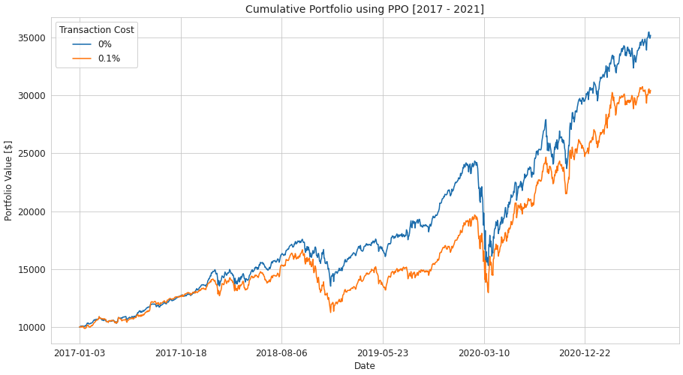
PPO Model Results
Cumulative portfolio returns of PPO model with and without transaction cost.

Slide 14
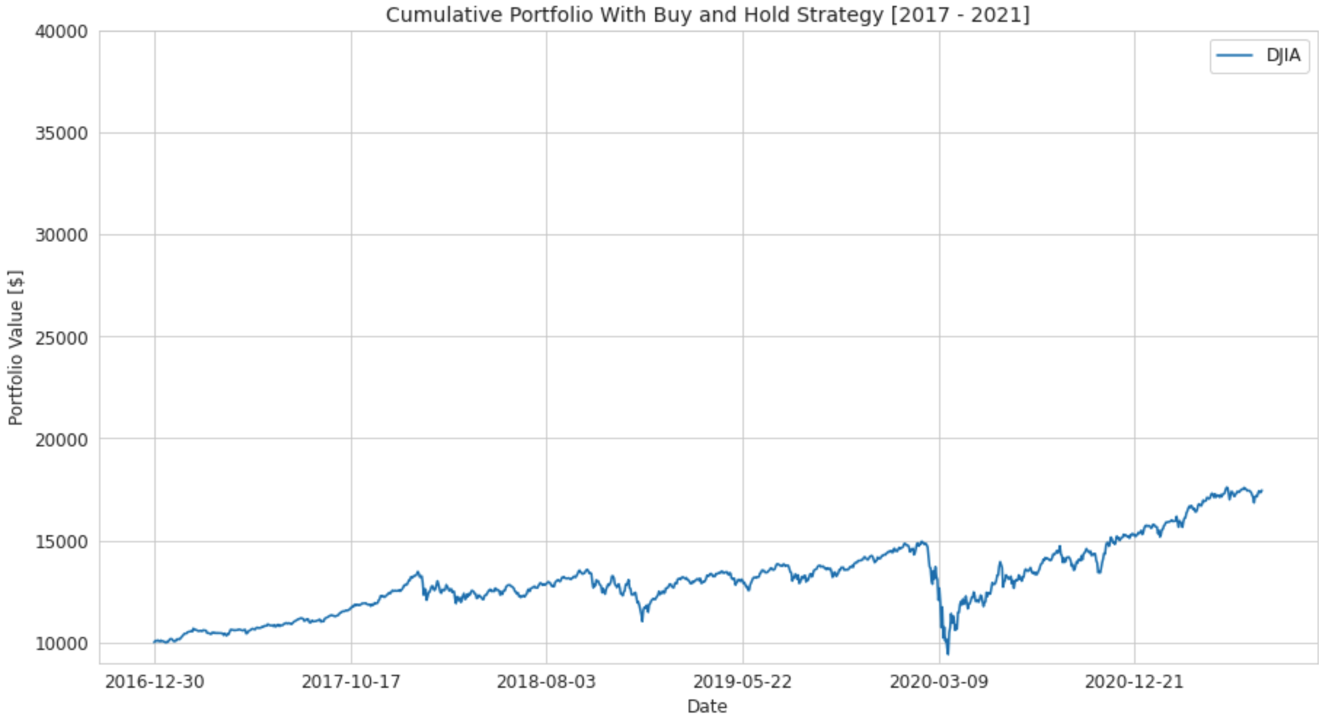
Buy and Hold Strategy Results
Cumulative portfolio returns of DJIA Index using Buy and Hold Strategy.

Slide 15
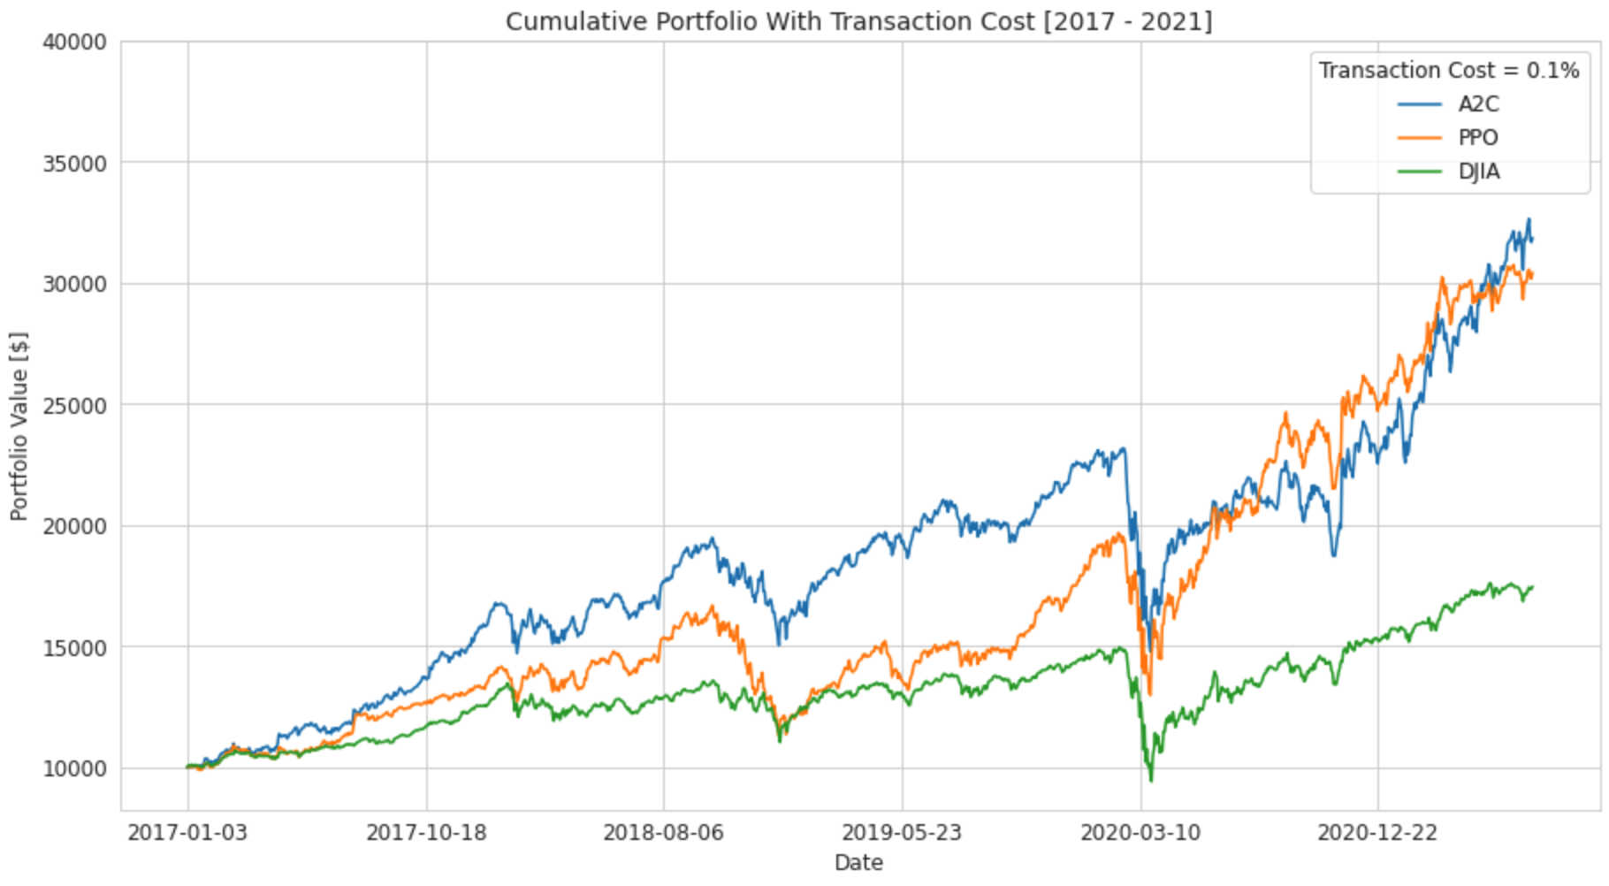
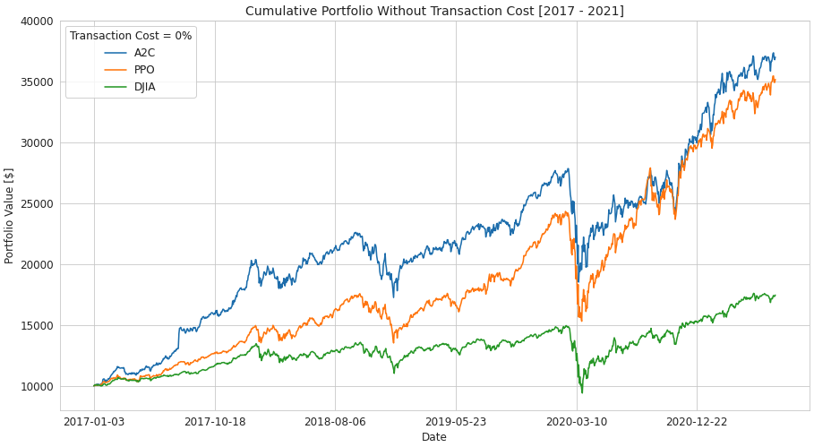
Model Results
The strategy employed by A2C and PPO models outperformed DJIA Index’s Buy and Hold strategy.

Slide 16
Evaluation
 | DJIA | PPO | A2C | PPO | A2C
 |  | 0% Transaction Cost |  | 0.1% Transaction Cost
Initial Portfolio | $10,000 | $10,000 | $10,000 | $10,000 | $10,000
Final Portfolio | $17,458.49 | $35,170.77 | $36,996.80 | $30,421.43 | $31,858.18
Annualized Returns | 15.73% | 36.41% | 38.07% | 32.44% | 33.86%
Sharpe Ratio | 0.088 | 0.160 | 0.164 | 0.138 | 0.142
A2C and PPO outperformed DJIA.
Annualized returns are almost doubled when RL-based Agent’s strategy was employed.
Overall A2C model has a better Sharpe ratio and final portfolio value.

Slide 17
Conclusion
This project facilitates the autonomous trading of stocks. The agent learns from market dynamics and determines whether to buy, sell, or hold a stock.
The model has not been validated adequately against other market data or trading strategies. Therefore, it might not be suited for real-world trading.
Future Work
Explore other RL-Algorithms and more technical indicators.
Developing strategy to dynamically change agent or algorithm used for trading based on market.

Slide 18
THANK YOU

Slide 19
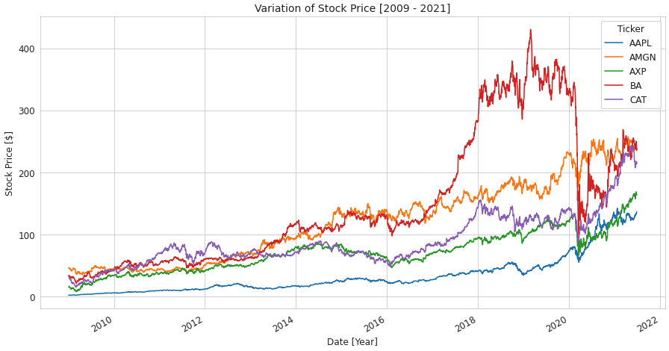
Data Exploration and Preparation (Backup)
Variation of stock price over a period of time.

Slide 20
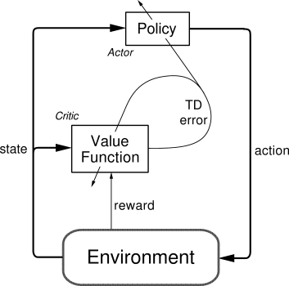
Methodology (Backup)
Actor-Critic Network

