Slide 1

INFO-6148 Natural Language Processing
F24-Project 2
Classification of Wikipedia Articles Using Spacy and ANN
By: Mohamed Ali

Slide 2
outline
Data Selection
Data Preprocessing
Spacy Classification
ANN Classification

Slide 3
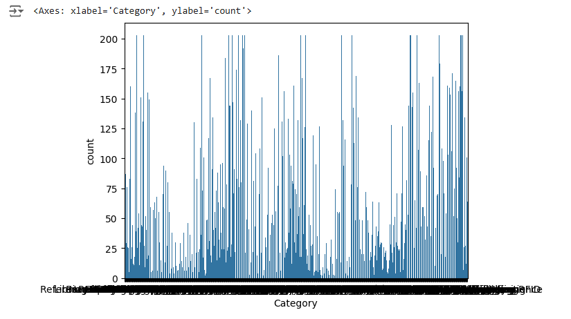
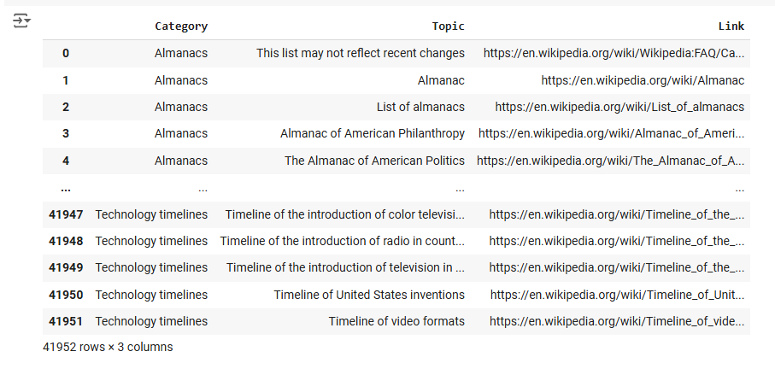
Data Selection

Slide 4
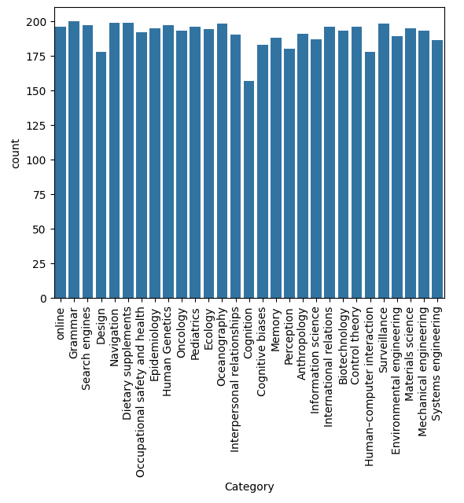
Data Selection
Taking categories with high number of pages

Slide 5
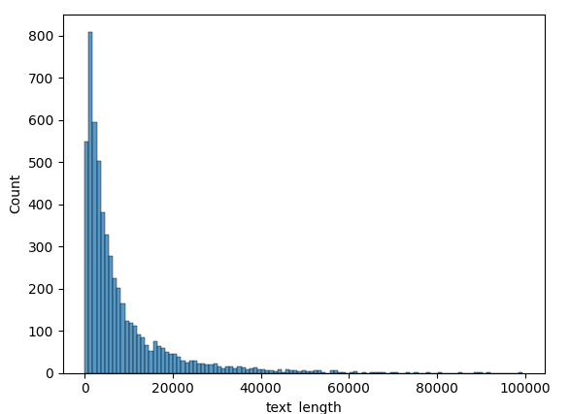
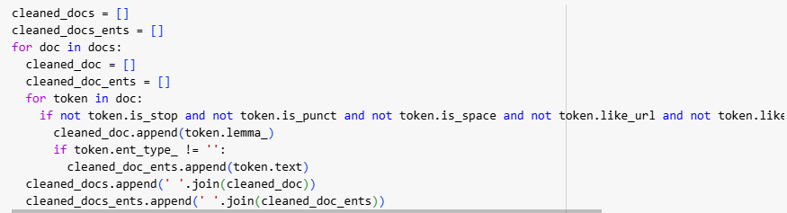
Removal of:
Punctuation
Stop words
Urls
Emails
Using toke alpha

Slide 6
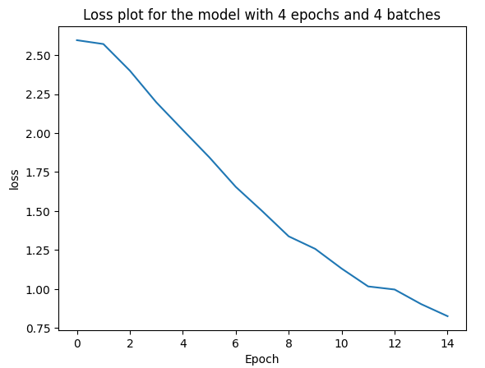
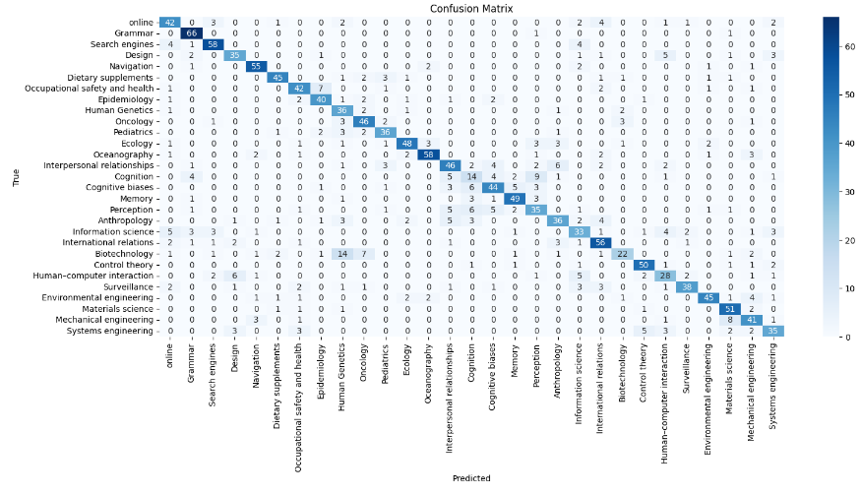
Spacy Classification
 | online | Grammar | Search engines | Design | Navigation | Dietary supplements | Occupational safety and health | Epidemiology | Human Genetics | Oncology | Information science | International relations | Biotechnology | Control theory | Human–computer interaction | Surveillance | Environmental engineering | Materials science | Mechanical engineering | Systems engineering
p | 0.688525 | 0.814815 | 0.840580 | 0.729167 | 0.859375 | 0.865385 | 0.750000 | 0.754717 | 0.529412 | 0.741935 | 0.600000 | 0.727273 | 0.733333 | 0.833333 | 0.595745 | 0.863636 | 0.865385 | 0.750000 | 0.683333 | 0.714286
r | 0.724138 | 0.970588 | 0.865672 | 0.714286 | 0.887097 | 0.803571 | 0.763636 | 0.784314 | 0.837209 | 0.821429 | 0.568966 | 0.811594 | 0.400000 | 0.862069 | 0.571429 | 0.703704 | 0.762712 | 0.894737 | 0.745455 | 0.660377
f | 0.705882 | 0.885906 | 0.852941 | 0.721649 | 0.873016 | 0.833333 | 0.756757 | 0.769231 | 0.648649 | 0.779661 | 0.584071 | 0.767123 | 0.517647 | 0.847458 | 0.583333 | 0.775510 | 0.810811 | 0.816000 | 0.713043 | 0.686275

Slide 7
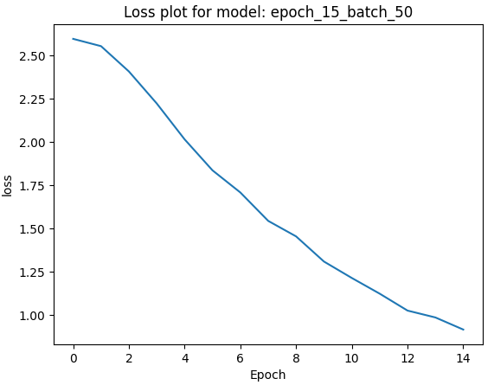
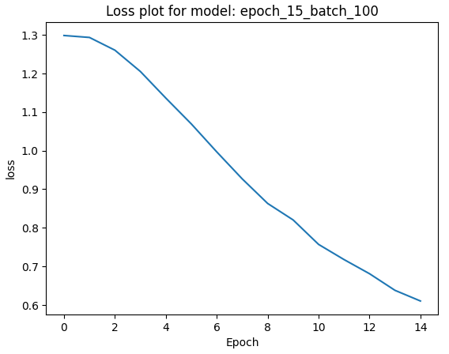
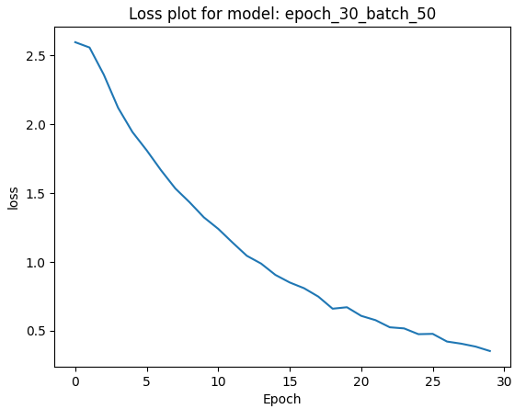
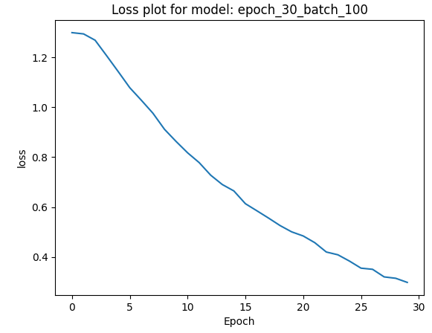
Spacy Classification
Loss curves for different hyperparams

Slide 8
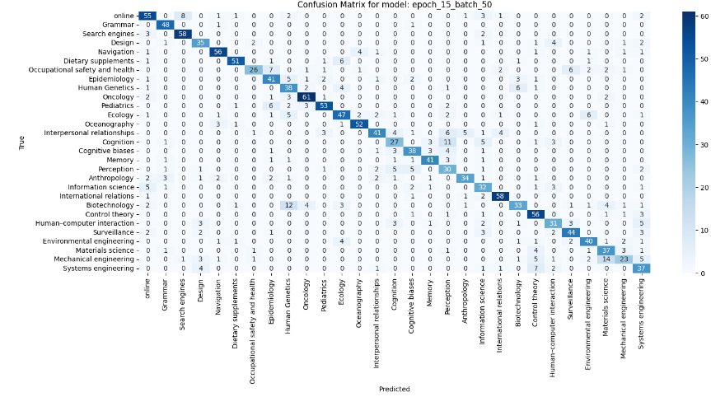
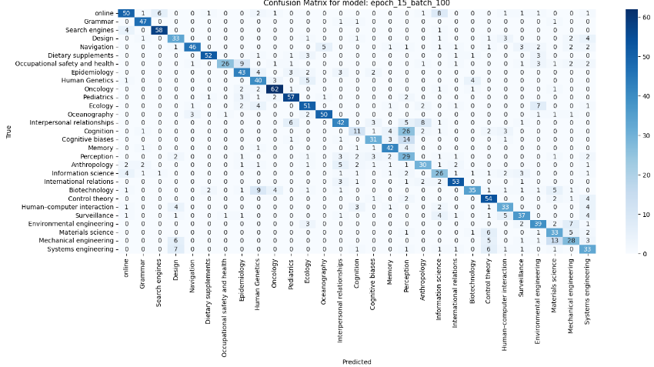
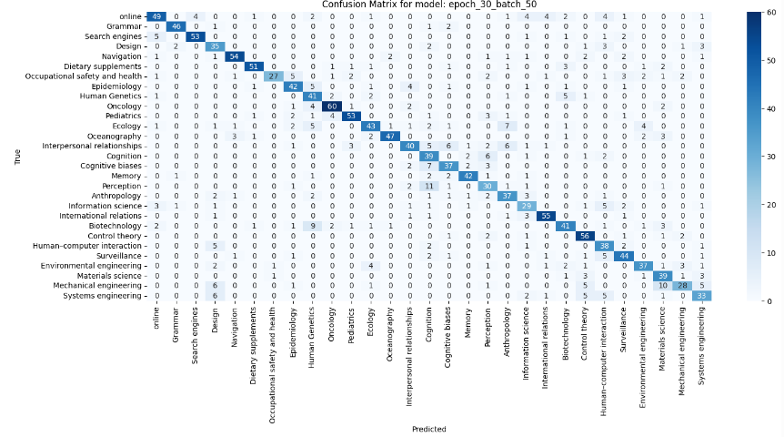

Spacy Classification

Slide 9

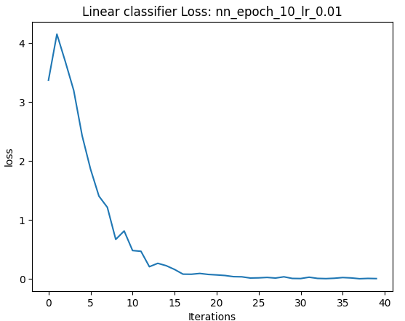
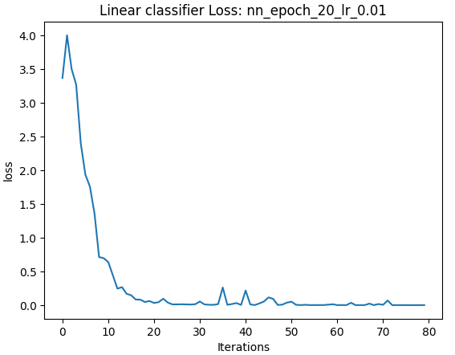
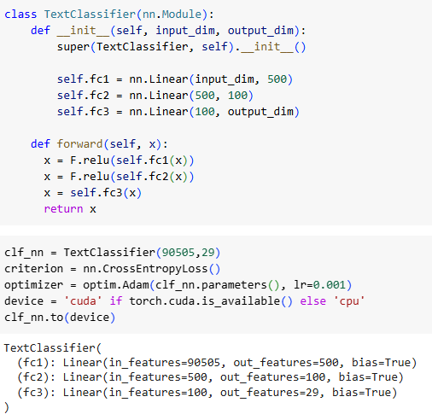
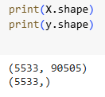
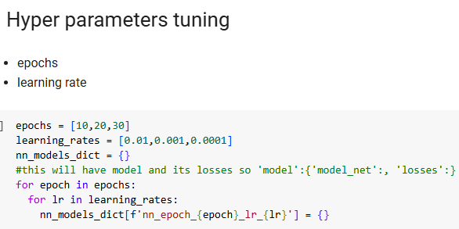
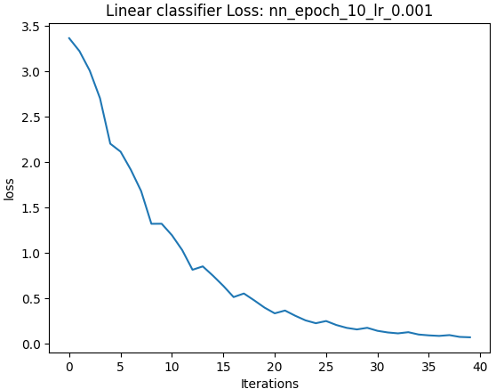
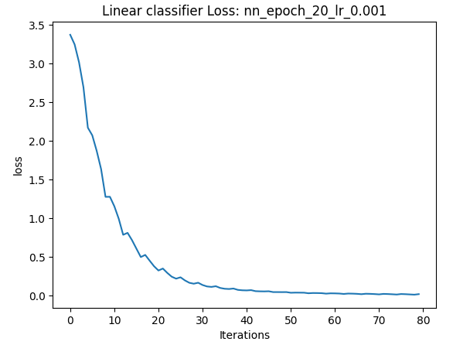
ANN Classification

Slide 10
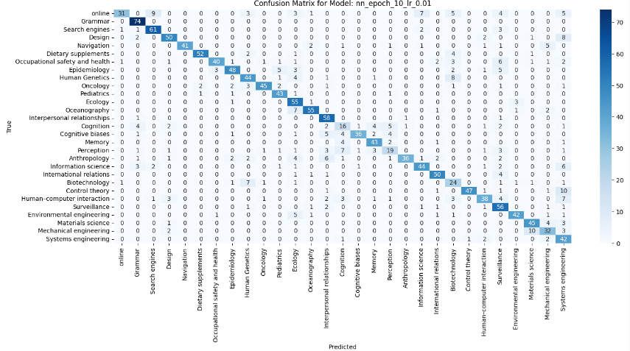
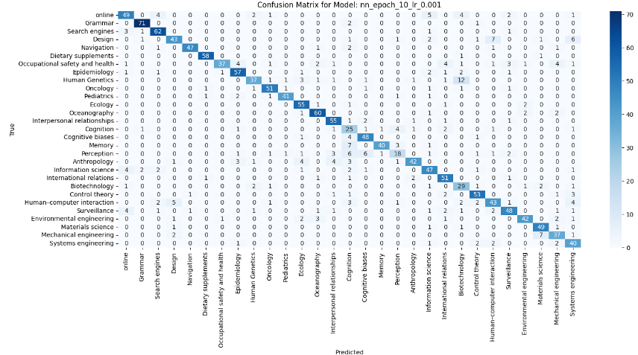

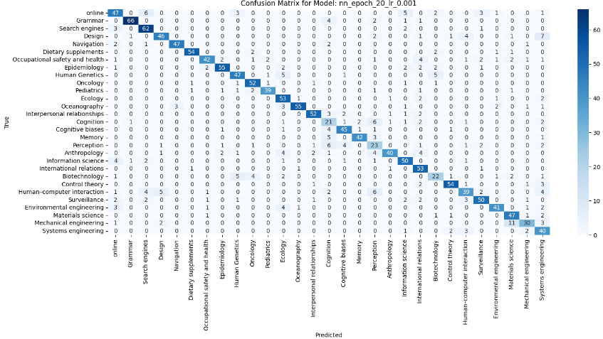
ANN Classification

Slide 11
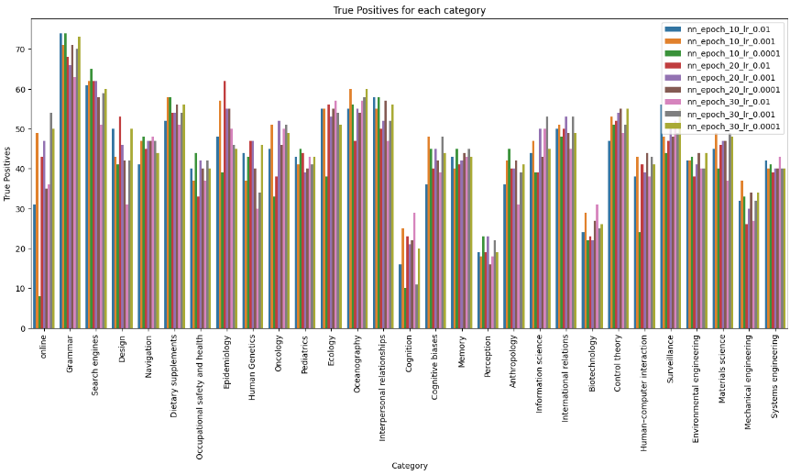
ANN Classification

Slide 12
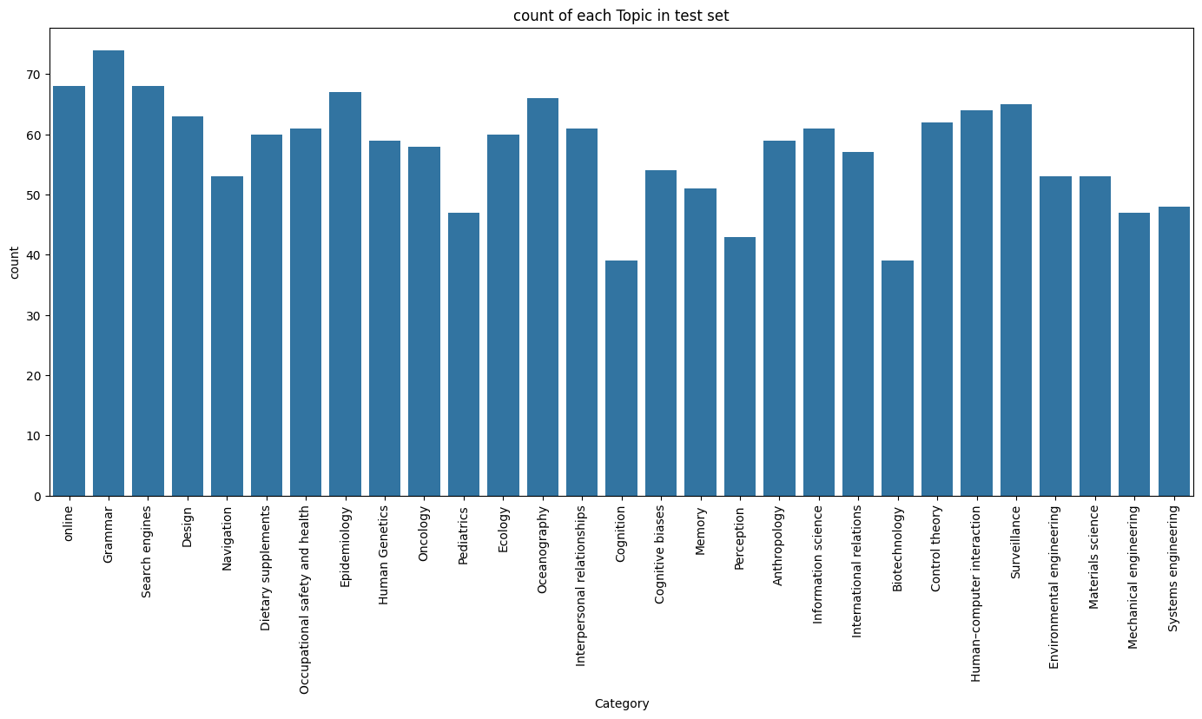
ANN Classification

Slide 13
Thank you ……. Q&A

