Slide 1
Peformance testing with JMeter
Mateusz Jamiołkowski

Slide 2
INTRODUCTIOn
Notes:
Performance is quite big issue in modern it world. Let me start with some notable examples of performance problems. One would be
https://youtu.be/vIjs_l4k-qE Witcher 3
Second one is DEFRA
PTT was supposed to do performance tests, but they delivered nothing
Later we run performance tests and found some problems, few of them which we resolved
There were problems with performance around land and BPS
During demo for prime minister ops screwed up kibana :)
Sending logs over network
We coulnd’t diagnose it
But problems with siti agri are still there
We couldn’t get list of parcels 8k for organisation
It wasn’t fixed untill then

Slide 3
foundations
Notes:
Before we dive deeper into JMeter let me highlight some foundations of performance testing

Slide 4
Why to do performance testing?
During dev we don’t put system under heavy laod
Check how system fulfills non-functional performance requirements
Some examples
Internal user login
Add business

Slide 5
Types of performance testing
Load testing
Stress testing
Soak testing
Spike testing

Slide 6
Preparing test scenarios
Real life scenarios
Not a black box testing
Remember to monitor test host and tested environment

Slide 7
The tool
Notes:
Now we understand what performance testing is about. Let’s take a look at tool for doing that

Slide 8
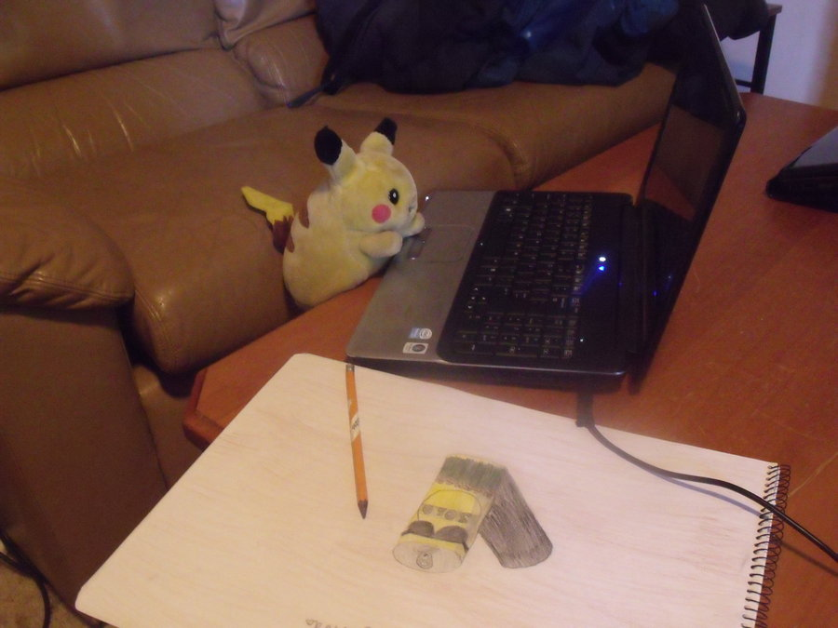
JMeter
Looks like crap
Written in Java
Most popular free tool of this kind
Clicka! Clicka!

Slide 9
Test elements
Thread Group
Samplers
Config Elements
Timers
Listeners
Logic Controllers
Assertions
Post-processors

Slide 10
Test structure
Test Plan
Thread Group
Defaults
HTTP Sampler
Timer
Listener

Slide 11
Demo time
Notes:
Now it’s time for some simple demonstration

Slide 12
Integrating with build server
Notes:
Running JMeter from GUI is useful. However it has some limits
Show how it looks on team city

Slide 13
Thanks

