Slide 1
Memory Management in Linux
Virtual Memory, Demand Paging, and Page Fault Analysis
Operating Systems (B24CS2T04)
Self-Learning Practice – Topic 5

Slide 2
Agenda
Why Memory Management Matters
Virtual Memory in Linux
How Demand Paging Works
Live Demo: Memory-Intensive Program
Page Fault Comparison using vmstat
Key Takeaways

Slide 3
Why Memory Management?
The Problem:
Physical RAM is limited (4 GB, 8 GB, 16 GB…)
Multiple processes run simultaneously
Each process thinks it owns all memory
The Solution: Virtual Memory
Every process gets its own private address space
The OS + hardware map virtual → physical transparently
Only actively-used pages consume RAM (demand paging)
Imagine a library where books are only fetched from the warehouse when someone asks for them — that’s demand paging.

Slide 4
Virtual Address Space Layout
Kernel Space | (not accessible from user mode)
Stack ↓ | (grows downwards)
Memory mapped | (shared libs, mmap)
Heap ↑ | (grows upwards – malloc)
BSS | (uninitialized globals)
Data | (initialized globals)
Text | program code
Each section is a Virtual Memory Area (VMA)
Kernel tracks them with vm_area_struct linked list
- All VMAs for a process live inside mm_struct — the per-process memory descriptor (also holds the pgd pointer to the top-level page table)
/proc/<pid>/maps shows the actual layout — DEMO: run cat /proc/self/maps

Slide 5
Page Tables & Translation
Virtual Adress (48 bits used on x86 – 64)
TLB (Translation Lookaside Buffer) caches recent translations
TLB miss → full 4-level walk (expensive!)
This is why access pattern matters
PDG(9) | PUD(9) | PMD(9) | PTE(9) | Offset(12)
Level 4 Page table | Level 3 Page table | Level 2 Page table | Level 1 Page table
Physical Frame + Offset
= Physical Address

Slide 6
What is a Page Fault?
Type | Cause | Cost
Minor fault | Page exists but no physical frame yet (first access) | ~microseconds
Major fault | Page data must be read from disk/swap | ~milliseconds (1000× slower)
Invalid fault | Access to unmapped address | → SIGSEGV (crash)
Key insight: malloc() does NOT allocate physical memory. It only reserves virtual addresses. Physical frames are allocated on first access via minor faults.

Slide 7
Demand Paging Flow
Program: mem[0] = 'A’
MMU checks page table Present?
PAGE FAULT (trap to kernel: do_page_fault)
YES
Normal access
Note
On a first read (not write), the kernel maps the global empty_zero_page instead of allocating a new frame — a read-optimization. A real physical frame is allocated only on the first write (copy-on-write from the zero page).
NO
Kernel: find_vma()
valid VMA?
NO
SIGSEGV
YES
Is the page
on swap?
YES
Major fault
(do_swap_page)
Minor Fault
Allocate frame
Update PTE
Flush TLB
Resume
NO
This is the beauty of demand paging — the kernel is lazy in the best way. It never does work upfront that might not be needed.

Slide 8
Our Demo Program Design
demand_paging_demo.c — Three phases:
Phase | What happens | Expected faults
1. malloc(512 MB) | Reserve virtual space | ~0 faults
2. Touch all pages | Write one byte per page | ~131,072 minor faults
3. Re-touch pages | Write again | ~0 faults (already in RAM)
Three access patterns to compare:
Sequential — page 0, 1, 2, 3 … (best locality)
Random — Fisher-Yates shuffled order (worst TLB behaviour)
Stride-64 — every 64th page, then wrap (moderate)
We measure faults by reading /proc/self/stat (fields 10 & 12)

Slide 9
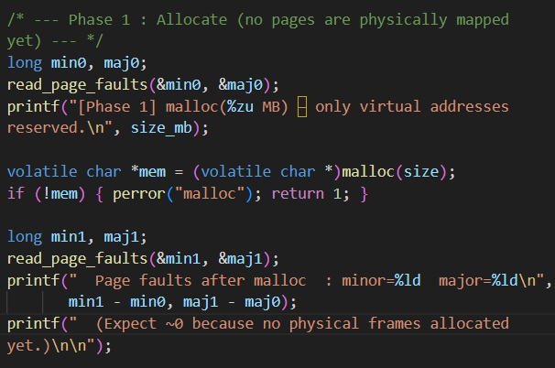
Our Demo Program Design
demand_paging_demo.c — Three phases:
Phase | What happens | Expected faults
1. malloc(512 MB) | Reserve virtual space | ~0 faults
2. Touch all pages | Write one byte per page | ~131,072 minor faults
3. Re-touch pages | Write again | ~0 faults (already in RAM)

Slide 10
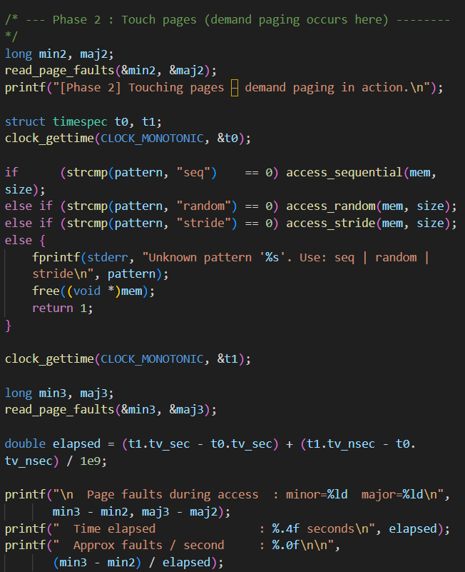
Our Demo Program Design
demand_paging_demo.c — Three phases:
Phase | What happens | Expected faults
1. malloc(512 MB) | Reserve virtual space | ~0 faults
2. Touch all pages | Write one byte per page | ~131,072 minor faults
3. Re-touch pages | Write again | ~0 faults (already in RAM)

Slide 11
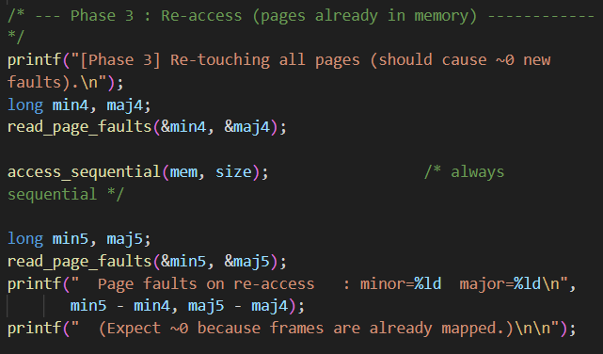
Our Demo Program Design
demand_paging_demo.c — Three phases:
Phase | What happens | Expected faults
1. malloc(512 MB) | Reserve virtual space | ~0 faults
2. Touch all pages | Write one byte per page | ~131,072 minor faults
3. Re-touch pages | Write again | ~0 faults (already in RAM)

Slide 12
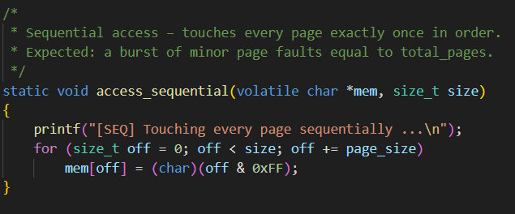
Our Demo Program Design
Three access patterns to compare:
Sequential — page 0, 1, 2, 3 … (best locality)
Random — Fisher-Yates shuffled order (worst TLB behaviour)
Stride-64 — every 64th page, then wrap (moderate)
We measure faults by reading /proc/self/stat (fields 10 & 12)

Slide 13
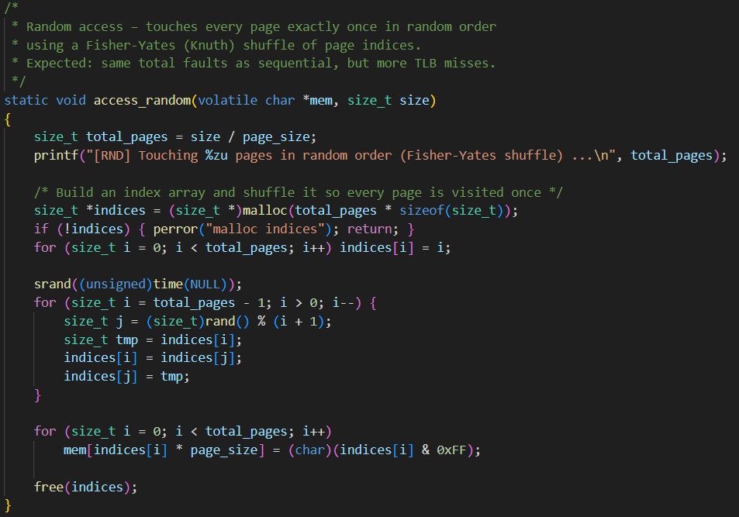
Our Demo Program Design
Three access patterns to compare:
Sequential — page 0, 1, 2, 3 … (best locality)
Random — Fisher-Yates shuffled order (worst TLB behaviour)
Stride-64 — every 64th page, then wrap (moderate)
We measure faults by reading /proc/self/stat (fields 10 & 12)

Slide 14
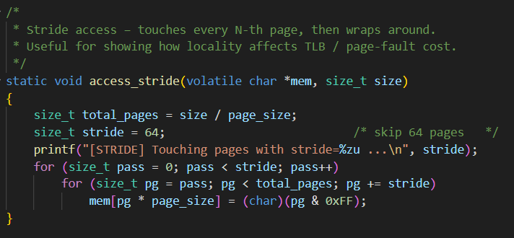
Our Demo Program Design
Three access patterns to compare:
Sequential — page 0, 1, 2, 3 … (best locality)
Random — Fisher-Yates shuffled order (worst TLB behaviour)
Stride-64 — every 64th page, then wrap (moderate)
We measure faults by reading /proc/self/stat (fields 10 & 12)

Slide 15
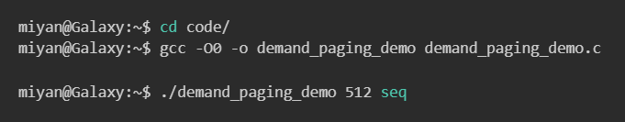
LIVE DEMO
Terminal 1
Terminal 2

Slide 16
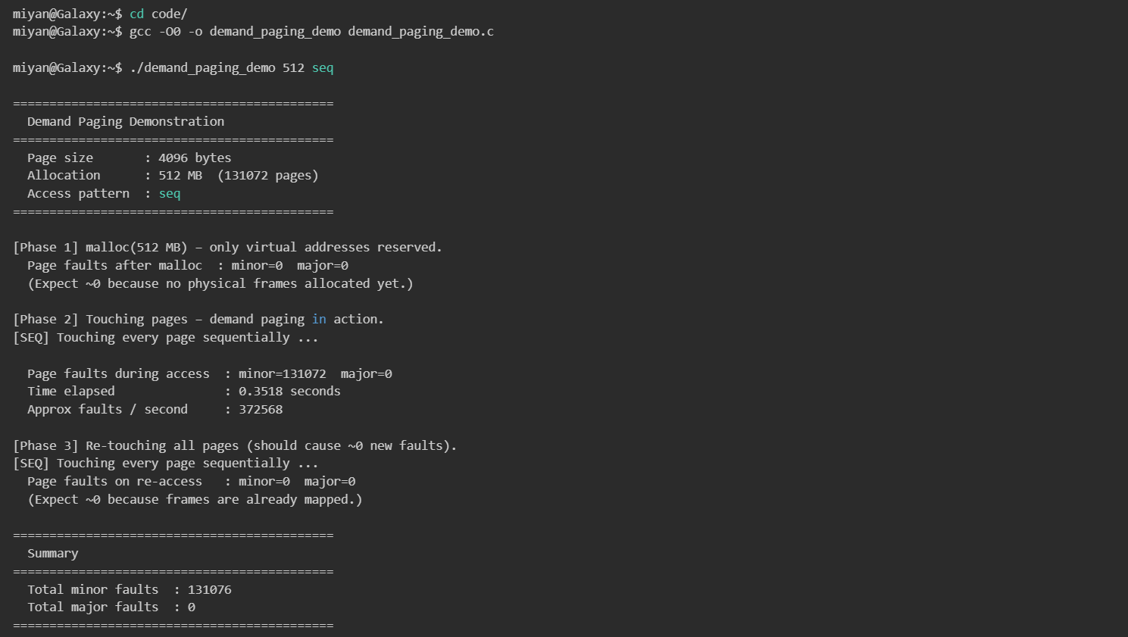
LIVE DEMO
Steps to show on screen:
# Terminal 1: compile and run gcc -O0 -o demand_paging_demo demand_paging_demo.c ./demand_paging_demo 512 seq # Terminal 2: watch vmstat vmstat 1
What to point out:
Phase 1: “See? Zero faults after malloc!”
Phase 2: “131,072 minor faults — exactly 512 MB ÷ 4 KB”
Phase 3: “Zero faults — pages are already mapped”
vmstat: “Watch free column drop by ~512 MB”
vmstat: “sy (system CPU) spikes — kernel is handling faults”
Then run the automated comparison and vmstat monitor:*bash# Terminal 1: run all 3 patterns and get a side-by-side tablechmod +x compare_page_faults.sh./compare_page_faults.sh 512# Terminal 3: automated vmstat capture (before/during/after)chmod +x vmstat_monitor.sh./vmstat_monitor.sh 512 seqcat vmstat_log_*.txt # show the captured summary
compare_page_faults.sh: "Same faults across all 3 patterns — but look at the time difference“
compare_page_faults.sh also saves per-pattern vmstat logs (vmstat_run_seq.log, vmstat_run_random.log, vmstat_run_stride.log) — you can diff them to see how system behaviour changes per pattern8. vmstat_monitor.sh: "This script automates the before/during/after vmstat capture we just did manually"

Slide 17
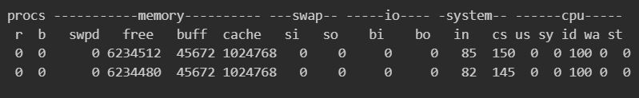
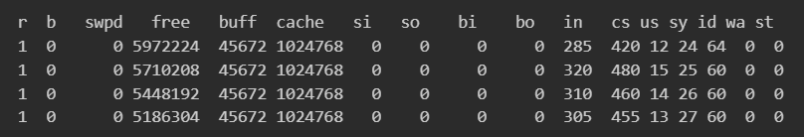

vmstat Output During Sequential Demo
Baseline (before demo starts):
During Phase 2 (sequential, 512 MB):
After demo finishes (memory freed):

Slide 18

vmstat Explained
Automated monitoring: vmstat_monitor.sh captures vmstat snapshots before, during, and after the demo run and writes a summary log — useful for including in reports.
To trigger swap activity: allocate more than available RAM
./demand_paging_demo 7000 seq # on 8 GB machine
# Now vmstat will show si/so > 0
Column | What to watch | Normal | During demo
free | Free RAM (KB) | ~6 GB | Drops by ~512 MB
si | Swap in (KB/s) | 0 | 0 (if RAM sufficient)
so | Swap out (KB/s) | 0 | 0 (if RAM sufficient)
sy | System CPU % | <5% | 20-30% (fault handling)

Slide 19
Comparison Results
Pattern | Minor Faults | Major Faults | Time (s)
Sequential | ~131,072 | 0 | ~0.35
Random | ~131,072 | 0 | ~0.85
Stride-64 | ~131,072 | 0 | ~0.55
(This table is the output of compare_page_faults.sh — saved to page_fault_comparison.txt)
Why same faults but different speed?
Same faults: All patterns touch every page once → same number of first-access faults
Different speed: TLB and cache locality!
Sequential: TLB entries reused within contiguous region; CPU prefetch works
Random: TLB thrashes; every access likely misses L1/L2/L3 cache
Stride-64: TLB partially effective; some prefetch benefit
Bonus: compare_page_faults.sh also captured per-pattern vmstat logs (vmstat_run_seq.log, vmstat_run_random.log, vmstat_run_stride.log) — you can compare sy and free deltas across patterns to see the system-level impact

Slide 20
Page Replacement
When RAM is full, the kernel must evict pages to make room.
Linux uses a two-list LRU approximation:
Pages start on the inactive list
If accessed again → promoted to active list
kswapd daemon periodically moves active → inactive
Active list is kept at ~2/3 of total page cache (modified 2Q algorithm)
Eviction candidates come from the inactive list tail
Active List
(recently used)
Inactive List
(candidates for eviction)
Evict /
Swap out

Slide 21
Thrashing
Thrashing = working set > physical memory → constant page-in/page-out
Symptoms:
CPU idle time is high (waiting for I/O)
vmstat shows si/so constantly > 0
System becomes unresponsive
Solutions:
Add more RAM
Reduce the number of concurrent processes
Use cgroups to limit per-process memory
Working set size estimation (PFF — Page Fault Frequency)

Slide 22
SDG Connection
SDG | Connection
SDG 9 (Industry & Infrastructure) | Virtual memory enables cloud infrastructure
SDG 12 (Responsible Consumption) | Demand paging = allocate only what you use
SDG 13 (Climate Action) | Efficient memory → fewer servers → less energy
SDG 4 (Quality Education) | Peer-taught video class; hands-on experimentation

Slide 23
Key Takeaways
Virtual memory gives every process its own isolated address space
malloc does NOT allocate physical RAM — it’s demand-paged
Minor faults (first access) are fast; major faults (swap) are slow
Access pattern doesn’t change fault count but greatly affects TLB/cache performance
vmstat is the go-to tool for monitoring memory and swap activity
Understanding these concepts is essential for writing performant systems software

Slide 24
Discussion & Further Exploration
Questions?
Further exploration:
perf stat -e page-faults,dTLB-load-misses ./demand_paging_demo 512 seq
Read Chapters 9–10 of Silberschatz (10th ed.)
OSTEP Chapters 18–22: https://pages.cs.wisc.edu/~remzi/OSTEP/

