Slide 1
PSCS_129_Design and Developed a personalized online meeting system for AICTE
CSE7101- Capstone Project
Review-1
Batch Number: CBC_02
Under the Supervision of,
Dr. Akshatha Y
School of Computer Science and Engineering
Presidency University
Roll Number | Student Name
20221CBC0029 20221CBC0033 20221CBC0042 | M Jeevitha Shree Krupank B.K Prajwal P Gowda
Name of the Program: School of Computer Science and Engineering
Name of the HoD: Dr. Pravinthraja S
Name of the Program Project Coordinator: Dr. H M Manjula
Name of the School Project Coordinators: Dr. Sampath A K , Dr. Geetha A

Slide 2
Problem Statement Number: PSCS_129
Organization: AICTE
Category (Hardware / Software / Both) : Software
Problem Description :
To build a personalized online meeting system tailored for AICTE, enabling secure and efficient communication
among students, faculty, and administrators.
The system should provide core meeting features such as video conferencing, chat, file sharing, and scheduling,
ensuring smooth collaboration in both academic and administrative activities.

Slide 3
Content
Problem Statement
Objectives
Background and Related work for title Selection
Analysis of Problem Statement
Innovation or Novel Contributions
Git-hub Link
Timeline of the Project
References

Slide 4
Problem Statement
Develop an online meeting platform for AICTE to address the need for efficient communication and collaboration among officials, institutions, faculty, and students.

Slide 5
Objectives
Smart Contract Automation: Develop and deploy smart contracts to automate attendance cerification and decision approvals.
Decentralized Identity Management(DID): Allow teachers, students, and admins to verify digital identities and access features based on their roles securely.
Immutable Record Keeping: Maintain tamper-proof logs of meeting minutes,academic records in distributed ledger using Hyperledger Fabric.

Slide 6
Background and Related work for title Selection
Sr. No. | First Author, Year | Title / Study | Methods Used | Strengths | Drawbacks
1 | Sharma et al., 2022 | Real-Time Online Meeting System for Colleges | WebRTC, Node.js backend, cloud-based streaming | Supports video, audio, and chat simultaneously | High server load during peak hours; occasional latency issues
2 | Rajesh Kumar, 2021 | IoT-based Classroom Monitoring in Online Meetings | Real-time sensor monitoring, automated attendance alerts | Enables remote supervision and attendance tracking | Sensor setup adds cost; scalability limited for large campuses
3 | Priya Singh et al., 2020 | Scalable Video Conferencing System | Microservices architecture, cloud deployment | Handles large number of participants efficiently | Complex deployment and maintenance
4 | Anil Verma et al., 2023 | Edge-assisted Online Education Platform | Edge servers, CDN integration, adaptive streaming | Reduces latency; improves user experience | Edge server requirement increases infrastructure cost
5 | AICTE Pilot Project, 2024 | Centralized Academic Online Meeting System | Centralized database, automated scheduling and reporting | Unified control, faster meeting setup | Single point of failure; downtime affects all sessions

Slide 7
Analysis of Problem Statement
Tech Stack for Online Meeting System
Frontend: React.js (Web) / Android Studio (Java/Kotlin for Mobile), XML UI
Backend: Node.js (Express.js)
Database: MongoDB / Firebase Firestore
Real-time Communication: WebRTC + Socket.io
Blockchain Layer:
Hyperledger Fabric (Private Blockchain for meeting records & authentication)
Smart Contracts (Chaincode in Node.js/Go)
IPFS (for decentralized storage of meeting recordings & shared files)
Authentication & Security: JWT, OAuth 2.0, Blockchain-based Decentralized Identity (DID)
Cloud & Deployment: AWS / GCP (for servers, STUN/TURN servers, Kubernetes, Docker)

Slide 8
Analysis of Problem Statement (contd...)
Software Requirements:
Frontend: React.js / Android Studio (Java/Kotlin)
Backend: Node.js with Express.js
Database: MongoDB / Firebase Firestore
Blockchain: Hyperledger Fabric, Smart Contracts
Real-time Communication: WebRTC, Socket.io
Hardware Requirements:
Development PC (min 8GB RAM, i5 processor, 256GB SSD)
Android Smartphone (min Android 8.0) / Browser with WebRTC support
Microphone & Webcam (for meetings)

Slide 9
Innovation or Novel Contributions
Attendance tracking
Increased number of participants
Immutable recording of session
Sign language support

Slide 10
Github Link
https://github.com/m-jeev-shree/online-meeting-system

Slide 11
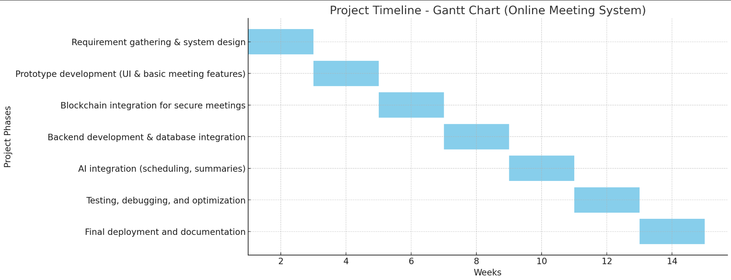
Timeline of the Project (Gantt Chart)

Slide 12
References (IEEE Paper format)
Ref ID | Author / Year | Title / Source | Link
[1] | Sharma et al., 2024 | Design and Develop an Online Meeting Platform for AICTE | iarjset.com PDF
[2] | Kumar et al., 2023 | AICTE Video Conference | irjmets.com PDF
[3] | ResearchGate, 2020 | Blockchain in Education Management: Present and Future Applications | researchgate.net
[4] | ResearchGate, 2023 | A Study of the New Role of Blockchain in the Indian Education System | researchgate.net
[5] | AICTE, 2023 | AICTE Vision and Initiatives | aicte.gov.in PDF
[6] | AICTE Webinar, 2025 | 2025: The Year of AI | firstindia.co.in

Slide 13


