Slide 1



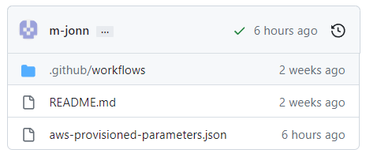
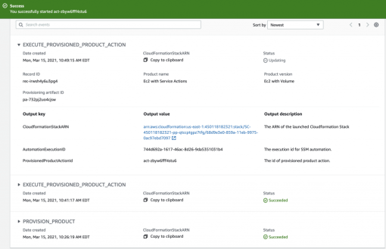

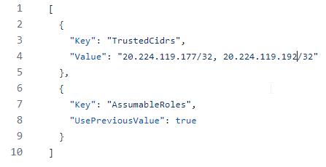


Github Project
aws-catalog-update-product-action
AWS Service Catalog
Commit your
Parameters
Updates your
Provisioned Product

