Slide 1



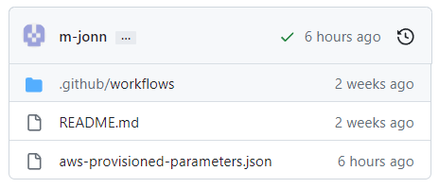
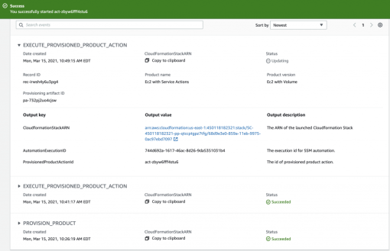
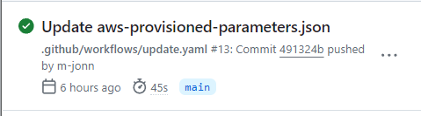

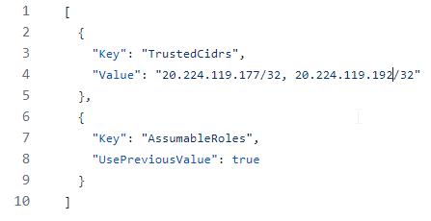


Github Project
aws-catalog-update-product-action
AWS Service Catalog
aws-provisioned-parameters.json
Commit your
Parameters
Updates your
Provisioned Product

