Slide 1



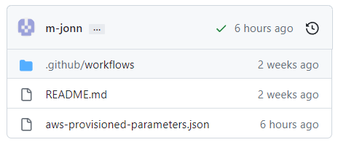
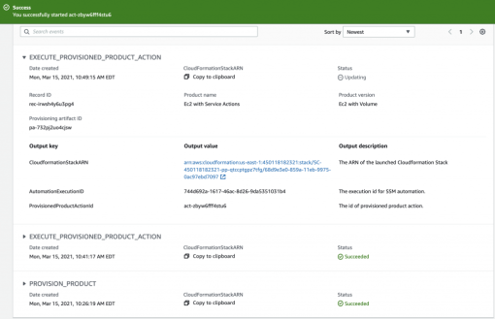




Github Project
aws-catalog-update-product-action
AWS Service Catalog
Commit
Update

