Slide 1
INTRODUCTION TO EMBEDDED SYSTEMS
UNIT-1

Slide 2
EMBEDDED SYSTEMS
An Embedded system is an electronic / electro- mechanical system designed to perform specific function
It is a combination of hardware and firmware(software)
Every embedded systems is unique, and hardware as well as the firmware is highly specialised to the application domain

Slide 3
EMBEDDED SYSTEMS (VS) GENERAL COMPUTING SYSTEMS
GENERAL PURPOSE COMPUTING SYSTEM | EMBEDDED SYSTEM
It is a combination of generic hardware and a general purpose operating system for executing variety of applications. | It is combination of special purpose hardware and embedded OS for executing specific set of applications.
Contains a General Purpose Operating Systems(GPOS) | May or may not contain an OS for functioning
Applications are alterable (Programmable) by the user. | The firmware of the ES is pre- programmed and it is non-alterable by the end user.
Performance is the key deciding factor in the selection of the system | Application-specific requirements( Like performance ,power,memory etc)
Response requirements are not time- critical | Highly time-critical.

Slide 4
HISTORY OF EMBEDDED SYSTEMS
Embedded Systems were in existence even before the IT evolution.
In the olden days embedded systems were built around the old vacuum tube and transistor technologies and the embedded algorithm was developed in low level languages.
Advances in semiconductor and Nano-Technology and IT revolution gave way to the development of miniature embedded systems.

Slide 5
The first recognised modern embedded system is the Apollo Guidance Computer(AGC) developed by the MIT instrumentation laboratory for the LUNAR EXPEDITION.
They ran the inertial guidance systems of both the Command Module(CM) and Lunar Excursion Module(LEM).
The command module was designed to encircle the moon while the Lunar Module and its crew were designed to go down to the moon surface and land there safely.
The Lunar Module featured in total 18 engines. There were 16 reaction control thrusters, a descent engine and an ascent engine.

Slide 6
The descent engine was designed to provide thrust to the lunar module out of the lunar orbit and land it safely on the moon.
The MIT’s original design was based on 4K words of ROM and 256 words of RAM.
By june 1963, it reached 10K ROM and 1K RAM.
The final configuration was 36K ROM and 2K of RAM.
The clock frequency of the first microchip photo model used in AGC was 1.024MHz and it was derived from a 2.048MHz crystal clock.

Slide 7
Around 5000 ICs supplied by Fairchild Semiconductor were used in this design.
The user interface unit of AGC is known as DSKY(Display/Keyboard).
DSKY looked like a calculator type keypad with an array of numerals.
The first mass-produced embedded system was the guidance computer for the Minuteman-I missile in 1961.
It was the “AUTONETICS D-17” guidance computer, but using discrete transistor logic and a hard-disk for main memory.

Slide 8
CLASSIFICATION OF EMBEDDED SYSTEMS
It is classified based on different criteria.
Based on generation
Complexity and performance requirements
Based on deterministic behaviour
Based on Triggering.

Slide 9
1) Classification based on Generation
First Generation
Second Generation
Third Generation
Fourth Generation

Slide 10
a) First Generation
8 – bit microprocessors
8085 and Z80, 4-bit microcontrollers
Simple hardware circuits with firmware developed In assembly code
Ex: Digital telephone keypads, stepper motor control units etc

Slide 11
b) Second Generation
16-bit microprocessors and 8 or 16 bit microcontrollers
The instruction set for the 1st or 2nd generation processors/controllers were much more complex and powerful than the 1st generation processors/controllers.
It has embedded operating systems for their operation
Ex: Data Acquisition systems, SCADA systems etc.

Slide 12
C) Third Generation
32- bit processors and 16-bit microcontrollers
DSP, ASICs
The instruction set of processors became more complex and powerful and the concept of pipelining also evolved

Slide 13
D) Fourth Generation
SoC, reconfigurable processors and multicore processors
These are making use of High performance real time embedded operating systems
Ex: Smart phone devices, mobile internet devices(MIDs) etc .

Slide 14
2) Classification based on Complexity and performance
i) Small – scale Embedded systems
Ii) Medium – scale Embedded systems
Iii) Large – scale Embedded systems

Slide 15
i) Small-scale embedded systems
Simple
These are built around low performance and low cost
8 or 16 bit microprocessors/ microcontrollers
May or may not contain an operating system

Slide 16
ii) Medium-scale Embedded system
These are slightly complex in hardware and firmware
Medium performance, low cost
16/ 32 microprocessors/microcontrollers, DSPs
Has OS that may be GPOS or RTOS

Slide 17
iii) Large-scale embedded systems/complex systems
Highly complex hardware and firmware
High performance
32or 64 bit RISC processors/controllers or Reconfigurable system on chip(RSoC) or multi- core processors and programmable logic devices
High performance RTOS

Slide 18
3) Classification based on deterministic behavior
The classification based on deterministic system behavior is applicable for ‘Real Time’ systems.
Embedded systems which are ‘Reactive’ ( like process control systems in industrial control applications) in nature can be classified based on the trigger.

Slide 19
3) Classification based on triggering
These are classified into two types
Event Triggered: Activities within the system (e.g., task run-times) are dynamic and depend upon occurrence of different events.
Time triggered: Activities within the system follow a statically computed schedule (i.e., they are allocated time slots during which they can take place) and thus by nature are predictable

Slide 20
APPLICATIONS OF EMBEDDED SYSTEMS
1.CONSUMER ELECTRONICS: camcorders, cameras, etc
2. HOUSEHOLD APPLIANCES: TV,DVD players, washing machine, Fridge, Microwave oven,etc
3.HOME AUTOMATION and SECURITY SYSTEMS: ACs , sprinklers, intruder detection alarms, closed circuit TV cameras, fine alarms, etc.
4. AUTOMATIVE INDUSTRY: Anti-lock breaking system(ABS), engine control, ignition systems, automatic navigation systems, etc.
5.TELECOM: cellular telephones, telephone switches, handset multimedia applications etc.

Slide 21
6. COMPUTER PEROPHERALS: printers, scanners, fax machines, etc.
7. COMPUTER NETWORKING SYSTEMS: Network routers, switches, hubs, firewalls, etc.
8. HEALTHCARE: Different kinds of scanners, EEG, ECG machines etc
9.MEASUREMENT & INSTRUMENTATION: Digital
multimeters, digital CROs, logic analyzers PLC systems, etc.
10.BANKING & RETAIL: Automatic teller machines (ATM) and currency counters, point of sales(POS)
11. CARD READERS: Barcode, smart card readers, handheld devices.

Slide 22
PURPOSE OF EMBEDDED SYSTEMS
Data collection/ Storage/ Representation
Data communication
Data(Signal) Processing
Monitoring
Control
Application specific user interface.

Slide 23
1. Data Collection/Storage/Representation
Performs acquisition of data from the external world.
The collected data can be either analog or digital
Data collection is usually done for storage, analysis, manipulation and transmission
The collected data may be stored directly in the system or may be transmitted to some other systems or it may be processed by the system or it may be deleted instantly after giving a meaningful representation

Slide 24
2. Data Communication
Embedded Data communication systems are deployed in applications ranging from complex satellite communication systems to simple home networking systems
Embedded Data communication systems are dedicated for data communication
The data communication can happen through a wired interface (like Ethernet, RS- 232C/USB/IEEE1394 etc) or wireless interface (like Wi-Fi, GSM,/GPRS, Bluetooth, ZigBee etc)
Network hubs, Routers, switches, Modems etc are typical examples for dedicated data transmission embedded systems

Slide 25
3. Data (Signal) Processing
Embedded systems with Signal processing functionalities are employed in applications demanding signal processing like Speech coding, synthesis, audio video codec, transmission applications etc
Computational intensive systems
Employs Digital Signal Processors (DSPs)

Slide 26
4. Monitoring
Embedded systems coming under this category are specifically designed for monitoring purpose
They are used for determining the state of some variables using input sensors
They cannot impose control over variables.
Electro Cardiogram (ECG) machine for monitoring the heart beat of a patient is a typical example for this
The sensors used in ECG are the different Electrodes connected to the patient’s body
Measuring instruments like Digital CRO, Digital Multi meter, Logic Analyzer etc. used in Control & Instrumentation applications are also examples of embedded systems for monitoring purpose

Slide 27
5. Control
Embedded systems with control functionalities are used for imposing control over some variables according to the changes in input variables
Embedded system with control functionality contains both sensors and actuators
Sensors are connected to the input port for capturing the changes in environmental variable or measuring variable
The actuators connected to the output port are controlled according to the changes in input variable to put an impact on the controlling variable to bring the controlled variable to the specified range

Slide 28
Contd…
Air conditioner for controlling room temperature is a typical example for embedded system with Control functionality
Air conditioner contains a room temperature sensing element (sensor) which may be a thermistor and a handheld unit for setting up (feeding) the desired temperature
The air compressor unit acts as the actuator. The compressor is controlled according to the current room temperature and the desired temperature set by the end user.

Slide 29
6. Application Specific User Interface
Embedded systems which are designed for a specific application
Contains Application Specific User interface (rather than general standard UI) like key board, Display units etc
Aimed at a specific target group of users
Mobile handsets, Control units in industrial applications etc are examples

Slide 30
Smart Running Shoes
CASE STUDY

Slide 31
Characteristics and Quality Attributes of Embedded Systems

Slide 32
CHARACTERISTICS OF AN EMBEDDED SYSTEM
(1) Application and domain specific
(2) Reactive and Real Time
(3) Operates in harsh environments
(4) Distributed
(5) Small size and weight
(6) Power concerns

Slide 33
Application and Domain Specific
They cannot be used for any other purpose.
It is the major criterion which distinguishes an embedded system from a general purpose computing system.
For example, you cannot replace the embedded control unit of your microwave oven with your air conditioner’s embedded control unit, because the embedded control units of microwave oven and air conditioner are specifically designed to perform certain specific tasks.

Slide 34
Reactive and Real Time
Any changes happening in the Real world (which is called an Event) are captured by the sensors or input devices in Real Time and the control algorithm running inside the unit reacts in a designed manner to bring the controlled output variables to the desired level.
Embedded systems produce changes in output in response to the changes in the input. So they are generally referred as Reactive Systems.
Real Time System operation means the timing behaviour of the system should be deterministic; meaning the system should respond to requests or tasks in a known amount of time.

Slide 35
Operates in Harsh Environment
The environment in which the embedded system deployed may be a dusty one or a high temperature zone or an area subject to vibrations and shock.
Systems placed in such areas should be capable to withstand all these adverse operating conditions.
The design should take care of the operating conditions of the area where the system is going to implement.
For example, if the system needs to be deployed in a high temperature zone, then all the components used in the system should be of high temperature grade.

Slide 36
Distributed
The term distributed means that embedded systems may be a part of larger systems.
Many numbers of such distributed embedded systems form a single large embedded control unit. An automatic vending machine is a typical example for this.
The vending machine contains a card reader (for pre-paid vending systems), a vending unit, etc.
Each of them are independent embedded units but they work together to perform the overall vending function.

Slide 37
Small Size and Weight
Product aesthetics is an important factor in choosing a product.
For example, when you plan to buy a new mobile phone, you may make a comparative study on the pros and cons of the products available in the market.
Definitely the product aesthetics (size, weight, shape, style, etc.) will be one of the deciding factors to choose a product.
People believe in the phrase “Small is beautiful”.
Most of the application domians also demands small sized and low weight products.

Slide 38
Power Concerns
Power management is another important factor that needs to be considered in designing embedded systems.
Embedded systems should be designed in such a way as to minimise the heat dissipation by the system.
The production of high amount of heat demands cooling requirements like cooling fans which in turn occupies additional space and make the system bulky.
Nowadays ultra low power components are available in the market.

Slide 39
QUALITY ATTRIBUTES OF EMBEDDED SYSTEMS

Slide 40
Operational Quality Attributes
(1) Response
(2) Throughput
(3) Reliability
(4) Maintainability
(5) Security
(6) Safety

Slide 41
(1) Response
Response is a measure of quickness of the system. It gives you an idea about how fast your system is tracking the changes in input variables.
Most of the embedded systems demand fast response which should be almost Real Time.
For example, an embedded system deployed in flight control application should respond in a Real Time manner.
Any response delay in the system will create potential impact to the safety of the flight as well as the passengers.

Slide 42
(2) Throughput
Throughput deals with the efficiency of a system.
In general, it can be defined as the rate of production or operation of a defined process over a stated period of time.
The rates can be expressed in terms of units of products, batches produced, or any other meaningful measurements.
Throughput is generally measured in terms of ‘Benchmark’.
Benchmark can be a set of performance criteria that a product is expected to meet or a standard product that can be used for comparing other products of the same product line.

Slide 43
(3) Reliability
Reliability is a measure of how much % you can rely upon the proper functioning of the system or what is the % susceptibility of the system to failures.
Mean Time Between Failures ( MTBF) and Mean Time To Repair ( MTTR) are the terms used in defining system reliability.
MTBF gives the frequency of failures in hours/weeks/months.
MTTR specifies how long the system is allowed to be out of order following a failure.

Slide 44
(4) Maintainability
Maintainability deals with support and maintenance to the end user or client in case of technical issues and product failures or on the basis of a routine system checkup.
Reliability and maintainability are considered as two complementary disciplines.
A more reliable system means a system with less corrective maintainability requirements and vice versa.
As the reliability of the system increases, the chances of failure and non-functioning also reduces, thereby the need for maintainability is also reduced.
Maintainability is closely related to the system availability.

Slide 45
(5) Security
‘Confidentiality’, ‘ Integrity’, and ‘ Availability’ (The term ‘Availability’ mentioned here is not related to the term ‘Availability’ mentioned under the ‘Maintainability’ section) are the three major measures of information security.
Confidentiality deals with the protection of data and application from unauthorized disclosure.
Integrity deals with the protection of data and application from unauthorized modification.
Availability deals with protection of data and application from unauthorized users.

Slide 46
(6) Safety
Safety deals with the possible damages that can happen to the operators, public and the environment due to the breakdown of an embedded system or due to the emission of radioactive or hazardous materials from the embedded products.
The breakdown of an embedded system may occur due to a hardware failure or a firmware failure.
Safety analysis is a must in product engineering to evaluate the anticipated damages and determine the best course of action to bring down the consequences of the damages to an acceptable level.

Slide 47
Non-Operational Quality Attributes
(1) Testability & Debug-ability
(2) Evolvability
(3) Portability
(4) Time to prototype and market
(5) Per unit and total cost.

Slide 48
(1) Testability & Debug-ability
Testability deals with how easily one can test the design, application and by which means he/she can test it.
For an embedded product, testability is applicable to both the embedded hardware and firmware.
Debug-ability is a means of debugging the product as such for figuring out the probable sources that create unexpected behavior in the total system.
Debug-ability has two aspects in the embedded system development context, namely, hardware level debugging and firmware level debugging.

Slide 49
(2) Evolvability
Evolvability is a term which is closely related to Biology. Evolvability is referred as the non-heritable variation.
For an embedded system, the quality attribute ‘Evolvability’ refers to the ease with which the embedded product (including firmware and hardware) can be modified to take advantage of new firmware or hardware technologies.

Slide 50
(3) Portability
Portability is a measure of ‘system independence’.
An embedded product is said to be portable if the product is capable of functioning ‘as such’ in various environments, target processors/controllers and embedded operating systems.
The ease with which an embedded product can be ported on to a new platform is a direct measure of the re-work required.

Slide 51
(4) Time to prototype and market
Time-to-market is the time elapsed between the conceptualization of a product and the time at which the product is ready for selling (for commercial product) or use (for non-commercial products).
The commercial embedded product market is highly competitive and time to market the product is a critical factor in the success of a commercial embedded product.
Product prototyping helps a lot in reducing time-to-market.
Whenever you have a product idea, you may not be certain about the feasibility of the idea.
Prototyping is an informal kind of rapid product development in which the important features of the product under consideration are developed.

Slide 52
(5) Per unit and total cost.
Cost is a factor which is closely monitored by both end user (those who buy the product) and product manufacturer (those who build the product).
Cost is a highly sensitive factor for commercial products.
Proper market study and cost benefit analysis should be carried out before taking a decision on the per-unit cost of the embedded product.
From a designer/product development company perspective the ultimate aim of a product is to generate marginal profit.
So the budget and total system cost should be properly balanced to provide a marginal profit.

Slide 53
The Product Life Cycle (PLC)
Every embedded product has a product life cycle which starts with the design and development phase.
The product idea generation, prototyping, Roadmap definition, actual product design and development are the activities carried out during this phase.
During the design and development phase there is only investment and no returns.
Once the product is ready to sell, it is introduced to the market.
This stage is known as the Product Introduction stage.

Slide 54
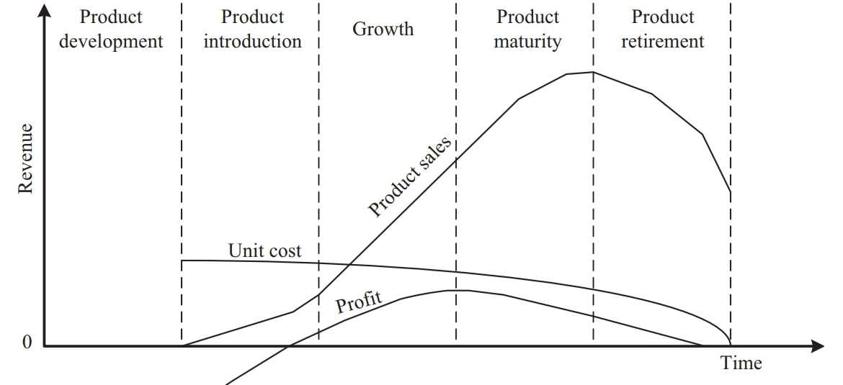
The Product Life Cycle (PLC)

Slide 55
In the growth phase, the product grabs high market share.
During the maturity phase, the growth and sales will be steady and the revenue reaches at its peak.
The Product Retirement/Decline phase starts with the drop in sales volume, market share and revenue.
The decline happens due to various reasons like competition from similar product with enhanced features or technology changes, etc.
At some point of the decline stage, the manufacturer announces discontinuing of the product.

Slide 56
Embedded Systems—Application- and Domain-Specific

Slide 57
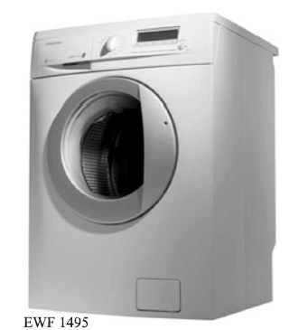
WASHING MACHINE—APPLICATION-SPECIFIC EMBEDDED SYSTEM

Slide 58
The actuator part of the washing machine consists of a motorized agitator, tumble tub, water drawing pump and inlet valve to control the flow of water into the unit.
The sensor part consists of the water temperature sensor, level sensor, etc.
The control part contains a microprocessor/controller based board with interfaces to the sensors and actuators.
The sensor data is fed back to the control unit and the control unit generates the necessary actuator outputs.
The control unit also provides connectivity to user interfaces like keypad for setting the washing time, selecting the type of material to be washed like light, medium, heavy duty, etc.
User feedback is reflected through the display unit and LEDs connected to the control board.

Slide 59
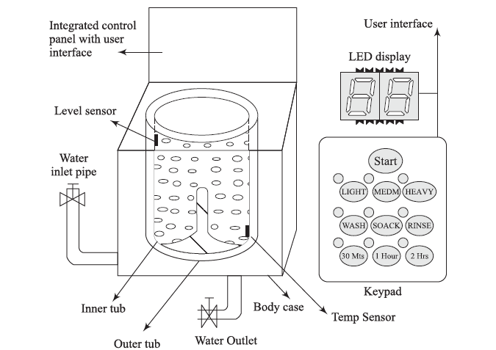

Slide 60
AUTOMOTIVE–DOMAIN SPECIFIC EXAMPLES OF EMBEDDED SYSTEM
Automotive embedded systems are the one where electronics take control over the mechanical and electrical systems.
The presence of automotive embedded system in a vehicle varies from simple mirror and wiper controls to complex air bag controller and Anti-lock Brake Systems (ABS).
Automotive embedded systems are normally built around microcontrollers or DSPs or a hybrid of the two and are generally known as Electronic Control Units (ECUs).

Slide 61
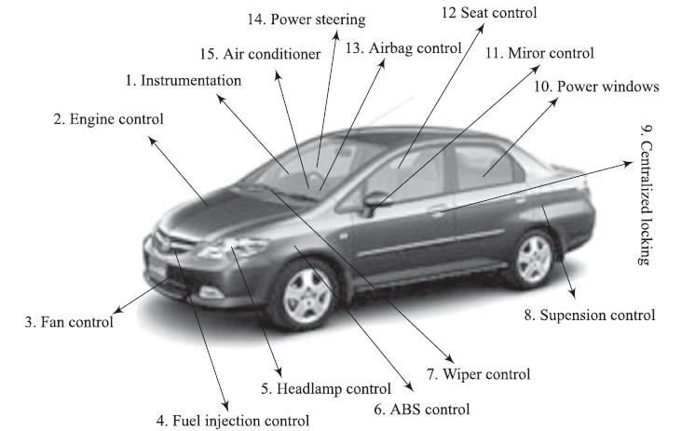

Slide 62
1. Inner Workings of Automotive Embedded Systems
High-speed Electronic Control Units (HECUs) - High-speed electronic control units ( HECUs) are deployed in critical control units requiring fast response. They include fuel injection systems, antilock brake systems, engine control, electronic throttle, steering controls, transmission control unit and central control unit.
Low-speed Electronic Control Units (LECUs) - Low-Speed Electronic Control Units ( LECUs) are deployed in applications where response time is not so critical.

Slide 63
2. Automotive Communication Buses
Controller Area Network (CAN)
Local Interconnect Network (LIN)
Media Oriented System Transport (MOST) Bus

Slide 64
a) Controller Area Network (CAN)
The CAN bus was originally proposed by Robert Bosch, pioneer in the Automotive embedded solution providers.
It supports medium speed (ISO11519-class B with data rates up to 125 Kbps) and high speed (ISO11898 class C with data rates up to 1Mbps) data transfer.
CAN is an event-driven protocol interface with support for error handling in data transmission.
It is generally employed in safety system like airbag control; power train systems like engine control and Antilock Brake System (ABS); and navigation systems like GPS.

Slide 65
b) Local Interconnect Network (LIN)
LIN bus is a single master multiple slave (up to 16 independent slave nodes) communication interface.
LIN is a low speed, single wire communication interface with support for data rates up to 20 Kbps and is used for sensor/actuator interfacing.
LIN bus follows the master communication triggering technique to eliminate the possible bus arbitration problem that can occur by the simultaneous talking of different slave nodes connected to a single interface bus.
LIN bus is employed in applications like mirror controls, fan controls, seat positioning controls, window controls, and position controls where response time is not a critical issue.

Slide 66
c) Media Oriented System Transport (MOST) Bus
The Media Oriented System Transport ( MOST) is targeted for high-bandwidth automotive multimedia networking (e.g. audio/video, infotainment system interfacing), used primarily in European cars.
A MOST bus is a multimedia fibre-optic point-to-point network implemented in a star, ring or daisy-chained topology over optical fibre cables.
The MOST bus specifications defi ne the physical (electrical and optical parameters) layer as well as the application layer, network layer, and media access control.
MOST bus is an optical fi bre cable connected between the Electrical Optical Converter (EOC) and Optical Electrical Converter (OEC), which would translate into the optical cable MOST bus.

Slide 67
3. Key Players of the Automotive Embedded Market
Silicon Providers - Analog Devices, Xilinx, Atmel, Maxim/Dallas, NXP Semiconductor, Renesas, Texas Instruments, Fujitsu, Infineon, Freescale Semiconductor, Microchip
Tools and Platform Providers – ENEA, The MathWorks, Keil Software, Lauterbach, Atego Modeling Tools, Microsoft
Solution Providers - Bosch Automotive, DENSO Automotive, Infosys Technologies, Delphi

Slide 68
a) Silicon Providers
Silicon providers are responsible for providing the necessary chips which are used in the control application development.
The chip may be a standard product like microcontroller or DSP or ADC/DAC chips.
Some applications may require specific chips and they are manufactured as Application Specific Integrated Chip (ASIC).

Slide 69
b) Tools and Platform Providers
Tools and platform providers are manufacturers and suppliers of various kinds of development tools and Real Time Embedded Operating Systems for developing and debugging different control unit related applications.
Tools fall into two categories, namely embedded software application development tools and embedded hardware development tools.
Sometimes the silicon suppliers provide the development suite for application development using their chip.
Some third-party suppliers may also provide development kits and libraries.

Slide 70
c) Solution Providers
Solution providers supply OEM and complete solution for automotive applications making use of the chips, platforms, and different development tools.

