Slide 1
Unit-5
Software Quality
Presentation Material
Department of Computer Science & Engineering
Course Code: | 22CS35XX | Semester: V
Course Title: | Software Engineering & Project Management | Year: III
Faculty Name: | Dr. Shreekant Salotagi

Slide 2
Module-5: Software Quality Syllabus
Defining software quality, quality models, ISO 9126, product and process metrics, product versus process quality management, Quality Management systems, process capability models, techniques to enhance software quality, testing-types, Software reliability, quality plans.

Slide 3
The importance of software quality
Increasing, criticality of software: The final customer or user is naturally anxious about the general quality of software, especially its reliability. software is used in more safety-critical applications, for example to control aircraft.
The intangibility of software: (something that exists but that cannot be touched,) It can make difficult to know that a project task was completed satisfactorily. Task outcomes can be made tangible by demanding that the developer produce deliverables.
Accumulating errors during software development: As computer system development comprises steps where the output from one step is the input to the next, the errors in the later deliverables will be added to those in the earlier steps,
Leading to an accumulating detrimental effect: ln general, the later in a project that an error is found the more expensive it will be to fix. because the number of errors in the system is unknown, the debugging phases of a project are particularly difficult to control.

Slide 4
Defining software quality
Software quality refers to how well a software product meets its intended purpose and satisfies the needs of its users and stakeholders.
Definition/description : definition of the quality characteristic;
Scale: the unit of measurement;
Test: the practical test of the extent to which the attribute quality exists;
Minimally acceptable: the worst value which might be acceptable if other characteristics compensated for it, and below which the product would have to be rejected out of hand;
Target range: the range of values within which it is planned the quality measurement value.
Finally: the value that applies currently.

Slide 5
The Measurements applicable to a quality characteristic
Availability: the percentage of a particular time interval that a system is usable;
Mean time between failures: the total service time divided by the number of failures;
Failure on demand: the probability that a system will not be available at the time required or the probability that a transaction will fail;
Support activity: the number of fault reports that are generated and processed.

Slide 6
Dimensions of Software Quality
Functional Quality:
Reflects how well the software meets functional requirements.
Ensures accuracy, correctness, and completeness.
Non-Functional Quality:
Addresses aspects like performance, scalability, security, and usability. . Includes the software's reliability, efficiency, and maintainability.
Process Quality:
Focuses on how the software is developed. A well-managed . development process leads to higher software quality.

Slide 7
ISO 9126 introduces another type of quality in use
ISO, Offers a structured way to evaluate software and Identifies areas of improvement during the software development lifecycle.
Effectiveness: the ability to achieve user goals with accuracy and completeness;
Productivity: avoiding the excessive use of resources, such as staff effort, in achieving user goals;
Safety: within reasonable levels of risk of harm to people and other entities such as business, software, property and the environment;
Satisfaction: smiling users.

Slide 8
ISO 9126 identifies 6-major external software quality characteristics:
Functional Suitability: Meeting specified requirements.
Reliability: Ability to perform under specified conditions consistently.
Usability: Ease of use and learnability.
Performance Efficiency: Responsiveness and resource usage.
Maintainability: Ease of updates and fixes.
Portability: Adaptability across different environments.
Aditional
Security: Protection against unauthorized access or attacks.
Compatibility: Ability to function in diverse hardware/software ecosystems.

Slide 9
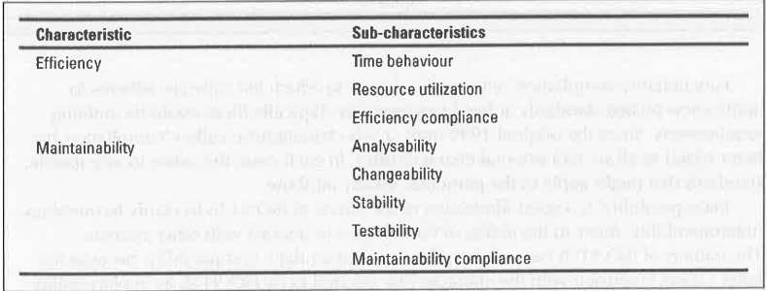
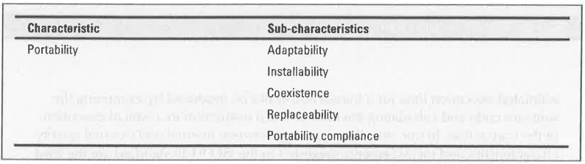

Slide 10
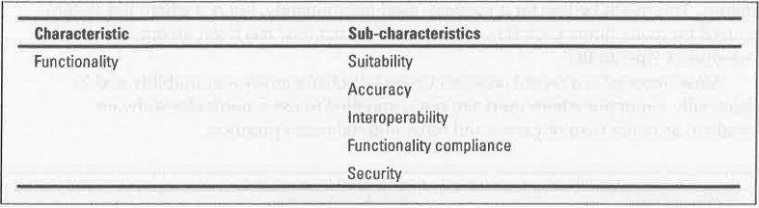
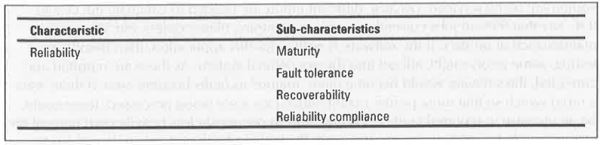
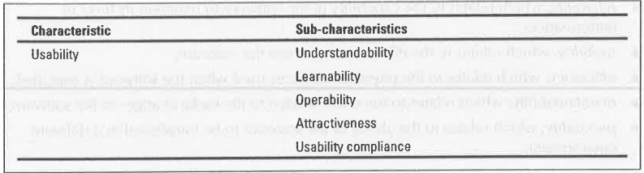

Slide 11
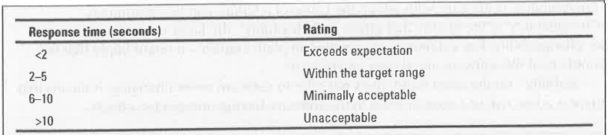
ISO 9126 Suggestions:
Judge the importance of each quality characteristic for the application: Thus reliability will be of particular concern with safety-critical systems while efficiency will be important for some real-time systems.
Select the extremal quality measurements within the ISO 9126 framework relevant to the qualities prioritized above: Thus for reliability mean time between failures would be an important measurement, while for efficiency, and more specifically 'time behaviour', response time would be an obvious measurement.
Map measurements into ratings that reflect user satisfaction For response time, for example, the mappings might be

Slide 12
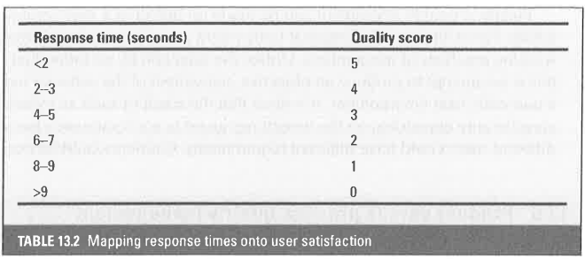
ISO 9126 Suggestions:
Identify the relevant internal measurements and the intermediate products in which they appear this would only be important where software was being developed, rather than existing software being evaluated..
Overall assessment of product quality To what extent is it possible to combine ratings for different quality characteristics into a single overall rating for the software

Slide 13
Product versus process quality management
Entry retirements, which have to be place before an activity can start. An example would be that a comprehensive set of test data and expected results be prepared and approved before program testing can commence.
implementation requirements, which define how the process is to be conducted. In the testing phase, for example, it could be raid down that whenever an error is found and conducted, all test runs must be repeated, even those that have previously been found to run correctly.
Exit requirements, which have to be fulfilled before an activity is claimed to have been completed. For example, for the testing phase to be recognized as being completed, all tests will have to have been run successfully with no outstanding errors.

Slide 14
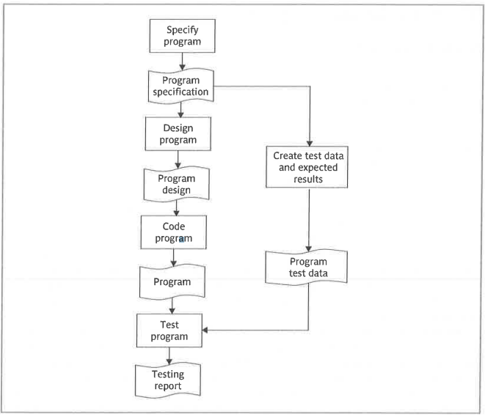
Example for sequence of processes and deliverables

Slide 15
Quality management systems
BS EN IS0 9001:2000 QMS requirements principles
Understanding the requirements of customers so that they can be met, or even exceeded;
leadership to provide the unity of purpose and direction needed to achieve quality objectives;
Involvement of staff at all levels;
A focus on the individual processes which create intermediate or deliverable products and services;
A focus on the systems of interrelated processes that create delivered products and services;
Continuous improvement of processes;
Decision making based on factual evidence;
Building mutually beneficial relationships with suppliers.

Slide 16
BS EN IS0 9001:2000 Principle Activities
Determining the needs and expectations of the customer;
Establishing quality policy, that is, a framework which allows the organization's objectives in relation to quality to be defined;
Design of the processes which will create the products (or deliver the services) which will have the qualities implied in the organization's quality objectives;
Allocation of the responsibilities for meeting these requirements for each element of each process;
Ensuring that resources are available to execute these processes properly;
Design of methods for measuring the effectiveness and efficiency of each process in contributing to the organization's quality objectives;
Gathering of measurements;
Identification of any discrepancies between the actual measurements and the target values;
Analysis and elimination of the causes of discrepancies.
DEDAEDGIA

Slide 17
ISO 9001 requirements for effective QMS
Documentation of objectives, procedures (in the form of a quality manual), plans, and records relating to the actual operation of processes. The documentation must be subject to a change control system that ensures that it is current.
Management responsibility-the organization needs to show that the QMS and the processes that produce goods and services conforming to the quality objectives are actively and properly managed.
Resources - an organization must ensure that adequate resources, including appropriately trained staff and appropriate infrastructure, are applied to the processes.
Production- of goals and the provision of services should be under controlled conditions to ensure adequate provision of information, work instruction, equipment, measurement devices, and post-delivery activities;

Slide 18
Production should be characterized by:
Planning;
Determination and review of customer requirements;
Effective communications between the customer and supplier;
Design and development being subject to planning control and review;
Requirements and other information used in design being clearly recorded;
Design outcomes being verified, validated and documented in a way that provides sufficient information for those who have to use the designs;
Changes to the designs should be properly controlled;
Adequate measures to specify and evaluate the quality of purchased components;
Measurement - to demonstrate that products conform to standards, and the QMS is effective, and to improve the effectiveness of processes that create products or services.

Slide 19
Process capability models
Level 1: “lnitial” The procedures followed tend to be haphazard. Some projects may be successful, but this tends to be because of the skills of particular individuals, including project managers.
Level 2: “Managed” Organizations at this level will have basic project management procedures in place.
Level 3: “Defined” The organization has defined the way that each task in the software development life cycle should be done.
Level 4: “Quantitatively managed” The products and processes involved in software development are subject to measurement and control.
Level 5: “Optimizing” Improvement in procedures can be designed and implemented using the data gathered from the measurement process.

Slide 20
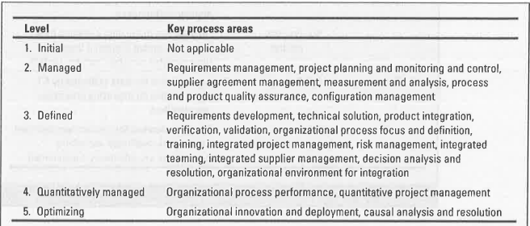
Process capability models

Slide 21
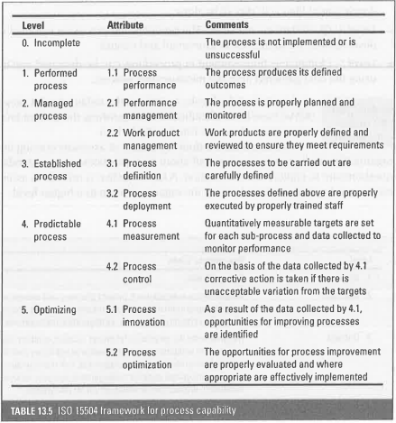
ISO 15504 Process Assessment

Slide 22
Techniques to enhance software quality
Increasing visibility: A landmark in the movement towards a focus on software quality of 'egoless programming'.
Procedural structure: At first, programmers were left to get on with writing programs as best they could.
Checking intermediate stages: lt is tempting to push forward quickly with the development of any engineered object until a 'working‘ model, however imperfect, has been produced which can then be 'debugged'.

Slide 23
lnspections
Inspections: can be applied to documents produced at any development stage. For instance, test cases need to be reviewed their production is usually not a high-profile task even though errors can get through to operational running because of their poor quality.
It is a very effective way of removing superficial errors;
It motivates developers to produce better structured and self-exploratory software;
It helps spread good programming practices as the participants discuss specific pieces of code;
It can enhance team spirit

Slide 24
The general principles behind the Fagan method
Inspections are carried out on all major deliverables'
All types of defect are noted - not just logic or function errors
Inspections can be carried out by colleagues at all levels except the very top
Inspections are carried out using a predefined set of steps
Inspection meetings do not last for more than two hours
The inspection is led by a moderator who has had specific training, in the technique.
The other participants have defined roles. For example, one person will act as a recorder and note all defects found, and another will act as reader and talk the other
participants through the document under inspection.
Checklists are used to assist the fault finding process.
Material is inspected at an optimal rate of about 100 lines an hour'
Statistics are maintained so that the effectiveness of the inspection process can be monitored.

Slide 25
Structured programmg and clean-room software development
A specification team, which obtains the user requirements and also a usage profile estimating the volume of use for each feature in the system;
A development team which develops the code but which does no machine testing of the program code produced;
A certification team which carries out testing

Slide 26
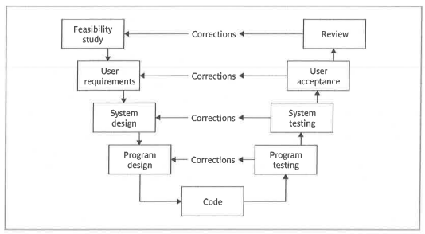
Testing
Testing is the process of evaluating a system, application, or product to ensure that it functions as intended, meets specified requirements, and is free of defects.

Slide 27
Types of Testing
Software Testing: Verifies that a software application performs as expected.
Functional Testing: Ensures the software meets functional requirements (e.g., unit testing, integration testing).
Non-Functional Testing: Examines aspects like performance, usability, and scalability.
Manual Testing: Testers execute test cases manually without using tools.
Automated Testing: Tools or scripts automatically run tests.
Hardware Testing: Checks physical components for defects or malfunctions.
Quality Testing in Manufacturing: Evaluates products for durability, safety, and compliance with standards.
User Acceptance Testing (UAT): Ensures that a product meets user needs and requirements.

Slide 28
Objectives of Testing
Identify and fix bugs or defects.
Validate that the product meets requirements.
Ensure the product is user-friendly and reliable.
Prevent future issues by identifying root causes of defects
Benefits of Testing
Enhances product quality.
Increases customer satisfaction.
Reduces maintenance costs.
Mitigates risks of failure in production environments.

Slide 29
The test cases are run either any one of the following situation
The issue is dismissed on the grounds that there has been a misunderstanding of a requirement by the tester.
The issue is identified as a fault which the developers need to correct – where development is being clone by contractors then they would be expected to cover the cost of the correction.
It is recognized that the software is i:ehaving as specified, but the requirement originally agreed is in fact incorrect - remedying this means adding a new requirement and a contractor could expect to receive payment for the additional work.
The issue is identified as a fault but is treated as an off-specification - it is decided that the application can be made operational with the error still in place.

Slide 30
Quality Plans
Purpose - scope of plan;
List of references to other documents;
Management arrangements, including organization, tasks and responsibilities;
Documentation to be Produced;
Standards, practices and conventions;
Reviews and audits;
Testing;
Problem reporting and corrective action;
Tools, techniques and methodologies;
Code, media and supplier control;
Records collection, maintenance and retention;
Training;
Risk management - the methods of risk management that are to be used

Slide 31
Thank You

