Slide 1


Slide 2
TEAM DETAILS
TEAM NAME:
Hackers
THEME :
AI IN HEALTHCARE
TEAM MEMBERS DETAILS:
Name Email
Phone
College
KARTHIKA M
karthikam3178@gmail.com
8884881806
DAYANANDA SAGAR UNIVERSITY
NAREN YASHWANTH N
narenyashwanth07@gmail.com
7795056371
DAYANANDA SAGAR UNIVERSITY
KARTHIK K P
kachilanda.karthik@gmail.com
9916354434
DAYANANDA SAGAR UNIVERSITY

Slide 3
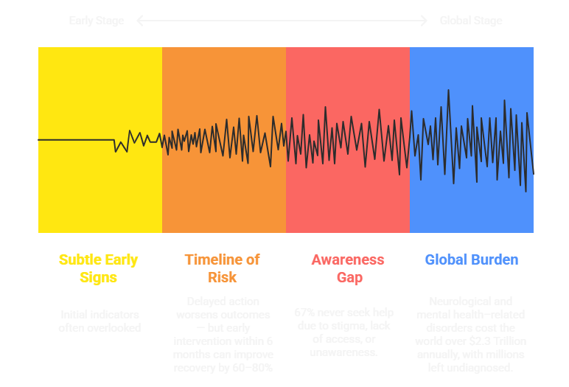
PROBLEM STATEMENT
The Invisible Crisis: Millions in the Blind Spot of Critical Early Warning Signs Going Undetected
Millions silently struggle with focus, fatigue, memory lapses, or emotional stress — yet most never seek help due to stigma, lack of access, or unawareness. ADHD, early Alzheimer’s, PTSD, and learning disorders often begin with subtle signs, long before clinical diagnosis. But today’s tools either rely on intrusive forms or medical infrastructure that many avoid.

Slide 4
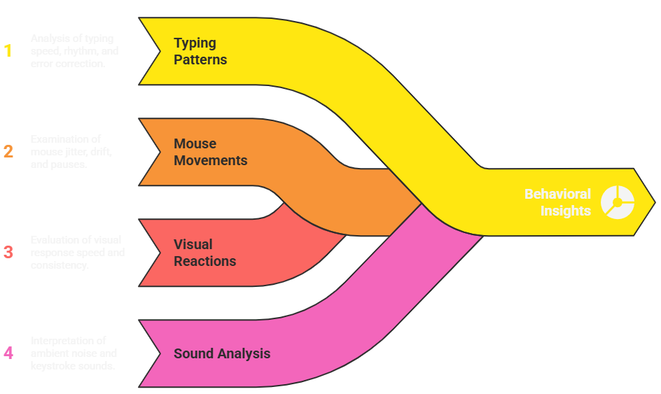
SOLUTION
NeuroSnap AI
“For the elderly parent forgetting more often and the son wondering if it’s just age.”
NeuroSnap AI is an ethical, browser-based platform (no downloads, no intrusive tests) that uses short Gamified Microtasks to passively capture your behavioral signals like-
Mind Snapshot
NeuroSnap AI creates a Mind Snapshot from the tracked behavioral signals
Tracks Mental Fitness across focus, stress, balance, and stability
Insights build from one session up to 30days
Flags concerning patterns subtly (no diagnosis, no stigma) and provides insights
Recommends consulting a professional, enabling timely action and self-awareness

Slide 5


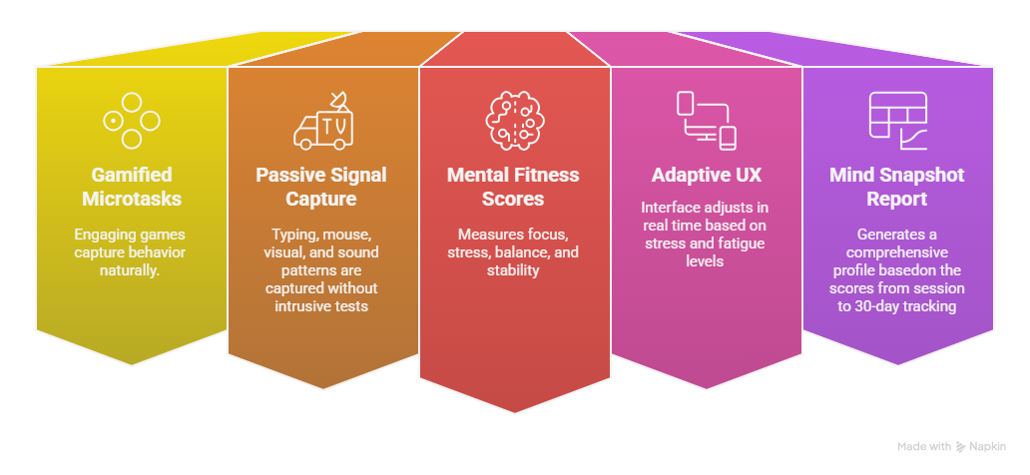
FEATURES
(List 3-4 main features of your solution)

Slide 6
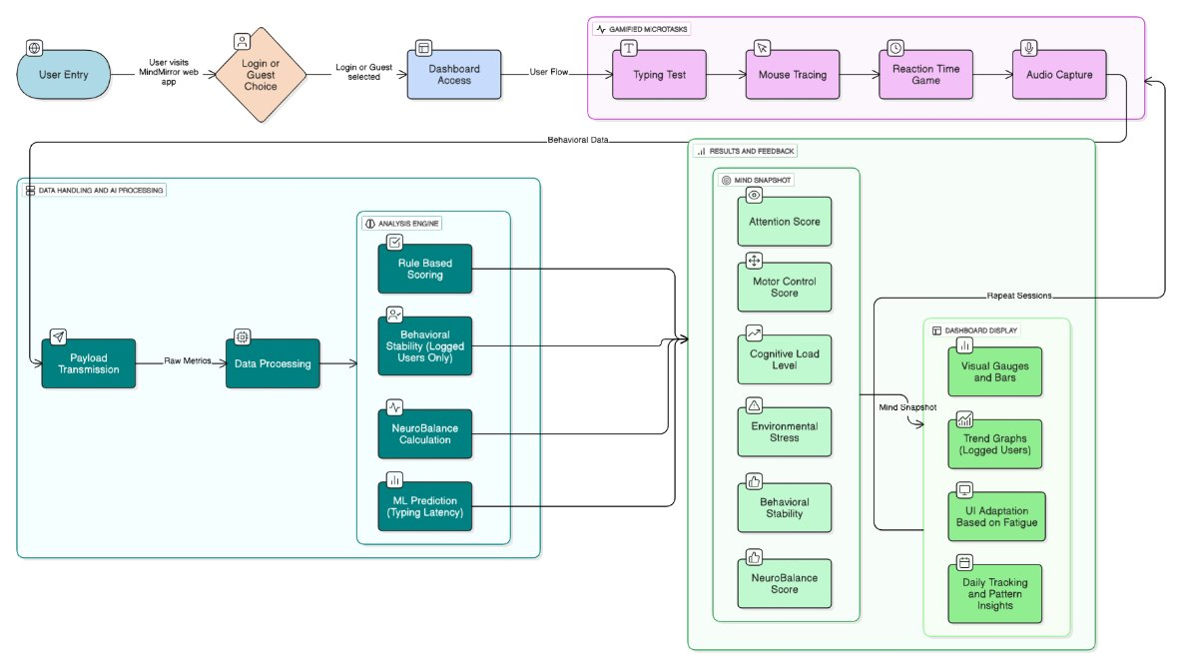
FLOWCHART
How does your solution work?(Flowchart Representation)

Slide 7
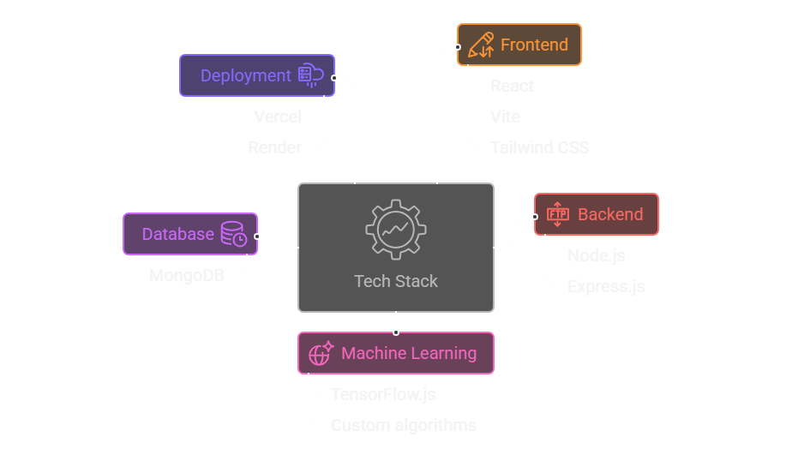
TECH STACK
(Mention programming languages,frameworks, tools)

Slide 8
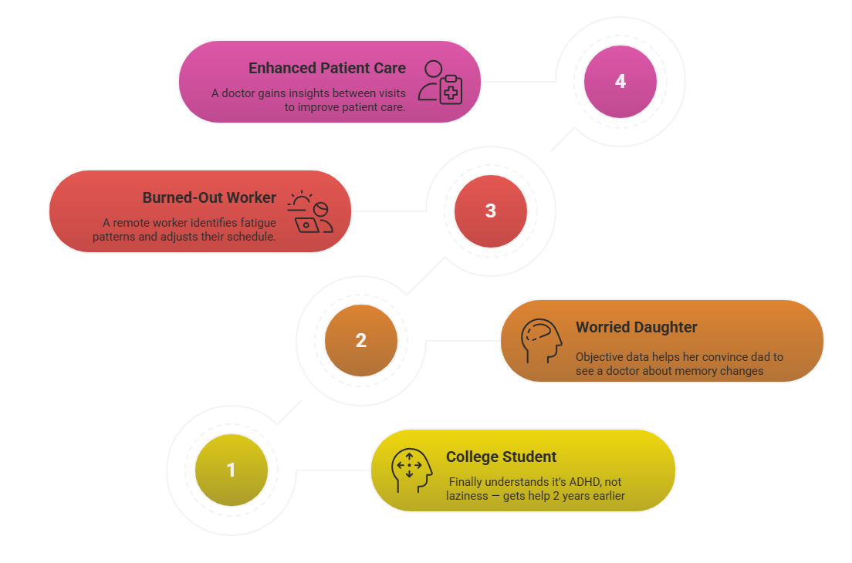
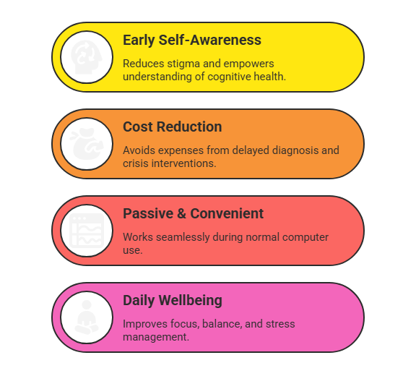
IMPACT
(How does your idea create value?)

