Slide 1

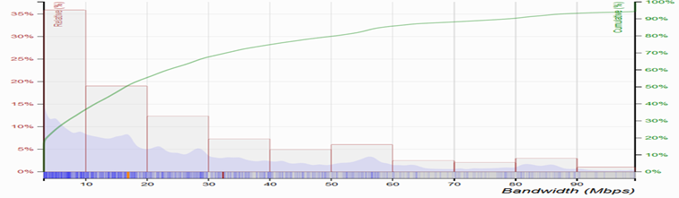
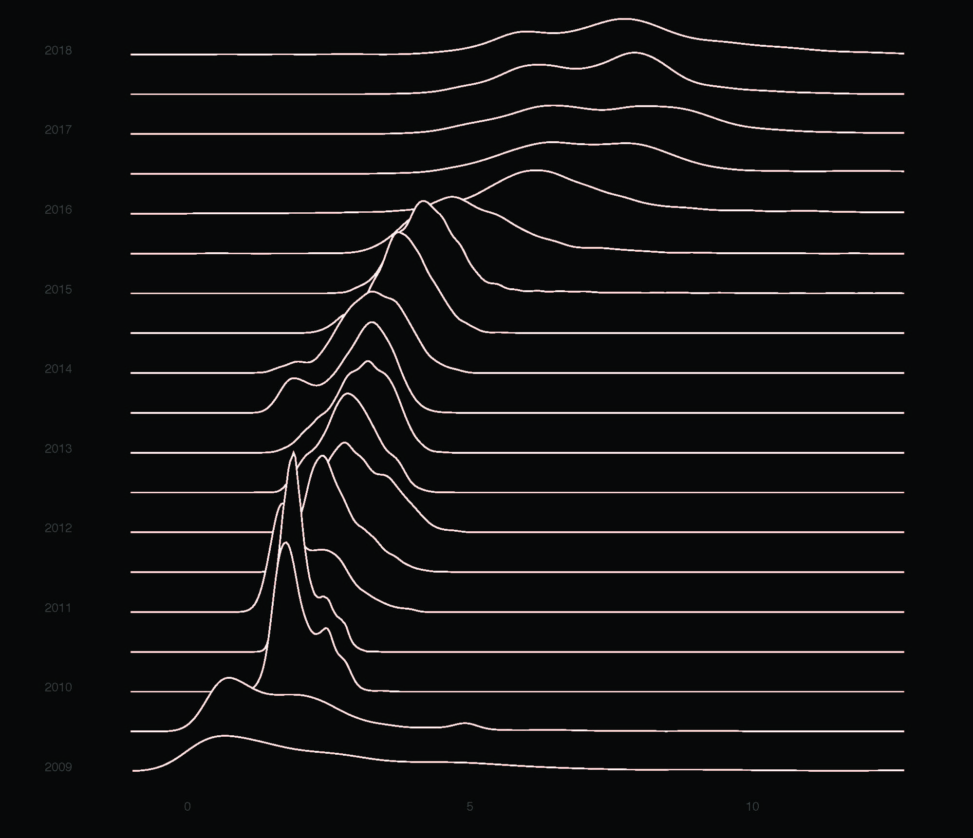
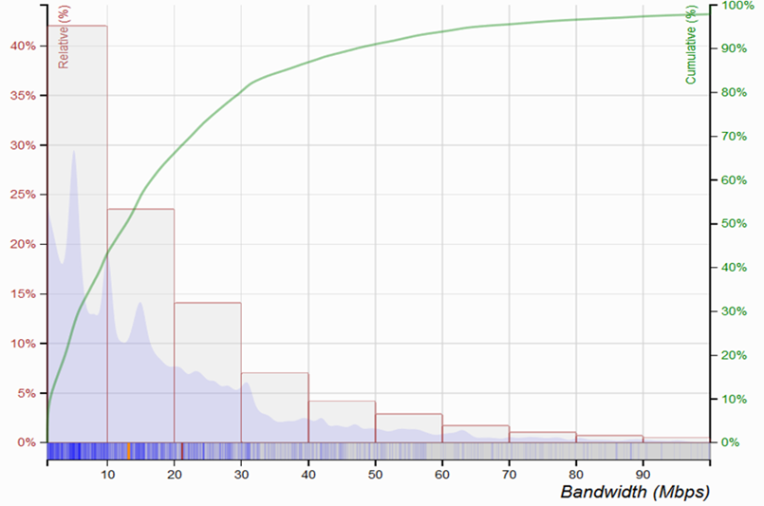
Standardized performance measurements,
cognitive dissonance, and
minimum universal service standards
| Reza Rajabiun
Research Fellow
Ted Rogers School of IT Management
Ryerson University & AMO, CEO eFilters Inc.
Toronto, Canada
10TH ANNIVERSARY
AUGUST 7-8, 2018
US: ~ 35% < 10 Mbps
Canada: ~40% < 10 Mbps
(M-Lab NDT/RIPEstat, 2016)
Notes:
Basic title slide

Slide 2

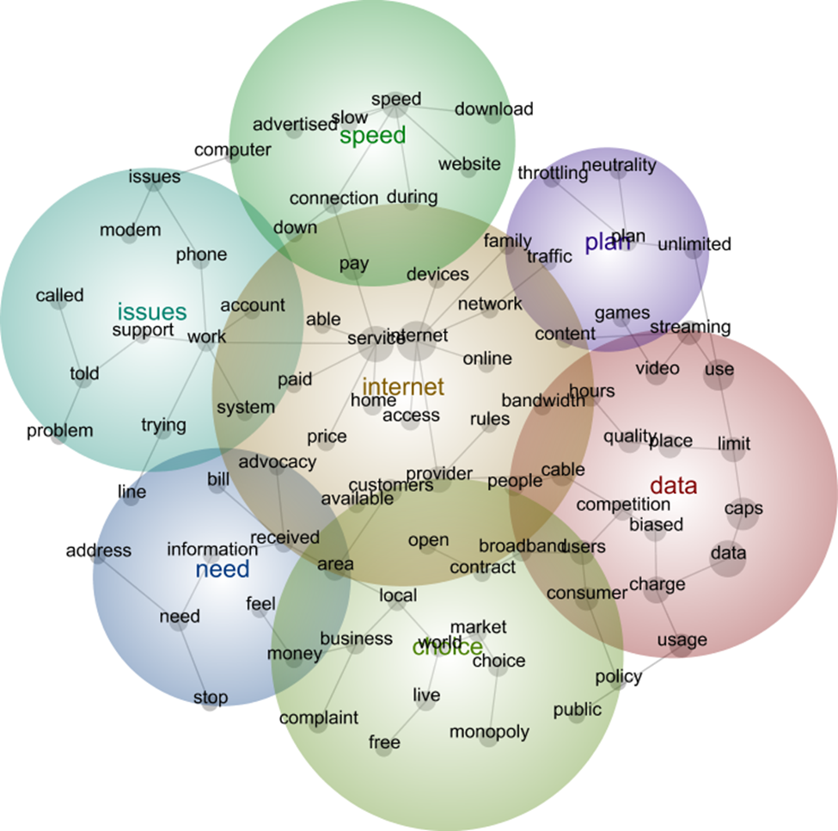
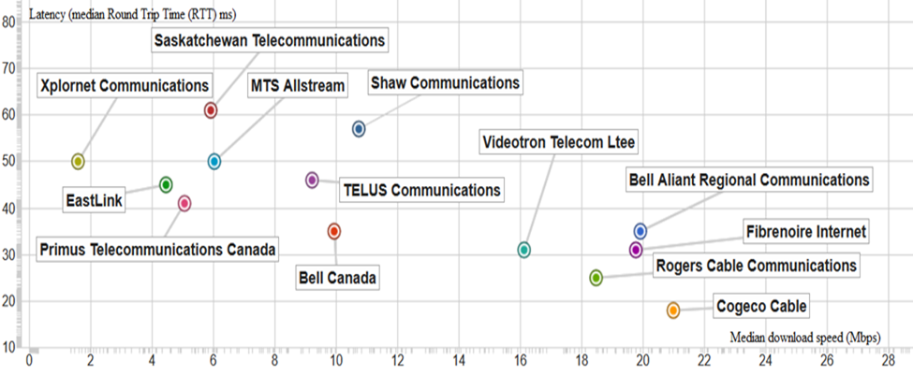
Consumers’ problem: Less than expected “best effort” speeds/QoS & network provider incentives/strategies
NLP analysis of FCC open Internet consumer complaints; NHMC FOIA
FCC NN: Rules v. min. standards
NTIA: Map effective v. advertised
Technological endowments + strategic provisioning choices shaping user experience (Interecon, 2017; JTPO, 2018)
Notes:
Basic text slide

Slide 3
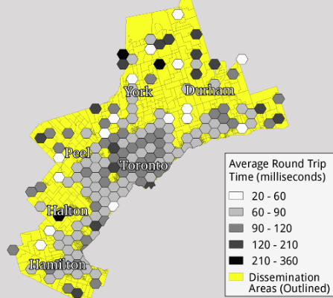
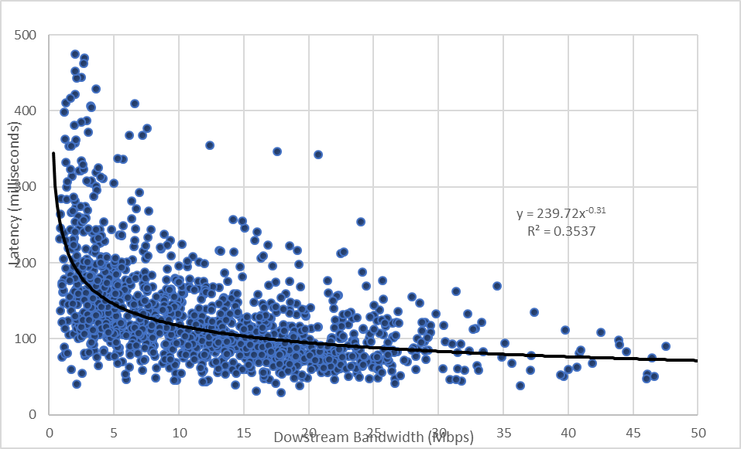
Applications to universal access policy in Canada → CRTC basic service minimum QoS standards
With Fenwick McKelvey, AMO, Concordia
(forthcoming in Information Society)
Not just a rural problem: ON-MOI (GTHA)
→ LTIP (2017)
Magnitude of capacity gaps extensive:
a) Economic Policy → Equality of opportunity/competitiveness
b) Universal access → Negative externalities from prioritized/sponsored “fast lanes”?
c) Strategic policy apps
d) “Big data” & validity
Notes:
Slide with text + image

