Slide 1
COMPILER
main.py
# Modular C Compiler from lexer import Lexer from parser import Parser from semantic import SemanticAnalyzer from optimizer import Optimizer from tac import TACGenerator from codegen import LLVMBackend def compile(src): tokens = Lexer(src).tokenize() ast = Parser(tokens).parse() SemanticAnalyzer(ast).check() Optimizer(ast).optimize() TACGenerator(ast).generate() LLVMBackend(ast).emit()
CONSTRUCTION
FINAL PROJECT
Modular Compiler for a Subset of C
Lexer · Parser (AST) · Semantic Analyzer
Constant Folding · TAC Generator · LLVM Backend
Python 3
LLVM IR
Recursive Descent
Compiler Construction · BSCS-12B · Spring 2026
Muhammad Mahad (408576) · Abdul Moiz (375299) · Muhammad Bashar Siddiqui (366006)

Slide 2
Contents
What's inside this presentation
01
Project Overview
06
Live Demo — Test Case 1
What the compiler does, tech stack, and output files
Simple Arithmetic + Constant Folding
02
Compiler Pipeline
07
Live Demo — Test Case 2
End-to-end six-phase architecture diagram
Loops + Dead Code Elimination
03
Subset & Grammar
08
Live Demo — Test Case 3
Supported features and context-free grammar
Functions + Arrays + LLVM IR
04
Phase Design
09
Limitations & Future Work
Deep dive into each of the 6 compilation phases
Known constraints and next steps
05
Running the Compiler
Setup and CLI usage

Slide 3
Project Overview
01
OUTPUT
FILES
🐍
Pure Python 3
🌳
Recursive Descent AST
No external dependencies. Runs in any standard Python 3 environment out of the box.
Hand-crafted top-down parser builds a full Abstract Syntax Tree for rich semantic analysis.
output
.tac
Three-Address
Code
output
.ll
⚡
Two IR Outputs
🔧
Optimisation Built-In
LLVM IR
for clang
Produces both Three-Address Code (.tac) and LLVM IR (.ll) for native compilation via clang.
Constant Folding and Dead Code Elimination run at the AST level before code generation.
.exe
Native
Binary

Slide 4
Compiler Pipeline
02
Source code enters at the top — each phase transforms it and passes the result to the next
📥 input.c
lexer.py
parser.py
semantic.py
🔤
Lexical Analyzer
🌳
Syntax Analyzer
🔍
Semantic Analyzer
Tokenizes input via regex
Recursive descent — builds AST
Symbol table, scope & type checks
→ Token Stream
→ AST
→ Annotated AST
optimizer.py
tac.py
codegen.py
⚡
Optimizer
📄
TAC Generator
🔧
LLVM Backend
Constant Folding & Dead Code Elim.
Post-order AST traversal → labels
alloca / load / store / getelptr
→ Optimized AST
→ output.tac
→ output.ll

Slide 5
Subset Definition & Grammar
03
Data Types
Arithmetic
Relational
Logical
Control Flow
Functions
int · float · double
+ − × / %
== != < > <= >=
&& || !
if-else · while · for
params · return
Innovation Features:
1D Arrays
Constant Folding
Dead Code Elimination
Context-Free Grammar (excerpt)
Program → Decl* Decl → Type ID ( '(' Params ')' Block | '[' NUMBER ']' ';' | [ '=' Expr ] ';' ) Block → '{' Stmt* '}' Stmt → IfStmt | WhileStmt | ForStmt | ReturnStmt | ExprStmt | Block IfStmt → 'if' '(' Expr ')' Stmt [ 'else' Stmt ] WhileStmt→ 'while' '(' Expr ')' Stmt ForStmt → 'for' '(' ExprStmt Expr ';' Expr ')' Stmt Expr → LogicalOr ( → LogicalAnd → Equality → Relational → Additive → … )

Slide 6
Phase Design — Part 1
04
01
lexer.py
02
parser.py
03
semantic.py
Lexical Analyzer
Syntax Analyzer
Semantic Analyzer
Tokenizes the input source using regular expressions.
Recursive Descent parser that builds a full Abstract Syntax Tree.
Stack-based symbol table enforces scoping and type rules.
Scans character-by-character using regex patterns
One function per grammar rule (parse_stmt, parse_expr, ...)
Push scope on block entry, pop on exit
Identifies: keywords, identifiers, numbers, operators, delimiters
Handles operator precedence through nested calls
Detects: duplicate declarations in same scope
Raises LexError on unrecognized characters
Supports assignment inside expressions for C-style for loops
Validates: variable used before declaration
Produces a flat ordered list of (type, value) token pairs
Raises SyntaxError with meaningful context messages
Checks: array index is an integer expression
example
example
example
int a = 5 + 3;
→ INT ID("a") ASSIGN
INT_LIT(5) PLUS INT_LIT(3) SEMI
int c = a * b;
→ AssignNode(
DeclNode('c'),
BinOpNode('*', ID(a), ID(b))
)
int x = 5;
int x = 3; // ← ERROR
→ SemanticError:
'x' already declared
in this scope

Slide 7
Phase Design — Part 2
04
04
optimizer.py
05
tac.py
06
codegen.py
Optimizer
TAC Generator
LLVM Backend
Performs AST-level optimizations before code generation.
Post-order AST traversal generates flat Three-Address Code.
Generates standard LLVM IR (.ll) from the optimized AST.
Constant Folding: evaluates literals at compile time
Each complex expression decomposed into temp variables (t1, t2…)
alloca for every local variable — proper SSA-like structure
Dead Code Elimination: removes if(0)/while(0) blocks
Labels generated for loops and conditionals (L1, L2…)
load / store pattern mirrors C memory semantics
Runs recursively on all AST nodes
Explicit func / begin_func / end_func / return markers
getelementptr handles array indexing
Reduces TAC and LLVM IR size significantly
Array ops: alloc_array, indexed read/write
Function calls: i32 @fname(i32 %arg, …) convention
example
example
example
int b = 5 + 3;
// After folding:
b = 8 // no add at runtime
if (0) { ... }
// Block removed entirely
t1 = a * b
c = t1
t2 = i < 10
if_false t2 goto L2
...
goto L1
L2:
%1 = alloca i32
store i32 10, i32* %1
%2 = load i32, i32* %1
%3 = mul i32 %2, %4
ret i32 %3

Slide 8
Running the Compiler
05
📁 Project Structure
Terminal
├─ lexer.py
Lexical tokenizer
Step 1 — Place all files in one directory
$
cd compiler/
├─ parser.py
Recursive descent parser
Step 2 — Compile a C source file
$
python main.py input.c
├─ ast_nodes.py
AST node definitions
Step 3 — View TAC output
├─ semantic.py
Symbol table & checker
$
cat output.tac
├─ optimizer.py
Constant fold + DCE
Step 4 — View LLVM IR
$
cat output.ll
├─ tac.py
TAC code generator
Step 5 — Compile to native binary via clang
├─ codegen.py
LLVM IR emitter
$
clang output.ll -o output.exe
Step 6 — Run the executable
├─ main.py
Entry point / orchestrator
$
./output.exe
✓ Zero external dependencies — pure Python 3 standard library only

Slide 9
01
What to expect on the next slides:
📄 Source Code
The C program fed into the compiler
🔣 Generated TAC
Three-Address Code from tac.py
LIVE DEMO
Simple Arithmetic
& Constant Folding
⚙️ LLVM IR
output.ll from codegen.py
test1_arithmetic.c
🖥️ Screenshot
Actual compiler run — all six phases

Slide 10
Test Case 1 — Source Code
test1_arithmetic.c
Constant Folding
test1_arithmetic.c
What the Optimizer Does
int main() { int a = 10; int b = 5 + 3; // Optimizer folds this → 8 int c = a * b; return c; }
🔎 Constant Folding
The expression 5 + 3 is evaluated entirely at compile time. The compiler sees two integer literals, folds them, and emits b = 8 directly into TAC — no addition instruction generated.
📦 No Redundant Instructions
The multiply a * b uses a temp variable (t1) but since a=10 and b=8 are known, a smart further pass could fold this too. The optimizer leaves runtime expressions untouched.
✅ Result
The TAC and LLVM IR are shorter and faster than a naive compile — this is the measurable benefit of compile-time optimisation.
$
python main.py test1_arithmetic.c
→ output.tac + output.ll

Slide 11
Test Case 1 — TAC & LLVM IR
output.tac
output.ll
Three-Address Code
LLVM Intermediate Representation
func main:
begin_func
a = 10
b = 8 // ← folded from 5+3
t1 = a * b
c = t1
return c
end_func
; LLVM IR Generated by Custom Compiler declare i32 @printf(i8*, ...) define i32 @main() { entry: %1 = alloca i32 store i32 10, i32* %1 %2 = alloca i32 store i32 8, i32* %2 ; ← constant folded %4 = load i32, i32* %1 %5 = load i32, i32* %2 %6 = mul i32 %4, %5 store i32 %6, i32* %3 ret i32 %7
}

Slide 12
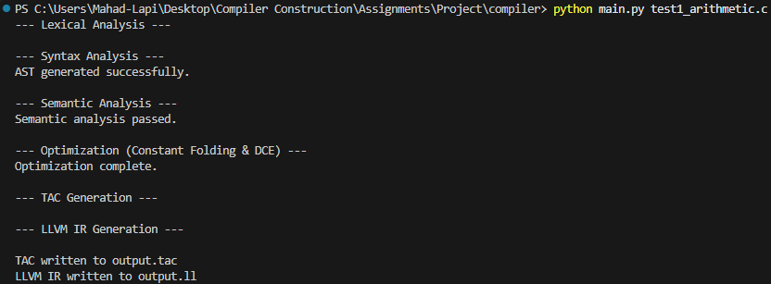
Test Case 1 — Live Terminal Output
python main.py test1_arithmetic.c
Lexer
Parser + Semantic
Optimizer
Output
Tokenization completes without errors
AST built, semantic checks passed
Constant folding & DCE applied
output.tac and output.ll written

Slide 13
02
What to expect on the next slides:
📄 Source Code
The C program fed into the compiler
🔣 Generated TAC
Three-Address Code from tac.py
LIVE DEMO
Loops & Dead Code
Elimination
⚙️ LLVM IR
output.ll from codegen.py
test2_loops.c
🖥️ Screenshot
Actual compiler run — all six phases

Slide 14
Test Case 2 — Source Code
test2_loops.c
Dead Code Elimination
test2_loops.c
Key Concepts Demonstrated
int main() { int sum = 0; int i = 0; while (i < 10) { sum = sum + i;
i = i +
1; } int j; for (j = 0; j < 5; j = j + 1) { sum = sum + j; } if (0) { // ← DEAD CODE — eliminated! sum = 0; } return sum;
}
while loop → TAC labels
L1/L2 labels with if_false and goto — standard structured loop translation.
for loop → same pattern
For loop desugared into init + while-style conditional, matching C semantics precisely.
Dead Code Elimination
if(0) { ... } block detected at optimizer level — the entire block is dropped before TAC/LLVM generation. Zero instructions emitted for it.
Temp variables
Each binary op gets its own temp (t1, t2, t3…), keeping TAC in strict three-operand form.

Slide 15
Test Case 2 — Three-Address Code
output.tac
TAC Structure Analysis
Three-Address Code
func main:
begin_func
sum =
0 i = 0 L1: // while loop start t1 = i < 10 if_false t1 goto L2 t2 = sum + i sum = t2 t3 = i + 1 i = t3 goto L1 L2: // for loop init j = 0 L3: // for loop start t4 = j < 5 if_false t4 goto L4 t5 = sum + j sum = t5 t6 = j + 1 j = t6 goto L3 L4: // if(0) block ELIMINATED
L1 → L2
while (i < 10) loop — 7 TAC instructions total
L3 → L4
for (j=0; j<5; j++) loop — 7 TAC instructions
if(0) block
ELIMINATED — 0 instructions. Only the label L4 remains as a jump target.
Temporaries
t1…t6 — each a single binary op result. Clean SSA-style naming.
Labels
L1, L2, L3, L4 — deterministic sequential labelling across all control flow.

Slide 16
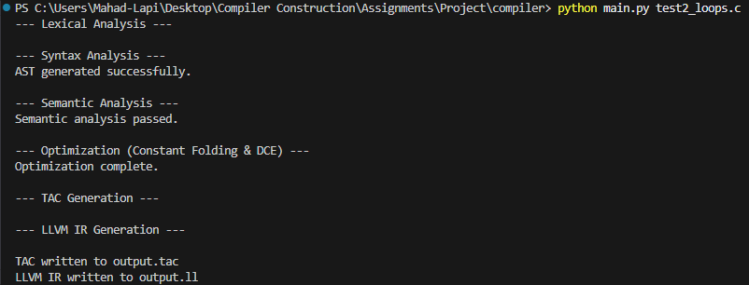
Test Case 2 — Live Terminal Output
python main.py test2_loops.c
✓ 6 Phases Complete
🔴 Dead Code Removed
📄 Both Outputs
All six pipeline stages ran and completed without errors.
if(0) block silently eliminated — 0 TAC instructions generated for it.
output.tac (3 loops, labels L1–L4) and output.ll written to disk.

Slide 17
03
What to expect on the next slides:
📄 Source Code
The C program fed into the compiler
🔣 Generated TAC
Three-Address Code from tac.py
LIVE DEMO
Functions & Arrays
+ LLVM Backend
⚙️ LLVM IR
output.ll from codegen.py
test3_functions_arrays.c
🖥️ Screenshot
Actual compiler run — all six phases

Slide 18
Test Case 3 — Source Code
test3_functions_arrays.c
Functions
1D Arrays
test3_functions_arrays.c
What This Tests
// User-defined function int add(int x, int y) { return x + y; } int main() { int arr[5]; // 1D array alloc arr[0] = 10; arr[1] = 20; int result = add(arr[0], arr[1]); return result;
}
🔤 Function Definition & Call
Compiler handles multi-function programs. add() is emitted first as a separate LLVM function with its own entry block.
🗃️ 1D Array Allocation
alloc_array arr, 5 in TAC maps to alloca i32, i32 5 in LLVM — the compiler correctly emits sized stack allocation.
📍 Array Indexing (getelementptr)
Read/write via arr[0] and arr[1] use getelementptr to compute element addresses — correct LLVM idiom.
📨 Parameter Passing
TAC param / call maps to LLVM i32 @add(i32 %6, i32 %8) — values loaded from array then passed by value.

Slide 19
Test Case 3 — TAC & LLVM IR
output.tac
output.ll
Three-Address Code
LLVM Intermediate Representation
func add: begin_func t1 = x + y return t1 end_func func main: begin_func alloc_array arr, 5 arr[0] = 10 arr[1] = 20 t2 = arr[0] t3 = arr[1] param t2 param t3 t4 = call add, 2 result = t4
return result
end_func
define i32 @add(i32 %x_arg, i32 %y_arg) { entry: %1 = alloca i32 store i32 %x_arg, i32* %1 %2 = alloca i32 store i32 %y_arg, i32* %2 %5 = add i32 %3, %4 ret i32 %5 } define i32 @main() { entry: %1 = alloca i32, i32 5 ; arr[5] %2 = getelementptr i32, i32* %1, i32 0 store i32 10, i32* %2 %3 = getelementptr i32, i32* %1, i32 1 store i32 20, i32* %3 %9 = call i32 @add(i32 %6, i32 %8) ret i32 %10
}

Slide 20
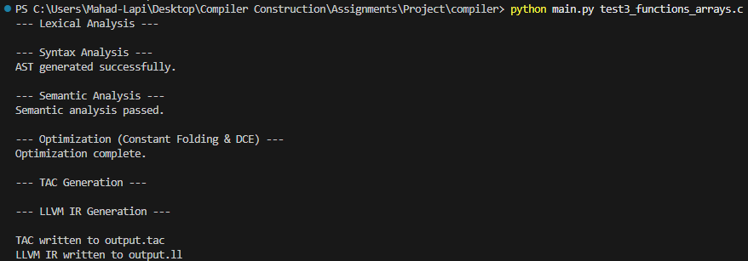
Test Case 3 — Live Terminal Output
python main.py test3_functions_arrays.c
✓ Multi-function
🗃️ Array ops
📨 Function call
Both @add and @main functions emitted correctly in LLVM IR.
getelementptr used for arr[0] and arr[1] — standard LLVM indexing.
@add(i32 %6, i32 %8) — values loaded from array and passed by value.

Slide 21
Limitations & Future Work
09
📦
1D Arrays Only
🚫
No Pointers / Structs
NOW
Single-dimensional arrays supported
NOW
Pointers and struct types are not in the grammar
Extend to multi-dimensional arrays and pointer arithmetic
Add pointer types (*) and struct definition / member access
NEXT
NEXT
⚡
No Short-Circuit Evaluation
🔢
Limited Type Promotion
NOW
Both sides of && / || always evaluated in LLVM IR
NOW
Implicit int↔float promotion is basic and incomplete
Implement lazy evaluation with conditional branches in codegen
Full type coercion table with float/double promotion rules
NEXT
NEXT

Slide 22
Thank You
Modular Compiler for a Subset of C
Lexer · Parser (AST) · Semantic Analyzer · Optimizer · TAC · LLVM Backend
Muhammad Mahad (408576) · Abdul Moiz (375299) · Muhammad Bashar Siddiqui (366006)
Compiler Construction · BSCS-12B · Spring 2026
Python 3
LLVM IR
Recursive Descent
Constant Folding
Dead Code Elim.
python main.py input.c → output.tac + output.ll

