Slide 1
Umbilical cord blood lead levels: predictions using micro-spatial child dentine measures.
Scuola di Economia e Statistica
Corso di Laurea Magistrale in BIOSTATISTICA
Marta Mainetti
Mat. 850868
Relatore: Prof. Giorgio Vittadini
Correlatore: Dr. Elena Colicino*
14th February 2025
* Department of Environmental Medicine and Climate Science
Icahn School of Medicine at Mount Sinai, New York, US.

Slide 2
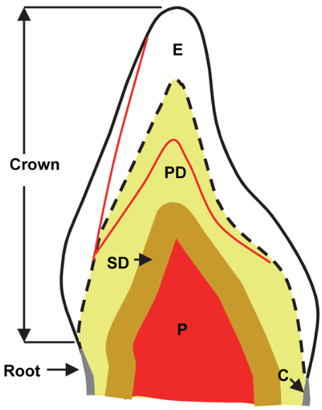
Background
Weekly time series^{1,2} of exposure to lead from tooth formation to the natural shedding of the tooth.
Exposure to lead and lead burden
Mothers transferring toxicity (in utero and ex utero)
Tooth dentine mineralization and lead burden
Lead Exposure
Umbilical cord blood lead
Measured at birth (μg/L)
Early childhood

Slide 3
Aims of the Project
Predict lead levels in cord blood from the lead levels measured in dentine of deciduous teeth
Assess the timepoints that better reflect the lead levels at birth
Duplex analysis:
No toxicity threshold for dentine lead levels
Continuous cord blood lead levels predictions.
Binary predictions: classifying the children in high and low lead levels (35 μg/L, CDC threshold).

Slide 4
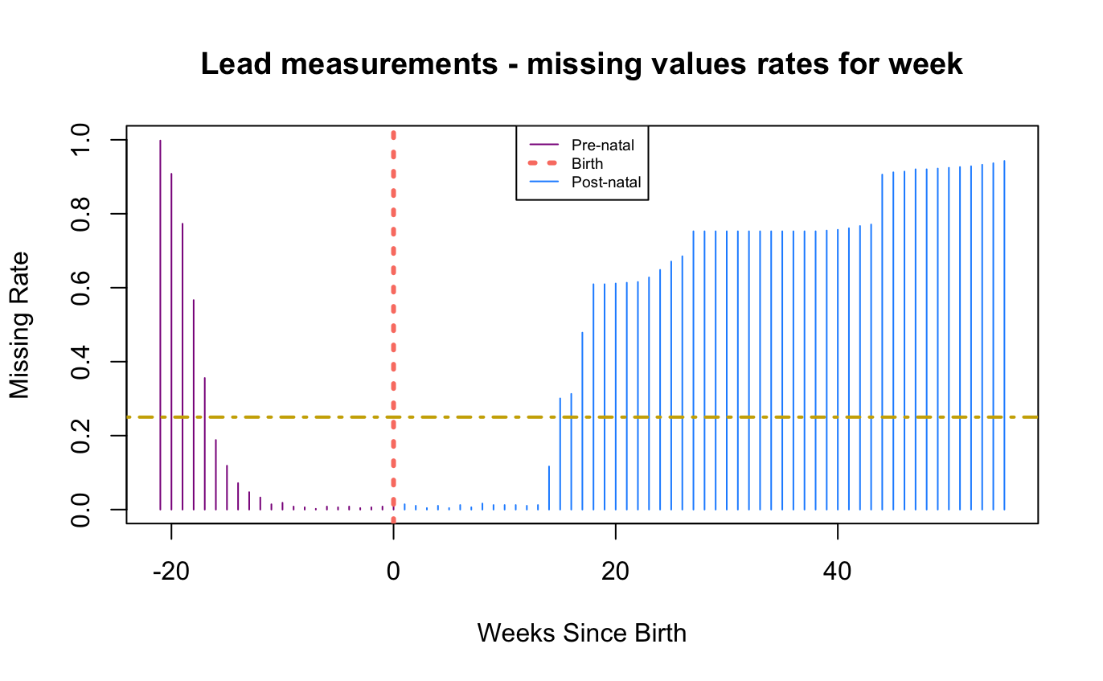
Data pre-processing: Sample selection
948 mother-child pairs involved in the PROGRESS study
489 children with dentine lead levels data
481 children with < 25% missing values in [-16, 14]
-16
14
259 children with cord blood lead levels
1 outlier
258 children in the main analysis

Slide 5
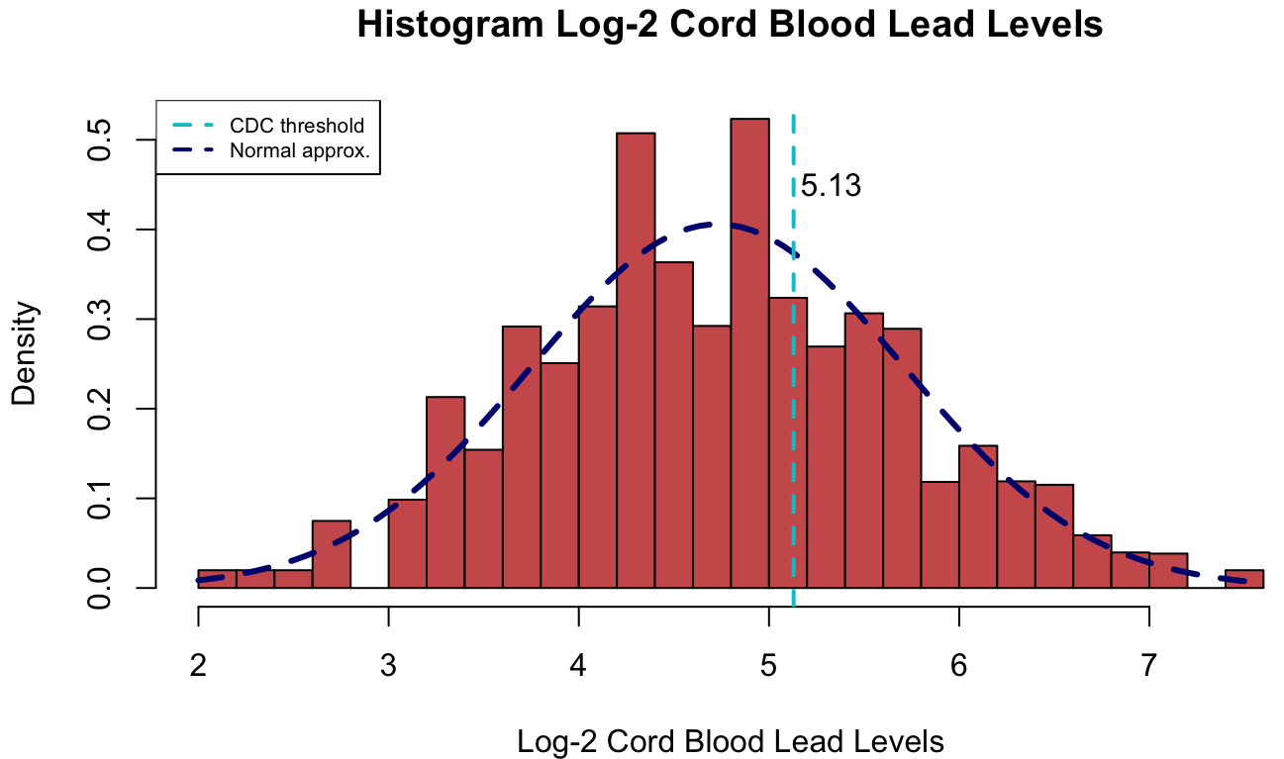
Data pre-processing: Exploratory Analysis
Log-2 transformation of lead levels:
Normality of the outcome (cord blood);
Interpretation of the exposure (dentine).
PROGRESS Participants Characteristics |  | Mean (SD) or N (%)
Socio-Economic Status | 1 - Low | 137 (53.1%)
 | 2 - Medium | 94 (36.4%)
 | 3 - High | 27 (10.5%)
Second-hand smoke exposure | No | 169 (65.5%)
 | Yes | 89 (34.5%)
Gender of the child | Male | 147 (57.0%)
 | Female | 111 (43.0%)
Maternal age (years) |  | 28.7 (5.6)
Cord Blood Lead Levels (μg/L) |  | 33.5 (25.6)
Log-2 Cord Blood Lead Levels |  | 4.73 (0.983)
Cord Blood Lead Levels | High (>35 μg/L) | 84 (32.6%)
 | Low (≤ 35 μg/L) | 174 (67.4%)

Slide 6
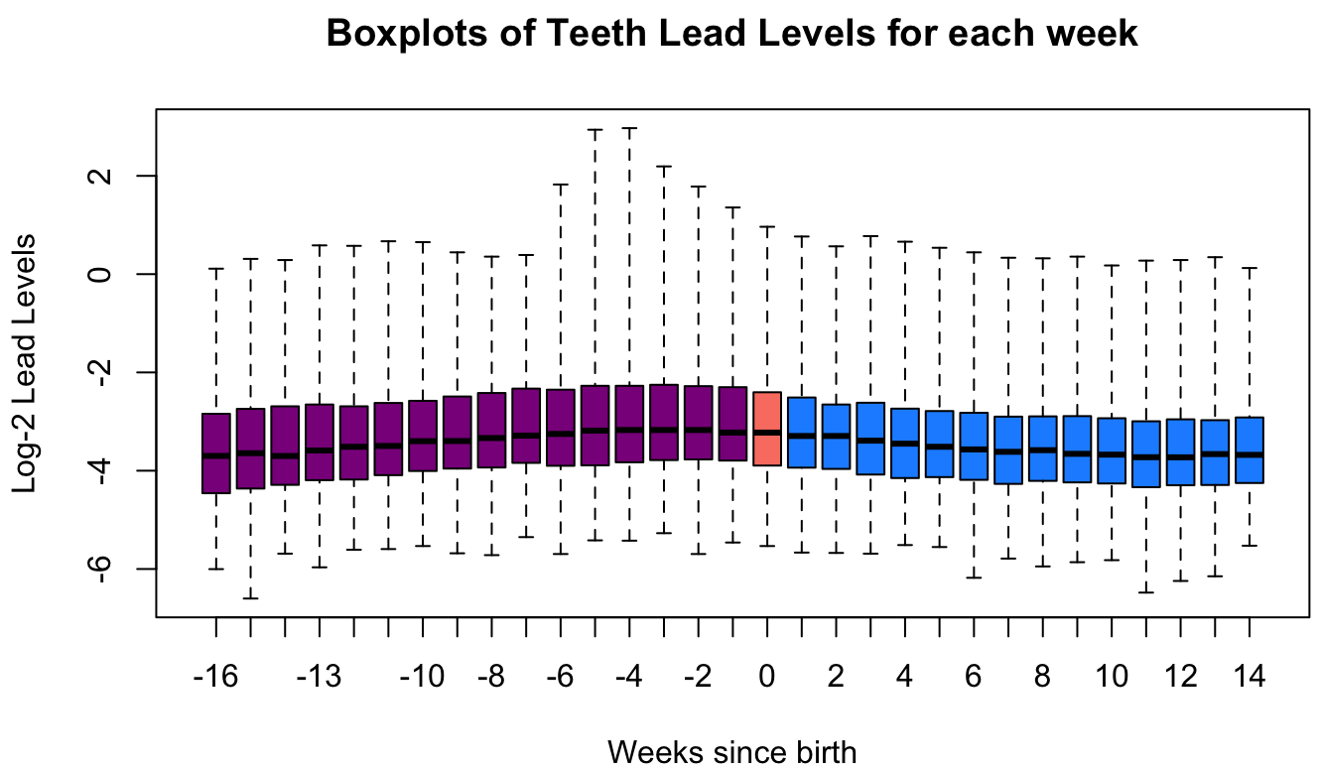
Deciduous teeth: Dentine Lead Levels
Missing Value imputation: Copy Mean³
Population mean
linear interpolation
In parallel, we considered narrowing the temporal span from 8 weeks before to 8 weeks after birth (17 weeks).

Slide 7
Statistical Methods: Super Learner⁴
Ensemble prediction algorithm
Collection of candidate learners
Learning data
Regression of the outcome on the
Cross Validated Predictions
Weights of ensemble prediction (Linear Combination)
Training set (80%): 206 - Testing set (20%): 52 subjects
5-fold Cross-Validation
100 iterations: average MSE and AUC
Small sample size
Considered both the 31-week and 17-week model
Dentine lead levels (Exposure):
Major predictors
Consecutive difference of exposure
Unscaled and scaled continuous covariates (exposure and mother’s age)
8 different settings

Slide 8
Super Learner: Candidate Learners
XGBOOST⁵
17-week model performance
Algorithm | MSE | AUC | MSE - scaled | AUC - scaled
XGBoost | 0.523 | 0.847 | 0.523 | 0.847
BKMR | 0.545 | 0.850 | 0.543 | 0.850
Super Learner | 0.547 | 0.848 | 0.561 | 0.847
Linear Model | 0.572 | 0.846 | 0.572 | 0.846
GAM | 0.575 | 0.843 | 0.575 | 0.843
HAL | 0.598 | 0.842 | 0.600 | 0.847
Mean | 0.973 | 0.500 | 0.973 | 0.500
PolyMars | 1.05 | 0.804 | 1.15 | 0.799
BKMR
POLYMARS
HAL
LINEAR MODEL
GAM
EXTREME GRADIENT BOOSTING ON 17-WEEK EXPOSURE

Slide 9
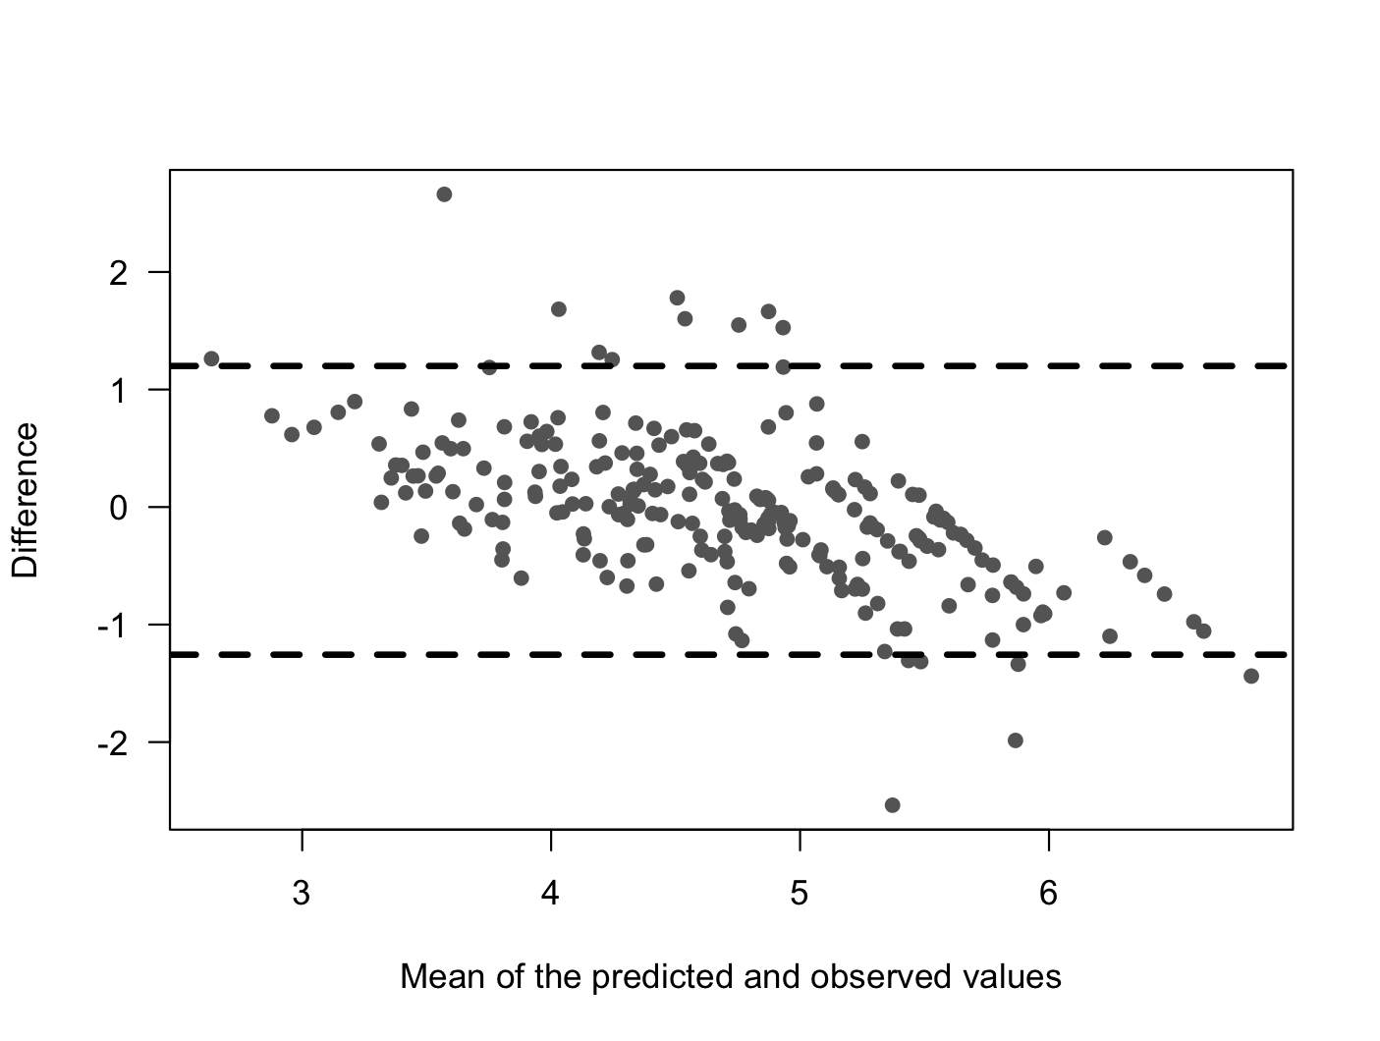
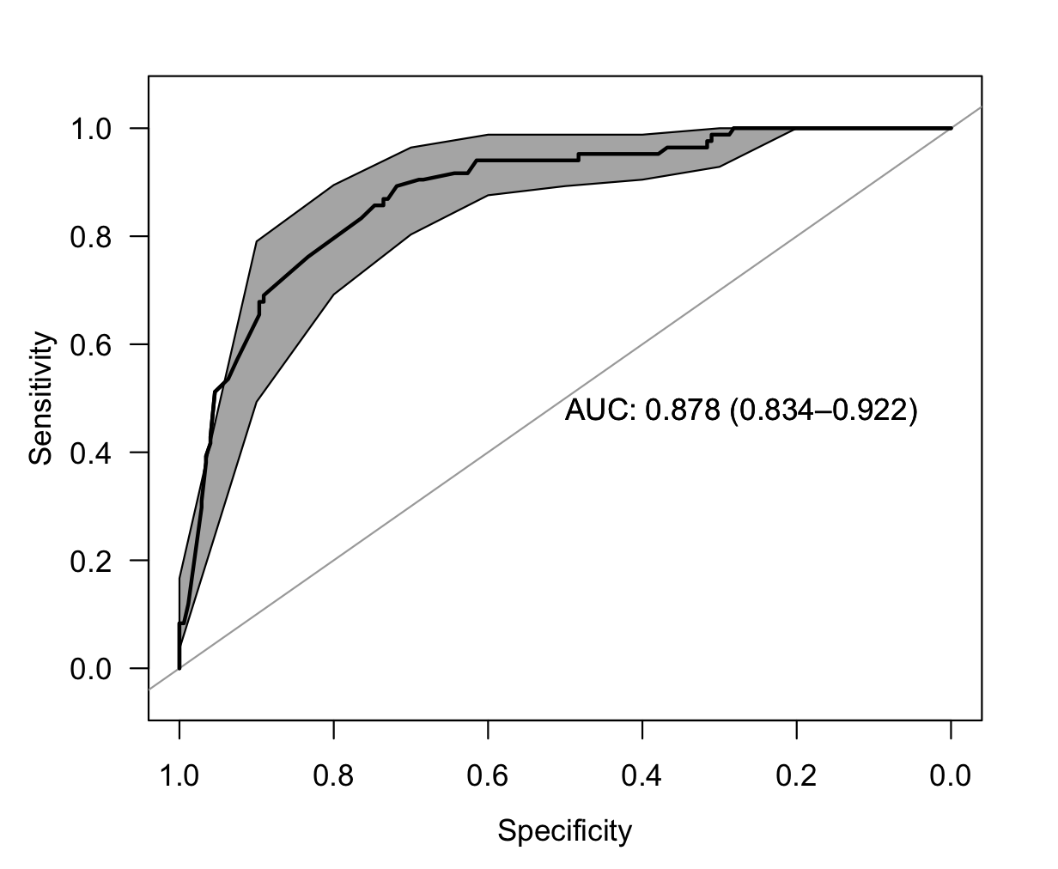
PERFORMANCE: Bland-Altman and ROC Curve
MSE = 0.392

Slide 10
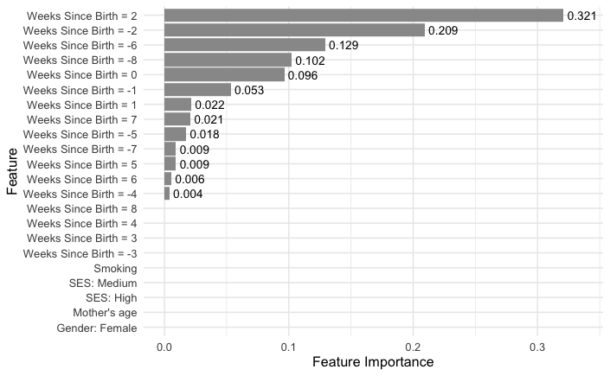
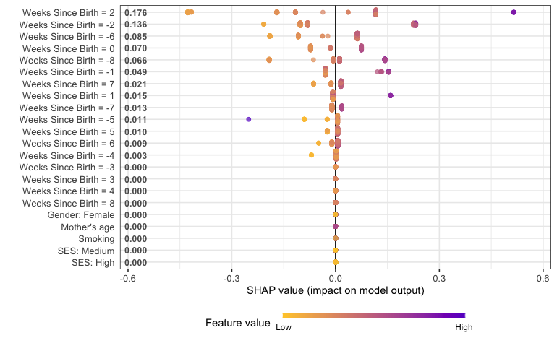
Explainability: Importance and SHAP

Slide 11
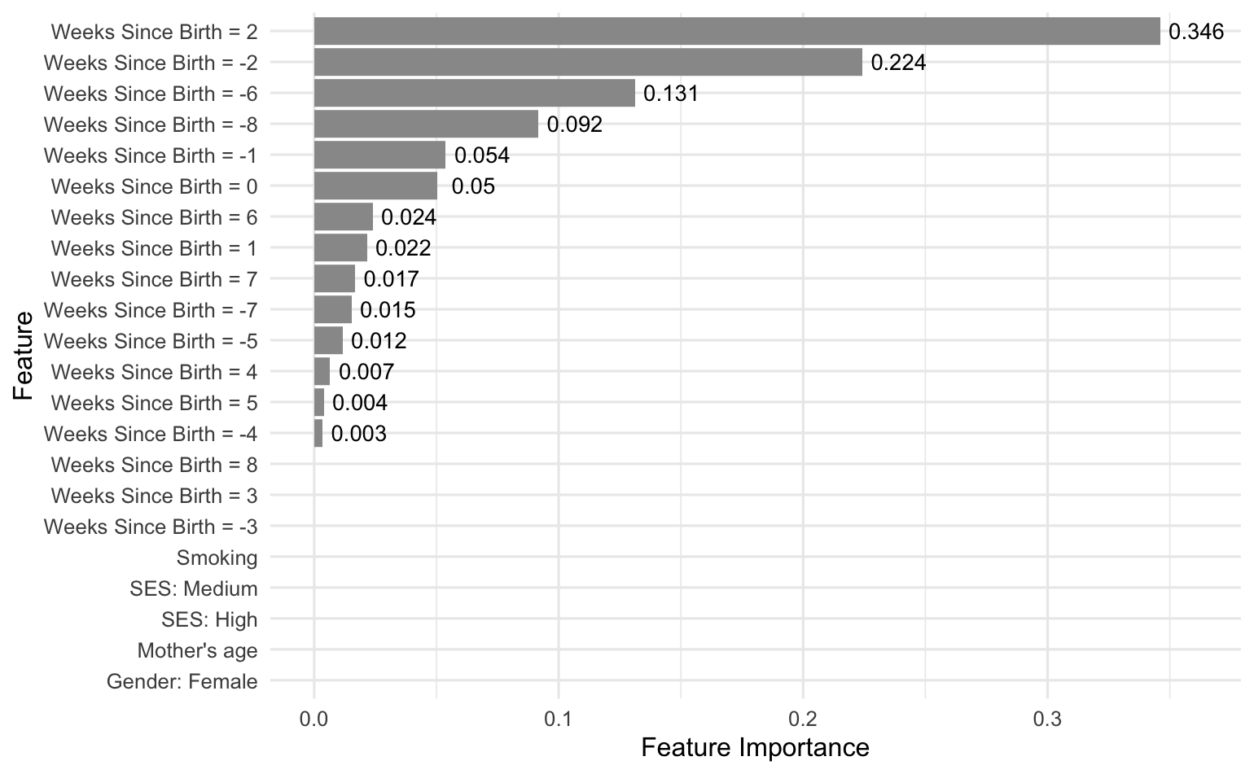
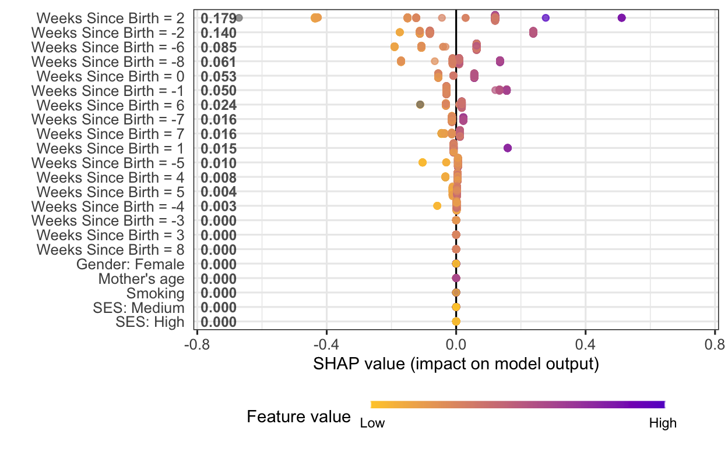
XGBoost: Missing values handling
Since XGBoost can handle missing data efficiently, we computed the model without imputing the unobserved values on the exposure (exposure in [-8, 8])
MSE = 0.390 (vs. 0.392); AUC = 0.878 (vs. 0.878)
Consistent results in terms of importance and SHAP

Slide 12
Conclusion: Key findings
The estimator chosen for the predictions is the XGBoost with the 17 week exposure
-8 -7 -6 -5 -4 -3 -2 -1
0
1 2 3 4 5 6 7 8
Weeks Since Birth
The most important timepoints with highest SHAP are +2, -2, -6, -8 and 0 weeks since birth
Socio-demographic covariates have no importance nor impact on the cord blood lead levels
Low influence of exposure missing values on the performance of the model - validity of imputation method

Slide 13
LIMITS
FURTHER DEVELOPMENTS
Reduced sample size due to missing values on lead levels in cord blood
Add other adjustment covariates:
Calcium and caffeine intake
Last Menstrual Period
Number of months of breastfeeding
Low generalizability of the model
Validate results on another hispanic cohort
3

Slide 14
Main References
Arora M, et al. Spatial distribution of lead in human primary teeth as a biomarker of pre- and neonatal lead exposure. Science of the Total Environment 371 2006: 55–62.
Arora M, Austin C. Teeth as a biomarker of past chemical exposure. Curr Opin Pediatr 2013, 25:261 – 267.
Genolicini C, et al. Copy Mean: A New Method to Impute Intermittent Missing Values in Longitudinal Studies. Open Journal of Statistics, 2013, 3, 26-40.
Van der Laan MJ, Polley EC, Hubbard AE. Super Learner. Statistical Applications in Genetics and Molecular Biology 2007, Vol. 6 Issue 1 Article 23.
Chen T, Guestrin C. XGBoost: A Scalable Tree Boosting System. KDD 2016, San Francisco.

Slide 15
THANK YOU FOR YOUR ATTENTION!
"Research is to see what everybody else has seen and think what nobody else has thought." — Albert Szent-Györgyi

