Slide 1
Sprint Seven
Team 205
Amardeep Singh
Nitin Sharma
Zufar Islam
Josh Ryan MacAdangdang
Matthew McArdle
Cody Nguyen
Maxim Brochin
CIS*3760
2022-10-03

Slide 2
What Went Well
The team was great at completing and delivering on their tasks
Everyone had the initiative to help one another understand the different components for this sprint
Completed the tasks early
2022

Slide 3
Improvements
Communicate more frequently on task completions
Outline more transparent requirements for each task
2022

Slide 4
46 Hours
Total Time Spent for Sprint 7
2022

Slide 5
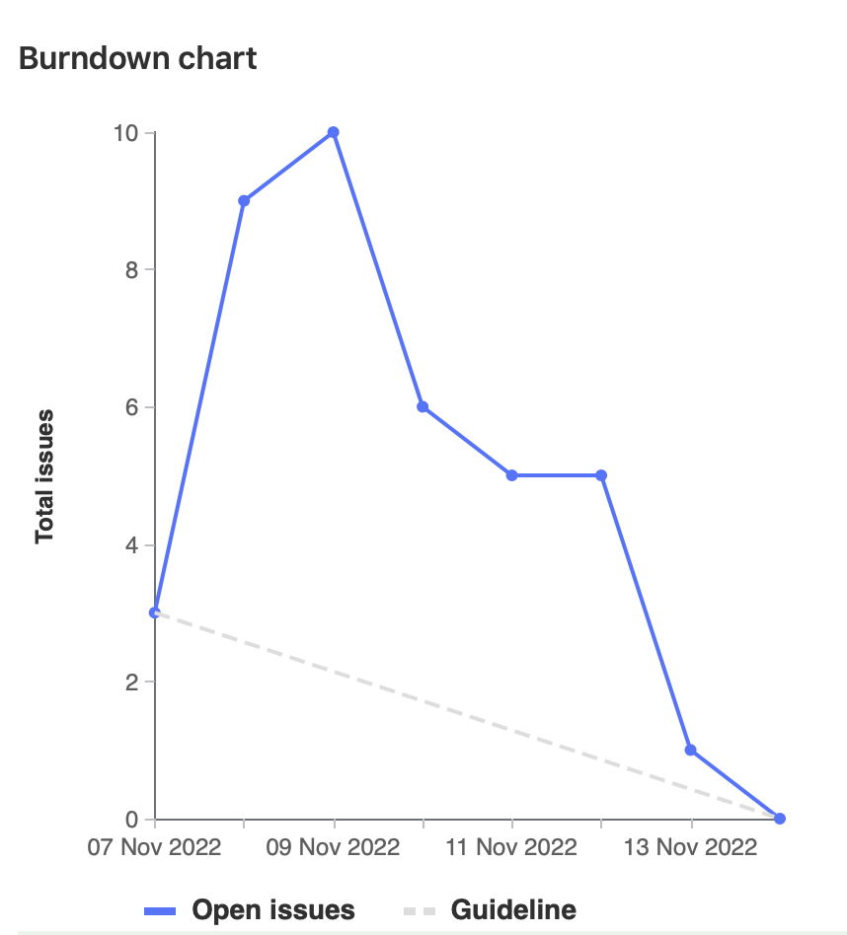
Burn Down Chart
2022

Slide 6
Amardeep Singh
Time 6.5 Hours | Weight 13
2022

Slide 7
Amardeep Singh
Research
Code Linting
Development
Time 6.5 Hours | Weight 13
Researched about code linting, GitLab CI/CD, and testing
Helped with Python code linting for API code
Added job to GitLab CI/CD for linting Python code for the API
2022

Slide 8
Matthew McArdle
Time 7 Hours | Weight 14
2022

Slide 9
Matthew McArdle
Development
Time 7 Hours | Weight 14
Created GitLab CI/CD pipeline
Created Deploy-Api and Deploy stages
Set up Cypress E2E Testing
Set up React unit testing
Knowledge-shared with rest of the group
2022

Slide 10
Nitin Sharma
Time 6.5 Hours | Weight 13
2022

Slide 11
Nitin Sharma
Research
Development
Time 6.5 Hours | Weight 13
Researched GITLAB CI/CD, Testing libraries, and code linting
Worked during team session on linting API code
2022

Slide 12
Josh Ryan MacAdangdang
Time 6 Hours | Weight 12
2022

Slide 13
Josh Ryan MacAdangdang
Research
Other
Time 6 Hours | Weight 12
Researched Code Linting frameworks.
Observed Cypress E2E testing.
2022

Slide 14
Zufar Islam
Time 7 Hours | Weight 14
2022

Slide 15
Zufar Islam
Research
Development
Time 7 Hours | Weight 14
Researched on flake8, eslint, unittest framework, gitlab CI/CD
Assisted in developing pylint as a team
Added eslint to the gitlab CI/CD pipelines
Reviewed Unittesting
2022

Slide 16
Maxim Brochin
Time 6.5 Hours | Weight 13
2022

Slide 17
Maxim Brochin
Research
Development
Time 6.5 Hours | Weight 13
Researched how to configure eslint with React
Researched topics on CI/CD
Worked on configuring eslint
2022

Slide 18
Cody Nguyen
Time 6.5 Hours | Weight 13
2022

Slide 19
Cody Nguyen
Development
Research
Time 6.5 Hours | Weight 13
Added test cases to Cypress
Cypress
2022

Slide 20
Demo
2022

Slide 21
Code Review
2022

