Slide 1


Slide 2

TEAM ORION
Orion is a prominent constellation located on the celestial equator and visible throughout the world. It is one of the most conspicuous and recognizable constellations in the night sky. It was named after Orion, a hunter in Greek mythology.

Slide 3

GROUP MEMBERS
Muhammad Mohsin Zafar
Nasir Ali
Wamiq Rehman
MS Computer Science (18-20)

Slide 4
MALWARE CLASSIFICATION
MACHINE LEARNING IN CYBER SECURITY
DEPARTMENT OF COMPUTER AND INFORMATION SCIENCES
PIEAS

Slide 5


Let’s understand the problem/motivation
Static Analysis
Domain Knowledge
Dynamic Analysis
Time Consumption
Outdated Malware Signatures

Slide 6

Formulating our PROBLEM AS ML PROBLEM
Problem is “Classifying a given file into one of 9 types of Malware”
So, we have a multiclass classification problem
For a single file (example) there is only one category so, our problem can now be termed as “Multiclass Single Label Classification”
Starting Simple, our objective is to find a decision function/algorithm that should be able to classify our files.

Slide 7

DATA AVAILABILITY
Microsoft Malware Classification Challenge (BIG, 2015)
Available @ Kaggle
17.5 GB Compressed Data Size
Approximately 215 GB Uncompressed Data size
Originally Dataset Contains Both .byte and .asm files (10868 each)
WE USED ONLY .ASM FILES

Slide 8
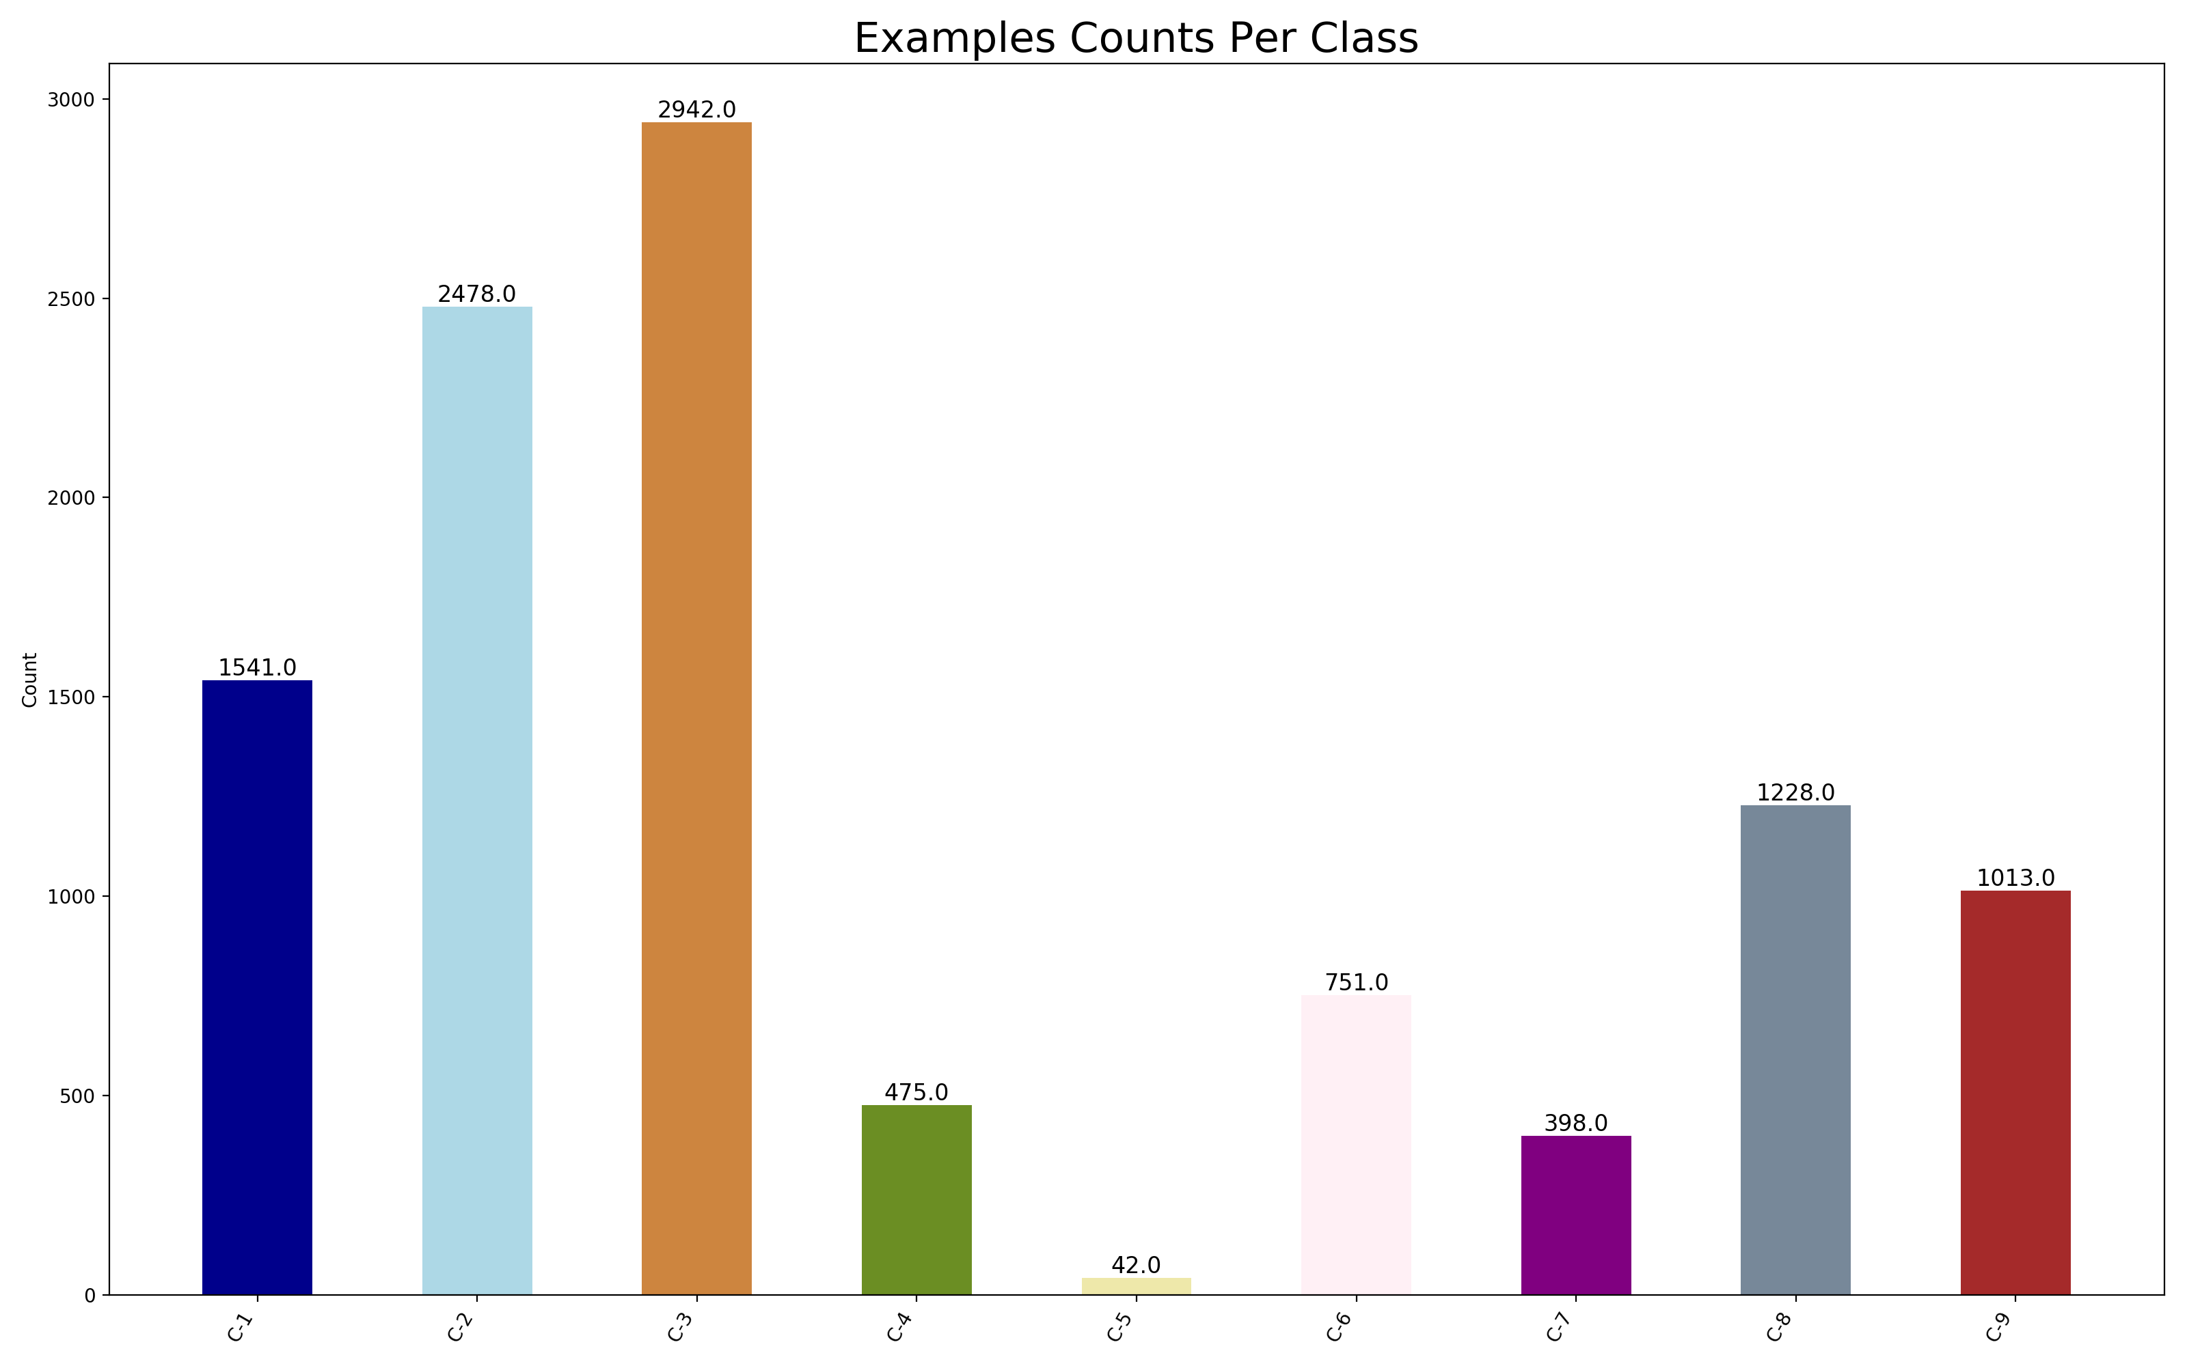
Insight on DATA
9 Classes of Malware in Data
Ramnit
Lollipop
Kelihos_ver3
Vundo
Simda
Tracur
Kelihos_ver1
Obfuscator.ACY
Gatak
Data is Imbalanced

Slide 9

Feature EXTRACTION
Extracted Features from .asm files
Extracted Features included;
Assembly File Metadata
Symbols
Registers
Opcodes
Sections
Data Definitions
API Calls
Total Features = 970
For 10868 Assembly Files this extraction took us about 4500 minutes

Slide 10

Data Preprocessing
Standardization was applied on the Dataset as a pre-processing step
Dataset was divided into Train Set and Test Set
Stratified Train Test Split with Ratio of 60:40 was employed for this purpose
Test Data was left aside for final usage/testing
Cross Validation and Training was applied on Train Set

Slide 11
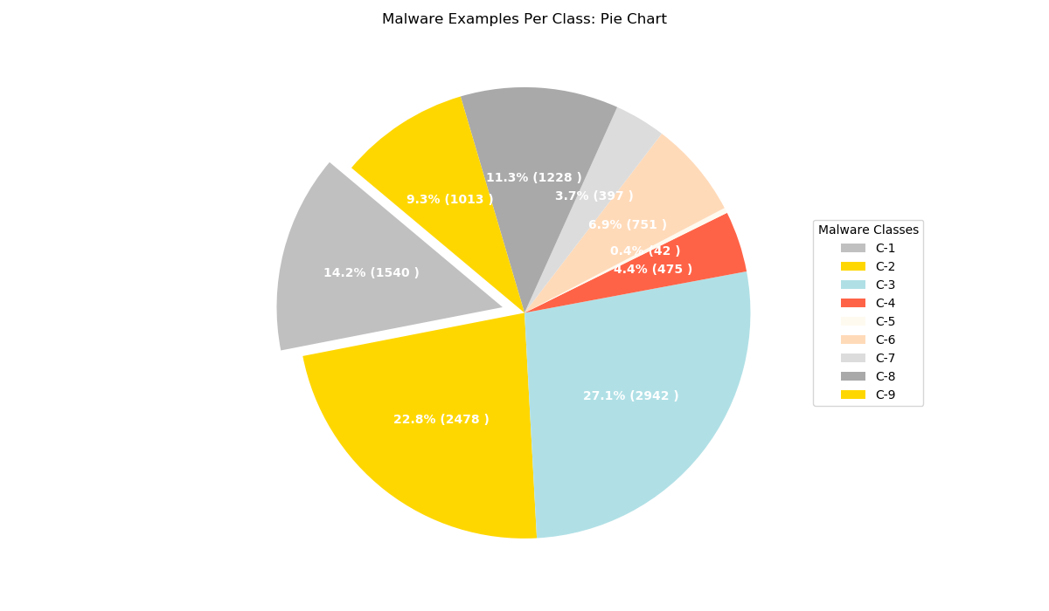
Data VISUALIZATION

Slide 12
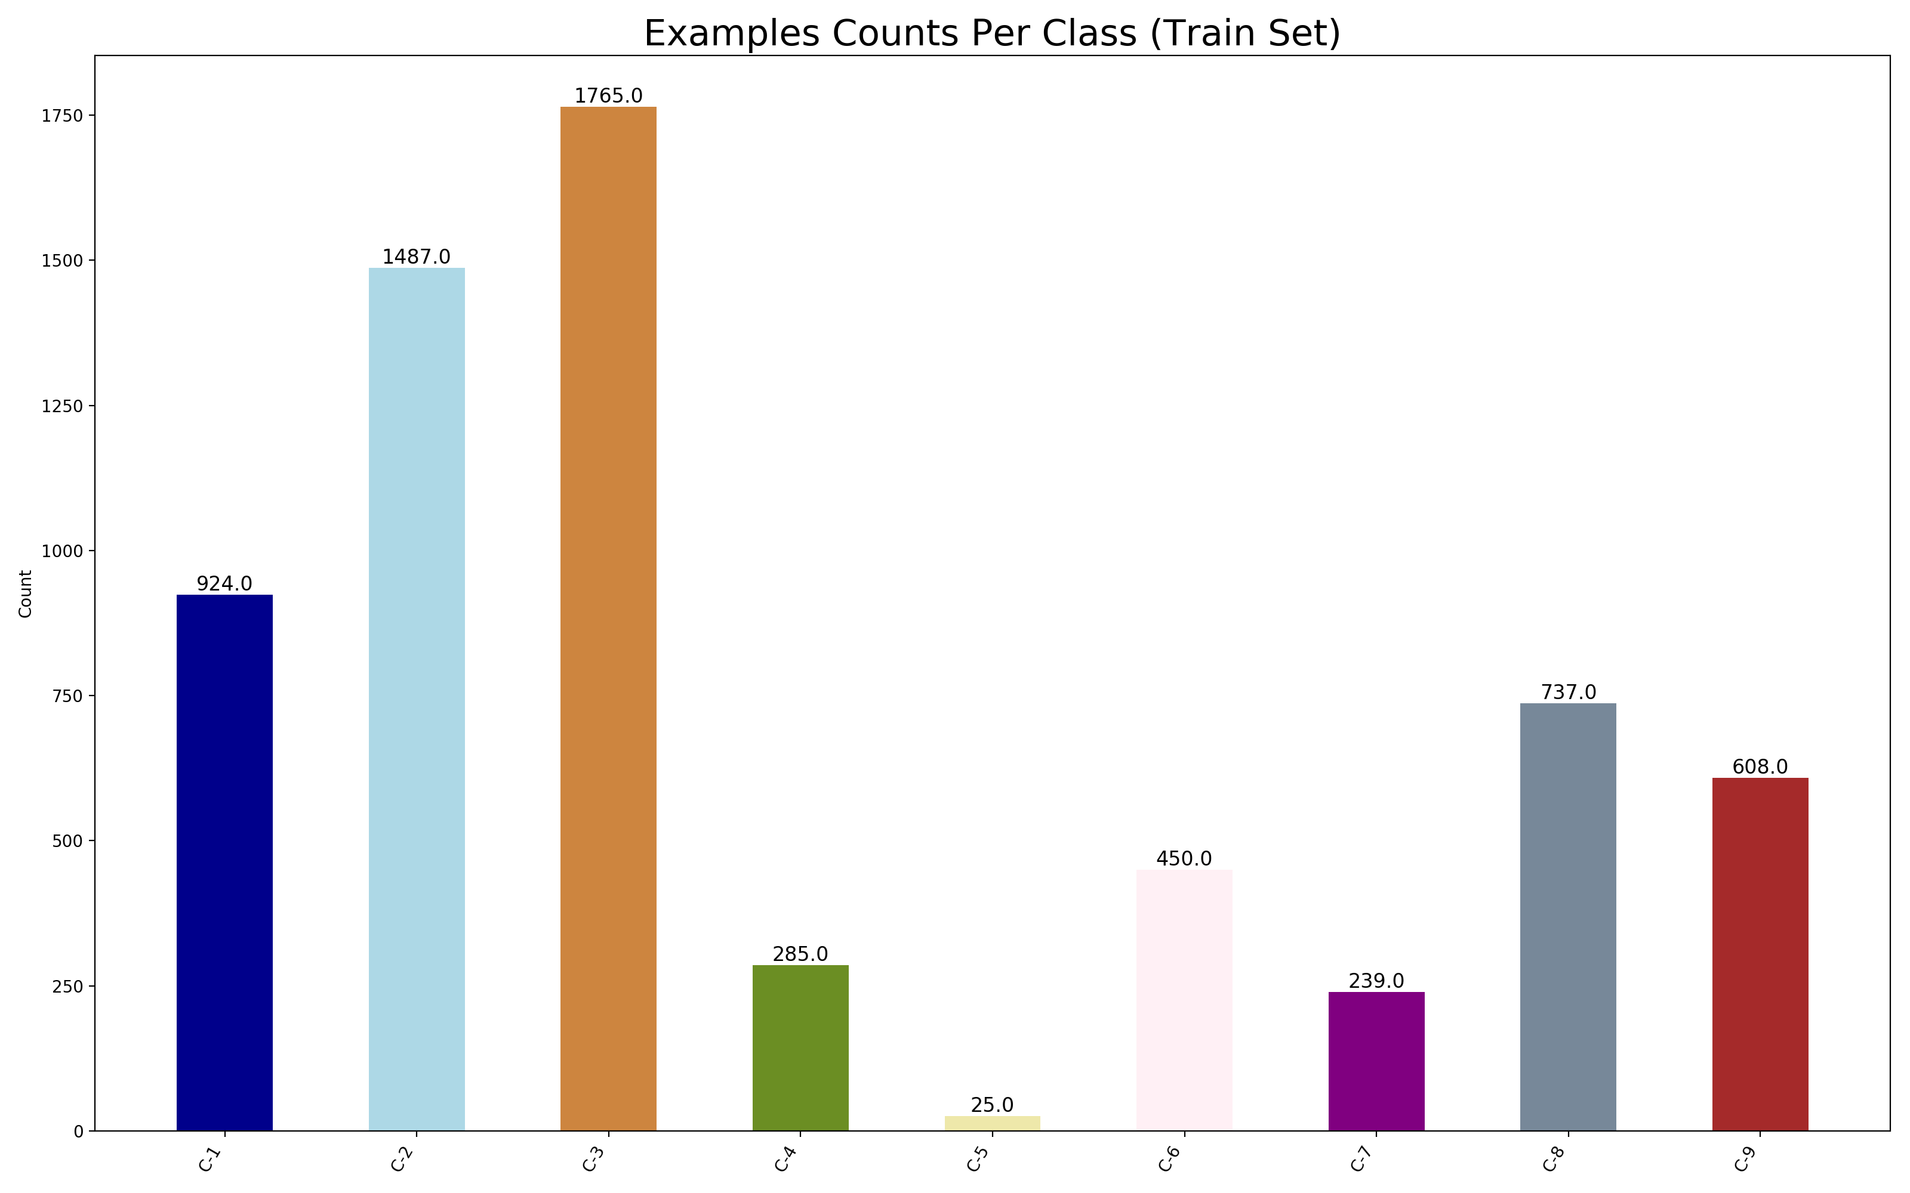
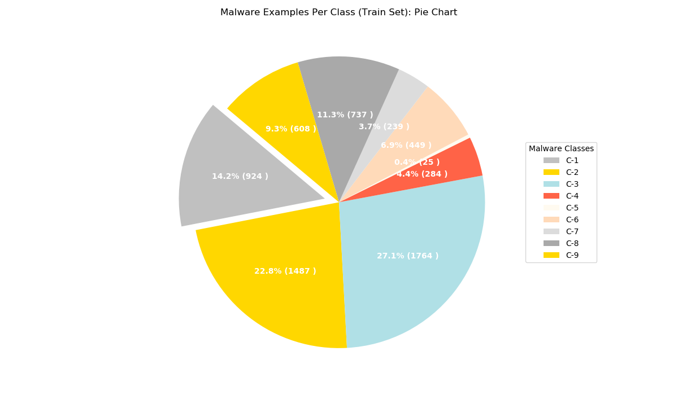
Data VISUALIZATION

Slide 13


Data VISUALIZATION

Slide 14
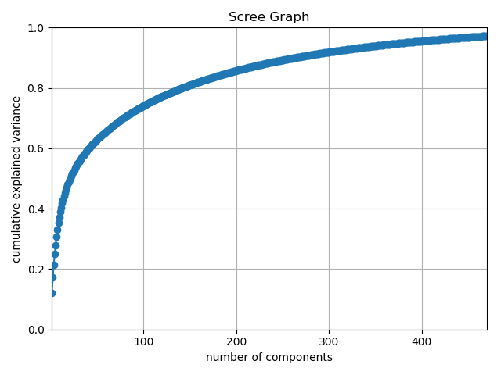
Feature reduction
Principal Component Analysis was employed for this purpose and Feature set was reduced to 400 features from 970 features while maintaining more than 95% variance.

Slide 15
Classification SCHEMES
K Nearest Neighbour Classifier
Support Vector Machine
Linear
RBF

Slide 16
Performance EVALUATION
Cross Validation Strategy
Stratified K-Fold (K=10)
Performance Metric
F1 Measure
AUC ROC

Slide 17

RESULTS (KNN GRID SEARCH)

Slide 18
p | k | C1_mean_f1 | C2_mean_f1 | C3_mean_f1 | C4_mean_f1 | C5_mean_f1 | C6_mean_f1 | C7_mean_f1 | C8_mean_f1 | C9_mean_f1 | overall_mean
2 | 2 | 0.952623 | 0.988606 | 0.996893 | 0.923892 | 0.216667 | 0.940156 | 0.946915 | 0.931552 | 0.948431 | 0.871748
2 | 3 | 0.94688 | 0.985593 | 0.996332 | 0.941989 | 0.183333 | 0.945544 | 0.963014 | 0.925895 | 0.948234 | 0.870757
2 | 4 | 0.956348 | 0.98525 | 0.996322 | 0.922067 | 0.116667 | 0.937232 | 0.955231 | 0.926611 | 0.93852 | 0.859361
2 | 5 | 0.950974 | 0.983627 | 0.996324 | 0.911203 | 0.116667 | 0.935197 | 0.942339 | 0.923644 | 0.942155 | 0.855792
2 | 6 | 0.949587 | 0.982316 | 0.996887 | 0.916227 | 0.116667 | 0.929105 | 0.935288 | 0.921408 | 0.92789 | 0.852819
2 | 7 | 0.944533 | 0.982001 | 0.996887 | 0.919972 | 0.066667 | 0.925722 | 0.928853 | 0.918272 | 0.927361 | 0.845585
2 | 8 | 0.94508 | 0.979716 | 0.996607 | 0.902346 | 0.066667 | 0.915136 | 0.909842 | 0.914633 | 0.906793 | 0.837424
2 | 9 | 0.942804 | 0.981036 | 0.996895 | 0.903328 | 0.066667 | 0.914072 | 0.900457 | 0.91163 | 0.908265 | 0.836128
2 | 10 | 0.940604 | 0.97845 | 0.996617 | 0.899069 | 0.066667 | 0.909952 | 0.905585 | 0.907967 | 0.892696 | 0.833067
3 | 4 | 0.902655 | 0.976926 | 0.99325 | 0.897688 | 0.183333 | 0.851262 | 0.924344 | 0.896667 | 0.860135 | 0.831807
3 | 2 | 0.933307 | 0.981654 | 0.993524 | 0.910685 | 0.08 | 0.894016 | 0.906522 | 0.906916 | 0.875616 | 0.83136
2 | 11 | 0.939367 | 0.976794 | 0.996335 | 0.900397 | 0.066667 | 0.908467 | 0.899068 | 0.907531 | 0.88708 | 0.831301

Slide 19
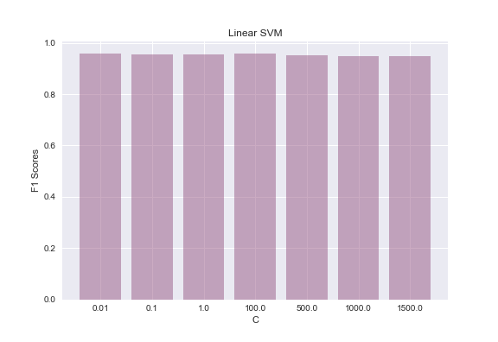
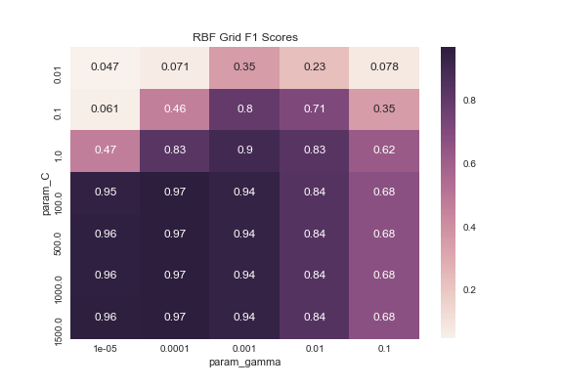
RESULTS (SVM GRID SEARCH) F1

Slide 20
Kernel | C | C1_mean_f1 | C2_mean_f1 | C3_mean_f1 | C4_mean_f1 | C5_mean_f1 | C6_mean_f1 | C7_mean_f1 | C8_mean_f1 | C9_mean_f1 | overall_mean
linear | 100 | 0.972566 | 0.994606 | 0.998023 | 0.970993 | 0.806667 | 0.974889 | 0.982585 | 0.952033 | 0.983591 | 0.95955
linear | 0.01 | 0.971314 | 0.995627 | 0.997738 | 0.967965 | 0.806667 | 0.969076 | 0.974492 | 0.954672 | 0.985204 | 0.958084
linear | 0.1 | 0.973009 | 0.995621 | 0.99802 | 0.977779 | 0.773333 | 0.975988 | 0.976917 | 0.952986 | 0.983591 | 0.95636
linear | 1 | 0.973585 | 0.994943 | 0.998303 | 0.969359 | 0.773333 | 0.975988 | 0.987576 | 0.950025 | 0.983591 | 0.9563
linear | 500 | 0.971514 | 0.994606 | 0.998588 | 0.964183 | 0.773333 | 0.966519 | 0.9695 | 0.945541 | 0.983591 | 0.951931
linear | 1000 | 0.972043 | 0.994606 | 0.99802 | 0.9623 | 0.773333 | 0.960319 | 0.962736 | 0.942851 | 0.982765 | 0.949886
linear | 1500 | 0.971547 | 0.994606 | 0.99802 | 0.957161 | 0.773333 | 0.962354 | 0.962736 | 0.941443 | 0.982765 | 0.94933

Slide 21
Kernel | C | Gamma | C1_mean_f1 | C2_mean_f1 | C3_mean_f1 | C4_mean_f1 | C5_mean_f1 | C6_mean_f1 | C7_mean_f1 | C8_mean_f1 | C9_mean_f1 | overall_mean
rbf | 1500 | 0.0001 | 0.974483 | 0.996283 | 0.997737 | 0.98614 | 0.856667 | 0.977919 | 0.985274 | 0.956473 | 0.986003 | 0.968553
rbf | 1000 | 0.0001 | 0.974483 | 0.996283 | 0.997737 | 0.982692 | 0.856667 | 0.977919 | 0.980996 | 0.956406 | 0.986003 | 0.967687
rbf | 500 | 0.0001 | 0.973936 | 0.996956 | 0.99802 | 0.982692 | 0.856667 | 0.979067 | 0.978957 | 0.956314 | 0.986003 | 0.967624
rbf | 100 | 0.0001 | 0.972802 | 0.996956 | 0.998584 | 0.977417 | 0.856667 | 0.979967 | 0.983402 | 0.955867 | 0.98519 | 0.967428
rbf | 1500 | 1.00E-05 | 0.972649 | 0.996289 | 0.998584 | 0.977588 | 0.806667 | 0.979114 | 0.983402 | 0.955197 | 0.986003 | 0.961721
rbf | 1000 | 1.00E-05 | 0.974208 | 0.996289 | 0.998584 | 0.97578 | 0.806667 | 0.973664 | 0.983402 | 0.955986 | 0.986003 | 0.961176
rbf | 500 | 1.00E-05 | 0.971453 | 0.995623 | 0.99802 | 0.967965 | 0.806667 | 0.968979 | 0.976533 | 0.953265 | 0.986816 | 0.958369
rbf | 100 | 1.00E-05 | 0.975149 | 0.995937 | 0.99802 | 0.959863 | 0.723333 | 0.962336 | 0.970054 | 0.953011 | 0.986869 | 0.947175
rbf | 1000 | 0.001 | 0.9565 | 0.994574 | 0.998584 | 0.98093 | 0.64 | 0.97627 | 0.985008 | 0.948371 | 0.980256 | 0.940055
rbf | 1500 | 0.001 | 0.9565 | 0.994574 | 0.998584 | 0.979235 | 0.64 | 0.974101 | 0.97844 | 0.948371 | 0.980256 | 0.938896
rbf | 500 | 0.001 | 0.9565 | 0.994574 | 0.999152 | 0.984262 | 0.62 | 0.977369 | 0.987136 | 0.950533 | 0.980256 | 0.938865
rbf | 100 | 0.001 | 0.957503 | 0.994574 | 0.997458 | 0.982569 | 0.62 | 0.976246 | 0.982871 | 0.951077 | 0.98103 | 0.938147

Slide 22
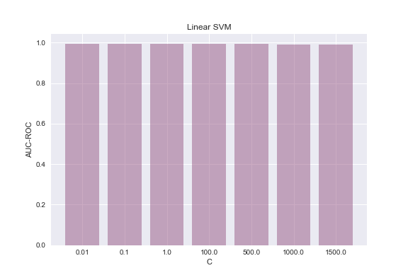
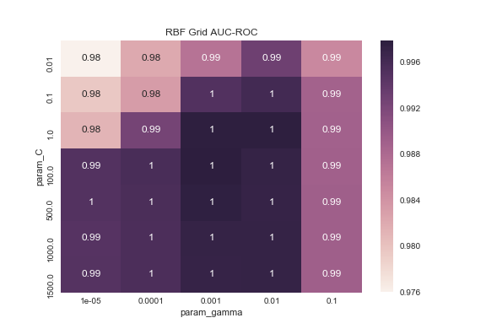
RESULTS (SVM GRID SEARCH) AUC ROC

Slide 23
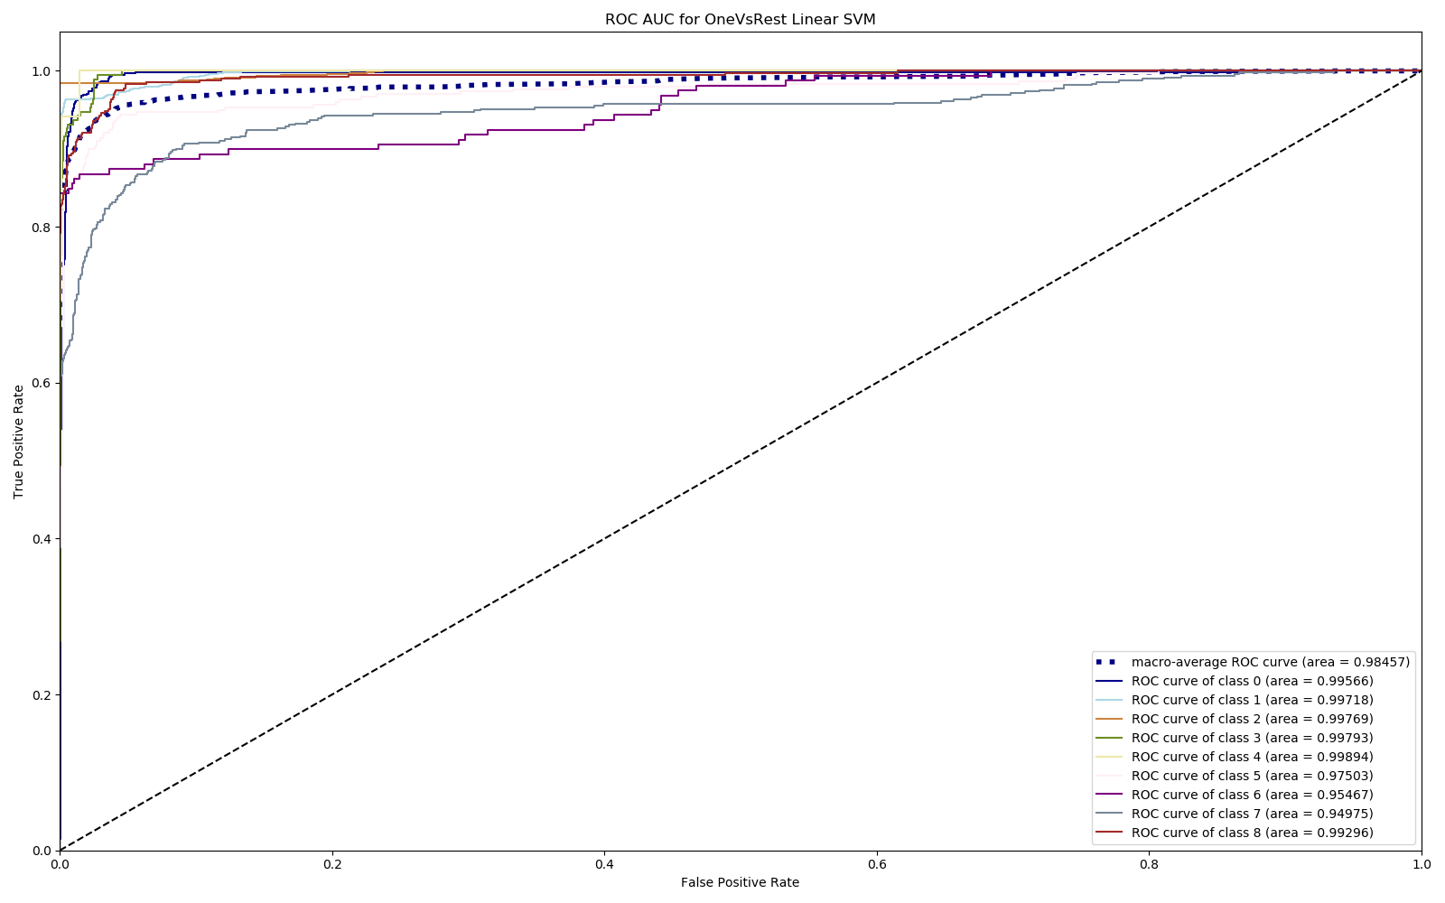
RESULTS (AUC ROC PLOT ON BEST PARAMS – Linear SVM)

Slide 24
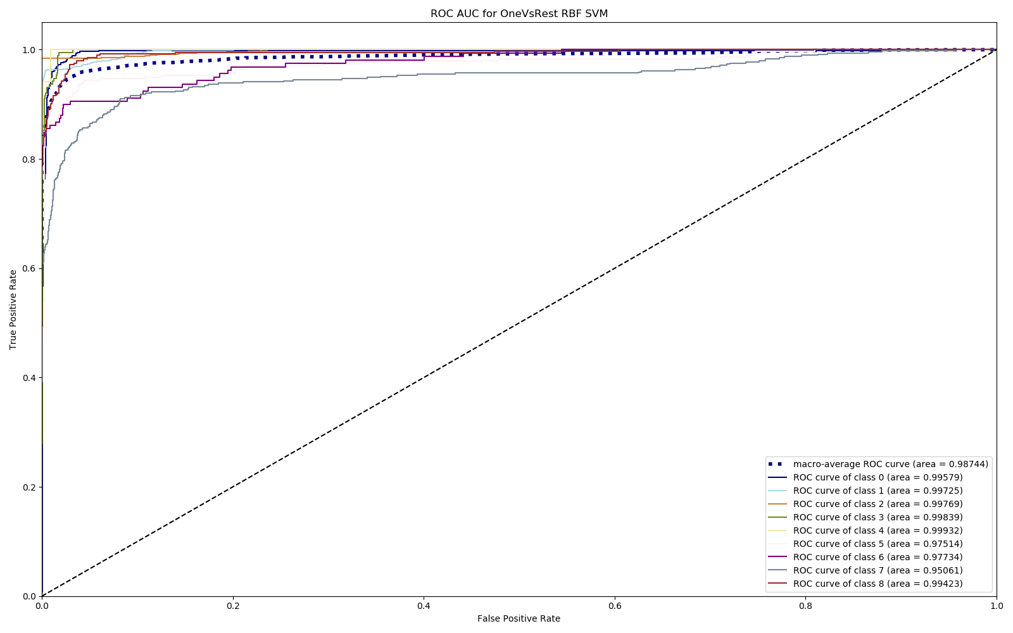
RESULTS (AUC ROC PLOT ON BEST PARAMS – RBF Kernel)

Slide 25
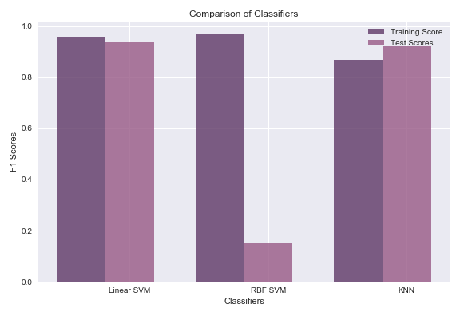
COMPARISON (CLASSIFICATION MODELS)

Slide 26
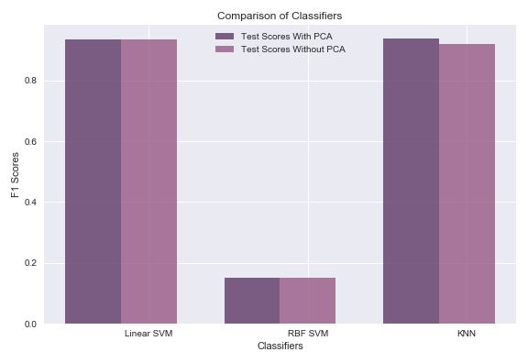
COMPARISON (Before & after PCA)

Slide 27
FUTURE DIRECTION OF RESEARCH
Application of Deep Learning Models
CNNs
RNNs
Exploration of other Evaluation Metrics
Malware Classification for Android Devices/IoT Devices

Slide 28
GROUP MEMEBERS’ CONTRIBUTIONS
Wamiq Rehman
Data Collection
Feature Extraction
Pre-processing
KNN Application
Nasir Ali
PCA Application
Visualizations
Muhammad Mohsin Zafar
SVM Application
Param Tuning

Slide 29
LEARNING DURING PROJECT
Data Pre Processing Techniques (Limited Scope)
Data Visualization
Manual GRID Search Application
Custom Score Evaluation during Cross Validation
Pipeline Completion for a ML Problem
Smart Work (By Splitting Task into sub-scripts)

Slide 30

REFERENCE PAPER – DEEP LEARNING AT THE SHALLOW END: Malware classification for non-domain experts
https://arxiv.org/abs/1807.08265

Slide 31
THANK YOU
MAY ALLAH BLESS US ALL (AMEEN)

