Slide 1

A Parallel Algorithm Template for Updating Single-Source Shortest Paths in Large-Scale Dynamic Networks
Presented By :
M. Azeem Ashfaq 22I-1057
M. Bilal Tariq 22I-1297
M. Nabeed Haider 22I-0871

Slide 2
Motivation: Dynamic Networks and SSSP Challenges
Real-World Relevance
SSSP Problem
Many complex systems—such as social, biological, and communication networks—are modeled as large, dynamic graphs. Their structures change over time, requiring fast, scalable analysis methods.
The Single Source Shortest Path (SSSP) problem is foundational for network analysis, supporting metrics like closeness and betweenness centrality. Existing parallel algorithms often assume static graphs, limiting their utility for dynamic scenarios.
Millions of nodes and billions of edges
Applications in transportation, cybersecurity, and more
Need for efficient, platform-independent updates
Scalability is critical for exascale computing

Slide 3
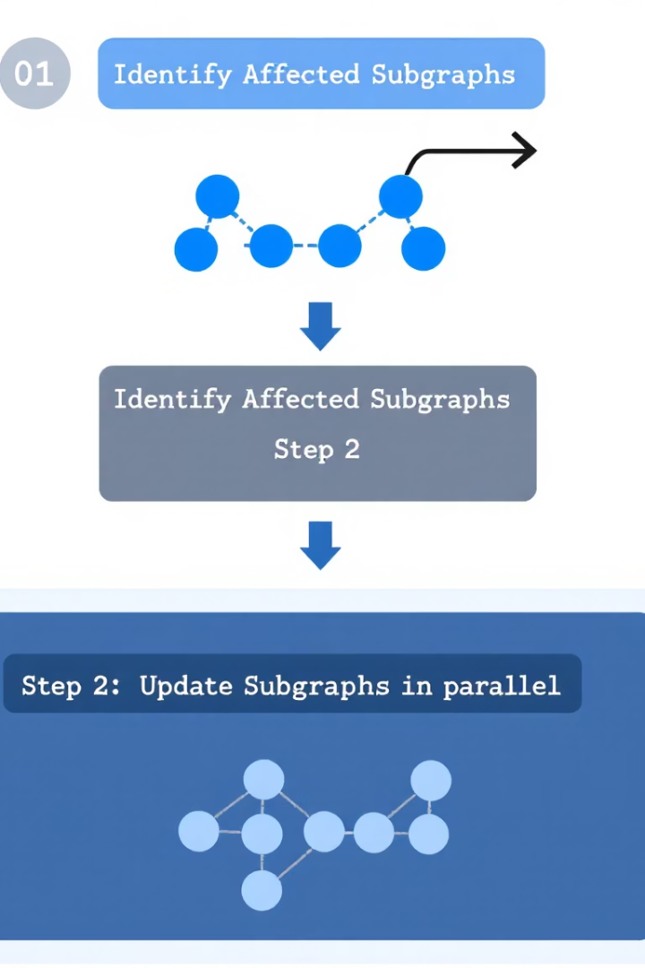
Framework Overview: Parallel SSSP Updates
Key Idea
Two-Step Process
Identify and update only the subgraphs affected by network changes, rather than recomputing the entire SSSP tree.
Step 1: Detect affected vertices in parallel. Step 2: Update these subgraphs, synchronizing only as needed.
Platform Independence
The framework is designed to be implemented efficiently on both shared-memory CPUs and GPUs, enabling broad scalability.

Slide 4




Algorithm Details: Data Structures & Parallel Steps
Rooted Tree Structure
The SSSP is stored as a rooted tree, with each vertex maintaining its parent, distance from the root, and flags for affected status.
Parallel Edge Processing
Edge insertions and deletions are processed in parallel to mark affected vertices, minimizing synchronization.
Iterative Updates
Affected subgraphs are updated iteratively, converging to correct distances without expensive locking mechanisms.

Slide 5
Implementation: Shared-Memory and GPU Approaches
Shared-Memory (CPU)
GPU Implementation
Uses OpenMP for parallelism, processing edge changes in batches. Asynchronous updates reduce synchronization overhead, and batch processing improves load balancing for large updates.
Employs CUDA and a Vertex-Marking Functional Block (VMFB) to parallelize marking and updating affected vertices. The approach leverages massive thread parallelism and efficient data structures like CSR.

Slide 6



Key Insights: When to Update vs. Recompute
Edge Deletions
2
As deletions increase beyond 50%, recomputing from scratch may become preferable, especially if a large portion of the network is affected.
Edge Insertions
Updating is highly efficient when most changes are insertions, requiring fewer computations than recomputation.
1
Batch Processing
Processing edge changes in batches and tuning asynchrony levels further improve performance and scalability.
3

Slide 7


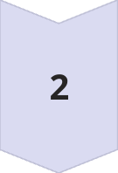
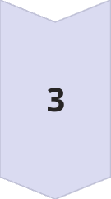
Conclusion & Future Directions
Novel Framework
Introduced a scalable, parallel template for updating SSSP in dynamic networks, validated on both CPU and GPU platforms.
Performance Gains
Achieved significant speedups over state-of-the-art recomputation methods, especially for insertion-heavy workloads.
Next Steps
Future work includes hybrid strategies that dynamically choose between updating and recomputing, and predictive algorithms for further optimization.

