Slide 1

An
Introduction to
Agile SCRUM Methodology

Slide 2
Presumptions
The audience is well aware of traditional software development methodologies like Waterfall Model, Iterative models, etc.

Slide 3
Agenda
  Introduction
  What is Agile Methodology?
  What is Scrum?
  History of Scrum
  Functionality of Scrum
  Components of Scrum
    Scrum Roles
    The Process
    Scrum Artifacts
  Scaling Scrum
  Q & A Session

Slide 4
Introduction
Classical methods of software development have many disadvantages:
  huge effort during the planning phase
  poor requirements conversion in a rapid changing environment
  treatment of staff as a factor of production
New methods:
Agile Software Development Methodology

Slide 5
What is Agile ?
Agile proponents believe
  Current software development processes are too heavyweight or cumbersome
    Too many things are done that are not directly related to software product being produced
  Current software development is too rigid
    Difficulty with incomplete or changing requirements
    Short development cycles (Internet applications)
  More active customer involvement needed
    CMM focuses on process

Slide 6
Contd…
Agile methods are considered
  Lightweight
  People-based rather than Plan-based
Several agile methods
  No single agile method
  XP most popular
No single definition
Agile Manifesto closest to a definition
  Set of principles
  Developed by Agile Alliance

Slide 7
Agile Manifesto
A Statement of Values
Individuals and interactions over processes and tools
Working software over comprehensive documentation
Customer collaboration over contract negotiation
Responding to change over following a plan
http://www.agilemanifesto.org

Slide 8
Agile Methods
Agile methods:
  Scrum
  Extreme Programming
  Adaptive Software Development (ASD)
  Dynamic System Development Method (DSDM)
  …
Agile Alliance (www.agilealliance.org)
  A non-profit organization promotes agile development

Slide 9
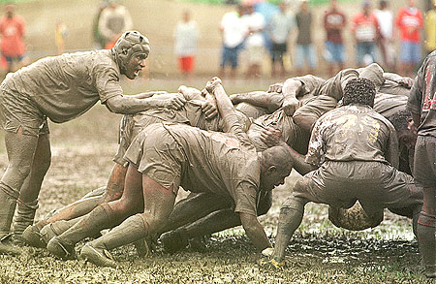
Scrum

Slide 10
Scrum in 100 words
Scrum is an agile process that allows us to focus on delivering the highest business value in the shortest time.
It allows us to rapidly and repeatedly inspect actual working software (every two weeks to one month).
The business sets the priorities. Our teams self-manage to determine the best way to deliver the highest priority features.
Every two weeks to a month anyone can see real working software and decide to release it as is or continue to enhance for another iteration.

Slide 11
History of Scrum
1995:
  analysis of common software development processes → not suitable for empirical, unpredictable and non-repeatable processes
  Design of a new method: Scrum by Jeff Sutherland & Ken Schwaber
  Enhancement of Scrum by Mike Beedle & combination of Scrum with Extreme Programming
1996:
  introduction of Scrum at OOPSLA conference
2001:
  publication “Agile Software Development with Scrum” by
  Ken Schwaber & Mike Beedle
Successful appliance of Scrum in over 50 companies
Founders are members in the Agile Alliance

Slide 12
Characteristics
Self-organizing teams
Product progresses in a series of month-long “sprints”
Requirements are captured as items in a list of “product backlog”
No specific engineering practices prescribed
Uses generative rules to create an agile environment for delivering projects
One of the “agile processes”

Slide 13

How Scrum Works?

Slide 14
Sprints
Scrum projects make progress in a series of “sprints”
  Analogous to XP iterations
Target duration is one month
  +/- a week or two
    But, a constant duration leads to a better rhythm
Product is designed, coded, and tested during the sprint

Slide 15
Sequential vs. Overlapping Dev.
Requirements
Design
Code
Test

Slide 16
No changes during the sprint
Change
Inputs
Sprint
Tested Code
Plan sprint durations around how long you can commit to keeping change out of the sprint

Slide 17
Scrum Framework
Roles : Product Owner, ScrumMaster, Team
Ceremonies : Sprint Planning, Sprint Review, Sprint Retrospective, & Daily Scrum Meeting
Artifacts : Product Backlog, Sprint Backlog, and Burndown Chart

Slide 18
Product Owner
Define the features of the product
Decide on release date and content
Be responsible for the profitability of the product (ROI)
Prioritize features according to market value
Adjust features and priority every iteration, as needed
Accept or reject work results.

Slide 19
The Scrum Master
Represents management to the project
Responsible for enacting Scrum values and practices
Removes impediments
Ensure that the team is fully functional and productive
Enable close cooperation across all roles and functions
Shield the team from external interferences

Slide 20
Scrum Team
Typically 5-10 people
Cross-functional
  QA, Programmers, UI Designers, etc.
Members should be full-time
  May be exceptions (e.g., System Admin, etc.)
Teams are self-organizing
  What to do if a team self-organizes someone off the team??
  Ideally, no titles but rarely a possibility
Membership can change only between sprints

Slide 21
Ceremonies
Sprint Planning Meeting
Sprint
Daily Scrum
Sprint Review Meeting

Slide 22
Spring Planning Meeting
Product Owner
Scrum Team
Customers
Management
Product Backlog
Sprint Planning
Meeting
Team Capabilities
Sprint Goal
Business Conditions
Technology
Sprint Backlog
Current Product

Slide 23
Parts of Sprint Planning Meeting
1st Part:
  Creating Product Backlog
  Determining the Sprint Goal.
  Participants: Product Owner, Scrum Master, Scrum Team
2nd Part:
  Participants: Scrum Master, Scrum Team
  Creating Sprint Backlog

Slide 24
Pre-Project/Kickoff Meeting
A special form of Sprint Planning Meeting
Meeting before the begin of the Project

Slide 25
Sprint
A month-long iteration, during which is incremented a product functionality
NO outside influence can interfere with the Scrum team during the Sprint
Each Sprint begins with the Daily Scrum Meeting

Slide 26
Daily Scrum
Parameters
  Daily
  15-minutes
  Stand-up
  Not for problem solving
Three questions:
  What did you do yesterday
  What will you do today?
  What obstacles are in your way?
Chickens and pigs are invited
  Help avoid other unnecessary meetings
Only pigs can talk

Slide 27
Daily Scrum
Is NOT a problem solving session
Is NOT a way to collect information about WHO is behind the schedule
Is a meeting in which team members make commitments to each other and to the Scrum Master
Is a good way for a Scrum Master to track the progress of the Team

Slide 28
Scrum FAQs
Why daily?
  “How does a project get to be a year late?”
    “One day at a time.”
      Fred Brooks, The Mythical Man-Month.
Can Scrum meetings be replaced by emailed status reports?
  No
    Entire team sees the whole picture every day
    Create peer pressure to do what you say you’ll do

Slide 29

Sprint Review Meeting
Team presents what it accomplished during the sprint
Typically takes the form of a demo of new features or underlying architecture
Informal
  2-hour prep time rule
Participants
  Customers
  Management
  Product Owner
  Other engineers

Slide 30
Sprint Retrospective Meeting
Scrum Team only
Feedback meeting
Three questions
  Start
  Stop
  Continue
Don’t skip for the first 5-6 sprints!!!

Slide 31
Product Backlog
A list of all desired work on the project
  Usually a combination of
    story-based work (“let user search and replace”)
    task-based work (“improve exception handling”)
List is prioritized by the Product Owner
  Typically a Product Manager, Marketing, Internal Customer, etc.

Slide 32
Product Backlog
Requirements for a system, expressed as a prioritized list of Backlog Items
Is managed and owned by a Product Owner
Spreadsheet (typically)
Usually is created during the Sprint Planning Meeting
Can be changed and re-prioritized before each PM

Slide 33
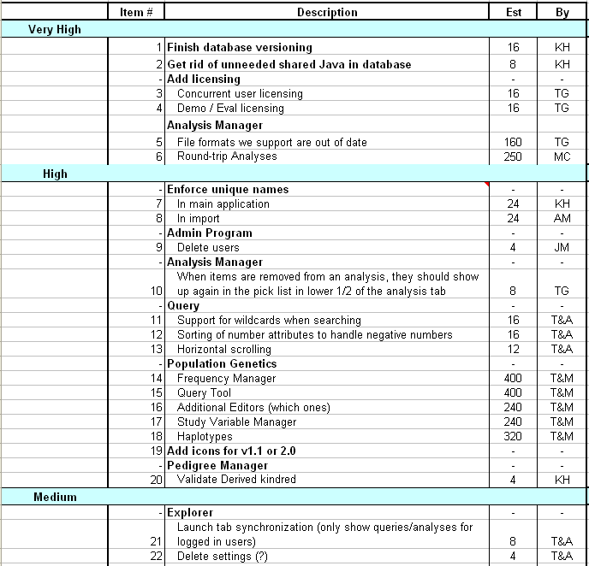
Sample Product Backlog

Slide 34
From Sprint Goal to Sprint Backlog
Scrum team takes the Sprint Goal and decides what tasks are necessary
Team self-organizes around how they’ll meet the Sprint Goal
  Manager doesn’t assign tasks to individuals
Managers don’t make decisions for the team
Sprint Backlog is created

Slide 35
Sprint Backlog during the Sprint
Changes
  Team adds new tasks whenever they need to in order to meet the Sprint Goal
  Team can remove unnecessary tasks
  But: Sprint Backlog can only be updated by the team
Estimates are updated whenever there’s new information

Slide 36
Sprint Backlog
A subset of Product Backlog Items, which define the work for a Sprint
Is created ONLY by Team members
Each Item has it’s own status
Should be updated every day

Slide 37
Sprint Backlog
No more than 300 tasks in the list
If a task requires more than 16 hours, it should be broken down
Team can add or subtract items from the list. Product Owner is not allowed to do it

Slide 38
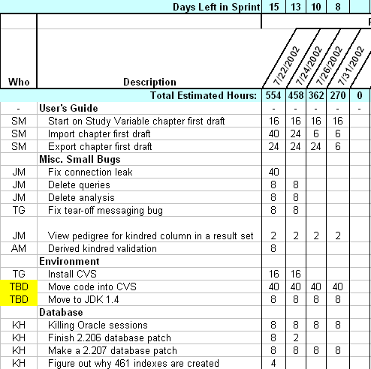
Sample Sprint Backlog

Slide 39
Sprint Burn down Chart
Depicts the total Sprint Backlog hours remaining per day
Shows the estimated amount of time to release
Ideally should burn down to zero to the end of the Sprint
Actually is not a straight line
Can bump UP

Slide 40
Information Radiator
"Two characteristics are key to a good information radiator. The first is that the information changes over time. This makes it worth a person's while to look at the display... The other characteristic is that it takes very little energy to view the display."

Slide 41
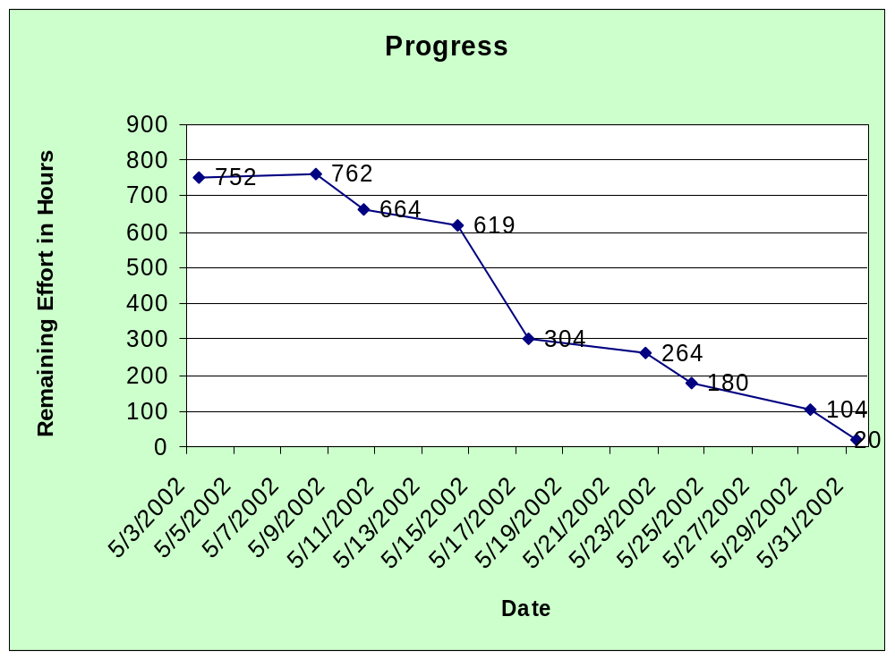
Sprint Burndown Chart

Slide 42
Release Burndown Chart
Will the release be done on right time?
X-axis: sprints
Y-axis: amount of hours remaining
The estimated work remaining can also burn up

Slide 43
Product Burndown Chart
Is a “big picture” view of project’s progress (all the releases)

Slide 44
Scalability of Scrum
A typical Scrum team is 6-10 people
Jeff Sutherland - up to over 800 people
"Scrum of Scrums" or what called "Meta-Scrum“
Frequency of meetings is based on the degree of coupling between packets

Slide 45
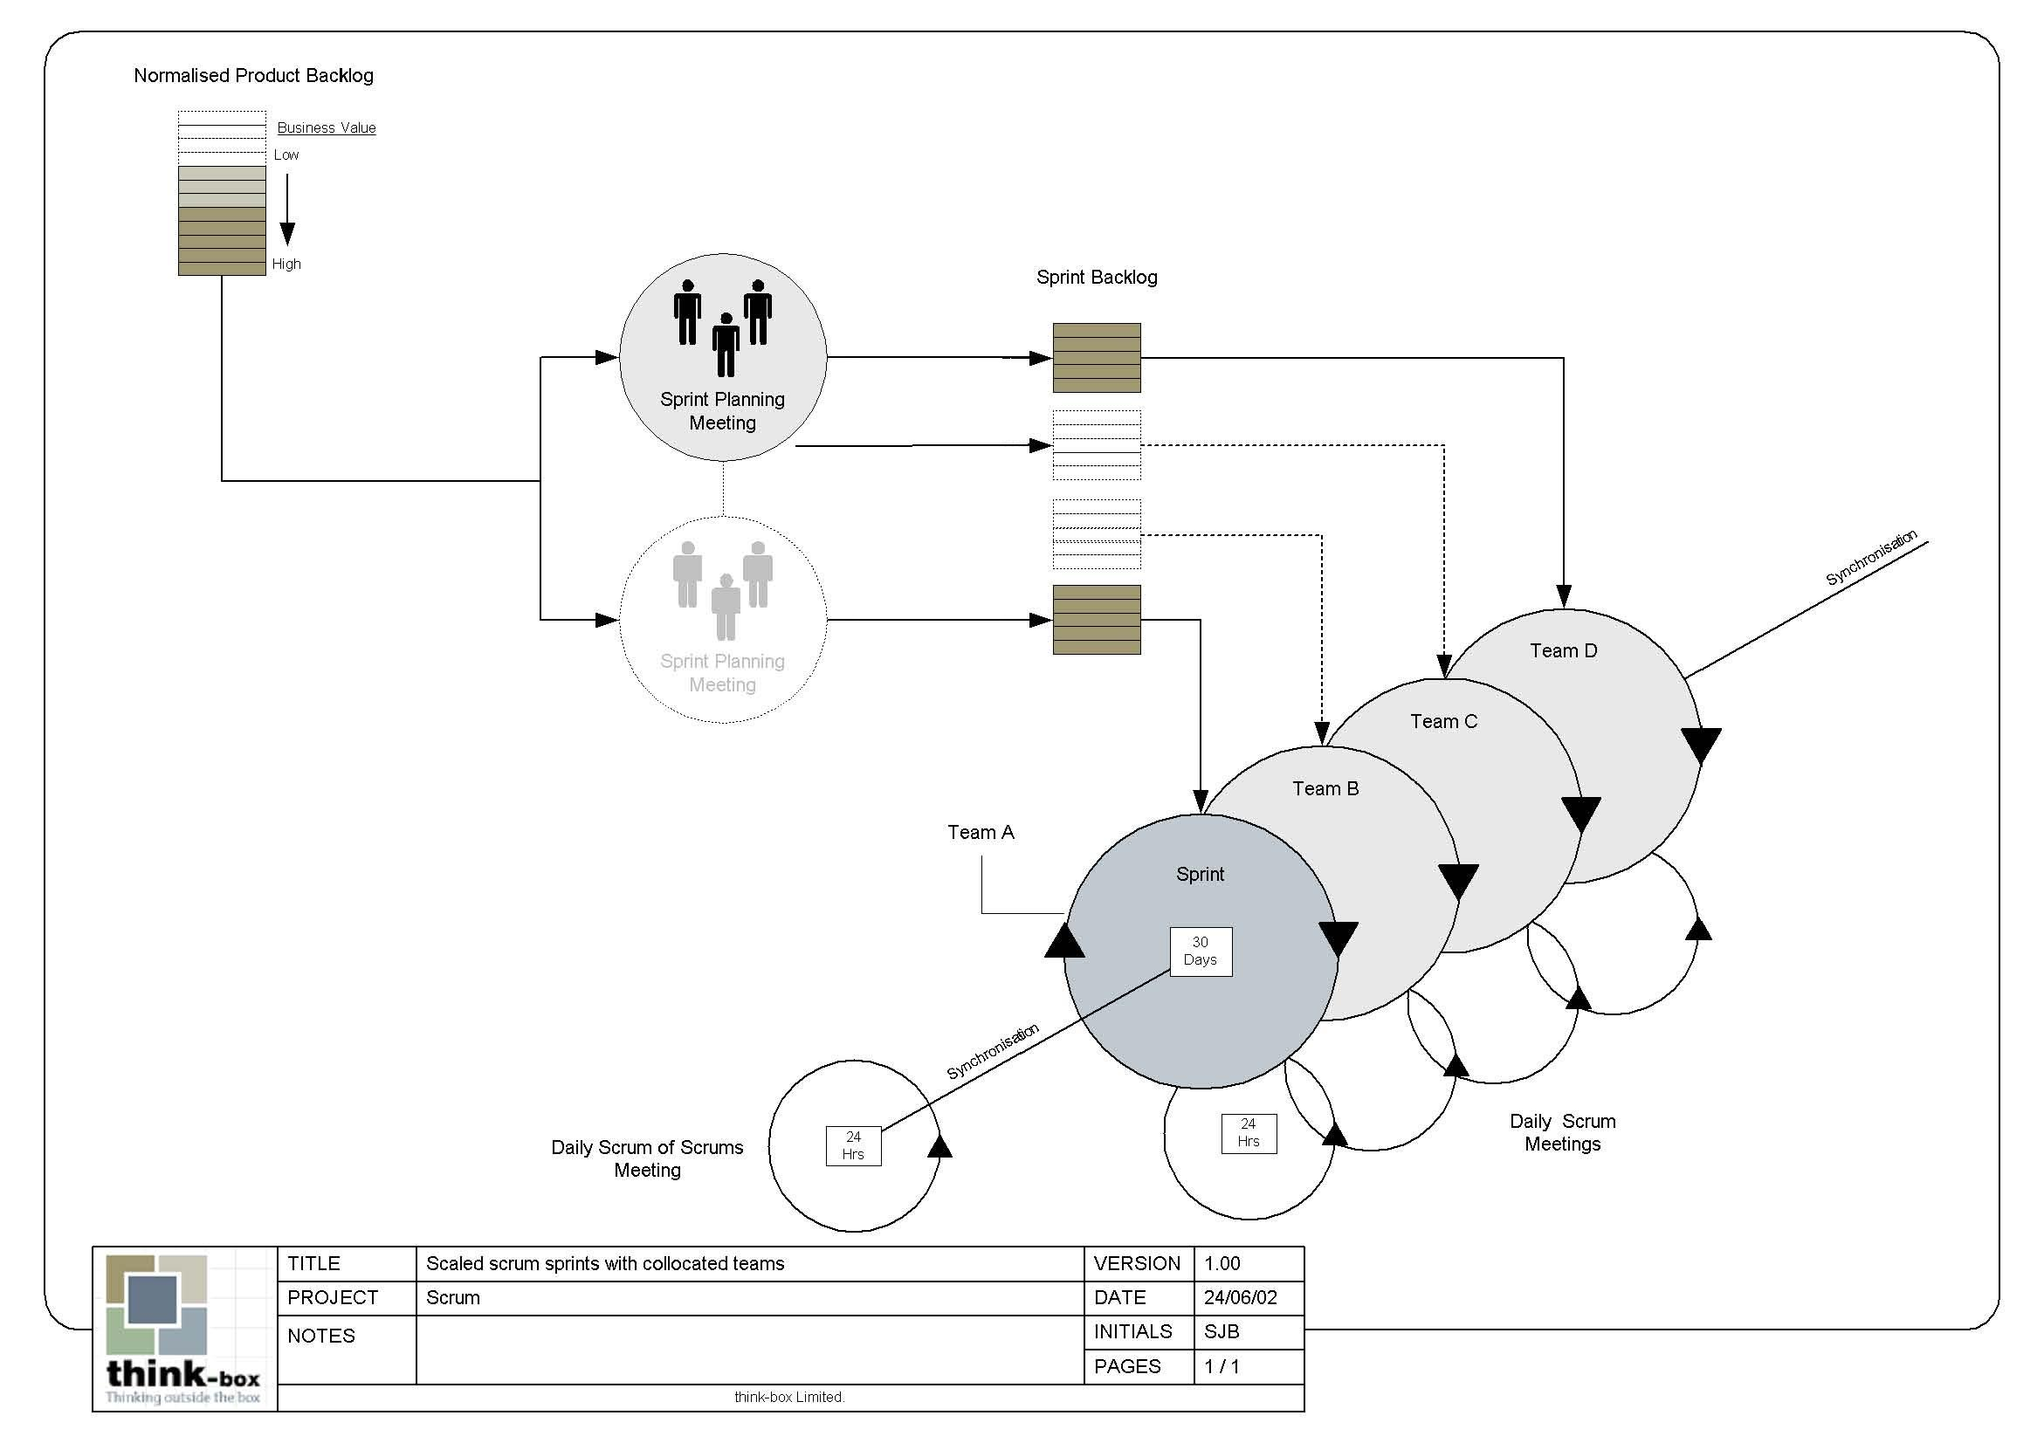
Scalability of Scrum

Slide 46
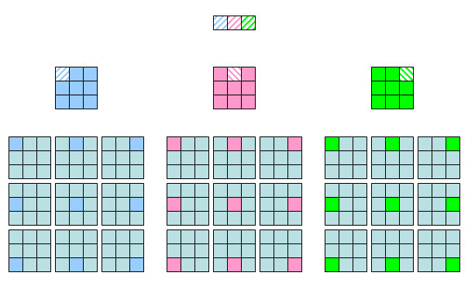
Scalability of Scrum

Slide 47
Pros/Cons
Advantages
  Completely developed and tested features in short iterations
  Simplicity of the process
  Clearly defined rules
  Increasing productivity
  Self-organizing
  each team member carries a lot of responsibility
  Improved communication
  Combination with Extreme Programming
Drawbacks
  “Undisciplined hacking” (no written documentation)
  Violation of responsibility
  Current mainly carried by the inventors

Slide 48
Thank You !!!

