Slide 1
Deep Learning Course
Majid Nasiri Manjili
Shahid Rajaee Teacher Training University

Slide 2
Introduce
Majid Nasiri
B.sc : Electronic (Shiraz University of Technology)
M.sc: Artificial Intelegence (Shahid Rajaee Teacher Training University)
Email: mail.ai@yahoo.com
Web: https://github.com/m-nasiri

Slide 3
Topics
Transfer Learning
Tensorboard
Autoencoder
Recurrent Neural Network
Deep System

Slide 4
Transfer Learning
Take advantage from the features the model has learned previously and apply these features to a new task.
In some domains, labeled data are in short supply
In some domains, the learning process is time consuming (Train with many GPUs for weeks)
In practice, very few people should train an entire CNN from scratch (with random initialization)
Smaller learning rate relatively ~1/10

Slide 5
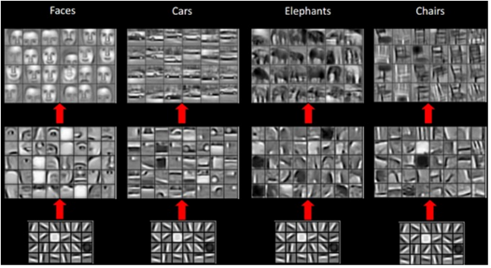
Transfer Learning Low/Mid/High level featuers

Slide 6
Transfer Learning How many layers initialize again
Low level Mid level High level Classifier

Slide 7
Transfer Learning How many layers initialize again
Size of new dataset
Similarity to the original dataset
Size | Similarity
Small | Similar | Train a linear classifier on top of conv layers
Large | Similar | Fine-tune through the full network
Small | Different | Train the classifier from activations earlier in the network
Large | Different | Fine-tune through the entire network

Slide 8
Transfer Learning
Save and Restore Model (checkpoint, save parameters as numpy file)

Slide 9
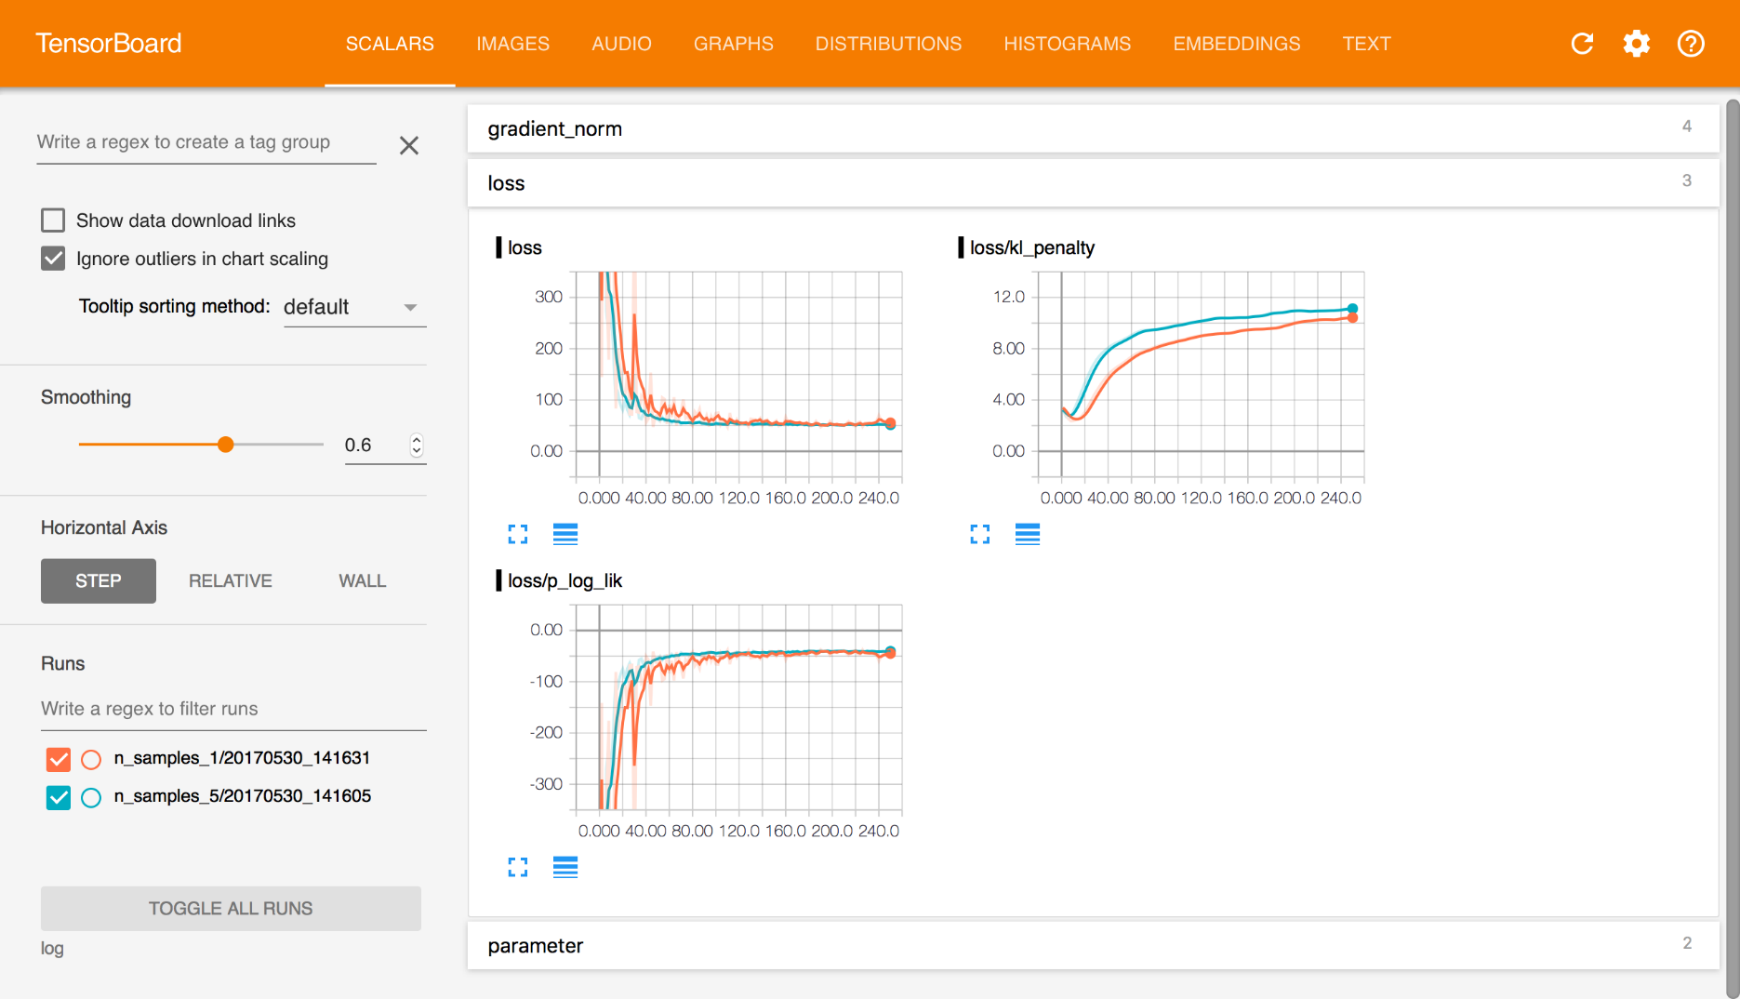
TensorBoard provides a suite of visualization tools to make it easier to understand, debug, and optimize Edward programs. You can use it “to visualize your TensorFlow graph, plot quantitative metrics about the execution of your graph, and show additional data like images tha t pass through it” (www.tensorflow.org)

Slide 10
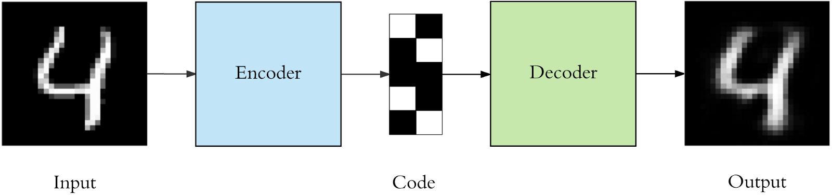
Autoencoder
specific type of feedforward neural networks
input is the same as the output
Input -> lower-dimensional -> output
Unsupervised (self-supervised)
Autoencoder components

Slide 11
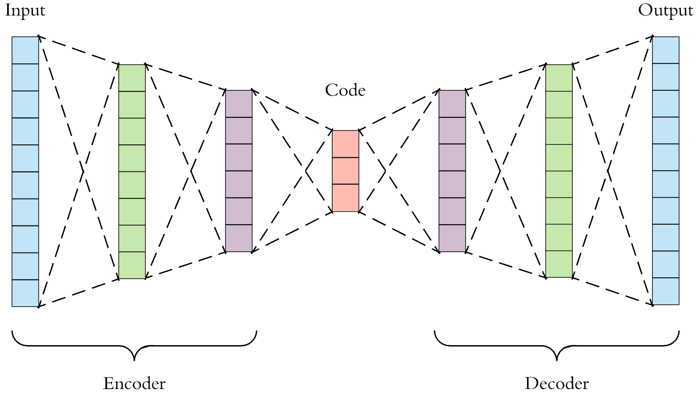
MLP Autoencoder
https://towardsdatascience.com/applied-deep-learning-part-3-autoencoders-1c083af4d798

Slide 12
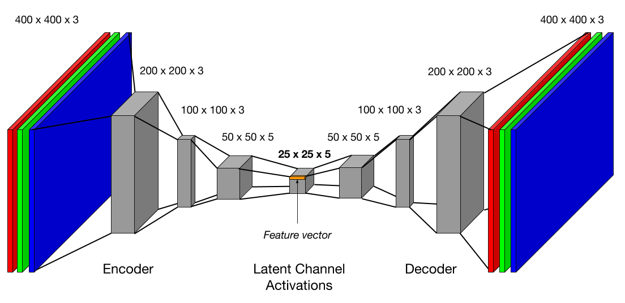
CNN Autoencoder
http://warp.whoi.edu/iros2017/

Slide 13
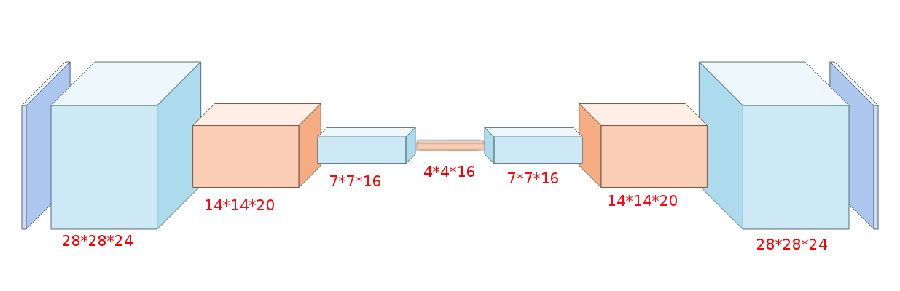
CNN Autoencoder mnist
https://github.com/m-nasiri/tensorflow/blob/master/convolutional_autoencoder

Slide 14
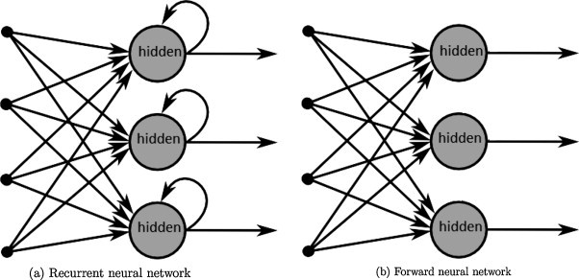
Recurrent Neural Network
Feedforward Neural Network takes decisions based on only the current input.
Recurrent Neural Network takes decisions based on current and previous inputs.

Slide 15
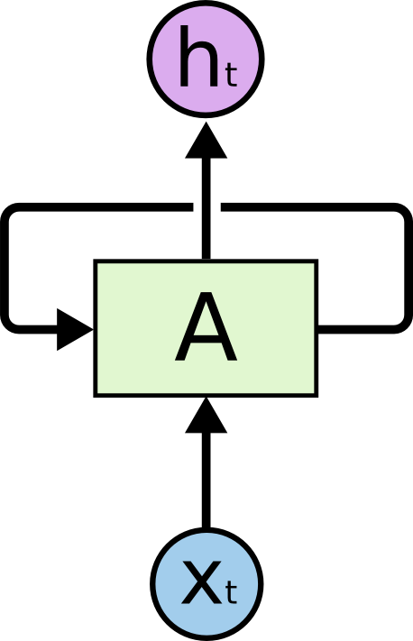
Recurrent Neural Network
Speech recognition
Language modeling
Translation
Image captioning
Networks with loops in them, allowing information to persist.
http://colah.github.io/posts/2015-08-Understanding-LSTMs/

Slide 16
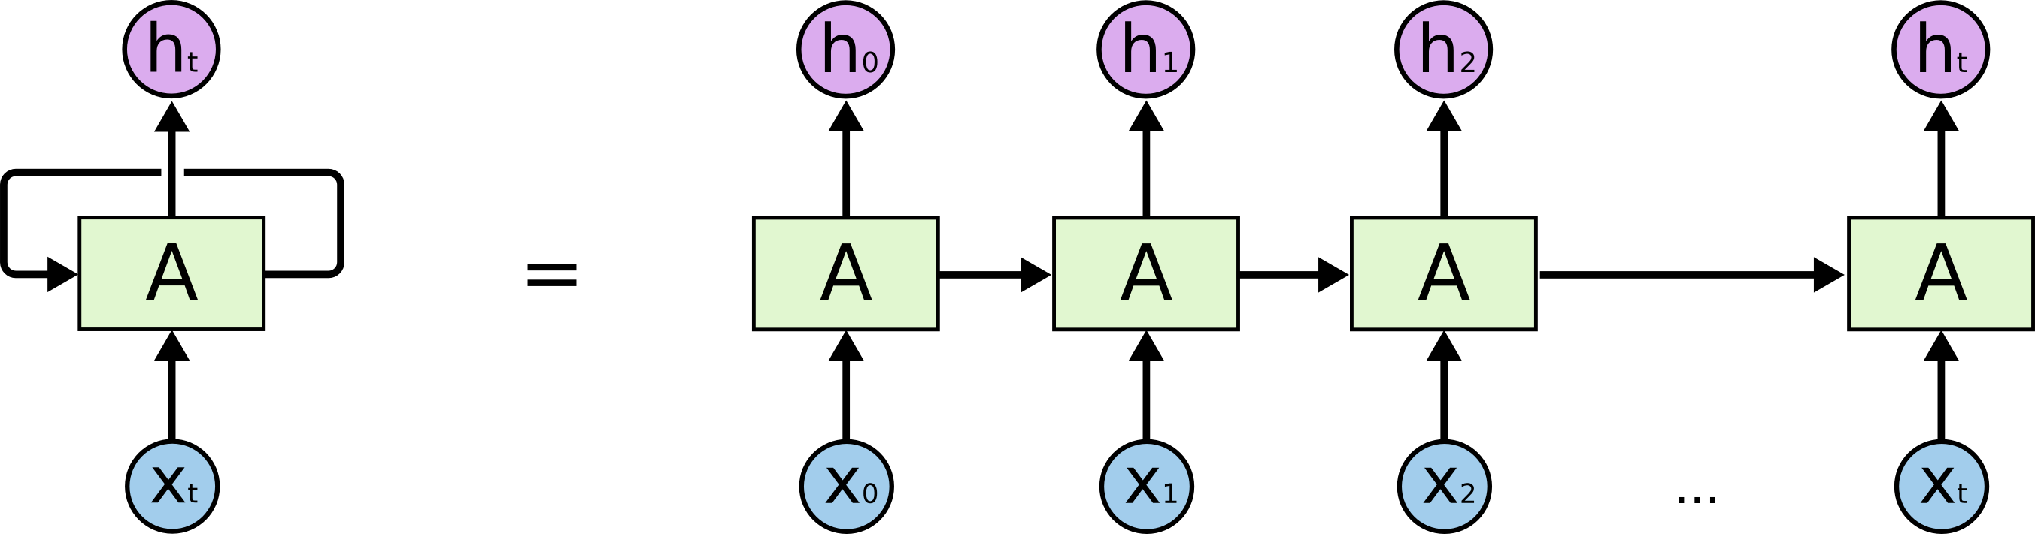
Recurrent Neural Network
Networks with loops in them, allowing information to persist.

Slide 17
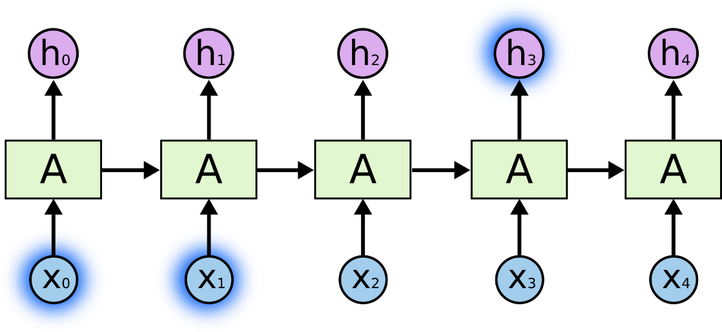
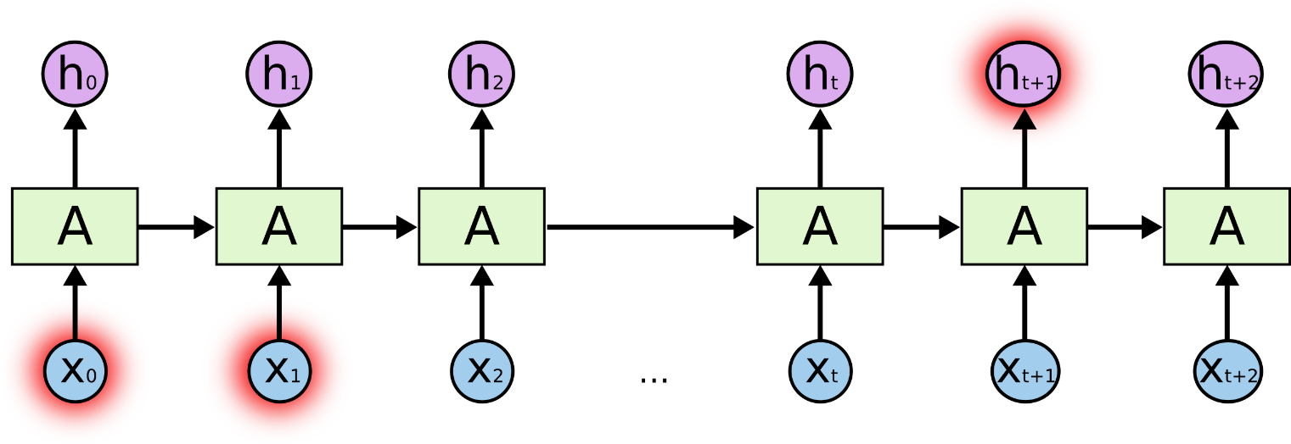
RNN vs LSTM
The clouds are in the sky
Small gap between the relevant information and the place that it’s needed
Short-term dependencies
I grew up in France… I speak fluent French
Long-term dependencies

Slide 18
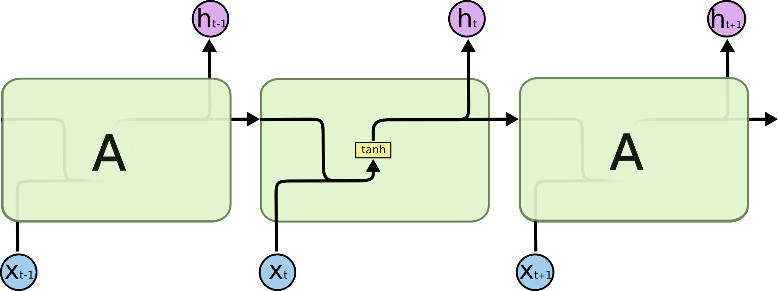
Recurrent Neural Network (RNN)

Slide 19

Long-Short Term Memory (LSTM)

Slide 20
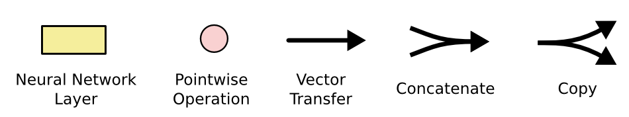
Long-Short Term Memory (LSTM)

Slide 21
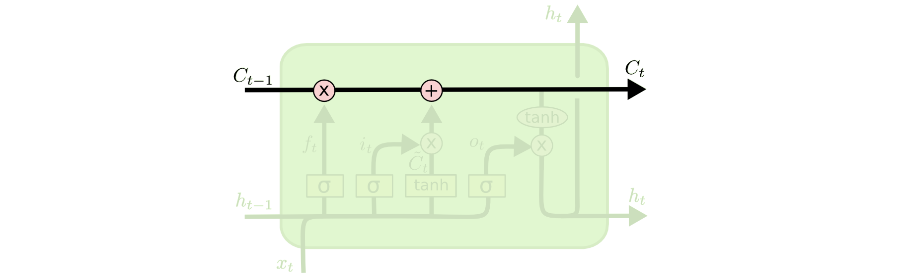
Long-Short Term Memory (LSTM)

Slide 22
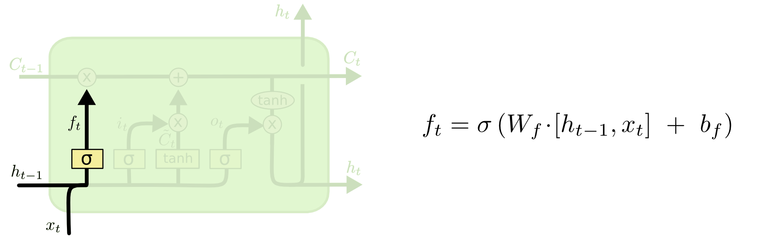
Long-Short Term Memory (LSTM)
When we see a new subject, we want to forget the gender of the old subject.

Slide 23
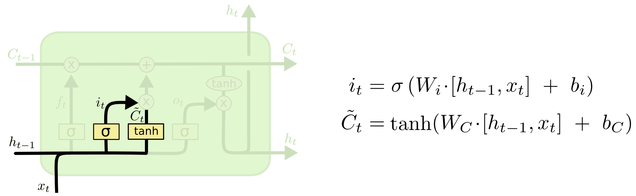
Long-Short Term Memory (LSTM)
sigmoid layer called the “input gate layer” decides which values we’ll update.
tanh layer creates a vector of new candidate values

Slide 24
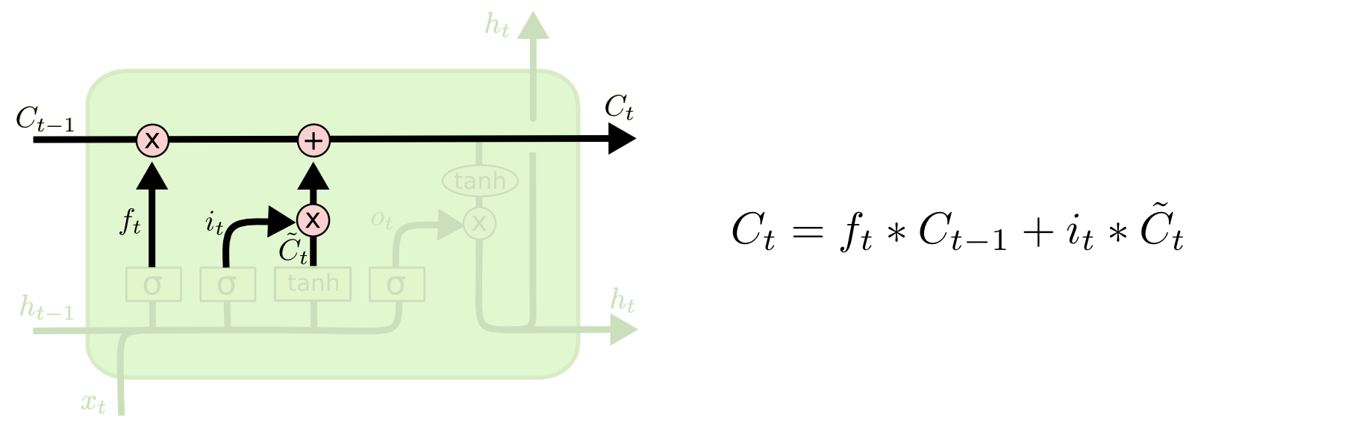
Long-Short Term Memory (LSTM)

Slide 25
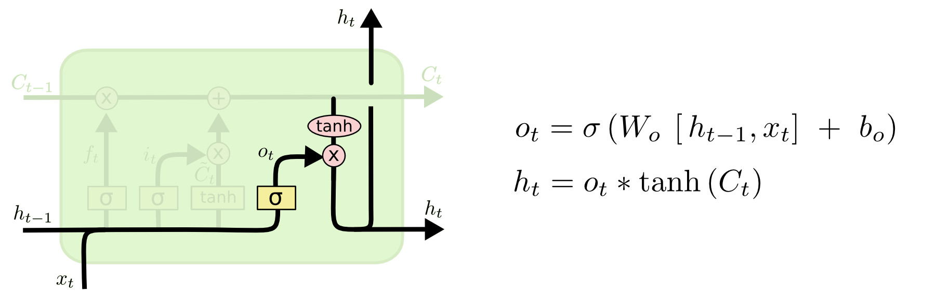
Long-Short Term Memory (LSTM)

Slide 26
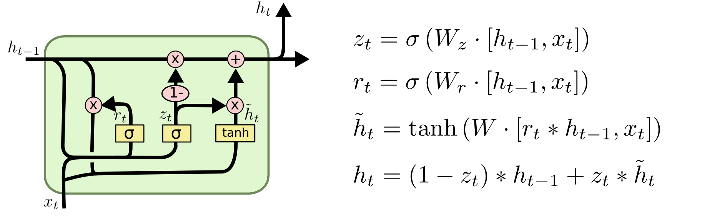
LSTM Variants

Slide 27
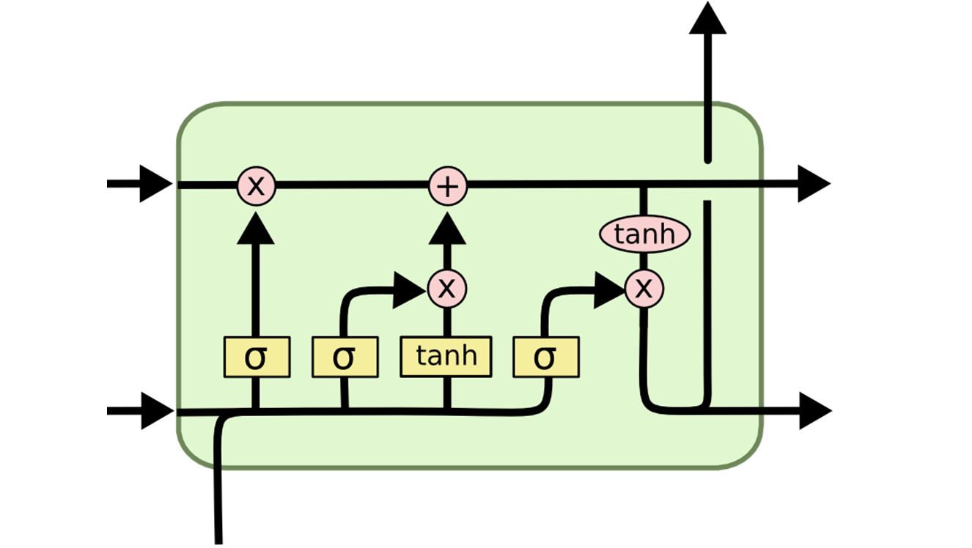
Long-Short Term Memory (LSTM)
prev_c = [N, H]
c = [N, H]
prev_h = [N, H]
h = [N, H]
X = [N, D]
N = batch size
D = seq_len
H = hidden size
X = [N, D]

