Slide 1

Steganography Vulnerabilities Scanner: Detection
and Analysis of Hidden Threats
Team_No: 11
Sl. No. | Reg. No. | Name of the student
1 | BL.EN.U4CSE22220 | D.Abhiram
2 | BL.EN.U4CSE22230 | K.S.Vamsi Krishna
3 | BL.EN.U4CSE22234 | M.Navaneeth

Slide 2
Problem Statement
Steganography, the practice of concealing information within digital media such as images, audio, and video, has emerged as both a tool for secure communication and a potential threat when used maliciously. While it supports privacy and confidentiality, it can also be exploited for unauthorized data transmission, malware concealment, or digital forensics evasion. Existing steganalysis tools are often resource-intensive, narrowly focused on specific file types, or lack accessibility for widespread use. There is a critical need for an efficient, lightweight, and versatile detection system capable of identifying hidden data across multiple media formats using simple yet effective analysis techniques. The challenge lies in developing a solution that balances detection accuracy, operational speed, and ease of deployment in resource-limited environments.

Slide 3
Introduction
Steganography is the art and science of concealing information within various forms of digital media—most commonly images, audio, and video files—in such a way that the presence of hidden data is not apparent to an observer. Unlike traditional encryption, which secures the content of a message but signals its existence, steganography aims to hide both the message and the fact that any communication is taking place. This makes it particularly attractive for both secure communication and malicious intent. While steganography has legitimate applications in digital rights management, watermarking, and confidential communication, it also introduces significant security threats. Cybercriminals and threat actors can exploit this technique to smuggle data, bypass security systems, or deliver malicious payloads. As the use of multimedia continues to grow, so does the potential for such covert techniques to be misused. Consequently, the ability to detect steganographic content has become increasingly important in the domains of cybersecurity, digital forensics, and information assurance.

Slide 4
Functionalities
The system enables detection of hidden data within digital media files such as images, audio, and video.
It supports multiple Steganographic methods including Least Significant Bit (LSB), StegHide, F5 algorithm, and Palette-based LSB, increasing its versatility across different media types.
Users can upload files through a web-based interface, where the system analyzes them for any embedded content using a rule-based approach.
Detection relies on statistical and structural techniques like entropy analysis, histogram inspection, chi-square testing, and bit-plane examination.
If steganography is detected, the system attempts to extract hidden messages using known decoding methods.
Results are presented with a confidence score, indicating the likelihood and type of steganographic technique used.
The application supports both a command-line and web-based interface (via Flask), with JSON responses for integration into automated systems.

Slide 5
Implementation Details
Framework Used: Python Flask for the web app backend.
Upload Handling: Files are saved in a local uploads/ directory using secure filename() to avoid injection risks.
Detection Logic: Encapsulated in detect steganography() and universal stegodetector() functions. Uses rule-based and statistical detection techniques.
Extraction Logic: Attempted if a known method (e.g., LSB) is detected. Uses extract stegodata() with fallback for unsupported types.
Frontend: HTML rendered via render template().JSON responses for API interaction. Virtual Environment: A .venv is included for managing dependencies locally.

Slide 6
Implementation Details
The Steganography Vulnerabilities Scanner is implemented using Python and Flask, providing a simple web-based interface for users to upload media files. Uploaded files are securely stored and passed to core detection functions such as detectsteganography() and universalstegodetector(). These functions analyze the file using statistical methods like entropy analysis, histogram inspection, chi-square testing, and bit-plane analysis to identify signs of hidden data. If steganography is detected, the system attempts to extract the hidden message using extractstegodata(). Results are displayed through a web interface or returned as JSON. The project uses a virtual environment for managing dependencies, making it easy to deploy and maintain.

Slide 7
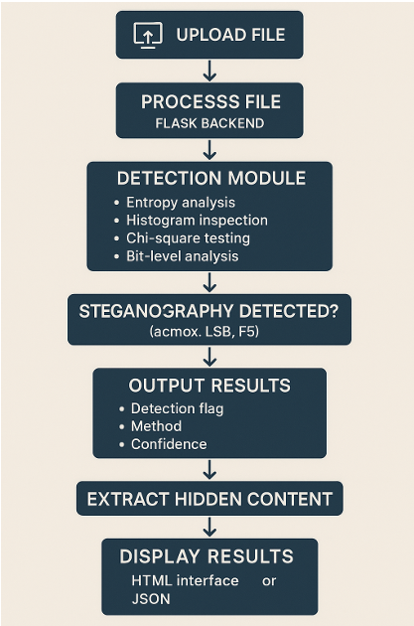
Block Diagram

Slide 8
Conclusion
The Steganography Vulnerabilities Scanner provides an efficient and practical solution for detecting hidden data in digital media.
Its use of lightweight, rule-based statistical techniques makes it fast and deployable even on resource-limited systems.
With support for multiple steganographic methods and media types, the system is highly adaptable and scalable.
The dual interface — both GUI and API — allows it to be used in forensic investigations, educational environments, and automated pipelines.
Overall, the project delivers an accessible yet powerful tool for enhancing digital security and uncovering hidden communication.

Slide 9
THANK YOU

