Slide 1
Automatic Epilepsy
Bsc’

Slide 2
Overview
Introduction
Motivation
Project Aim
Problem Statement
Data
Method
ECG Signals
Video Signals
Feature Extraction
Machine Learning Pipeline
Performance Evaluation
Results and Discussion
Regression Model
Classification Model
Features
Conclusion

Slide 3
Introduction
Motivation
Project Aim

Slide 4
Problem Statement
”How can a possible Convolutional-Recurrent Neural Network (C-RNN) be built to predict people's heart rate based on features of facial videos?”
"Investigate if there's a difference in the signals conveyed in the subsections of the facial videos?”
”How can the cognitive experiment be reproduced using a machine learning agent?”

Slide 5
Data
Data consist of 13 persons
ECG and Videos
30 fps, resolution 480 x 640 pixels
Cover person upper extremities and face
Heart activity using ECG electrodes
Sample rate: 2048 Hz

Slide 6
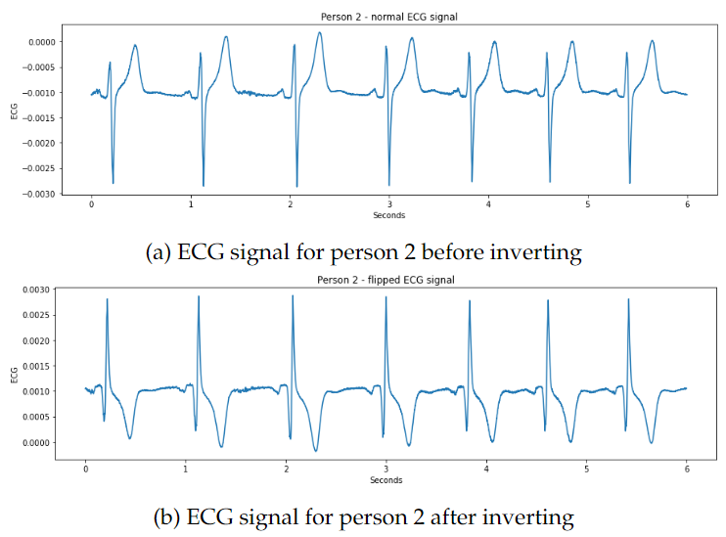
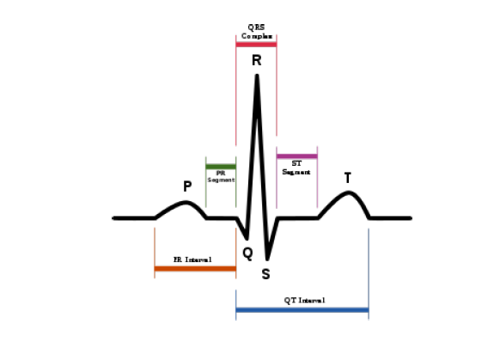
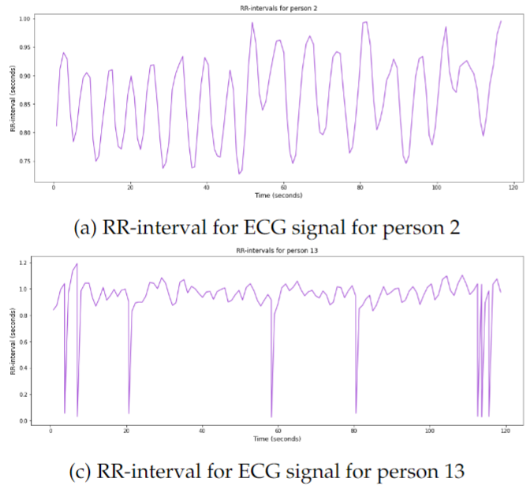
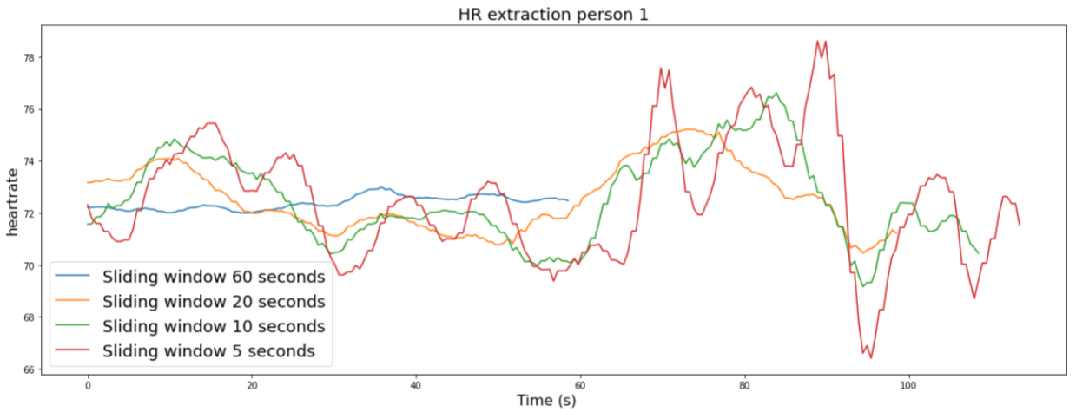
ECG Signals
Peak detection
T and S wave
Correction
RR-intervals
Heart rate extraction

Slide 7
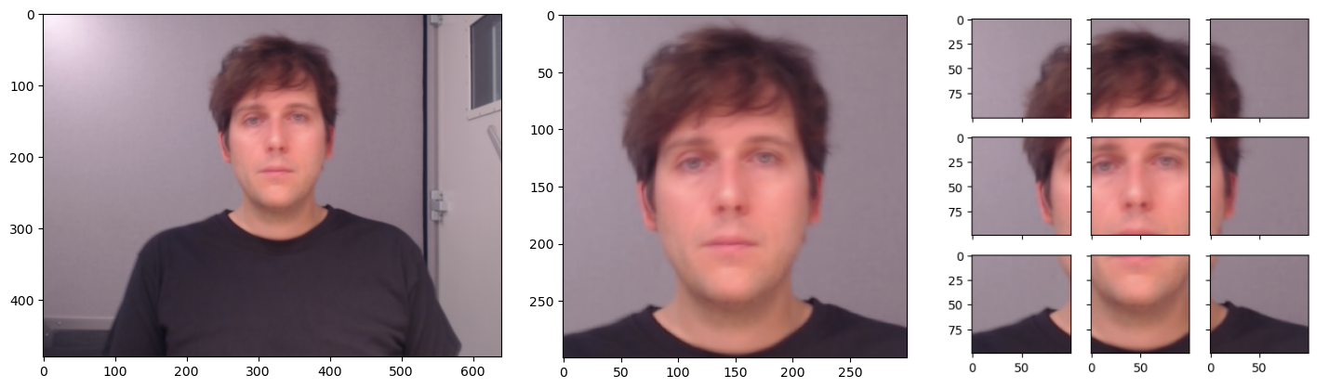
Video Signals: Region of Interest (ROI)
Original ROI Sub frame

Slide 8
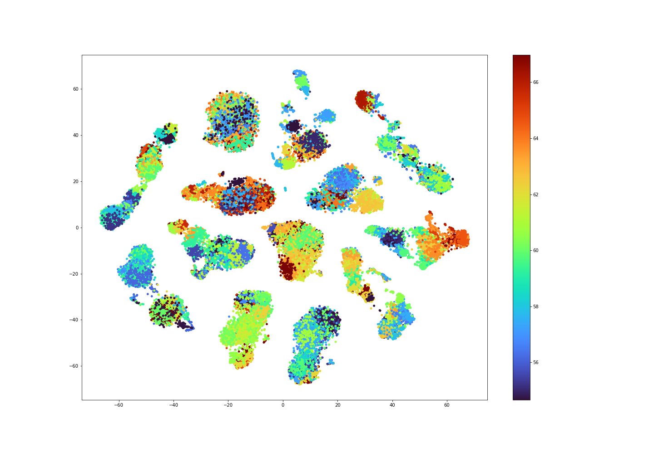
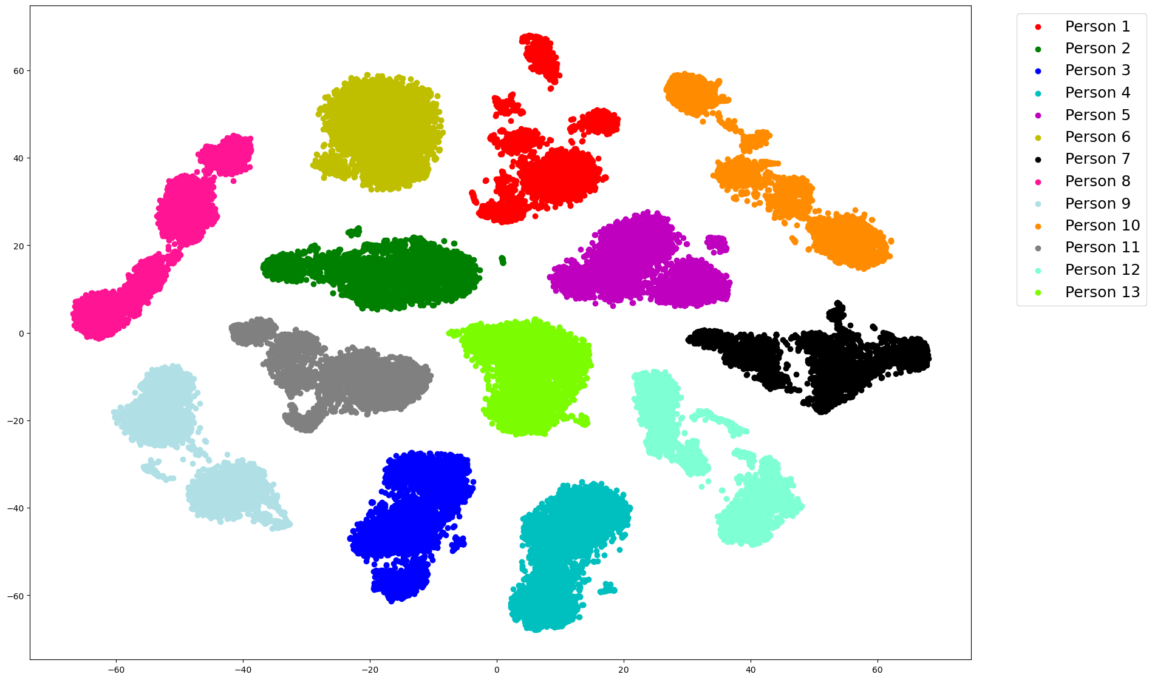
Feature Extraction

Slide 9
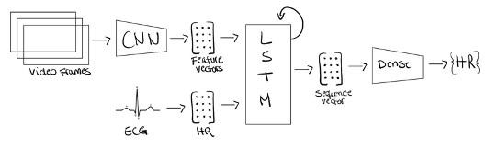
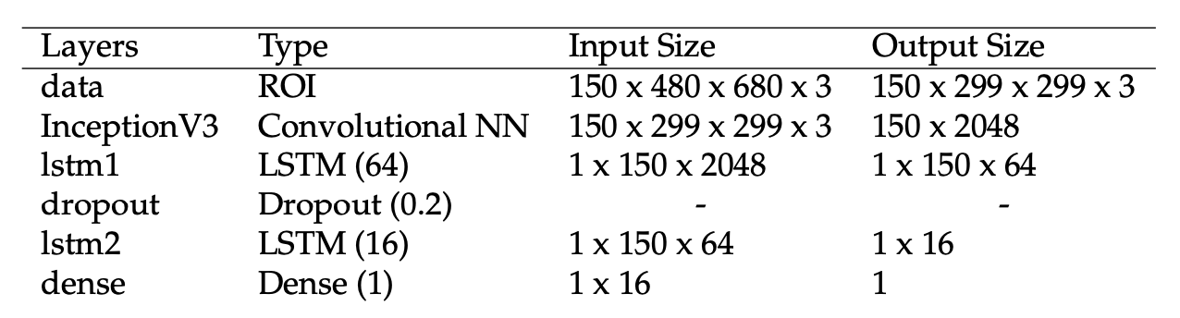
Machine Learning Pipeline
Regression

Slide 10

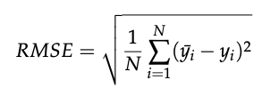
Machine Learning Performance Evaluation
Cross-Validation
Baseline model
Regression model evaluation
MSE
RMSE
Classification model evaluation
Confusion matrix

Slide 11
Results and Discussion: Regression Model
Learning Curve
Prediction Performance

Slide 12
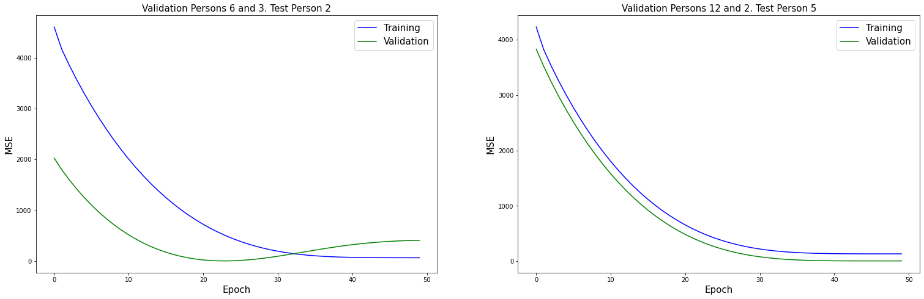
Learning Curve

Slide 13
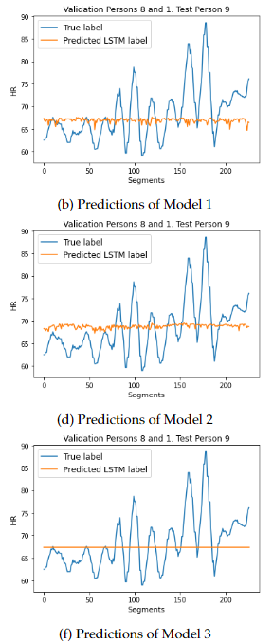
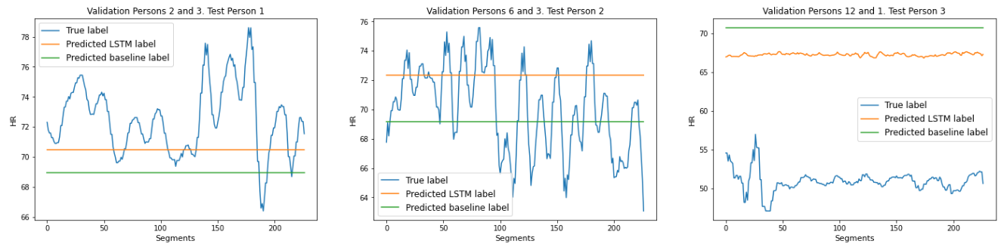
Regression Prediction Peformance
Model complexity performance
Final model performance
Complexity
Baseline performance: 9.14
LSTM performance: 7.96

Slide 14
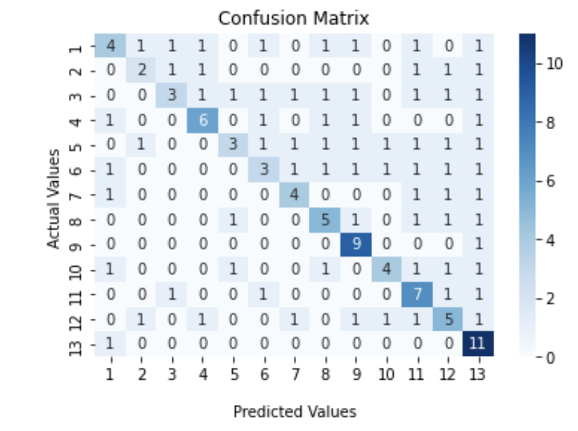

Results and Discussion – Classification Model
Accuracy $=\frac{66}{138}=0.48$
Notes:
A 13 x 13 confusion matrix over 138 classification tasks. The confusion matrix illustrates how the model have misclassified and correctly classified the different persons. If we look at the accuracy we see that out of 138 classifications the model predicts correctly 66 times and this is just below 50%.
From the confusion matrix we can that some of the persons have a higher probability of being predicted correctly or wrongly. For instance, it can be seen that in 23 out of 24 times where person 13 is in the binary classification problem, the model predicts person 13. However, the prediction is only correct 11 out of 23 times, which indicates that it predicts person 13 nearly every time it occurs.
Additionally, it is worth noticing that the predictions are not distributed equally as the classifier predicts some persons more than others as we saw for person 13. This means that the classifier is not fair for all labels.
A performance better than 50% accuracy is expected of a binary classifier, and the participants in the cognitive experiment perform an accuracy of 58 %. Firstly, looking at the results, the given regression model used in this project does not perform well enough to make a reasonable classification model. Secondly, the structure of the classification model relies heavily on the MSE which might not be optimal. This leaves the question of why make a binary classification model based on a regression model?

Slide 15
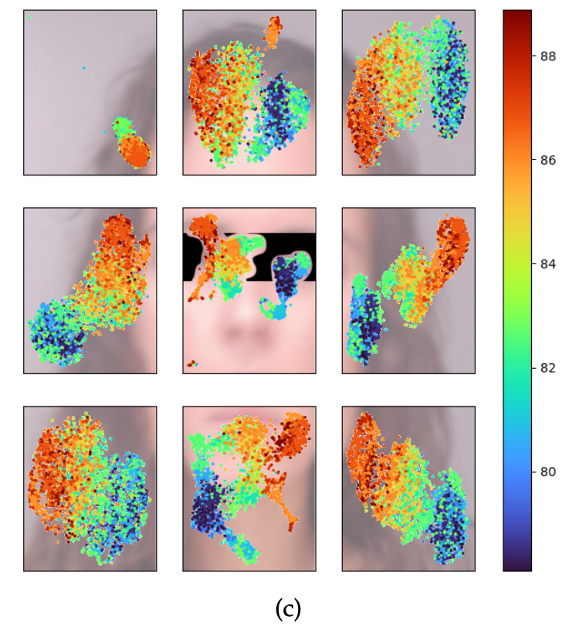
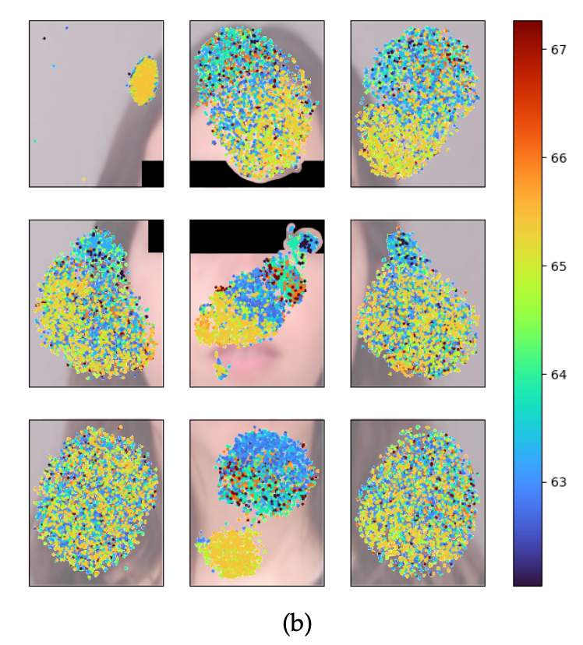
Results and Discussion: Feature Importance

Slide 16
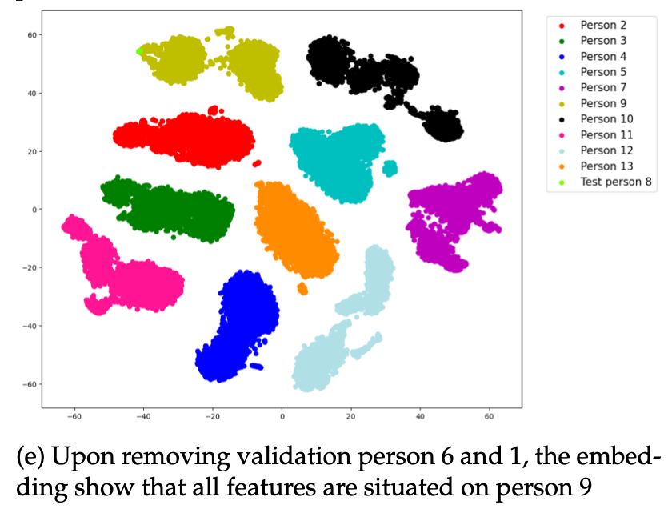
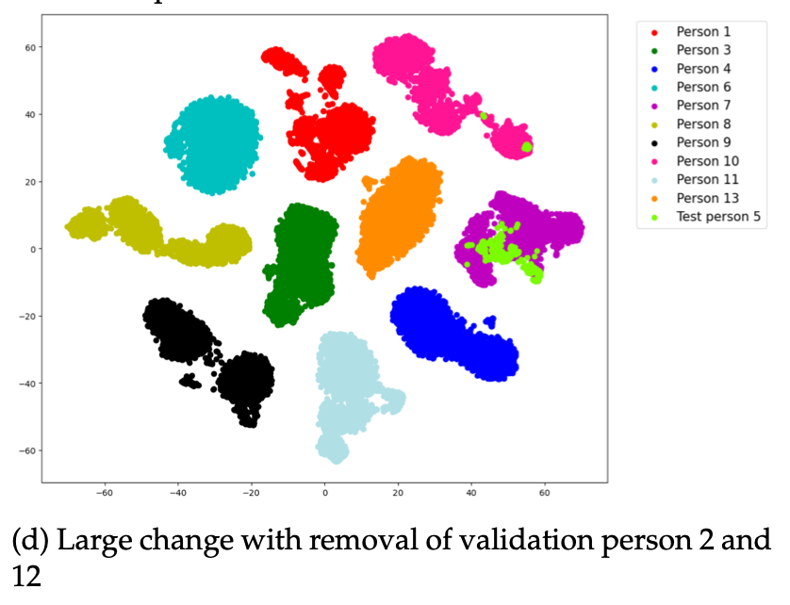
Results and Discussion: Feature Embeddings
Test person 8's predicted heart rate: 70
Average heart rate of person 9: 68
Test person 5's predicted heart rate: 68
Average heart rate of person 7: 84.

Slide 17
Conclusion
Indication of improvement compared to the baseline
Predictions
Available data set
Feature extraction method was too inaccurate
InceptionV3?
Inconclusive investigation
Classification model
Should not be made in extension of the model

