Slide 1
Epileptic Seizure Detection Based on EEG Signals and Machine Learning
BSc Thesis

Slide 2

Overview
Introduction
Data
Method
EEG Signals
Feature Extraction
Machine Learning Problem
Performance Evaluation
Results and Discussion
Conclusion and Reflection

Slide 3
Introduction
50 million people suffer from epileptic seizures today
”A High-Performance Seizure Detection Algorithm based on Discrete Wavelet Transform (DWT) and EEG” – Chen et al., 2017
The paper investigates the five frequency bands for EEG with different wavelet families and selects different statistical features of the bands for binary classification
Accuracy: 92.30%, Sensitivity: 91.71%, Specificity: 92.89%

Slide 4
Project Aim
extract the statistical feature vectors using the same configurations for DWT like Chen et al.
investigate whether the dimensionality reduction methods PCA and t-SNE on the statistical feature vectors can be used to predict just as well in a binary classification setting

Slide 5
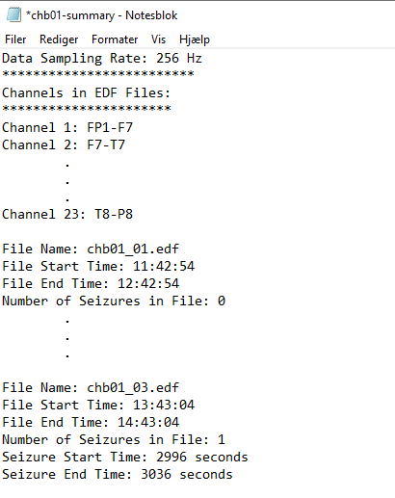
Data
Children’s Hospital, Boston & Massachusetts Institute of Technology (CHB-MIT)
Clinical assessment for the severity of epileptic seizure and candidacy for surgical intervention
24 cases from 23 pediatric patients (one patient had a second recording 1.5 years after the first recording [chb01, chb21])
In most cases each .edf recordings contain exactly one hour of digitized EEG signals using 23 channels.

Slide 6
Methods

Slide 7
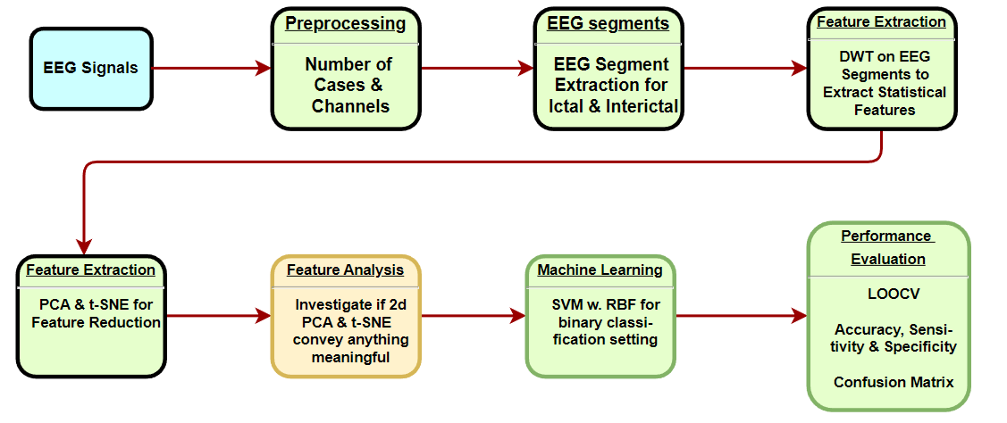
Flowchart

Slide 8
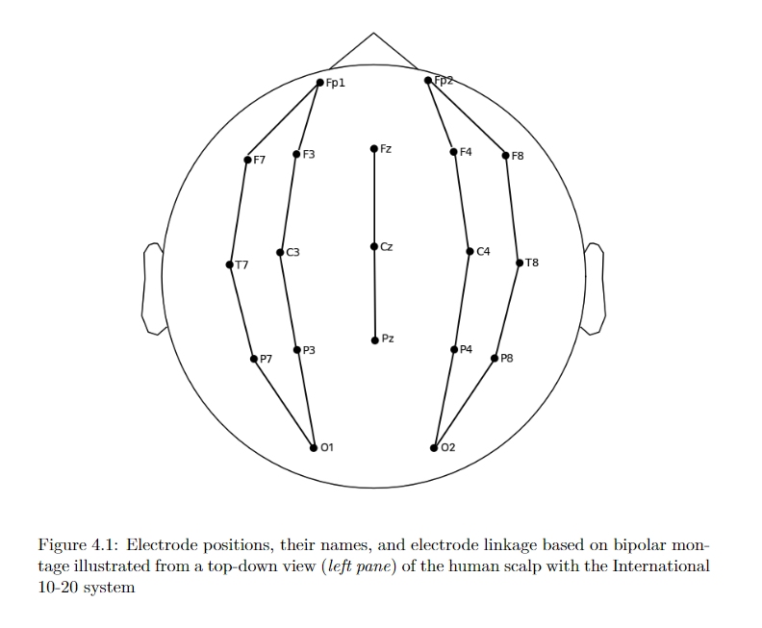
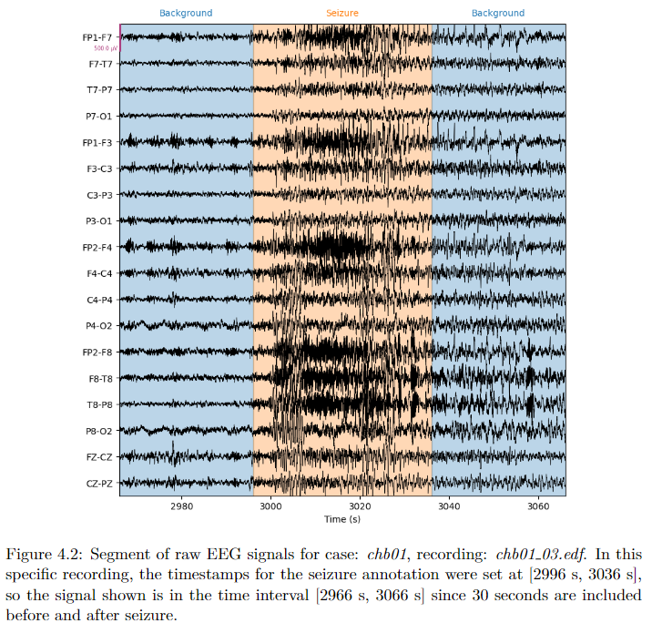
EEG Preprocessing and Segments
23 cases; consequently only 18 channels
4-second segments
ictal segments extracted from middle of seizure annotation
interictal segments extracted 1 minute after seizure end
In total, 182 ictal and 182 interictal segments

Slide 9
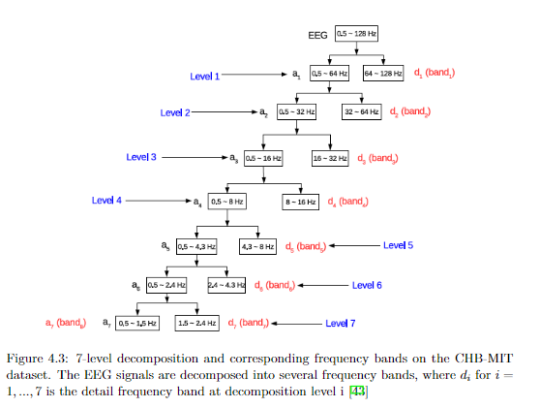
Feature Extraction
Principal Component Analysis (PCA)
t-distributed Stochastic Neighborhood Embedding (t-SNE)
Discrete Wavelet Transform
$$ℝ^{42}→ℝ^{2}$$
2 components for PCA and t-SNE
Hyperparameter perplexity of different values were investigated
Coiflet family, coif3, decomposition levels 2-7
Coefficients of each decomposition level:
max, min, mean, std, normalized std, skewness and energy

Slide 10
Machine Learning Problem
Binary Classification Setting
Is a given signal ictal or interictal?
Support Vector Machine
Radial Basis Function
Outcomes
True Positives (TP)
True Negatives (TN)
False Positives (FP)
False Negatives (FN)

Slide 11
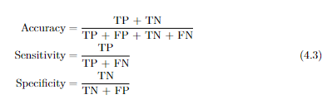
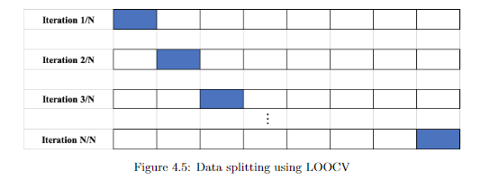
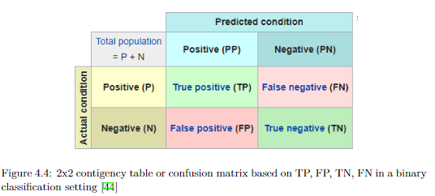
Performance Evaluation

Slide 12
Results and Discussion

Slide 13
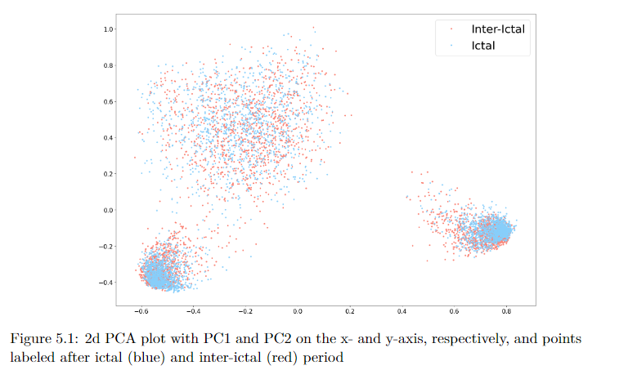
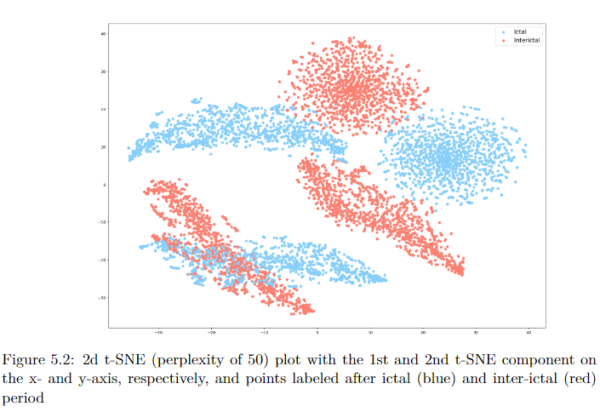
Comparison of PCA and t-SNE

Slide 14
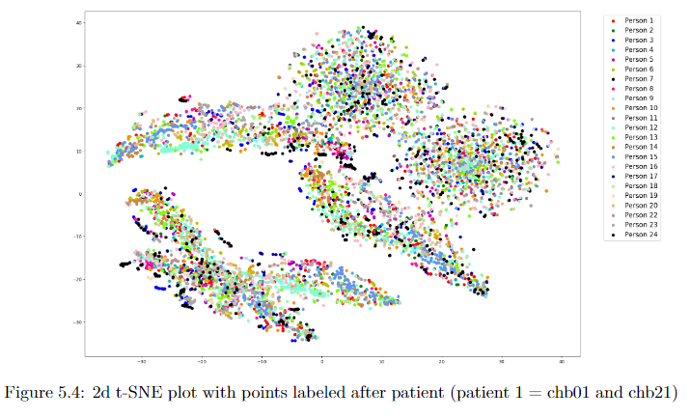
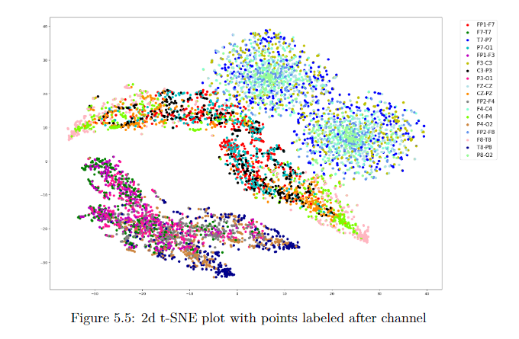
t-SNE in-depth

Slide 15
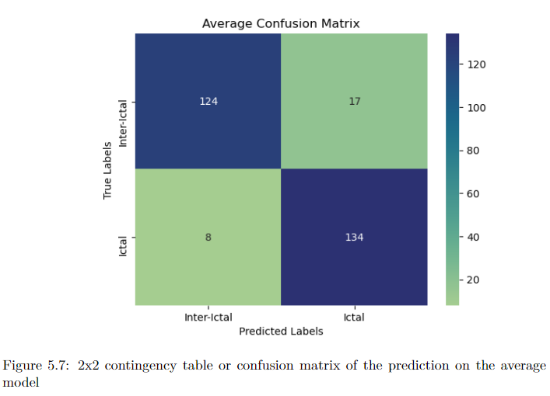
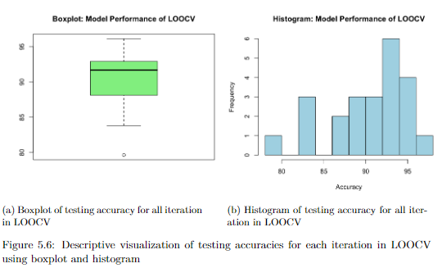
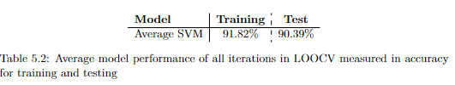

Model Performance

Slide 16
Alternative Approaches & Future Work
Hyperparameter Optimization
Ictal and Interictal segments
Shortcomings of t-SNE
Similarity between points are preserved, not distances between clusters
Unknown how well it will generalize on other datasets
Forecasting Epileptic Seizures
RNN (LSTM or newer popular “Transformer” network)

Slide 17
Conclusion

